Slide 1
Survey on the transition time from ACSF to Manual Driving
Submitted by the expert of Japan
Informal Document: ACSF-04-14
Toyota Motor Corporation

Slide 2
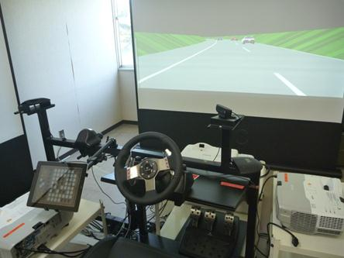
Experimental Condition
Purpose
  To obtain the experimental data of the transition time from ACSF system to Manual driving. To set several conditions of the driver when ACSF on, including doing Sub-task.
  Experimental Set-up
      Simple Driving Simulator (Fixed system with only front screen)
      Sub-task : Watching a movie or playing a game to use the tablet PC.
      Driver put his hands on knees during ACSF on.
      Sudden Audible warning to inform the transition demand.
Experimental System

Slide 3
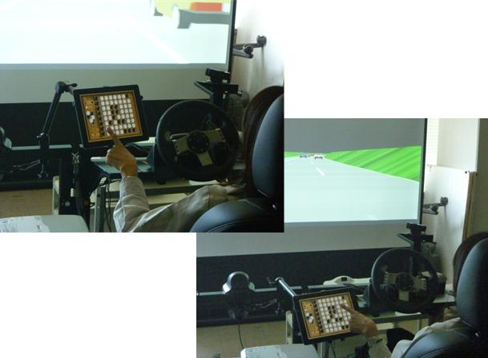
Experimental Condition
  Driver’s Condition
    Sub-task : None, Watching a movie, Playing a game
    Tablet PC’s position
    : Upper (Left upper of Steering), Lower (near Driver’s knee)
    Warning : Beep sound
  Driver’s Response Time
    From the start of Beep sound to Driver’s steering input.
←Upper position (Game)
Steering Angle
Time
Response Time
Beep
Lower position (Game)→

Slide 4
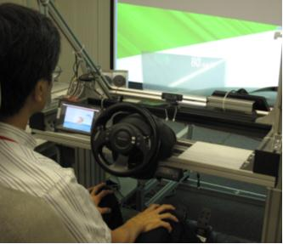
Results of Driver’s response time
Results (10 panels)
Driver’s response time is rather stable whether with Sub-task or without.
Maximum
Mean Response Time (s)
None | Movie | Movie | Game | Game
 | (Upper) | (Lower) | (Upper) | (Lower)
Sub-task (Tablet position)
 | Response Time (sec)
 | None | Movie (U) | Movie (L) | Game (U) | Game (L)
Sub-task
Mean | 1.9 | 1.9 | 2.1 | 1.7 | 1.7
Standard Deviation | 0.25 | 0.12 | 0.29 | 0.09 | 0.14
Min. | 1.4 | 1.5 | 1.3 | 1.5 | 1.2
Max. | 2.9 | 2.6 | 3.6 | 2.4 | 2.4
Mean:1.9sec, Min:1.2sec, Max:3.6sec

