Slide 1
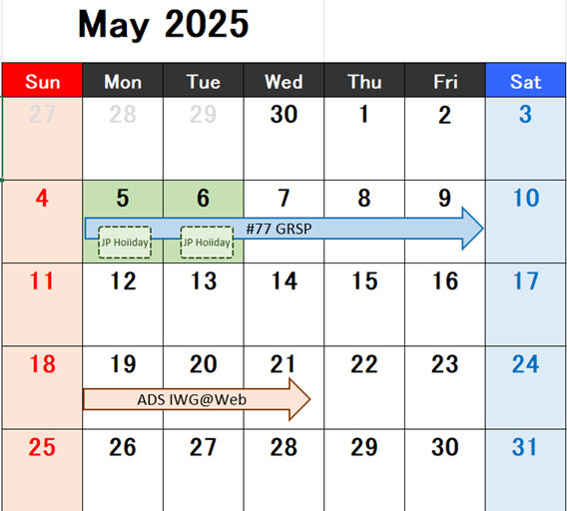
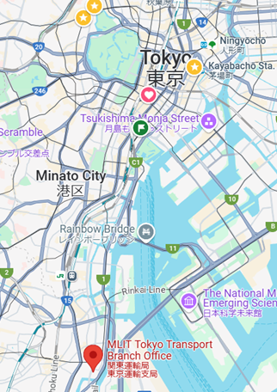
PTI IWG@JAPAN
PTI-37-05
Schedule candidate
Time plan
DAY | EVENT | NOTE
1 | AM: PTI IWG (PM: CITA Workshop) | The place will be around Hibiya, Tokyo.
2 | AM: Inspection Center Tour PM: Designated Garage Tour | The move will be by chartered bus.
Tokyo Station
Hibiya
Candidate
By chartered bus
(10km, 30min)
Shinagawa Station
Inspection Center

