Slide 1
Representative vehicle

Slide 2


Representative vehicle
Reminder
Representative vehicle
Defines number of calculations to be performed
Calculation burden exponentially increase with exact configuration of vehicle without substantial gain
Hence, irrespective of levels a representative vehicle definition is required to represent a family of vehicle
Should be precise enough for the purpose and less administrative burden
Modular Approach
Due to complex nature of production and usage of vehicle, a ‘modular approach’ will be suitable for carbon footprint calculation
Modular approach: Each phase of life cycle of vehicle will be calculated separately and then combined for a given vehicle
This reflects the present practice in industry

Slide 3





Modular approach
Upstream:
Materials & production
Down stream:
Use phase
Downstream:
End of life
Reference section | 3 | 4 | 5
Influencing factors | Depends on Country/region of production Vehicle type Powertrain type | Depends on Country/region of usage Powertrain configuration according to regional regulations etc. | Depends on Country/region of recycling Vehicle type Powertrain type
Family | LCA group (as defined in 3.1) | Powertrain group (as defined in 4.1) | End of Life group (as defined in 5.1)
Calculation Approach | Extrapolation method (as defined in 3.2) | Interpolation or inertia approach depending on country/region of usage (as defined in 4.2) | Extrapolation method (as defined in 5.2)
To be confirmed by SG5

Slide 4

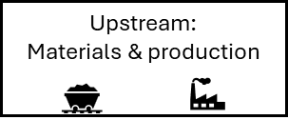

Calculation overview: Level 3
Define a vehicle for LCA declarations
Step 3
Upstream
emission
Step 3.1 :
Check in which ‘LCA group’ the defined vehicle’ belongs to
Step 2
Downstream emission: Use phase
Step 2.1 :
Check in which interpolation family the ‘defined vehicle‘ belongs to
Step 4
Downstream : End of Life
emission
Step 4.1 :
Check in which ‘LCA group’ the defined vehicle’ belongs to
Step 3.2 :
Consider the mass of the ‘vehicle high’* considered for the ‘downstream emission’
Step 2.2 :
Take the energy consumption value of the ‘vehicle High’ of that interpolation family
Step 4.2 :
Consider the mass of the ‘vehicle high’* considered for the ‘downstream emission’
Step 3.3 :
Estimate upstream carbon footprint by extrapolation from ‘representative vehicle of larger ‘LCA group’ using ‘UEF’
To be confirmed by SG5
Step 2.3 :
Calculate down stream emission (considering service life, deterioration factor etc.)
Step 4.3 :
Estimate EoL carbon footprint by extrapolation from ‘representative vehicle of larger ‘LCA group’ using ‘UEF’
Traction battery emission
Optional**: Traction battery carbon footprint & weight to be considered separately
Total Carbon footprint
Step 4:
Total Vehicle CFP = Upstream CFP + Downstream CFP + EoL CFP + Battery**
* Traction Battery’s mass & its carbon footprint to be excluded
**For vehicle with traction batteries

Slide 5
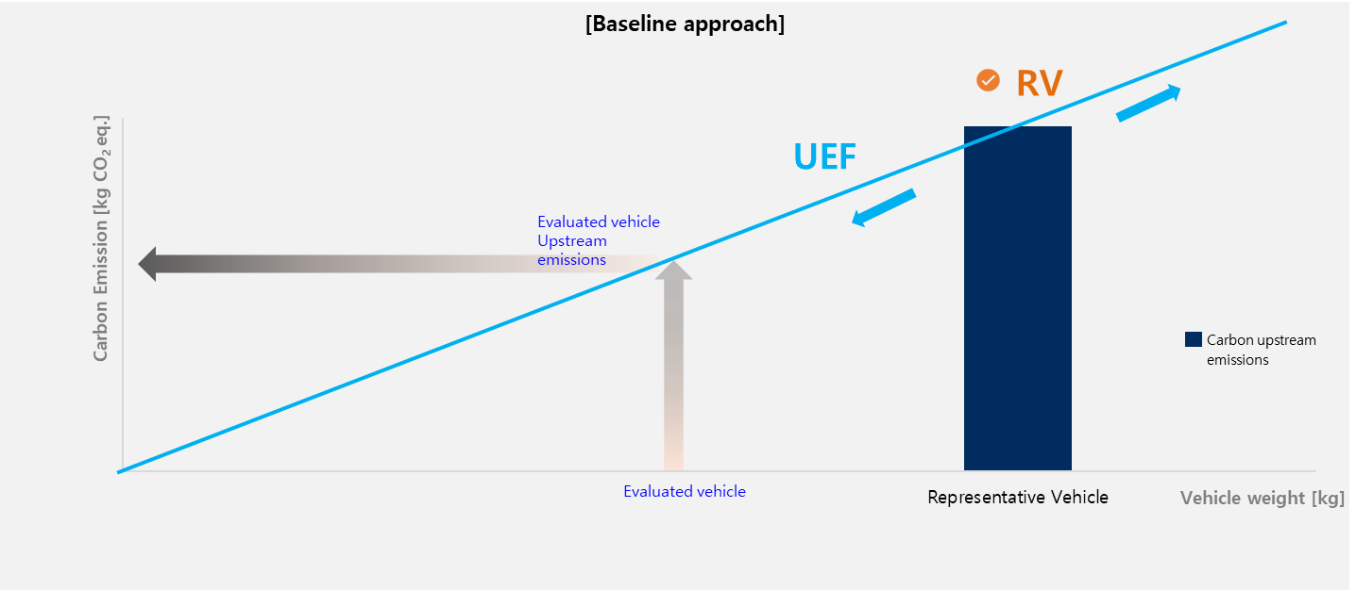

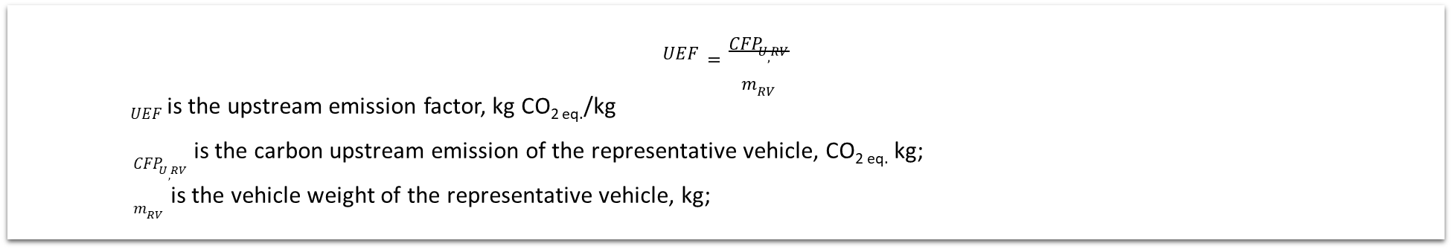
Upstream emission: Base line approach (SG3 discussion)
Cluster vehicles into a LCA group
LCA group:
  Vehicle type
  Powertrain energy type (petrol, EV etc.)
  Location of production
  Traction battery (for electrified vehicles)
Representative vehicle : Choose heaviest vehicle configuration (in OEM catalogue) in LCA group
Calculate ‘upstream emission’ for RV as defined by SG2 and SG3
Calculate ‘upstream emission factor’
$$UEF=\frac{{CFP}_{U, RV}}{m_{RV}}$$
$UEF$ is the upstream emission factor, kg CO_{2 eq.}/kg
${CFP}_{U, RV}$ is the carbon upstream emission of the representative vehicle, CO_{2 eq.} kg;
$m_{RV}$ is the vehicle weight of the representative vehicle, kg;

Slide 6


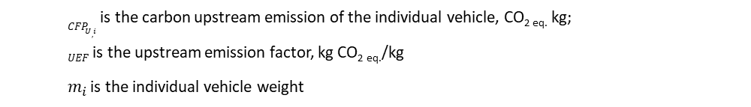
Upstream emission: Estimation of required vehicle (SG3 discussion)
Powertrain group
(IP-family / inertia class)
LCA group
Vehicle weight
$${CFP}_{U, i}=UEF × m_{i}$$
${CFP}_{U, i}$ is the carbon upstream emission of the individual vehicle, CO_{2 eq.} kg;
$UEF$ is the upstream emission factor, kg CO_{2 eq.}/kg
$m_{i}$ is the individual vehicle weight
Vehicle on which CFP value is required
Worstcase conf. cover other vehicle
Estimate upstream LCA value on same ‘use phase vehicle conf.

Slide 7














Downstream emission: Use phase
CO_{2e}
=
CO_{2e Material}
+
CO_{2e Production}
+
CO_{2e Use phase}
+
CO_{2e Second life}
+
CO_{2e Recycling}
Not in Scope
Present practice:
Energy consumption is defined for a powertrain group in every region of the world ( IP family etc.)
Representative vehicle are defined in an interpolation or inertia class approach
Proposal :
As they already exist => its better to refer to regional regulations for powertrain group
CO_{2e use phase}
=
CO_{2e Show room}
Not in Scope
+
CO_{2e energy cons}
CO_{2e energy cons}
=
Energy consumption
X
Conversion factor
well-to-Wheel
X
Service
Life
+
CO_{2e maintenance}
+
Present practice:
Maintenance and leakage are not part of any powertrain group criteria
Proposal :
Impact of leakage & maintenance are reported to be very low and hence variation of these emissions in a powertrain group will be very low
Propose to use the worst-case vehicle of a powertrain group as the representative vehicle (same as energy consumption)
CO_{2e leakage}
+
CO_{2e Secondary use}
Not in Scope

Slide 8


Downstream emission: Use phase
Reminder
Each individual vehicle has ‘energy consumption’ value in the official document ( COC etc.)
Broadly there are two types of approach: Interpolation & Inertia class
CO₂
CO₂
Cycle Energy Demand
Mass
Energy consumption of individual vehicle calculated by interpolation approach :
Europe
Japan
China ?
…
Energy consumption of individual vehicle calculated by inertia approach :
Korea
US
Brazil
…

Slide 9

Downstream emission: Use phase (level 3)
Worst case energy consumption can cover other vehicles
CO₂
CO₂
Cycle Energy Demand
Mass
Regions using interpolation approach => vehicle high will cover all other vehicle in that interpolation family
Regions using Inertial class => highest inertia class can cover all other inertia class below in a powertrain group

Slide 10


Downstream emission-Use phase : Level
Upstream
Downstream –Use phase
LCA group
Level 1 & 2
LCA group
Level 3
Powertrain group
Level 4
Individual vehicle

Slide 11



Downstream emission- Use phase: Maintenance & leakage
Two option agreed in SG4
Option 1
CO_{2e maintenance}
=
parts & consumables
X
Replacement Frequency
X
Carbon emission factor
OR
Option 2
CO_{2e maintenance}
=
Fixed factor
X
Open question
Level 2: fixed factor (option 2) ?
Level 3: priority for fixed factor (option 2) and if OEM can provide details then can use ‘option 1’
Level 4: priority for ‘option 1’ with OEM data

Slide 12
Downstream emission- Use phase: overview
Grouping of vehicle: (section 4.1)
Group vehicles into powertrain criteria
Arrange vehicles according to mass/energy : (section 4.2)
Organize vehicles into different inertia class or interpolation group
Level 3
Level 4
Selection of representative vehicle: (Section 4.3)
In case of Interpolation: Choose vehicle high
In case of Inertia class: Choose highest inertia class
Selection of representative vehicle: (Section 4.4)
In case of Interpolation: individual vehicle
In case of Inertia class: individual inertia class
Calculation of in-use energy consumption : (section Y.Y SG4)
Calculate using ‘representative vehicle definition’
Calculation of in-use energy consumption : (section Y.Y SG4)
Calculate using ‘individual vehicle definition’
Calculation of maintenance & leakage: (section Y.Z.1 of SG4)
Calculate using ‘representative vehicle definition’
Calculation maintenance & leakage: (section Y.Z.2 of SG4)
Calculate using ‘representative vehicle definition
In-use CFP = in-use energy consumption + maintenance/ leakage

