Slide 1
Next LEDr categories
H8, H16, HB4
TFSR-23-02
(based on LS-1632)
W. Schlager, P. Plathner
2025-02-26

Slide 2
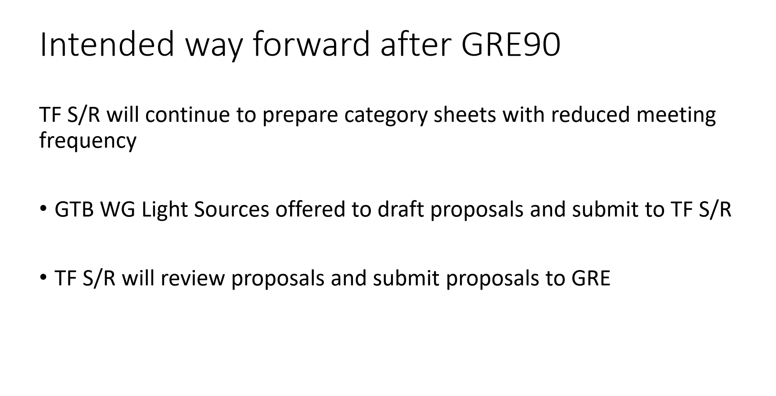
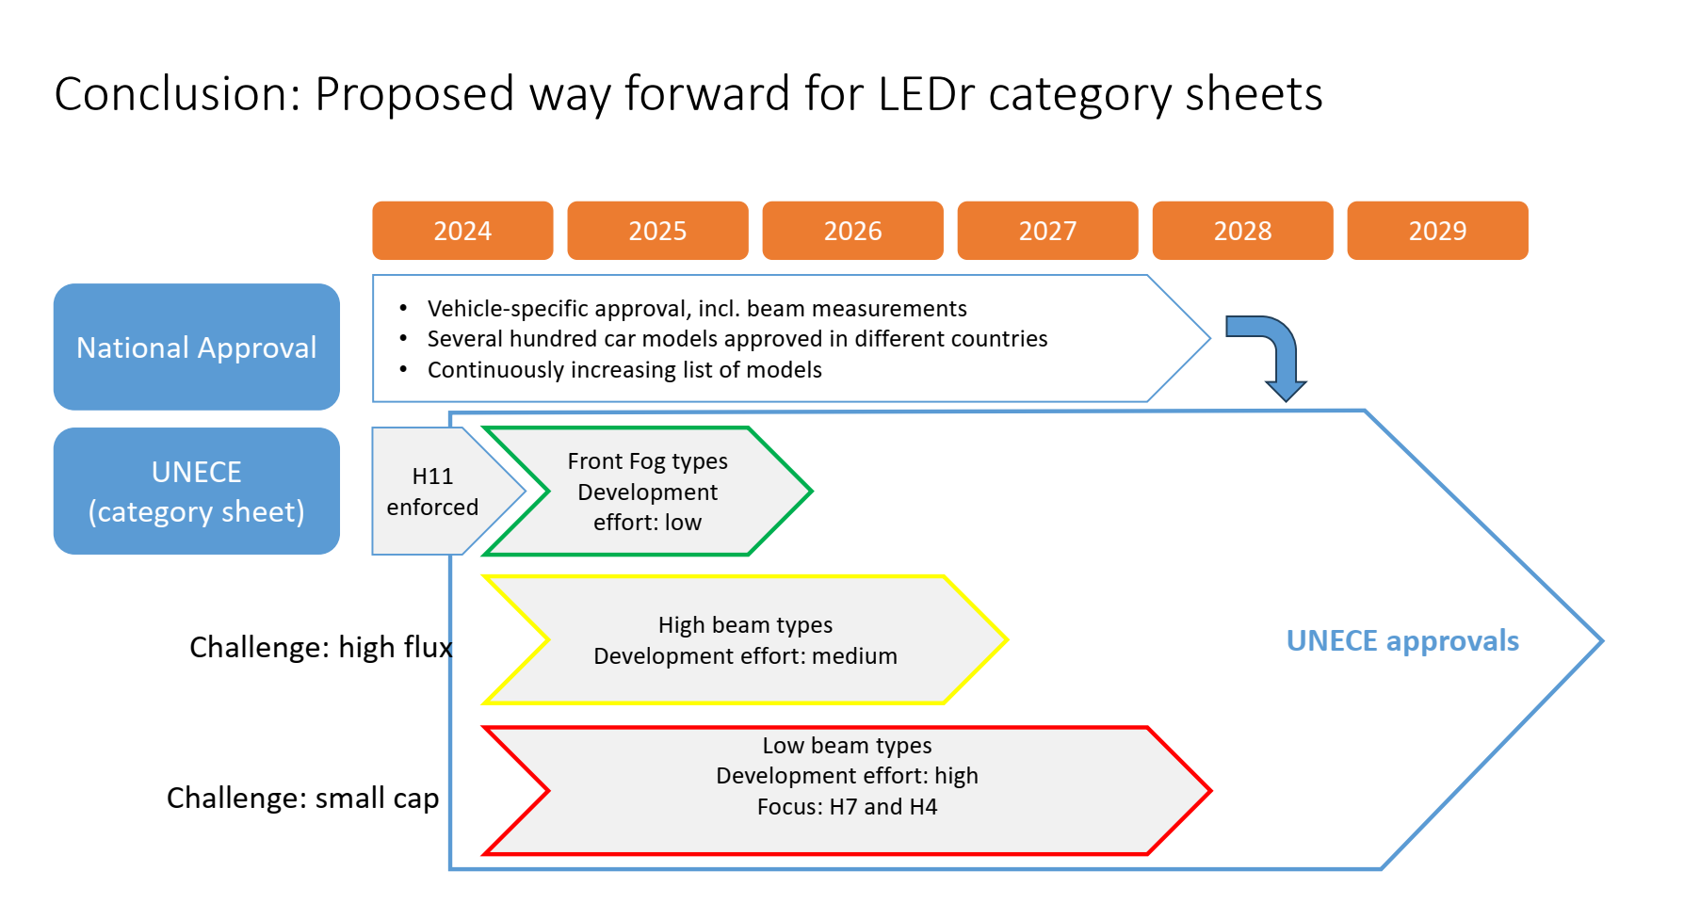
Outcome GRE91
See GRE-91-14

Slide 3
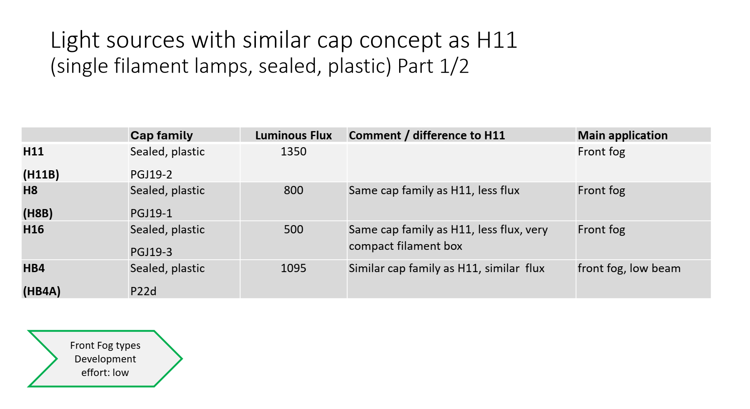
Outcome GRE91
Technical discussion needed on category sheet: H8, H16, HB4
See GRE-91-14
Target: formal proposal for GRE in October 2025

Slide 4
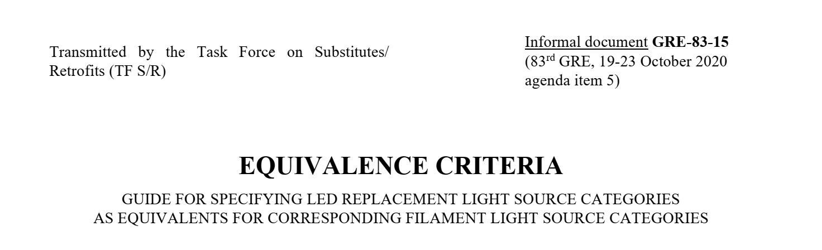
Technical items e.g. for H8 based on H11 sheet – using GRE-83-15
Only two-sided approach
Mechanical outline → same as H11
Photometry
  Flux → same as H8 halogen
  LEA → see next page
  Contrast → same as H11
  Intensity distribution → similar as H11
Thermal performance → same as H11
Electrical parameters
  Include high efficiency version
  Remove “failure footnote” for front fog categories
➔ See draft H8-LEDr sheet: TFSR-23-03 (LS-1629)

Slide 5
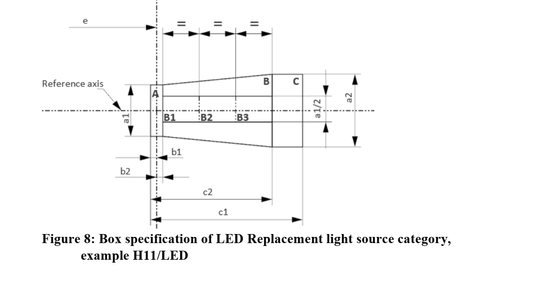
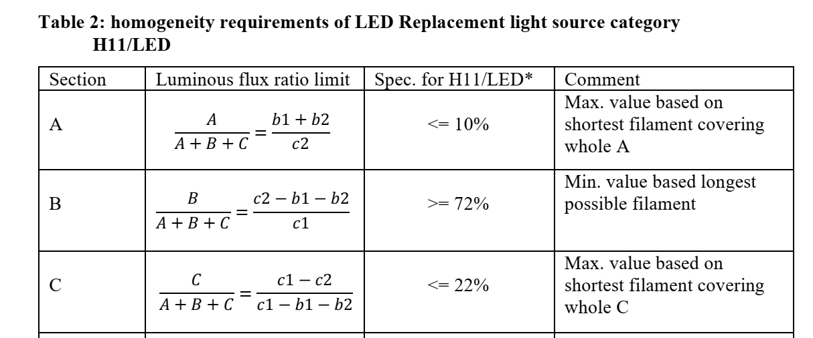
LEA analysis (trapezoidal box)
reminder
Based on GRE-83-15 „Equivalence criteria“ Annex 3B
To cover size, position and homogenity

Slide 6
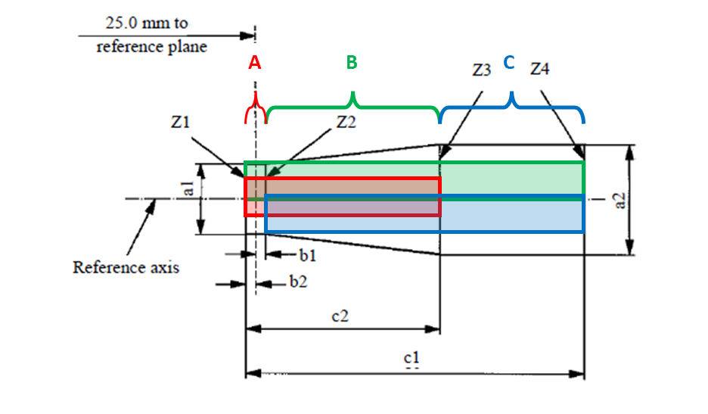
LEA calculations (trapezoidal box)

Slide 7
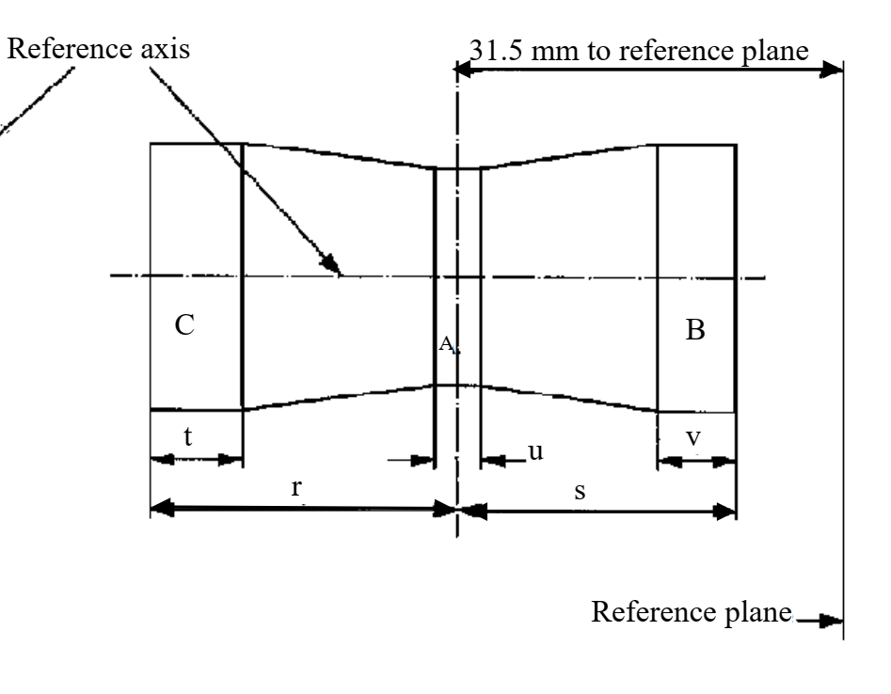
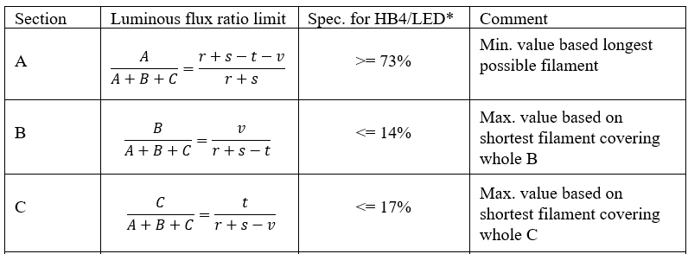
LEA calculations HB4 (butterfly box)
Based on same principle as shown for trapezoidal box (GRE-83-15)
To cover size, position and homogenity

Slide 8
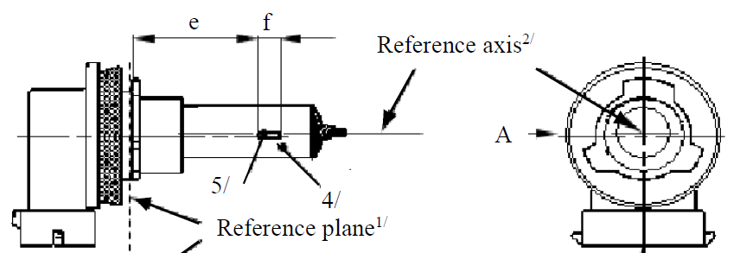
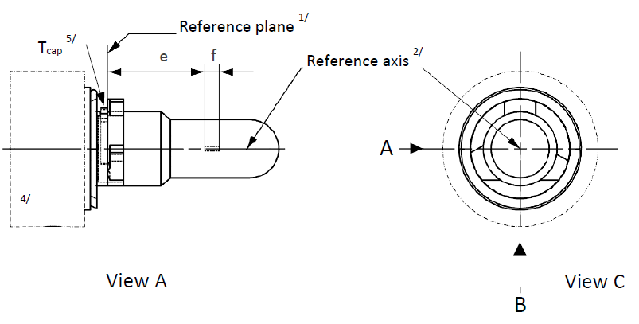
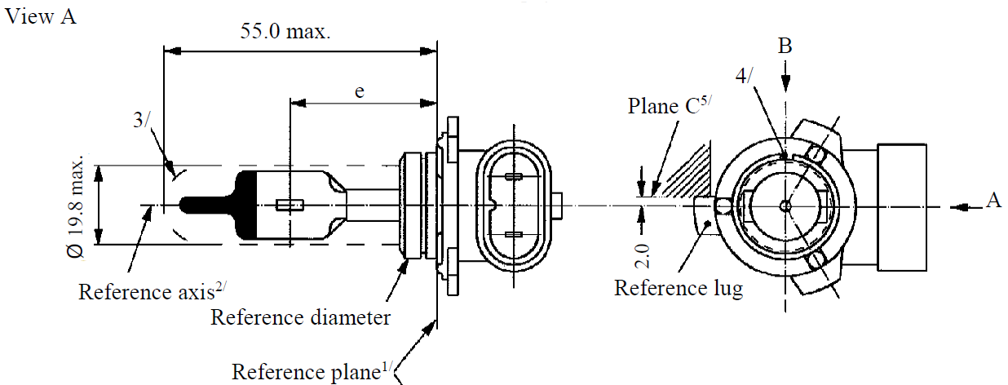
 | Filament sheet | LEDr sheet
H11 H8 H16 Trapezoidal box
HB4 Butterfly box
B
View A
View C
WGLS preference:
First „rotate“ HB4 filament drawing into
„H11 orientation“, then apply H11 LEDr
view convention
Not preferred:
Keep orientation and view convention of HB4 filament

