Slide 1
GRE Task Force
LED Substitutes / Retrofits (TF S/R)
Status report for GRE92
Submitted by the Task Force on Substitutes / Retrofits (TF S/R)
Informal document GRE-92-xx
(92nd GRE, 22 to 25 April 2025,
agenda item 5)
TFSR-23-04
DRAFT
xx/03/2025
Ph. Bailey, UK (Chairman)
Ph. Plathner, IEC (Secretary)

Slide 2

Meetings of TF S/R
Actions completed :
Step 1: LED Substitutes
Step 2: LED Replacements (“Retrofits”)
  Step 2A: Administrative items
  Step 2B: Technical items based on “full equivalence”
  Step 2C: Re-evaluate equivalence criteria of LEDr for Road Illumination (→ H11)
Step 3: develop further category sheets
22nd meeting 2024-October-08: online meeting (report: TFSR-22-03)
23rd meeting 2025-03-28: online meeting
(report: TFSR-23-xx)
Next planned:
24th meeting 2025-06-26 (TBC): online meeting

Slide 3
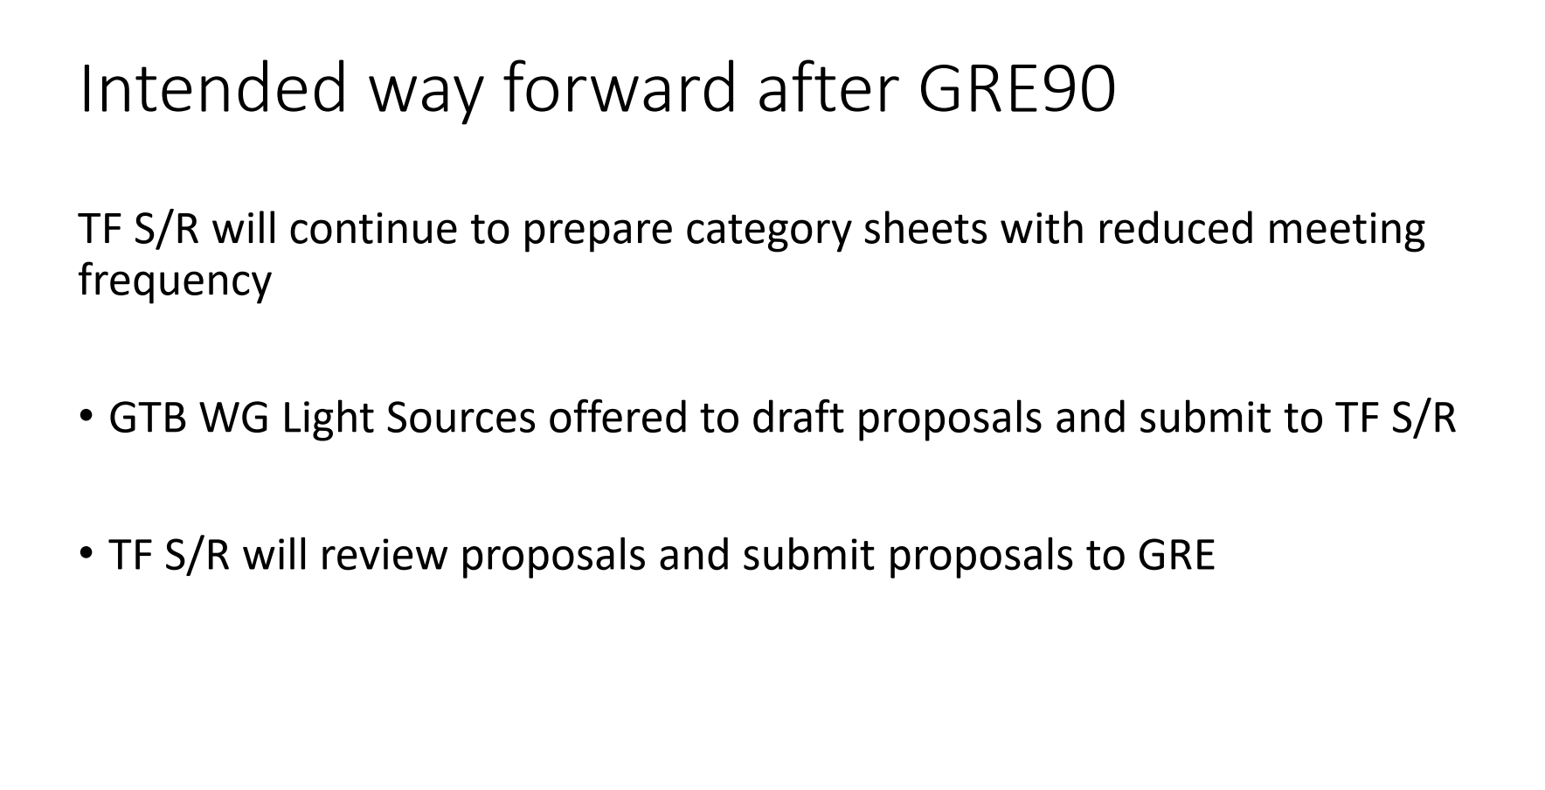
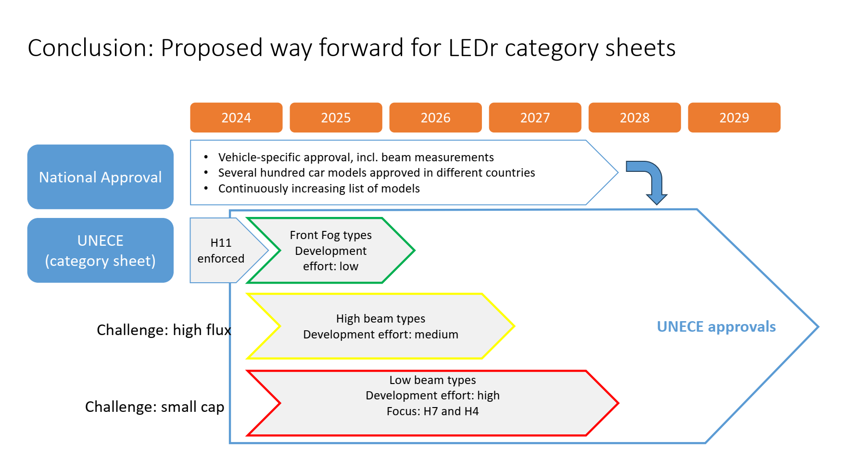
Way Forward, Time Planning
See GRE-91-14

Slide 4
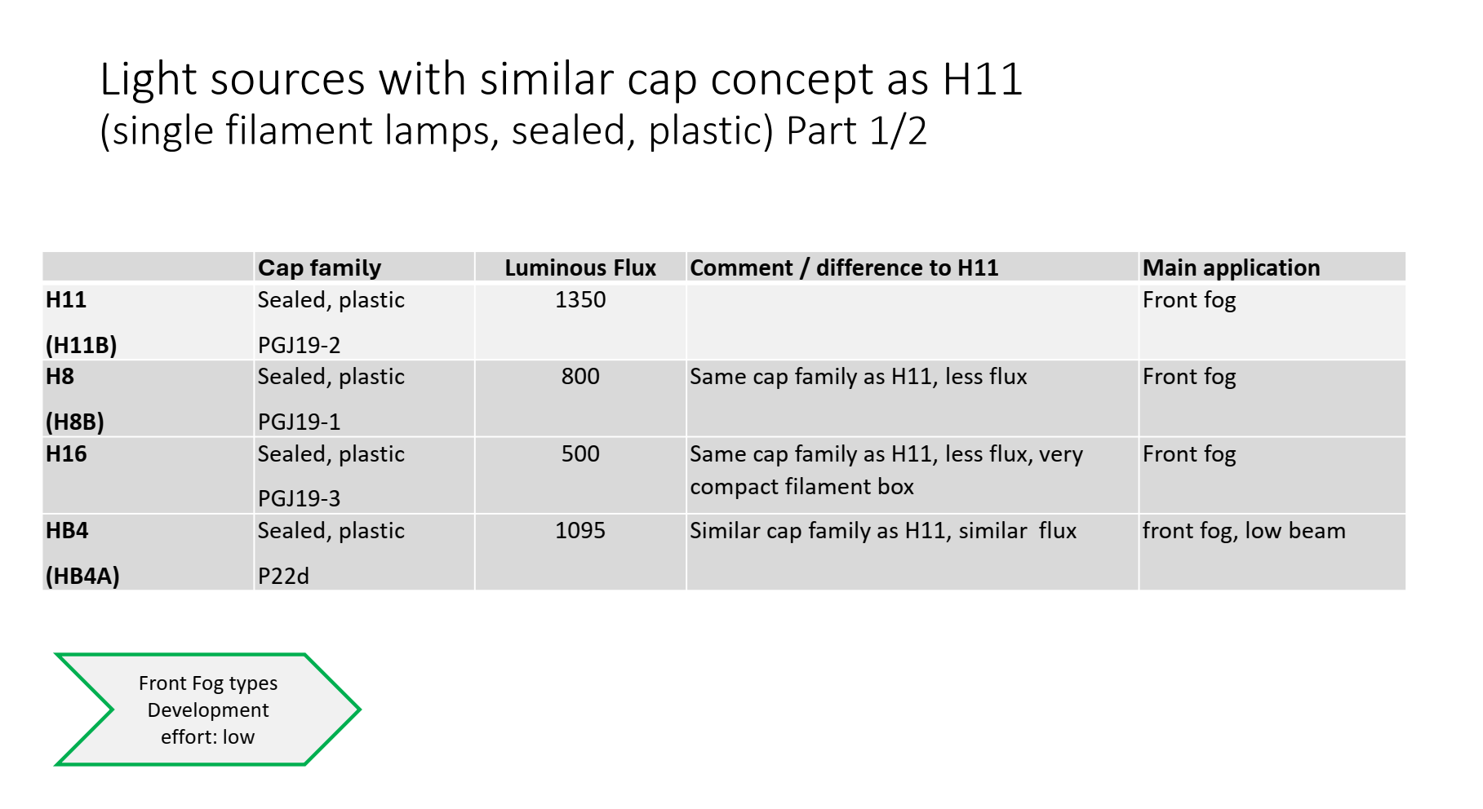
Front Fog Types
Target: formal proposal for GRE in October 2025
Technical discussion ongoing in WGLS: H8, H16, HB4
See GRE-91-14

Slide 5
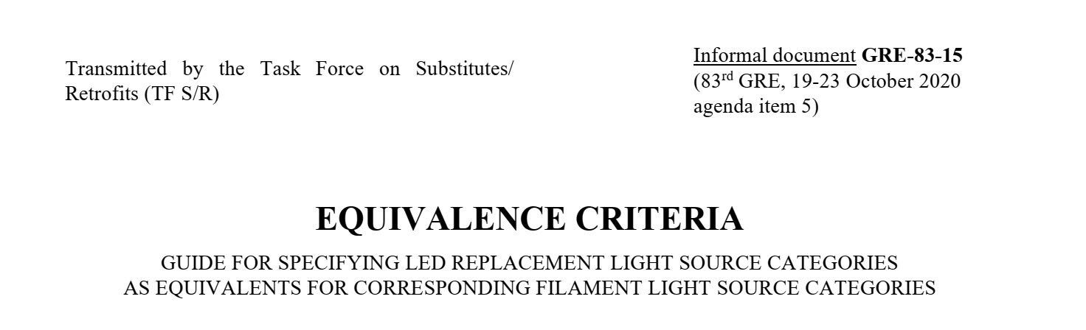
Technical items for front fog types based on H11 sheet – using GRE-83-15
Only two-sided approach
Mechanical outline → based on H11 approach
Photometry
  Flux → same as halogen bulb
  LEA → trapezoidal box (H8, H16) , butterfly box (HB4)
  Contrast → same as H11
  Intensity distribution → based on H11 approach
Thermal performance → based on H11 approach
Electrical parameters
  Include high efficiency version → same as H11
  Remove “failure footnote” for front fog categories
➔ Draft H8 LEDr sheet, see GRE-92-xx

