Slide 1
ETRTO comments on JASIC document WT-66-2
Document WT-66-3
IWG WGWT meeting 13 February 2025

Slide 2
Introduction
ETRTO thanks JASIC for providing the amendment proposal to IWG WGWT Terms of Reference (WT-66-2), bringing further clarity to the ongoing (slide 3 of WT-64-2) and future activities in the IWG WGWT.
ETRTO agree with the JASIC timeline proposal and the approach to fix a target KPI for workplan step 1, preferably before GRBP 81st session.
ETRTO shared a suitable proposal for the target KPI, as presented in document WT-62-7v1 slide 6 (see slide 4).

Slide 3
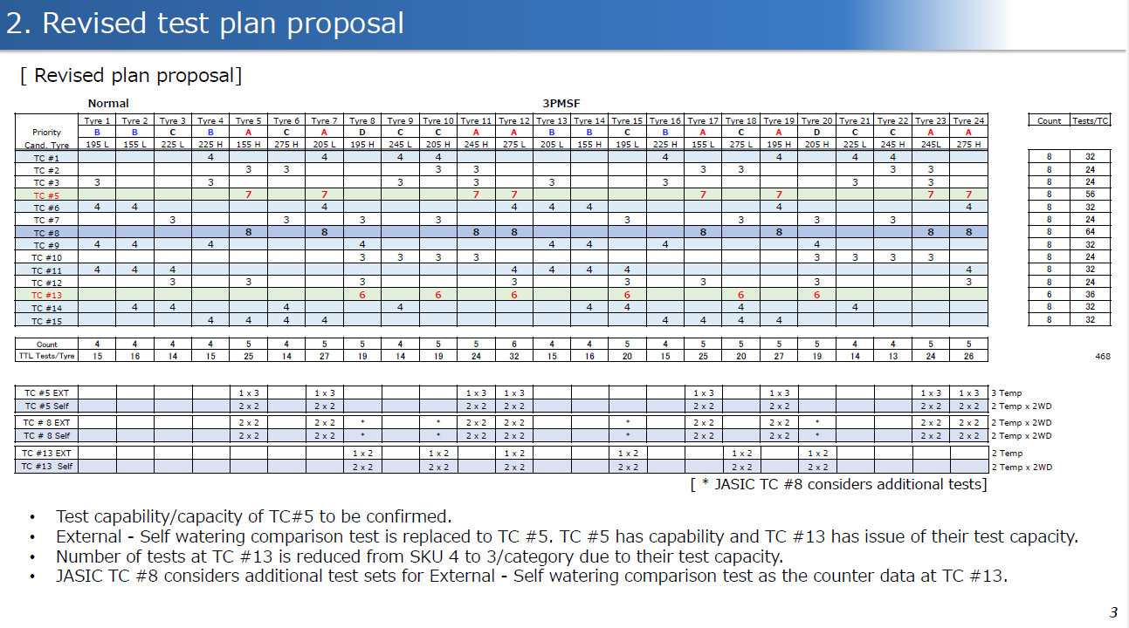
Slide 3 of WT-64-2

Slide 4
Target KPI for stage 1 evaluation
content extracted from document WT-62-7v1
Proposal:
Improve the test Weighted Std.Dev. by at least half of the improvement realized for the WGI in ‘new’ state.
 | Weighted Standard Deviation
 | Trailer method | Vehicle method
Wet Grip Index – New Tires
Old WGI (YYYY) | 0.083 | 0.083 | Source: (RRT 2019-21)
WGI ISO23671:2021 (2021) | 0.063 | 0.071
Wet grip Index – Worn Tires
WWGI (2021) | 0.087 | 0.081 | Source: (WTPP-26-6)
WWGI (2025) | 0.077 | 0.071
24% improvement
12% improvement
Rationale:
Wet Grip in ‘worn’ state may not achieve the same level of test data dispersion as the Wet Grip in ‘new’ state does, due to addition of candidate tyres buffing as well as a higher sensitivity to water depth levels resulting from the minimized profile depths of tested tyres.
The proposed improvement in weighted standard deviation is seen as bringing the uncertainty to at a more than acceptable level and would represent a significant step in a short timeframe.

Slide 5
Conclusions
The ETRTO target KPI proposal is both suitable and adequate. In addition to the rationale presented in previous slide, the following arguments must be considered:
  Wet grip worn tyre is a threshold limit only for type approval purposes (while wet grip in New state is for both type approval + label differentiation)
  After approximately 2 years of wet grip in worn state testing and certification (with previous and current R117.03 an R117.04), no concerns have been raised from test centers regarding the test precision.
  The ETRTO target KPI proposal represents a significant improvement for the precision of wet grip worn tyre testing.
ETRTO remains committed to actively participate and contribute to the workplan as agreed in the IWG WGWT.

Slide 6
Thank you

