Slide 1

Conditional Automation (Level 3)
Use-Case Description
Submitted by OICA Document No. ITS/AD-06-06
(6th ITS/AD, 3 November 2015, agenda item 3-2)
Submitted by the Experts of OICA as Input to the IWG ITS/AD
November 3, 2015
Geneva

Slide 2
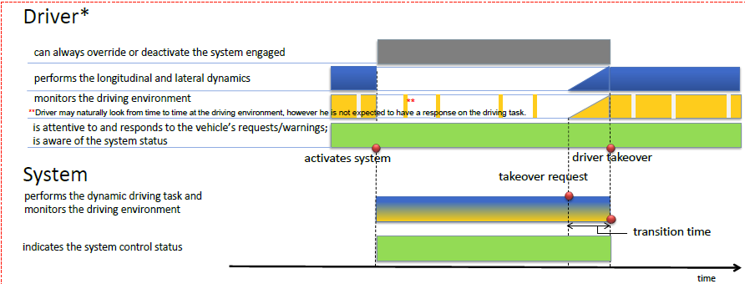

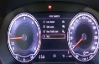










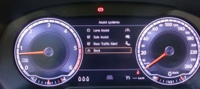


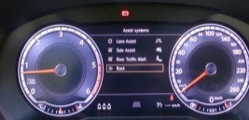
NOTE: Exemplary HMI - R&D is ongoing to find optimal solutions
Level 3 system outline
Status | System Off (Manual Driving) | Nominal system operation | Take over scenario(Warning cascade) |  | System OFF (Manual driving)
 |  |  | Optional takeover request | Takeover demand
Driver
HMI (Example) Text message (Example)
traffic
traffic
traffic
Lv3 Stand-by
Lv3 Activate
Take over!
Take over!
Lv3 Stand-by
03. November 2015, IWG ITS/AD, United Nations, Geneva | Slide #3

Slide 3

NOTE: Exemplary HMI - R&D is ongoing to find optimal solutions
Illustrated version for OICA Use-Case Description of Level 3
■ Example A : Traffic Jam Function
V=0-60km/h, Highway only, Same lane only, preceding vehicle needed
Driver can always override the system.
 | Manual driving | Nominal system operation | Takeover scenario(Warning cascade) |  | Manual driving
 |  |  | Optional takeover request | Takeover demand
Driver | *L & L control Environment monitoring | Ready to resume to driving | takeover |  | *L & L control Environment monitoring
System | Stand-by | *L & L control Environment monitoring |  |  | Stand-by
HMI (Example)
Lv3
Stand-by
Lv3
Activate
Takeover!
Takeover!
Lv3
Stand-by
Yellow or red cluster symbol
Text messages in the instrument cluster
Etc.
Red cluster symbol
Non-visual alert, like an acoustic or haptic alert
*L & L control : Lateral & Longitudinal control

Slide 4

NOTE: Exemplary HMI - R&D is ongoing to find optimal solutions
Illustrated version for OICA Use-Case Description of Level 3
■ Example B : Motorway driving Function
V=0-130km/h, Highway only, lane change include
Driver can always override the system.
 | Manual driving | Nominal system operation | Takeover scenario(Warning cascade) |  | Manual driving
 |  |  | Optional takeover request | Takeover demand
Driver | *L & L control Environment monitoring | Ready to resume to driving | takeover |  | *L & L control Environment monitoring
System | Stand-by | *L & L control Environment monitoring |  |  | Stand-by
HMI (Example)
Lv3
Stand-by
Lv3
Activate
Takeover
Takeover
Lv3
Stand-by
Abcd..
Takeover!
Takeover!
Yellow or red cluster symbol
Text messages in the instrument cluster
Etc.
Red cluster symbol
Non-visual alert, like an acoustic or haptic alert
*L & L control : Lateral & Longitudinal control

Slide 5
NOTE: Exemplary HMI - R&D is ongoing to find optimal solutions
Illustrated version for OICA Use-Case Description of Level 3
■ Example B : Motorway driving Function - Takeover scenario
V=0-130km/h, Highway only, lane change include
Driver can always override the system.
 | Approaching Construction Zone (Warning cascade) |  | Weather(rain) become worse (Warning cascade)
 | Optional takeover request | Takeover demand | Optional takeover request | Takeover demand
Driver | takeover |  | takeover
System | *L & L control Environment monitoring |  | *L & L control Environment monitoring
HMI (Example)
Takeover
Takeover
Takeover
Takeover
Takeover!
Takeover!
Takeover!
Takeover!
Yellow or red cluster symbol
Text messages in the instrument cluster
Etc.
Red cluster symbol
Non-visual alert, like an acoustic or haptic alert
Yellow or red cluster symbol
Text messages in the instrument cluster
Etc.
Red cluster symbol
Non-visual alert, like an acoustic or haptic alert
*L & L control : Lateral & Longitudinal control

