Slide 1
Transmitted by the Republic of Korea
PSG-03-XX
The KOREA-Comment on proposed amendments to GTR 6 by OICA/CLEPA
24. Feb. 2016

Slide 2
Contents
Table of Contents
1. Background
2. Application/Scope of GTR 6
3. 227g ball Test
4. Comment of The KOREA
-2-
Notes:
2

Slide 3
1. Background
OICA/CLEPA proposed amendments to GTR No. 6 from informal
document(GRSG-107-23) and also discussed at PSG-2nd about them.
The chair of IWG PSG requested to review the proposal of OICA/CLEPA
by the KOREA experts as the technical sponsor.
The KOREA comment is to consider both the progress direction of IWG
PSG and current issue of Ceramic printed area.
-3-
Notes:
3

Slide 4
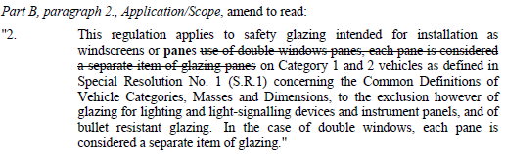
2. Application/Scope of GTR 6
The OICA/CLEPA proposals is to aim amendment about an obvious
mistake in the scope of GTR 6.
The KOREA position :
- The KOREA absolutely agree and support to amend the scope of
GTR 6 because GTR No 6 applied other pane such as toughened
glass etc. as well as both windscreen and double window panes.
-4-
Notes:
4

Slide 5

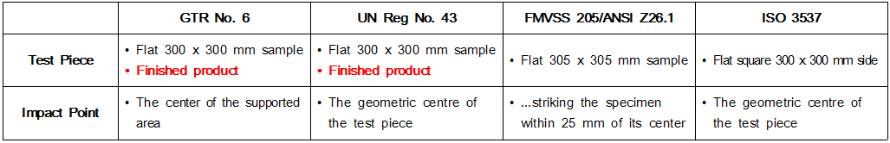
3. 227g ball Test
The OICA/CLEPA proposals is to aim amendment about 227g ball
drop test same as ISO 3537/UN Reg No. 43
The KOREA position :
- Simple comparison table of 227g ball test on toughened glass
-5-
Notes:
5

Slide 6
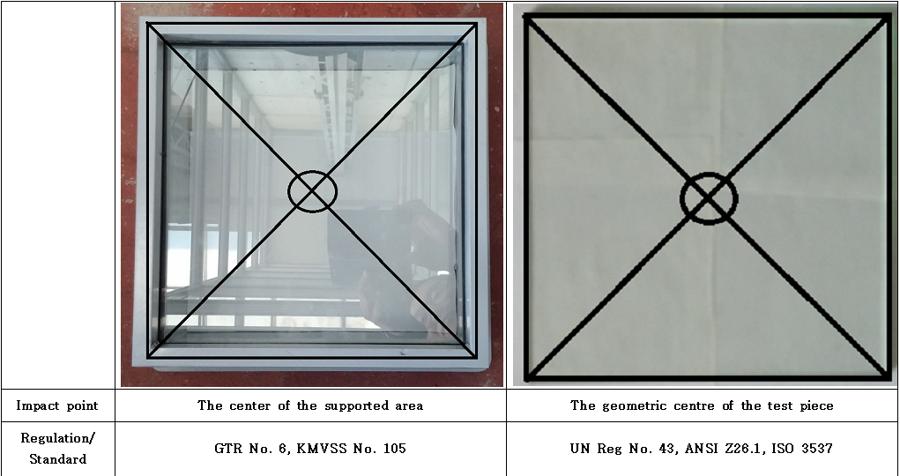
3. 227g ball Test
The KOREA position(2) :
- Simple comparison of 227g ball test procedure on toughened glass
● In case of Flat 300 x 300 mm sample :
· Completely Same as the impact point both the center of
supported area and the geometric centre of test piece
-6-
Notes:
6

Slide 7
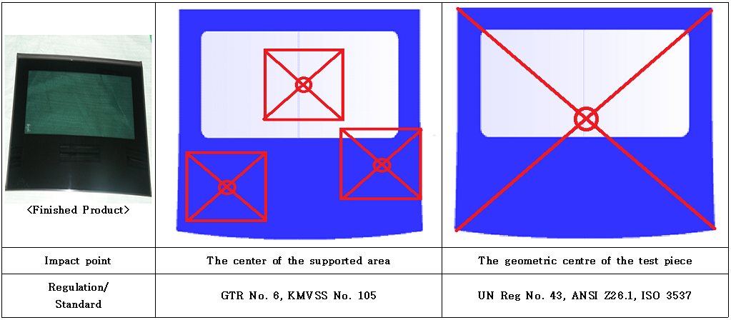
3. 227g ball Test
The KOREA position(3) :
- Simple comparison of 227g ball test procedure on toughened glass
● In case of finished products :
· To be possible to be different impact point between the center of
supported area and the geometric centre of test piece
-7-
Notes:
7

Slide 8
4. Comment of the KOREA
The KOREA agree to amend the scope of GTR 6 from OICA/CLEPA
proposal.
However the Korea request to consider amendments of 227g ball
test to OICA/CLEPA proposal after completing adoption of GTR 6
amendment regarding the limitation of ceramic printed area because
of the following reasons.
- No include the ceramic printed area of vulnerable strength in test
area of 227g ball drop test.
- No conform to be the purpose of IWG PSG for limit the ceramic
printed area to be weaker strength in order to safety driving.
-8-
Notes:
8

Slide 9
Thank you for your attention !
Notes:
9

