Slide 1
Maintenance parts

Slide 2
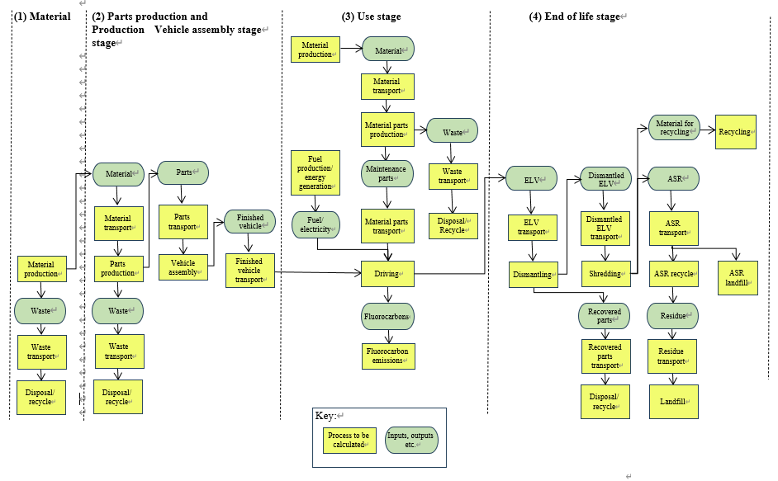
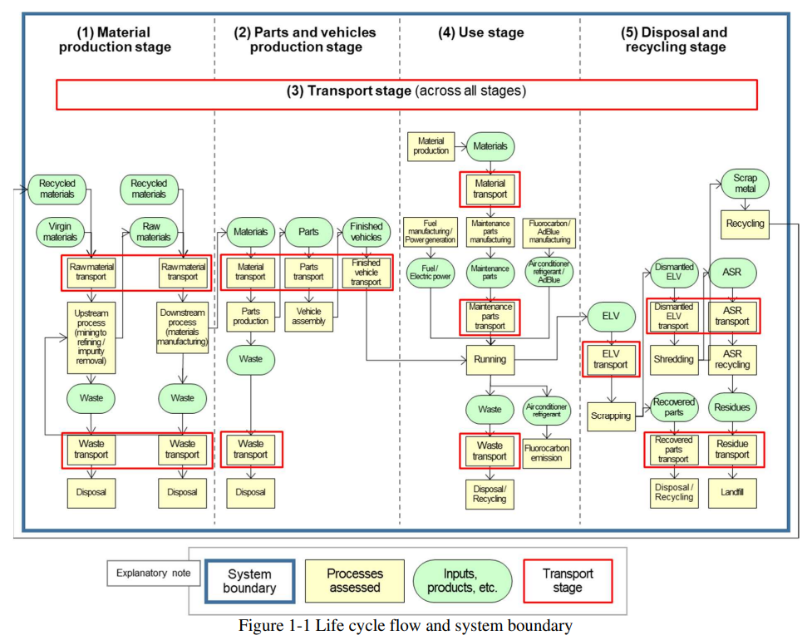
“Waste” in maintenance parts
Current draft
Proposal (JAMA guidelines)
“Waste” in the current draft is “yield”. This is already included in upstream “Maintenance parts production”.
As one of important processes in maintenance parts, parts removed at the replacement have to be considered. This is “waste” in use phase. (ref. JAMA guidelines)
https://www.jama.or.jp/operation/ecology/LCA/pdf/JAMA_guidelines_CFP_2024_en.pdf

