Slide 1
STATS19 KSI & Collision Data for Bus/Coach and VRU
Great Britain 2013 - 2023
10 February 2025
OFFICIAL – SENSITIVE
NOT GOVERNMENT POLICY

Slide 2
Introduction
The STATS19 database collates information on road traffic collisions in Great Britain.
This review is for an 11-year timeframe to establish the total number of Killed or Seriously Injured (KSIs) road users when there is a collision between a bus/coach and a Vulnerable Road User (VRU). The VRUs include mobility scooters, pedal cycles, motorcycles and pedestrians.
For slides 5-10, the total numbers is a count of vehicles, not casualties. It includes all collisions with at least one VRU casualty (pedestrian, pedal cyclist, motorcyclist or mobility scooter rider), and at least one bus/coach - including multiple vehicle collisions where the VRU and bus/coach may not have collided with each other.
STATS19 data only contains data from collisions on public highways, therefore collisions that have occurred at bus station and in vehicle depots are unlikely to be captured in this data.

Slide 3
Total KSIs involving a Bus/Coach and VRU
Number of VRUs killed or seriously injured in collisions involving at least one bus/coach, GB 2013 to 2023. Split into VRU type.
Total KSIs over the 10-year period:
Mobility scooters = 11
Motorcyclist = 525
Pedal cyclist = 822
Pedestrian = 3261
Total = 4619
2020-2021 are COVID years when traffic levels were reduced

Slide 4
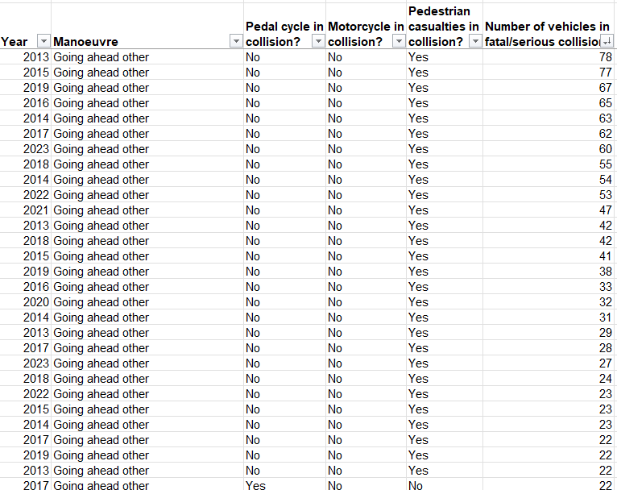
Analysis of common manoeuvres
When reviewing the number of collisions between bus/coach and VRU (2013-2023) the highest number were when a bus/coach was performing a ‘Going ahead other’ manoeuvre (this is generic driving and not a specific manoeuvre).
As the Taskforce’s intention is to look at low speed manoeuvres the following criteria have been selected for further analysis:
Moving off
Slowing or stopping
Waiting to go – held up
Turning left
Turning right
Reversing

Slide 5
Collisions involving a Bus/Coach and VRU during a ‘Moving Off’ manoeuvre
Total ‘moving off’ collisions = 454
2020-2021 are COVID years when traffic levels were reduced

Slide 6
Collisions involving a Bus/Coach and VRU during a ‘Slowing or Stopping’ manoeuvre
Total ‘Slowing or Stopping’ collisions = 313
2020-2021 are COVID years when traffic levels were reduced,
but interesting that collisions with cyclists increased only for this manoeuvre. There were more people cycling but unclear why other manoeuvres were unaffected.
Unclear why 2022 was the lowest year.

Slide 7
Collisions involving a Bus/Coach and VRU during a ‘Waiting to go – held up’ manoeuvre
Total ‘Waiting to go – held up’ collisions = 214
2020-2021 are COVID years when traffic levels were reduced
Unclear why there was a large increase in 2017

Slide 8
Collisions involving a Bus/Coach and VRU during a ‘Turning left’ manoeuvre
Total ‘Turing left’ collisions = 223
2020-2021 are COVID years when traffic levels were reduced
Only slight reduction in 2020-21, lowest seen in 2022.
Unclear why 2016 was the highest year.

Slide 9
Collisions involving a Bus/Coach and VRU during ‘Turning Right’ manoeuvre
Total ‘Turning right’ collisions = 298
2020-2021 are COVID years when traffic levels were reduced
To note, there is a higher number of collisions when a bus/coach is turning right compared to left.
To note, there is a higher number of motorcyclists (79) and pedal cyclists (57) in this manoeuvre compared to any other.

Slide 10
Collisions involving a Bus/Coach and VRU during a ‘Reversing’ manoeuvre
Over the 11-year period there have been 16 collisions involving a VRU and Bus/Coach while the vehicle is reversing. Noting this is only data from public highways.

