Slide 1
Revised Logistic information for
#39 PTI-IWG-IWG in Tokyo
(May 2025)
Informal Document PTI-38-07
38th Meeting of IWG on PTI
2nd April 2025
Copyright 02/07/2024 JASIC, all rights reserved. For reproduction permission and all other issues, please contact jasic@jasic.org .

Slide 2
PTI IWG Tokyo Meeting (in hybrid format)
Date and time: *time is in JST(UTC+09:00)
Wed. 28 May. 9:30-12:30 and Reception starting at 18:00
Thu. 29 May. 9:00-16:00(tbc)
Venue:
HIBIKOKU CONFERENCE SQUARE (28th, IWG and Reception party)
8th Floor, Hibiyakokusai Bldg., 2-2-3 Uchisaiwaicho, Chiyoda-ku, Tokyo 100-0011, Japan
TEL: +81(0)3-5157-5039 FAX: +81(0)3-5157-5040
Move to google map
JASIC OFFICE (29th, Technical tour)
7th floor, Zennihon Truck Sogo Kaikan., 3-2-5 Yotsuya, Shinjuku-ku, Tokyo 160-0004
TEL: +81-(0)3-5362-7751
Move to google map
For registration, please access this online registration format to fill in the necessary information.
For inquiry, please contact Mr. Issei KATO i-kato@jasic.org and Mr. Tomoshi FUJITA fujita@jasic.org.

Slide 3

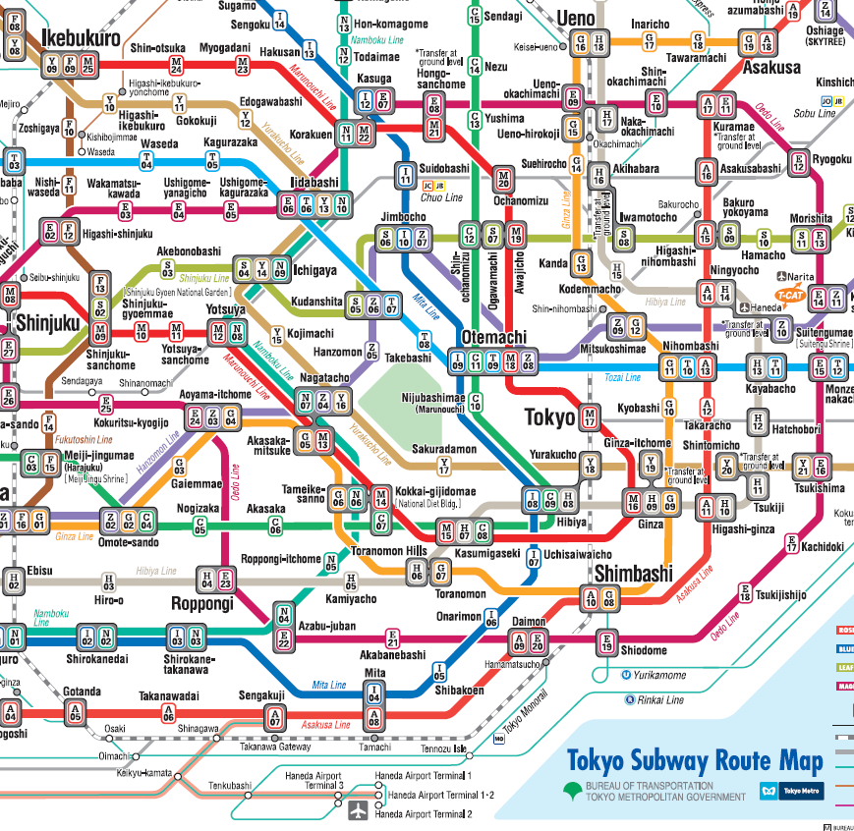
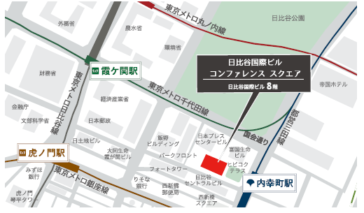
Access to the venue (28th of May, PTI IWG)
Venue: HIBIKOKU CONFERENCE SQUARE(日比谷国際ビルコンファレンススクエア)
Address: 8th Floor, Hibiyakokusai Bldg., 2-2-3 Uchisaiwaicho,
Chiyoda-ku, Tokyo 100-0011, Japan (東京都千代田区内幸町2丁目2-3 日比谷国際ビル8F)
TEL: +81(0)3-5157-5039 FAX: +81(0)3-5157-5040 https://hibikoku.tokyo/ (in Japanese only)
Nearest Metro Stations:
Kasumigaseki Sta.
(Tokyo Metro Chiyoda Line, Hibiya Line, Marunouchi Line)
3 mins. from C4 Exit (both ground/underground* routes are available)
Uchisaiwaicho Sta. (Toei Mita Line)
1min.from A6 Exit(underground route*) or
1 min from A7 Exit (ground route)
*The underground route is recommended on a rainy day!
Please see the following pages for detail!
Kasumigaseki Sta.
Toranomon Sta.
Uchisaiwaicho Sta.
Hibikoku Conference Square
https://www.tokyometro.jp/lang_en/index.html
https://www.jreast.co.jp/multi/en/

Slide 4
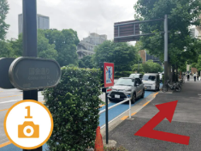
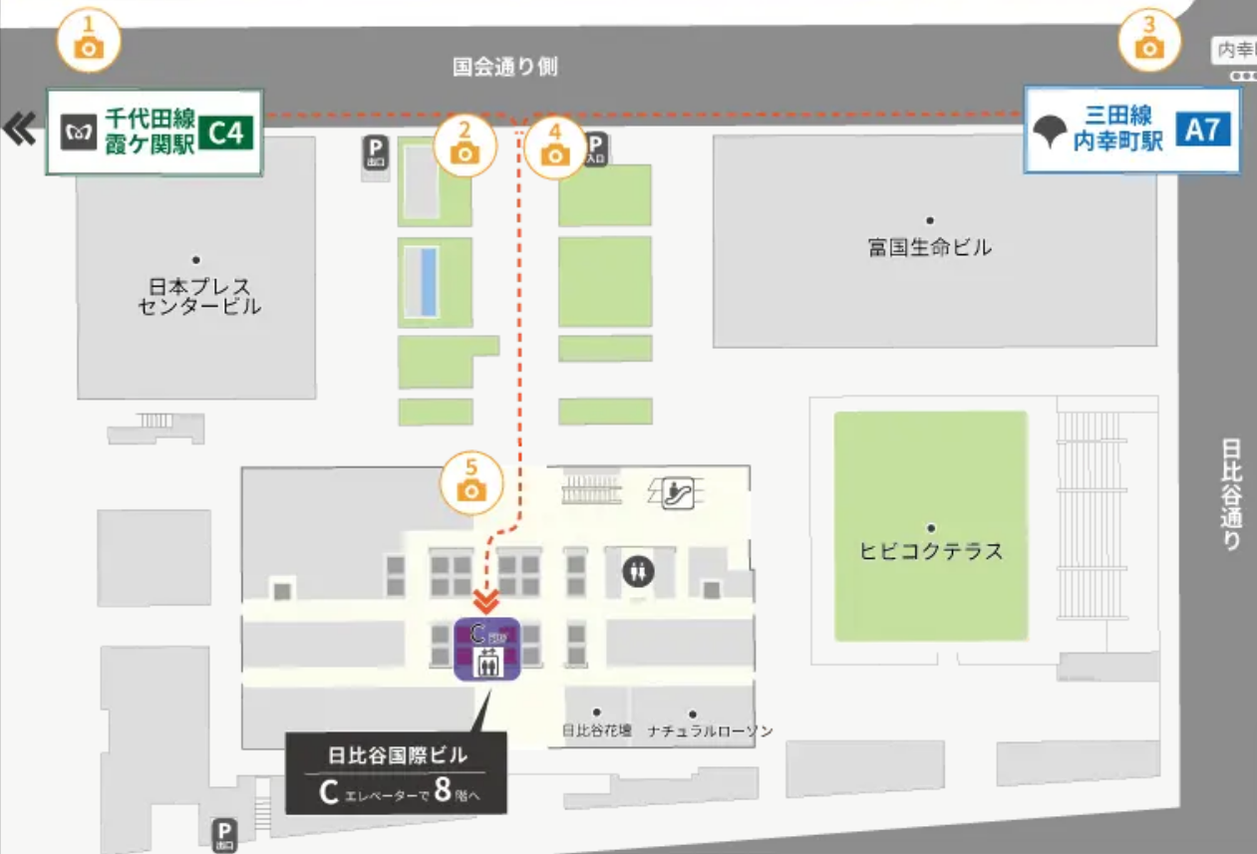
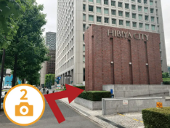
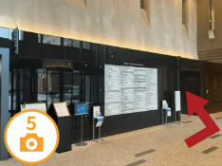
Access to the venue (28th of May, PTI IWG)
From Kasumigaseki Station
(Tokyo Metro Chiyoda Line, Hibiya Line, or Marunouchi Line)
Go along “国会通りKokkai-dori St.” to the right.
#1 Ground route
When you see the sign “HIBIYA CITY“ (red brick building), turn right and enter the Hibiya Kokusai Bldg.
Passing the tenant information board, turn left and take “C” Elevator to the 8th Floor.
Be careful! The nearest “D” Elevator does not stop at 8th Floor.
Please take C ELV to the 8th Floor.
D
Please take A7 Exit at Uchisaiwaicho Station.
Tenant information board

Slide 5
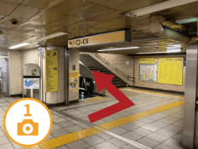
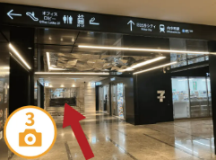
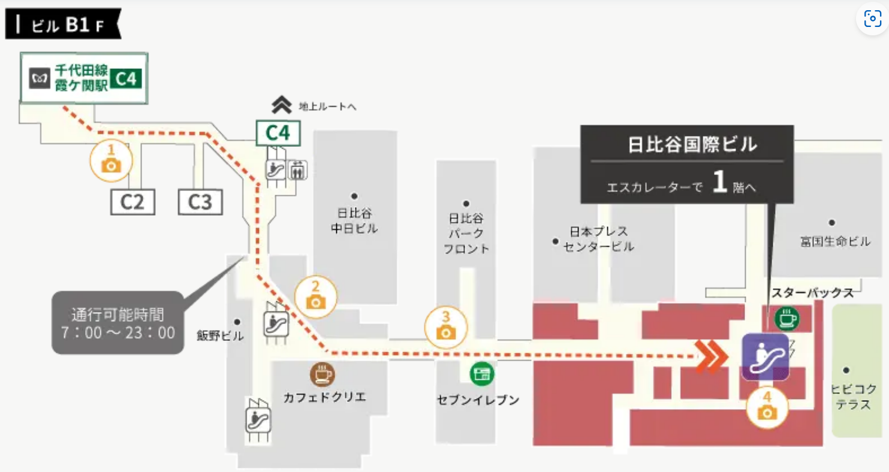
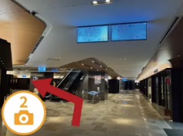
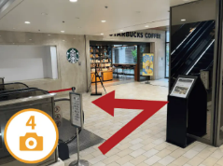
Access to the venue (28th of May, PTI IWG)
From Kasumigaseki Station
(Tokyo Metro Chiyoda Line, Hibiya Line, Marunouchi Line)
#2 Underground route
(recommended on a rainy day!)
Proceed to the direction marked Exit C2-C4.
Go straight passing the 7-Eleven on your right.
This page shows the route from the automatic gate ticket closest to Exit C4 of Chiyoda Line.
Proceed to the direction of the arrow on the sign above. You will see Café de CRIE on your right.
Take the escalator near Starbucks from B1F to 1F.
(continued to the next page)

Slide 6
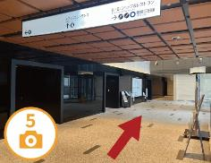
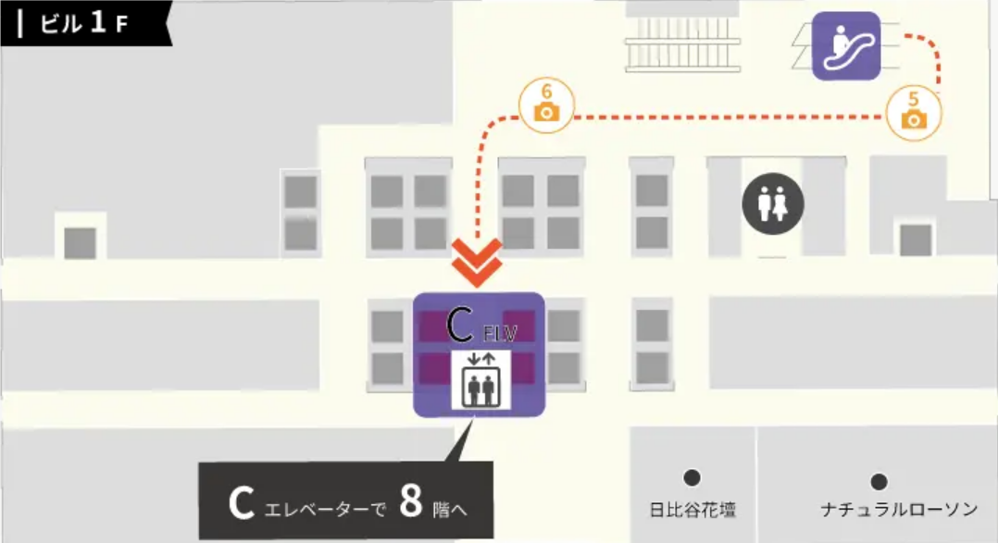
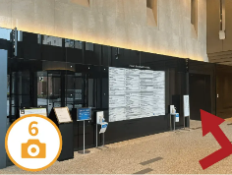
Access to the venue (28th of May, PTI IWG)
From Kasumigaseki Station
(Tokyo Metro Chiyoda Line, Hibiya Line,
Marunouchi Line)
Make a U-turn and go straight.
#2 Underground route (cont’d)
Passing the tenant information board, turn left and take “C” Elevator to the 8th Floor.
Be careful! The nearest “D” Elevator does not stop at 8th Floor.
D
Please take C ELV to the 8th floor.
Tenant information board

Slide 7
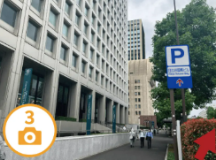
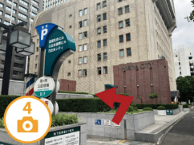
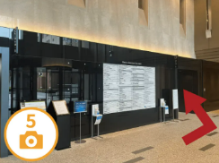
Access to the venue (28th of May, PTI IWG)
From Uchisaiwaicho Station
(Toei Mita Line)
Follow the arrow on the P sign. (It says Hibiya Kokusai Bldg in small letters.)
#1 Ground route
Turn left just before "HIBIYA CITY" (the red brick building)
Enter the Hibiya Kokusai Bldg. Passing the tenant information board, turn left and take “C” Elevator to the 8th Floor.
Be careful! The nearest “D” Elevator does not stop at 8th Floor.
Please take C ELV to the 8th floor.
D
Please take A7 Exit at Uchisaiwaicho Station.
Tenant information board

Slide 8
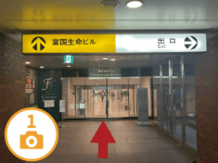
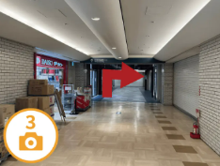
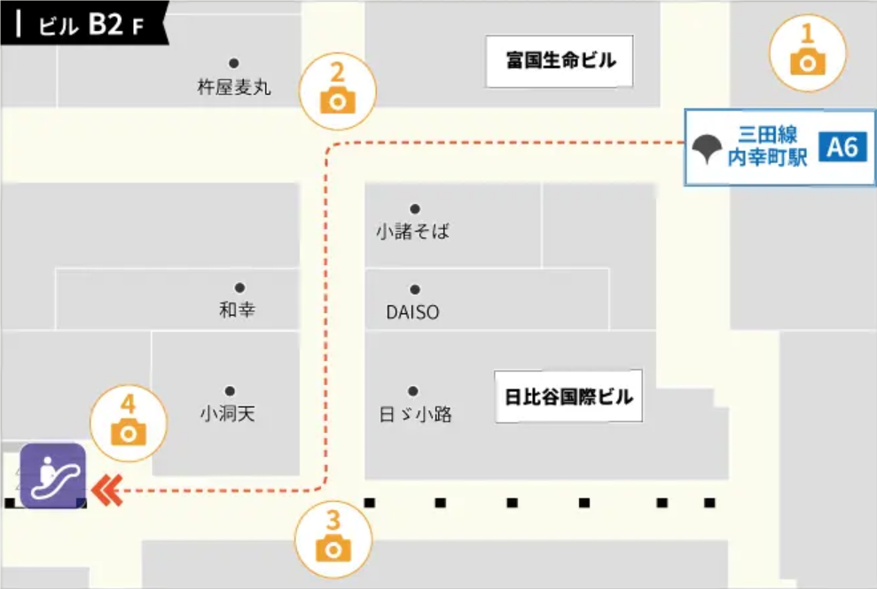
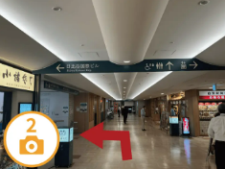
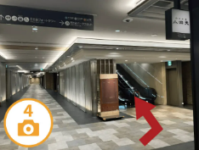
Access to the venue (28th of May, PTI IWG)
From Uchisaiwaicho Station
(Toei Mita Line)
#2 Underground route
(recommended on a rainy day!)
After exiting A6,
follow this yellow arrow
sign to enter Fukokuseimei
building and go straight.
Turn right at the corner.
Please take A6 Exit at Uchisaiwaicho Station.
Turn left. Proceed to the direction of Hibiya Kokusai Bldg. (See the sign above)
Take the escalator on your right from B2F up to 1F.
(continued to the next page)

Slide 9
Access to the venue (28th of May, PTI IWG)
From Uchisaiwaicho Station
(Toei Mita Line)
Make a U-turn and go straight
#2 Underground route (cont’d)
Passing the tenant information board, turn left and take “C” Elevator to the 8th Floor.
Be careful! The nearest “D” Elevator does not stop at 8th Floor.
D
Please take C ELV to the 8th floor.
Tenant information board

Slide 10
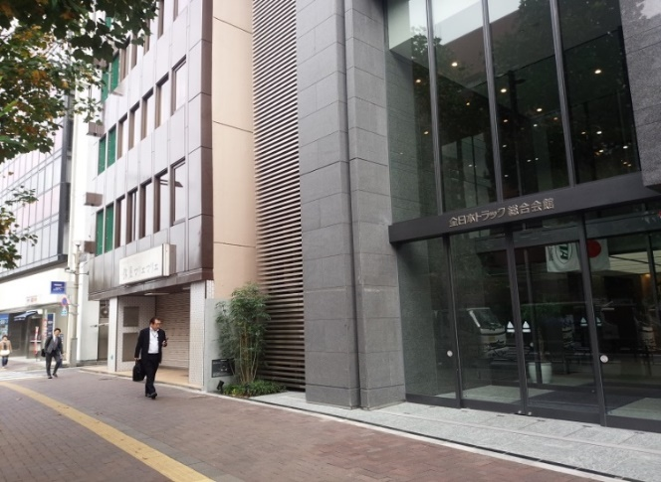
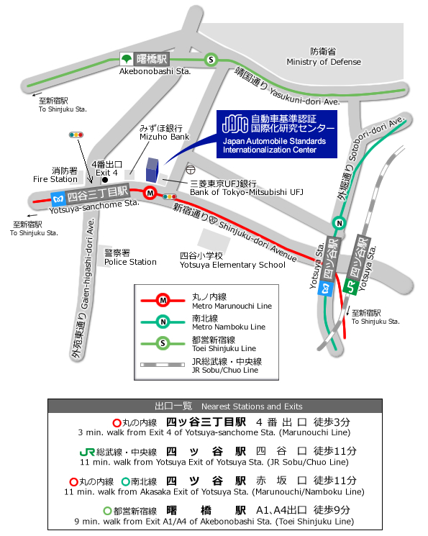
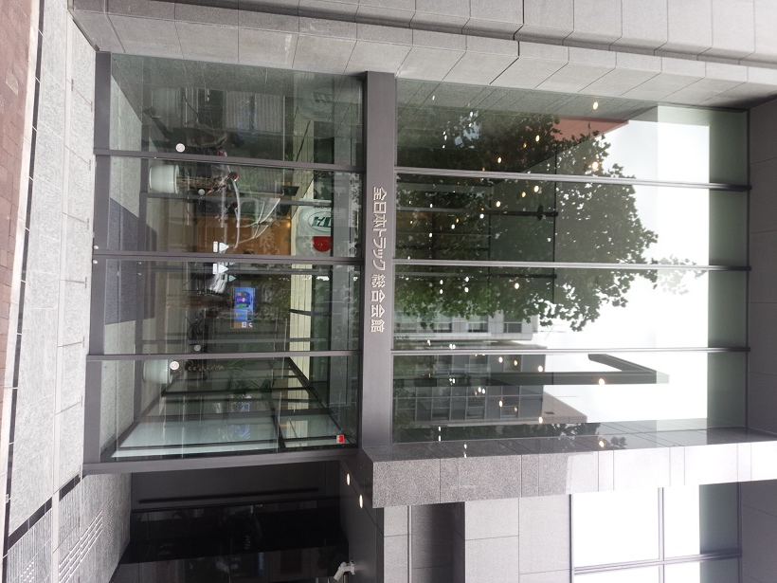
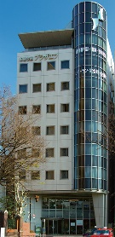


Access to the venue (29th of May, Technical tour)
JASIC OFFICE (since August 2014)
7th floor, Zennihon Truck Sogo Kaikan., 3-2-5 Yotsuya, Shinjuku-ku, Tokyo 160-0004
〒160-0004 東京都新宿区四谷三丁目２番５ 全日本トラック総合会館７階
PHONE +81-(0)3-5362-7751
7th Floor
JC
04
This building!
JB
14
JC
04
JB
14
ENTRANCE OF
THE BUILDING

Slide 11
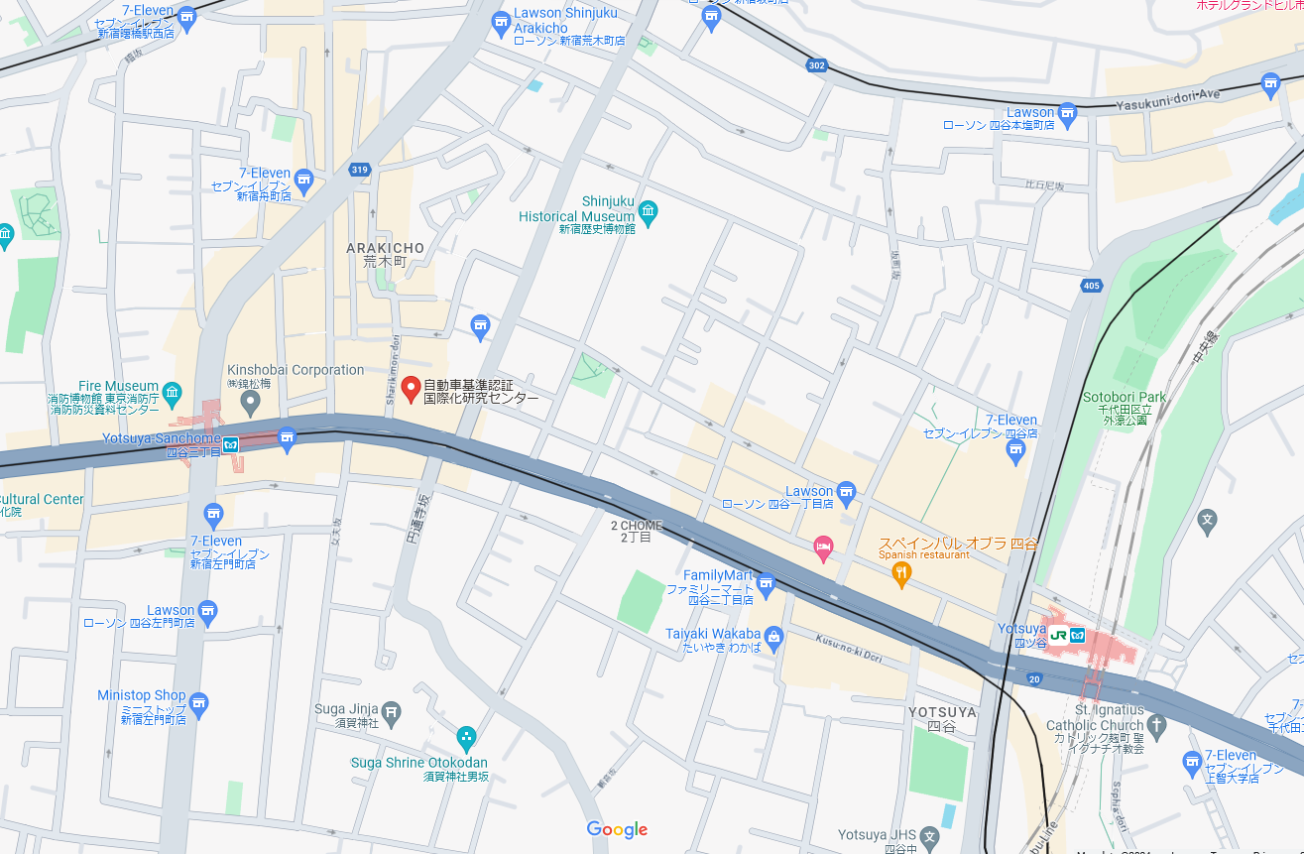

Access to the venue (29th of May, Technical tour)
From Yotsuya Station (JR & Metro) or Yotsuya sanchome Station (Metro) to JASIC on Google Map
JASIC

Slide 12
Accommodations
Hotels that are close to the meeting location are:
Imperial Hotel : https://www.imperialhotel.co.jp/en?stt_lang=en
Tokyo Station Hotel : https://www.thetokyostationhotel.jp/
The Okura Tokyo : https://theokuratokyo.jp/en/
Marunouchi Hotel : https://www.marunouchi-hotel.co.jp/
Dai-ichi Hotel Tokyo : https://www.hankyu-hotel.com/en/hotel/dh/dhtokyo
Daiwa Roynet Hotel SHIMBASHI : https://www.daiwaroynet.jp/en/shinbashi/
CANDEO HOTELS TOKYO SHIMBASHI : https://www.candeohotels.com/en/tokyo-shimbashi/
Sotetsu Fresa Inn Shimbashi Hibiyaguchi : https://sotetsu-hotels.com/en/fresa-inn/shimbashi/
Please also search by apps. (booking.com, etc.) for your preference.

Slide 13



Other Useful Information
JASIC Website : http://www.jasic.org/e/03_location/location_jasic.htm
Narita International Airport Website : https://www.narita-airport.jp/en/
Haneda Airport International Passenger Terminal Website : https://tokyo-haneda.com/en/
JR lines in the Tokyo area : https://www.jreast.co.jp/e/downloads/
Tokyo Metro Guide : http://www.tokyometro.jp/en/index.html
Japan Transit Planner : https://world.jorudan.co.jp/mln/en/
Official Tourism Website of Japan : http://www.jnto.go.jp/eng/
The Official Tokyo Travel Guide : http://www.gotokyo.org/en/index.html

Slide 14
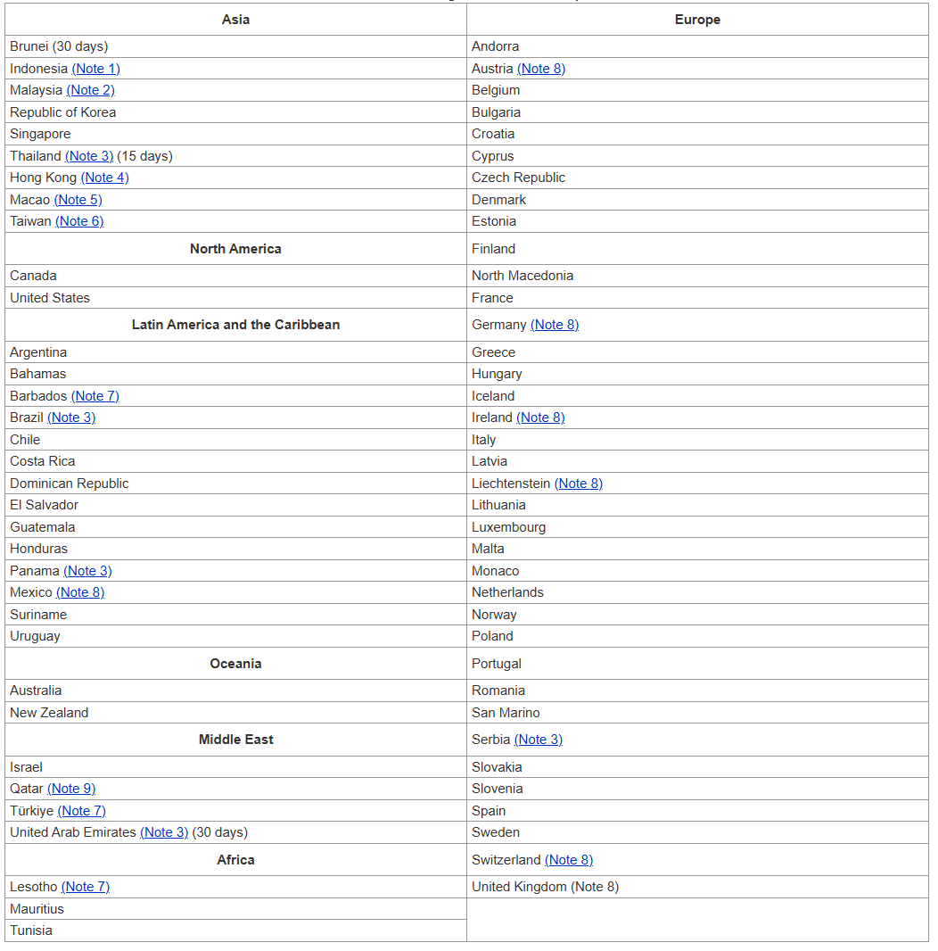
VISA Information
71 Countries and Regions for Visa Exemptions (3 March, 2025)
Link: Exemption of Visa (Short-Term Stay) https://www.mofa.go.jp/j_info/visit/visa/short/novisa.html

Slide 15

Contact information
If you have any question,
please contact
Mr.KATO(i-kato@jasic.org)
and
Mr.FUJITA(fujita@jasic.org)

