Slide 1
IWG-ADS update to GRVA
ADS-09-03
9th ADS IWG session
19 May 2025
Draft proposal for IWG discussion
Submitted for the GRVA 22nd session June 2025

Slide 2
Progress since 21st session of GRVA (Jan 2025)
Jan 2025
GRVA 21st session
Feb 2025
IWG-ADS 6th session
(online)
March 2025
IWG-ADS 7th session
(Netherlands)
April 2025
IWG-ADS 8th session
(Japan)
May 2025
IWG-ADS 9th – 11th sessions
(online)
1st draft of consolidated common provisions
(ADS-06-04r1)
2nd draft of consolidated common provisions
(ADS-08-04r1)
Open issues tracker
(ADS-08-05r1)
3rd draft of consolidated common provisions
(ADS-09-XX)

Slide 3
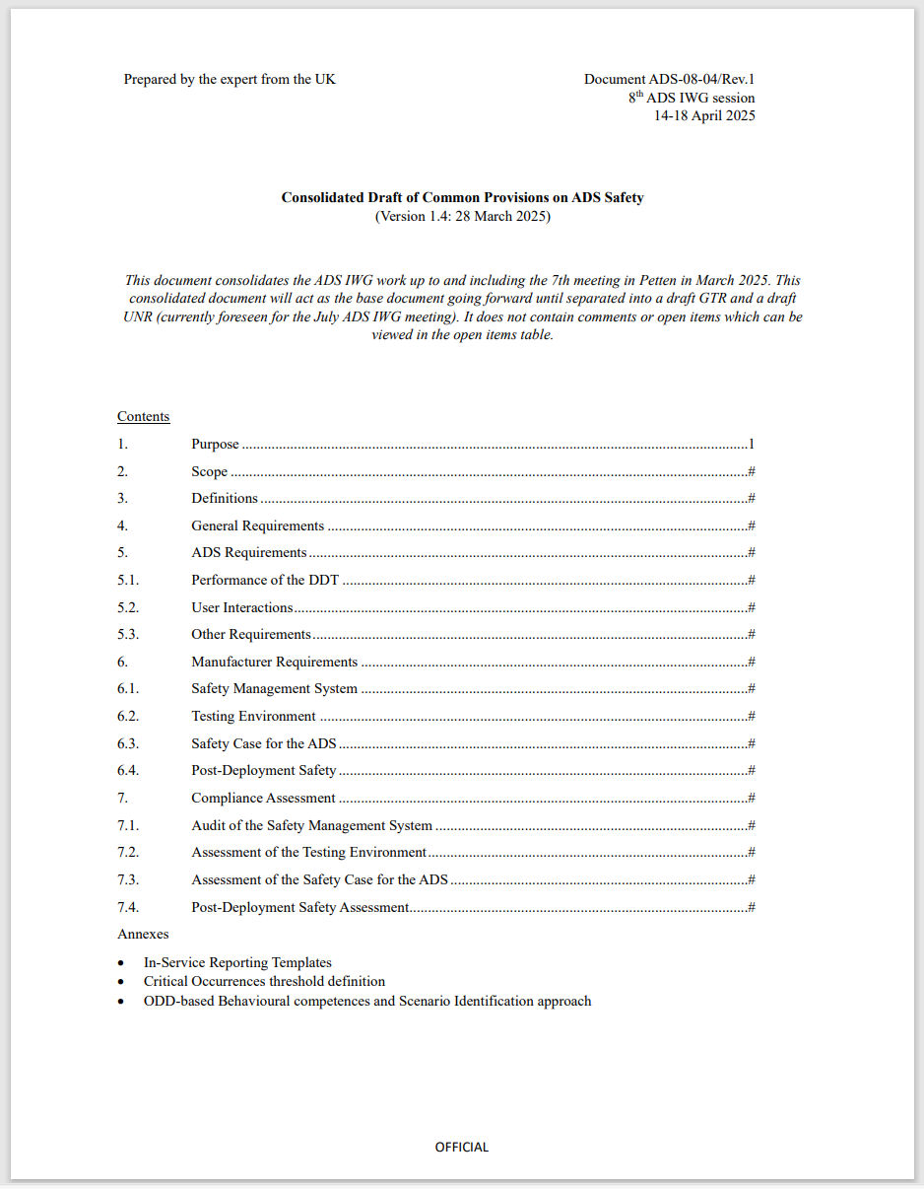
Overview of the draft ‘common provisions’
Consolidated draft common provisions contain the basis of the requirements for the GTR and UNR for automated driving systems. Key building blocks include:
Requirements on the ADS
  Ability to perform the dynamic driving task (§5.1)
  Safe interactions between users and the ADS (§5.2)
Safety Management System (§6.1)
  Safety policies, principles and culture
  Risk management and ADS design and development
  Personnel competencies
Safety case (§6.3)
  Claims, arguments and evidence supporting assertion that the ADS is ‘free of unreasonable risk’ (considering functional safety and SOTIF)
Post-deployment safety
  In-service monitoring (§6.1) and reporting (§6.4)
Audit and assessment
  Audit of safety management systems (§7.1)
  Credibility assessment of the test environment (§7.2)
  Assessment of safety case (§7.3)
  Confirmatory testing (§7.3)

Slide 4
Product cycle
Safety case: “Free from unreasonable risk”
Establish Safety Management system (SMS)
Define use case
ADS requirements
Design and develop ADS in accordance with SMS
Define functionality and operational design domain
Develop the safety case*, arguing the absence of unreasonable risk and that the requirements are met
Safety Of The Intended Functionality
Functional Safety
Cybersecurity
Undertake in-service monitoring and reporting
Safety concept
*“Safety case” means structured documentation that provides a compelling, comprehensible, and valid case that the ADS meets the relevant ADS requirements of this regulation and is free from unreasonable risks to the ADS vehicle user(s) and other road users (ADS-08-07r1). See also ADS-04-16 on safety cases.
(For illustration only)

Slide 5
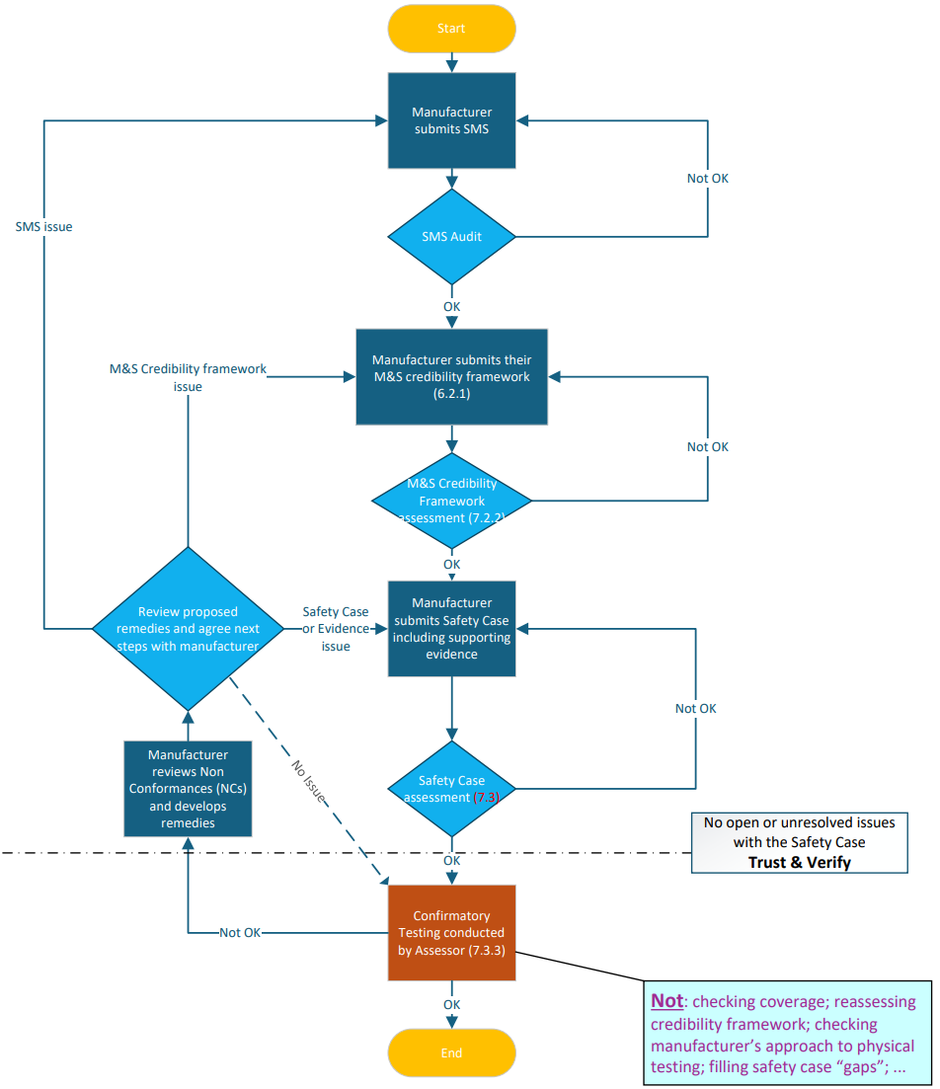
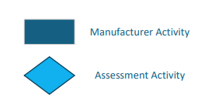
Compliance assessment flow
Key:
(For illustration only)
(see document ADS-08-12)

Slide 6
[Specific discussion items for consideration by GRVA]

Slide 7
Plan going forward
March 2026
WP.29
(informal documents UNR and GTR?)
June 2026
WP.29
(considers UNR and GTR working documents)
September 2025
IWG-ADS #13
(web)
October 2025
IWG-ADS #14
(Canada)
December 2025
IWG-ADS #15
(Japan)
July 2025
IWG-ADS #12
(Helsinki)
September 2025
GRVA
(informal documents for GTR and UNR)
November 2025
Working document submission for GRVA Jan 2026
January 2026
GRVA
(working documents for UNR and GTR)
March 2026
Working document submission for WP.29 June 2026

