Slide 1
IWG-ADS update to GRVA
ADS-10-02
10th ADS IWG session
23 May 2025
Draft proposal for IWG discussion
based on ADS-09-03
Submitted for the GRVA 22nd session June 2025

Slide 2
Progress since 21st session of GRVA (Jan 2025)
Jan 2025
GRVA 21st session
Feb 2025
IWG-ADS 6th session
(online)
March 2025
IWG-ADS 7th session
(Netherlands)
April 2025
IWG-ADS 8th session
(Japan)
May 2025
IWG-ADS 9th – 11th sessions
(online)
1st draft of consolidated common provisions
(ADS-06-04r1)
2nd draft of consolidated common provisions
(ADS-08-04r1)
Open issues tracker
(ADS-08-05r1)
3rd draft of consolidated common provisions
(ADS-09-XX)

Slide 3
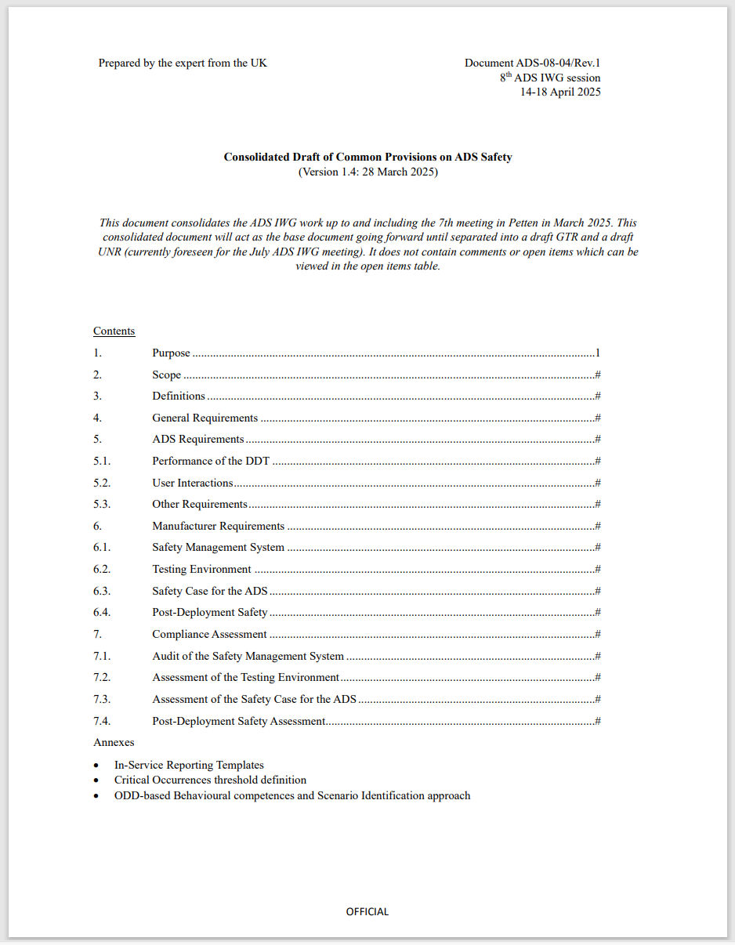
Overview of the draft ‘common provisions’
Consolidated draft common provisions contain the basis of the requirements for the GTR and UNR for automated driving systems.
Requirements on the ADS (§5)
  Ability to perform the dynamic driving task (§5.1)
  Safe interactions between users and the ADS (§5.2)
Manufacturer requirements (§6)
  Safety Management System (§6.1)
  Test environment credibility (§6.2)
  Safety case (§6.3)
  Post-deployment safety (§6.4)
Compliance assessment (§7)
  Audit of the Safety Management System (§7.1)
  Assessment of the test environment (§7.2)
  Assessment of the safety case (§7.3)
  Post-deployment safety assessment (§7.5)
… plus supporting annexes

Slide 4








Manufacturer activities
A Safety Management System (SMS) is a systematic approach to managing safety.
  Organisational safety policies, principles and culture
  Processes for risk management and ADS design and development
  Personnel competencies
Establish a safety management system (§6.1)
Design and develop an ADS meeting the requirements set out in (§5)
The draft common provisions set requirements for the ADS regarding
  Performance of the ‘dynamic driving task’
  Interactions between users and the ADS
Perform test environment credibility assessment (§6.2)
Ensure that the test environment and toolchains (e.g. virtual testing toolchains) are appropriate for their use.
A safety case is structured documentation that provides a compelling, comprehensible, and valid case that the ADS meets the relevant ADS requirements of this regulation and is free from unreasonable risks to the ADS vehicle user(s) and other road users.
Develop a safety case (§6.3)
Undertake in-service monitoring (§6.1) and reporting (§6.4)
Monitoring the performance of the ADS once in use and reporting on specified occurrences.

Slide 5




Assessor activities
Audit the Safety Management System (§7.1)
A single SMS may cover multiple ADS.
For UNR, issue a ‘certificate of compliance’ (GRVA workshop output).
Assess test environment (§7.2)
Physical and virtual test environments.
Assess safety case (§7.3)
Is the safety case complete and robust?
Are the requirements of the UNR and GTR met?
Perform confirmatory testing (§7.3)
[Requirements still under construction.]
Assess the performance of the ADS using physical testing.

Slide 6
Remaining activities
Finalise common provisions ‘open items’
Integrate workshop outputs and split into GTR and UNR
Integrate data storage system provisions (input from IWG-EDR/DSSAD expected in June)
Drafting work necessary to develop implementable GTR and UNR

Slide 7
Plan going forward
March 2026
WP.29
(informal documents UNR and GTR?)
June 2026
WP.29
(considers UNR and GTR working documents)
September 2025
IWG-ADS #13
(web)
October 2025
IWG-ADS #14
(Canada)
December 2025
IWG-ADS #15
(Japan)
July 2025
IWG-ADS #12
(Helsinki)
September 2025
GRVA
(informal documents for GTR and UNR)
November 2025
Working document submission for GRVA Jan 2026
January 2026
GRVA
(working documents and informal documents for UNR and GTR)
March 2026
Working document submission for WP.29 June 2026
Aims:
Most of the ‘common provisions’ completed
DSSAD draft regulatory text reviewed
Workshop deliverables 1 and 2 integrated with common provisions to create a draft UNR and draft GTR
Note – plan shown as of June 2025. Further meetings may be scheduled. Possible further work beyond June 2026.

