Slide 1
Transmitted by the Netherlands
Informal Document GRPE-92-XX
92nd GRPE, 26th – 18th of March, 2025,
agenda item 17
Report to 92nd Session of GRPE
(March 2025)
Task Force Automated Vehicles Regulation Screening
(TF-AVRS)

Slide 2


TF-AVRS
Number of Meetings
Participants
(Contracting Parties & NGOs)
Meetings
9 TF-AVRS in 2023
10 TF-AVRS in 2024
20th TF-AVRS: 14th January 2025
21st TF-AVRS: 17th February 2025
22nd TF-AVRS: 10th March 2025
1st TF-AVRS Sub-Group: 17th March 2025
23rd TF-AVRS: 24th March 2025
2nd TF-AVRS Sub-Group: 4th April 2025 (face-to-face)
24th TF-AVRS: 17th April 2025
CPs:
Germany, France, United Kingdom, The Netherlands
NGO‘s:
OICA, EUROMOT
Report TF-AVRS – GRPE-92

Slide 3
TF-AVRS
Targets
WP29 requests a screening of regulation for application of Automated Vehicles.
  GRVA proposed a template for the screening
  TF-FADS (GRVA) provides further guidance
GRVA is preparing an ADS Regulation for the 58 and 98 agreement
  Working on informal documents for GRPE-92/GRPE-93
  Working on formal documents for GRPE-94
Roles
Co-Chairs: Mr. Sandor Vass – EC/JRC and [Mr. Niels den Ouden – NL] =>Vacant
Secretariat: Ms. Banita Fidyova - AVERE
TF-AVRS wikipage
https://wiki.unece.org/pages/viewpage.action?pageId=198672917&src=contextnavpagetreemode
Report TF-AVRS – GRPE-92

Slide 4
TF-AVRS Screening process: Considered items
1. Terminology
    Relevant terms based on GRVA guidance (accelerator, handle-bar type steering)
2. Use cases AVs
    Driverless AVs
      With passenger
      Without passengers (cargo)
    AVs with driver
    Bi-directional AV’s => on hold for the moment
3. Other considered items
    Telltales & warning signals
    Test modes
Report TF-AVRS – GRPE-92

Slide 5
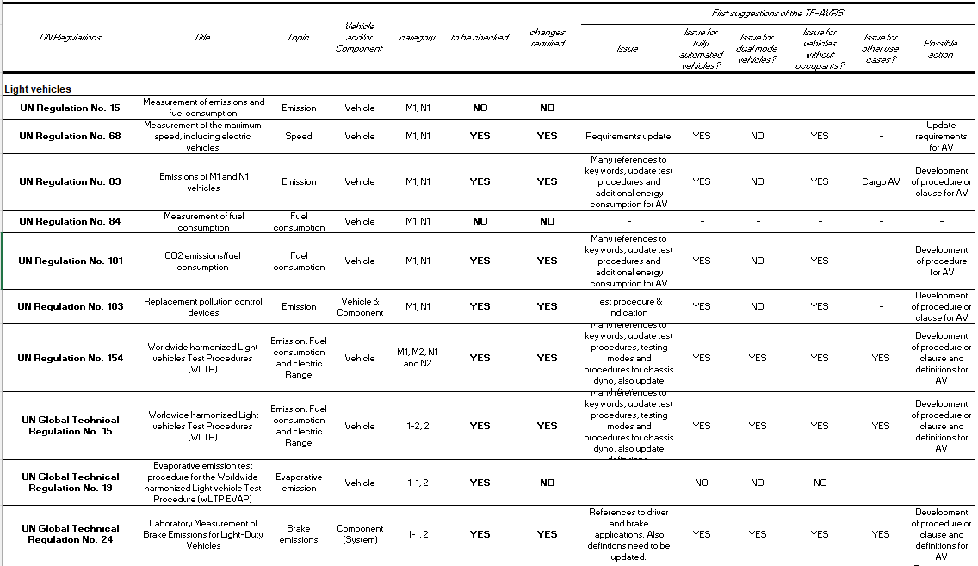
Report TF-AVRS – GRPE-92

Slide 6
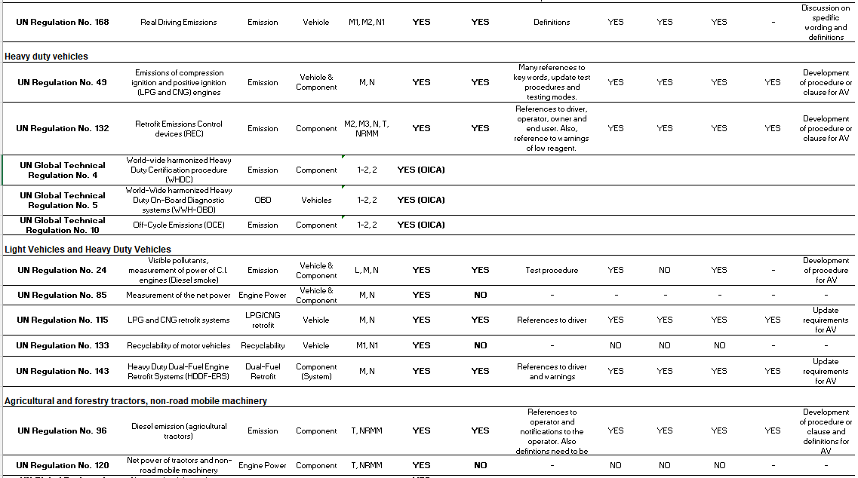
Report TF-AVRS – GRPE-92

Slide 7
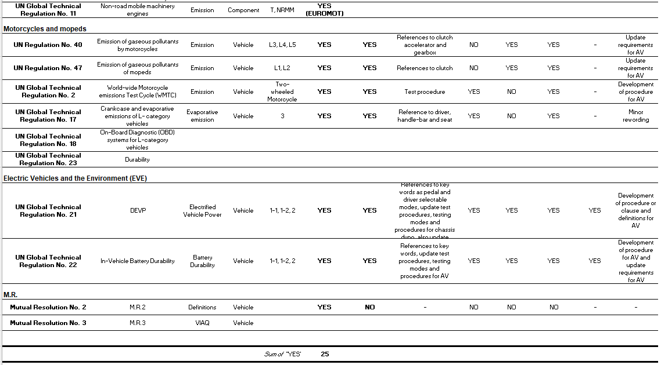
Report TF-AVRS – GRPE-92

Slide 8
TF-AVRS Screening results
No vehicle categories will be excluded from screening
2 Regulations are excluded from screening (old)
25 regulations are screened => 10 since last GRPE
4 regulations are planned to be screened
3 regulations still need to be addressed
  2 L-category UN GTR/UN R
  1 M.R.
Report TF-AVRS – GRPE-92

Slide 9
TF-AVRS Amendments to GRPE Regulations
First focus on UN R83 and UN R154. If these Regulations are tackled, then most of the fundamental discussions related to ADS vehicles in GRPE Regulations seem to be covered.
Timeline for amending GRPE Regulations is short. All amendments should be ready before the end of this year.
Important to use definitions and wordings used in other GR’s and to be consistent in GRPE Regulations.
Report TF-AVRS – GRPE-92

Slide 10
TF-AVRS Amendments to GRPE Regulations
Discussions on non dynamic driver tasks of ADS vehicles (Non-DDT).
  MIL and inducements warnings should be addressed by ADS/operator.
  ADS Regulation should cover the expected behaviour of ADS vehicles in case of notifications.
Discussions on driver related actions during tests.
  Tests performed by drivers should be performed by ADS vehicles.
  ADS vehicles should be taught/able to drive coast down tests and test drive cycles on roller benches.
  Fundamental discussions which need to be addressed by TF-AVRS.
Report TF-AVRS – GRPE-92

Slide 11
TF-AVRS Provisional GRPE planning 2025
Submission of
working documents
for GRPE-92
GRPE-92
Submission of
working documents
for GRPE-93
GRPE-93
Adoption of TF-AVRS
priority Regulations
Submission of
working documents
for GRPE-94
Dec 24
Mar 25
Jul 25
Oct 25
Dec 25
Possible submission of
informal documents
for GRPE-92 from
TF-AVRS on priority
Regulations
Possible submission of
working documents
for GRPE-93 from
TF-AVRS on priority
Regulations
Submission of
informal documents
for GRPE-93 from
TF-AVRS on
all other Regulations
Submission of
working documents
for GRPE-95 from
TF-AVRS on
all other Regulations
Report TF-AVRS – GRPE-92

Slide 12
TF-AVRS Provisional GRPE planning 2026
Submission of
working documents
for GRPE-94
GRPE-94
Adoption of TF-AVRS
all other Regulations
Submission of
working documents
for GRPE-95
GRPE-95
Planned adoption of ADS Regulations in WP.29-200
Dec 25
Mar 26
Jul 26
Oct 26
Nov 26
Submission of
working documents
for GRPE-95 from
TF-AVRS on
all other Regulations
Report TF-AVRS – GRPE-92

Slide 13
TF-AVRS Next steps
Continue with meetings at least once per month and two sub-groups to cover the work. One sub-group for the fundamental discussions and amendments to the Regulations and one sub-group for the non-controversial (little/easy) amendments to the Regulations.
Participants from CP’s and NGO’s are really needed to continue with the amendments of the GRPE Regulations.
TF-AVRS is considering to submit formal documents to GRPE-93 for non-controversial changes to GRPE Regulations to lessen the burden for TF-AVRS and GRPE.
Changes to GRPE Regulations should be in place before the ADS Regulations are ready in 2026.
Report TF-AVRS – GRPE-92

Slide 14
Thank you for your attention
Report TF-AVRS – GRPE-92

