Slide 1
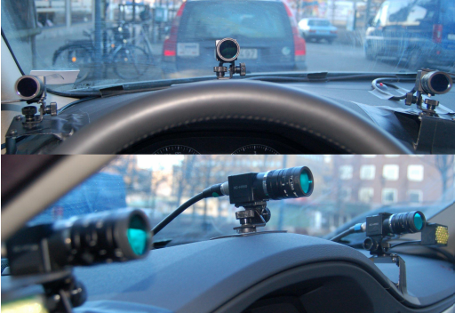
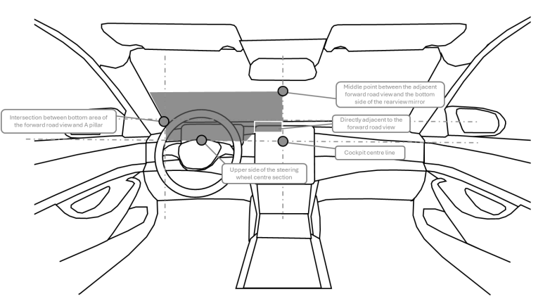
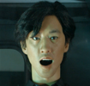
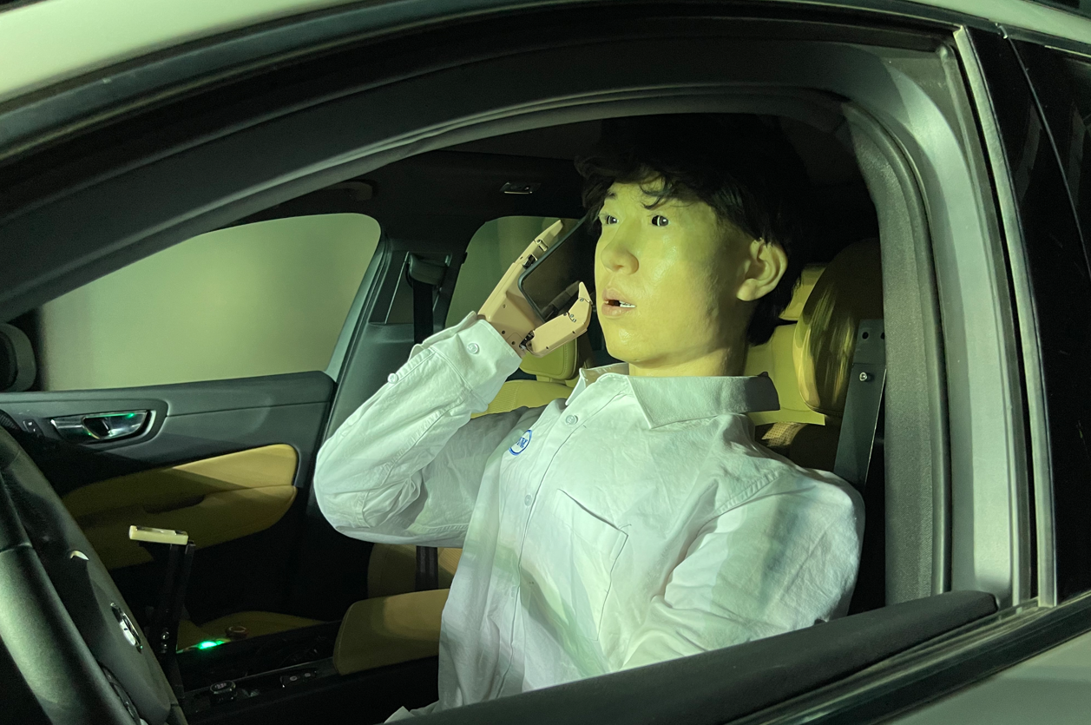
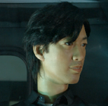
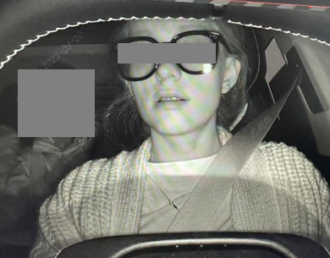
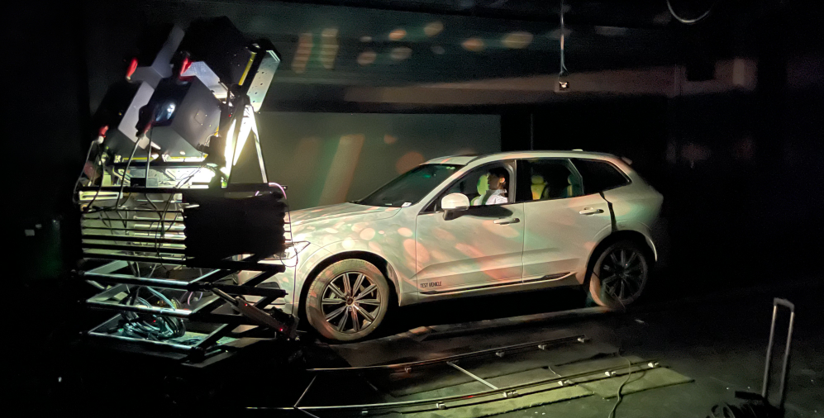
Submitted by the expert from China
Introduction of the GB/T 41797-2022（DAMS） standard in China
Zhang Lu, Zhang Shan, Zhang Guangxiu
2025.04.06

Slide 2
Driver Attention Monitoring System in China
Name of the standard：Performance requirements and test methods for driver attention monitoring system（GB/T 41797─2022）
Type：Recommended National Standard
Release date：2022.10.12
Implementation date：2023.5.1
Scope：This document specifies the general requirements, performance requirements and test methods of the driver attention monitoring system. This document applies to Class M and N vehicles equipped with driver attention monitoring systems based on image recognition technology. Others have the system with the same function can be executed as a reference.
Driver distraction：When driving a vehicle, the driver is unable to concentrate on the driving task due to fatigue driving, interference from the external environment, or actions unrelated to driving.

Slide 3
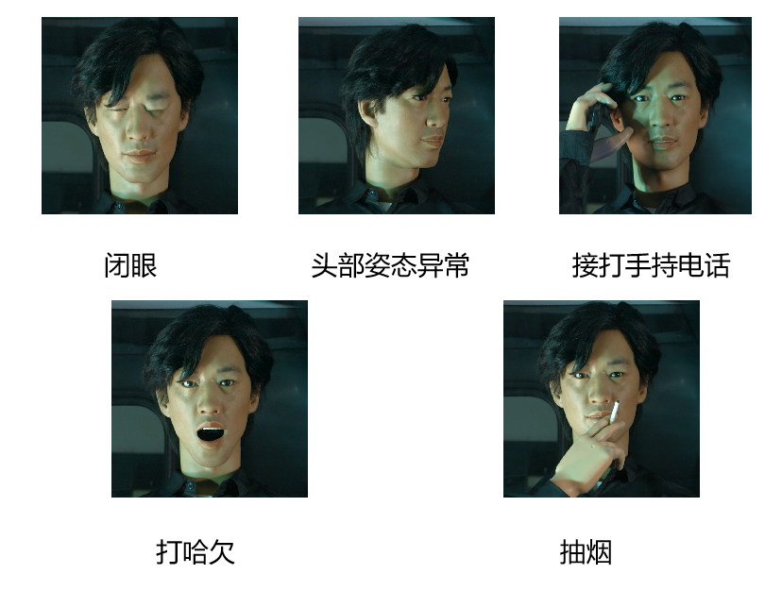
Technical Requirements
Performance requirements
The behavior of the system monitoring
System recognition capability requirements（Real driver test）
The number of correct identification is not less than 2/3
Each behavior was identified at least once in a single trial
Detection rate and accuracy requirements
（Bionic robot test）
The system should send a warning within 1.5s, and the detection rate and accuracy should be greater than or equal to 95%
Close Eyes
Abnormal Head Posture
Use Phone
Yawn
Smoking

Slide 4
Test Method
Test Method
Bionic robot test
The bionic robot performs five distraction behaviors as required to verify the performance requirements such as system detection rate and accuracy
Real driver test
The testers were required to perform five distracting behaviors to verify the basic recognition ability of the system.
Comprehensively verify the function and performance of the system
Requirements of bionic robot
General requirements for bionic robot
Dimensions, eyes, mouth, head range of motion, movements, accuracy, data recording
Feature requirements for bionic robot
Feature points, skin materials
Installation requirements for bionic robot
Head, arms, hands, torso, robot movements

Slide 5
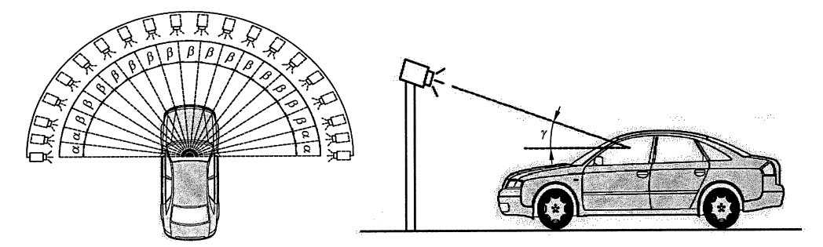
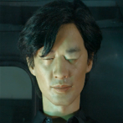
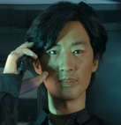

DAMS TEST
DMS test in China：Have been promoted and recognized in China, with over 20+ vehicle tested
DAMS laboratory
Bionic robot
Bionic robot simulates making phone calls
Personification, robustness, and stability,
Size of the bionic robot meet human dimensions of adult male.
DAMS test laboratory
Aged 17-60 (Men) | P1 | P50 | P90
height（mm） | 1604 | 1687 | 1773
weight（kg） | 55 | 68 | 83
Place a vehicle in DAMS laboratory and simulate lighting using a solar simulator. Conduct lighting experiments at different angles using a solar simulator.
The bionic robot can complete multiple repetitive actions, such as closing eyes, looking up, yawning, make phone calls, smoking, etc

Slide 6
Suggestions
1、Set selection rules，when selecting drivers for real vehicle testing.
(1) Firstly, consider the target customer group of the test vehicle.
For example：If the vehicle is an truck (N₁), the number of middle-aged male drivers can increase and the number of young female drivers can decrease.
(2) Secondly, the selected drivers should have undergone KSS training and examination.
For example：Different drivers are given the same training, then self-practice and passing the exam.
(3) Finally, distinguish the physiological characteristics of drivers.
For example：Divide drivers into different groups based on their age, height, and eye size, while considering factors such as gender, occupation, driving experience, and wearing of glasses.

Slide 7
Suggestions
2、It is suggested to add the test content of the performance index of the DDADWS based on the bionic robot.
(1) The movement of the bionic robot can be controlled, which supporting the completion of multiple repetitive tests, so that the results of the test are highly consistent, and the accuracy and objectivity of the test are improved.
(2) The time of the motion control of the bionic robot is highly accuracy , which can support the test of the system response in a short time.
(3) The posture and deflection angle of the head, body and hands of the bionic robot can be accurately measured to ensure the accuracy of the test results.

Slide 8
Thanks for attention!

