Slide 1
A-LCA IWG SG2 MTG
Schedule for GRPE drafting
Comment to Material part for 1st drafting
SG2 regular meeting
Mar 27th 2025

Slide 2
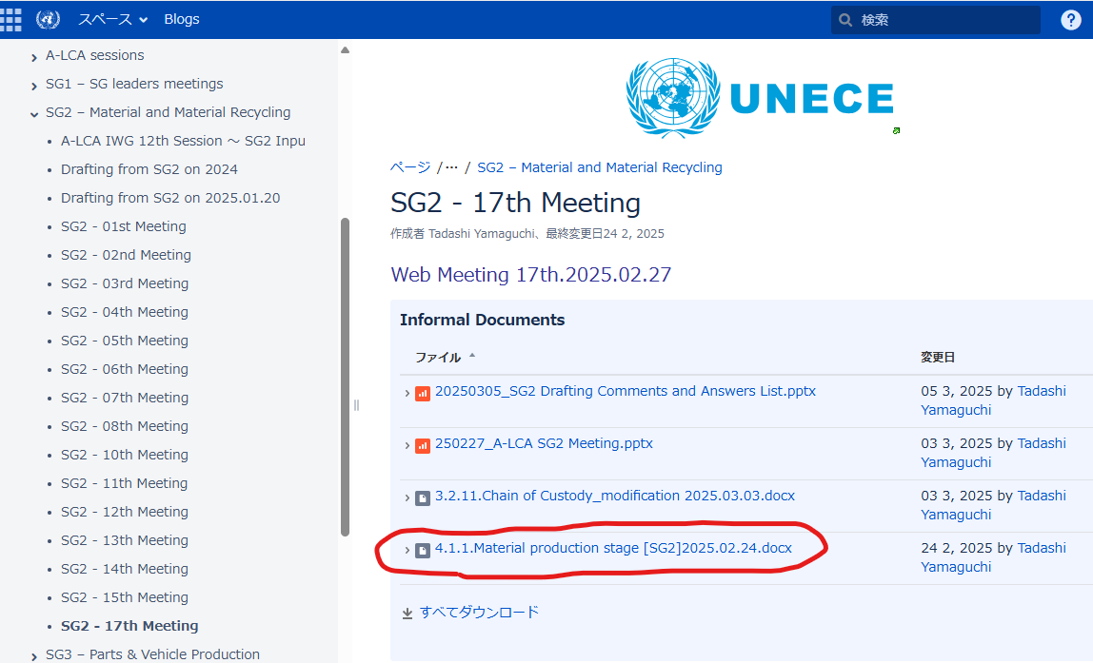
Schedule for GRPE drafting
Schedule for GRPE drafting
A-LCA IWG 22nd
GRPE 1stdraft
SG7 Meeting
GRPE Working document submit
WP29 submit
3/25
4/14
4/24
5/12
6/19～6/20?
7月
10月
26年3月
Now
3rd draft
Limit to SG7
Final draft
Limit to SG7
A-LCA IWG 23rd
Final draft CHK
GRPE Working document review
SG2 -Latest draft-UNECE Wiki
←latest one
SG7 announce
1stdraft for GRPE is coming from Tokyo meeting ver
※Material part is not latest one
SG7 – Drafting - Transport - Vehicle Regulations - UNECE Wiki

Slide 3
Comment to Material part for 1st drafting
1. Material table
2. Battery material boundary

Slide 4
SG2 regular meeting
3. SG2 regular meeting
 | 2025
 | Apr | May | Jun | Jul | Aug | Sep | Oct
week | 4th Thu
day | 24 | 29 | 26 | 24 | 28 | 25 | 23
time | 11-12 am CET 18-19 pm JST
Summer time
A-LCA IWG 22nd
GRPE 1stdraft
SG7 Meeting
GRPE Working document submit
WP29 submit
3/25
4/14
4/24
5/12
6/19～6/20?
7月
10月
26年3月
Now
3rd draft
Limit to SG7
Final draft
Limit to SG7
A-LCA IWG 23rd
Final draft CHK
GRPE Working document review

