Slide 1
A-LCA IWG SG2 MTG
Schedule for GRPE drafting
Comment to Material part for 1st drafting
SG2 regular meeting
ETRMA input to the SG2 draft
Mar 27th 2025

Slide 2
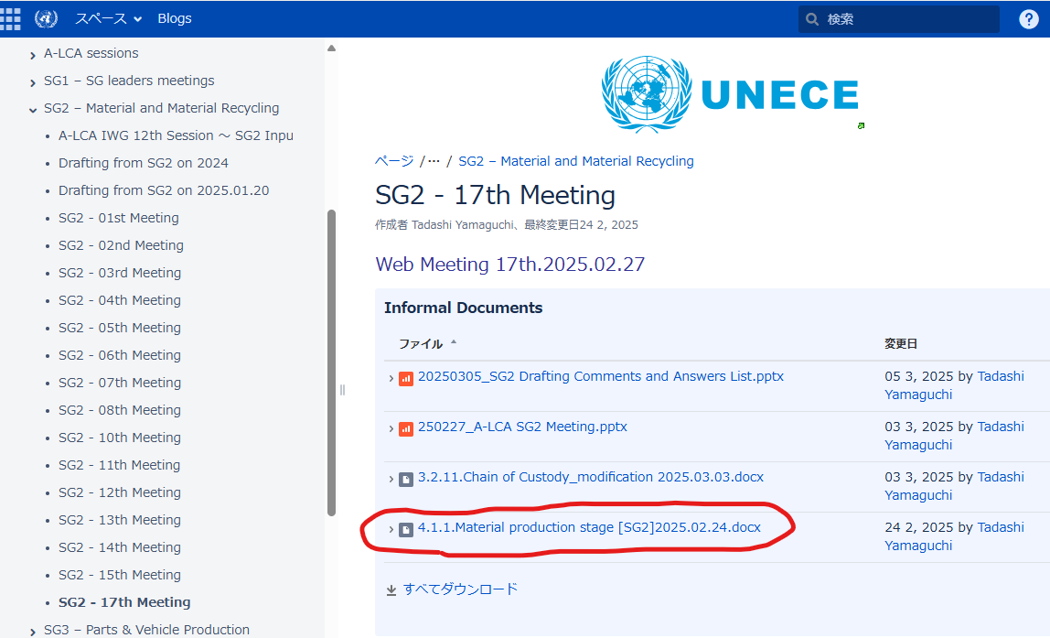
Schedule for GRPE drafting
Schedule for GRPE drafting
A-LCA IWG 22nd
GRPE 1stdraft
SG7 Meeting
GRPE Working document submit
WP29 submit
3/25
4/14
4/24
5/12
6/19～6/20?
7月
10月
26年3月
Now
3rd draft
Limit to SG7
Final draft
Limit to SG7
A-LCA IWG 23rd
Final draft CHK
GRPE Working document review
SG2 -Latest draft-UNECE Wiki
←latest one
<27Mar’25>
Status report of the IWG on A-LCA
(A-LCA) Status report of the IWG on A-LCA | UNECE
SG7 announce
1stdraft for GRPE is coming from Tokyo meeting ver
※Material part is not latest one
SG7 – Drafting - Transport - Vehicle Regulations - UNECE Wiki

Slide 3

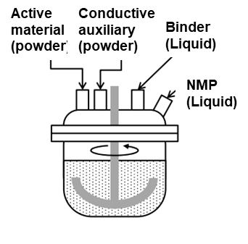

Comment to Material part for 1st drafting
2. Battery material boundary
[Option-1]
[Option-2]
Lithium Sulfate
Mixing
Active material
(Cathode)
Drying
Pressing
Cathode
Cell Production
Cell
Lithium Sulfate
Mixing
Active material
(Cathode)
Drying
Pressing
Cathode
Cell Production
Cell
Nickel Sulfate
Additives
Nickel Sulfate
Additives
Manganese Sulfate
Solvent
Manganese Sulfate
Solvent
Cobalt Sulfate
Alminium foil
Cobalt Sulfate
Alminium foil
Lithium Sulfate
Mixing
Active material
(Anode)
Drying
Pressing
Anode
Lithium Sulfate
Mixing
Active material
(Anode)
Drying
Pressing
Anode
Graphite
Additives
Graphite
Additives
Solvent
Solvent
Copper foil
Copper foil
Lithium Sulfate
Mixing
Electrolyte
Lithium Sulfate
Mixing
Electrolyte
Solvent
Separator
Solvent
Separator
Steel
Sheet
Housing production
Housing
Steel
Sheet
Housing production
Housing
Other
Other

Slide 4
Comment to Material part for 1st drafting
2. Battery material boundary
[Option-3]
Lithium Sulfate
Mixing
Active material
(Cathode)
Drying
Pressing
Cathode
Cell Production
Cell
Nickel Sulfate
Additives
Manganese Sulfate
Solvent
Cobalt Sulfate
Alminium foil
Lithium Sulfate
Mixing
Active material
(Anode)
Drying
Pressing
Anode
Graphite
Additives
Solvent
Copper foil
Lithium Sulfate
Mixing
Electrolyte
Solvent
Separator
Steel
Sheet
Housing production
Housing
Other

Slide 5
SG2 regular meeting
3. SG2 regular meeting
 | 2025
 | Apr | May | Jun | Jul | Aug | Sep | Oct
week | 4th Thu
day | 24 | 29 | 26 | 24 | 28 | 25 | 23
time | 11-12 am CET 18-19 pm JST
Summer time
<Follow up task>
Drafting Methodology: Review and modify the drafting to ensure non-standard references like IMDS are properly handled and consider how to manage changes in these non-standards. (All SG groups)
Battery Material System Boundary: Clarify and document the separation of responsibilities between SG2 and SG3 for the battery material system boundary, ensuring that downstream processes are covered by SG3.

