Slide 1
Cluster #2
EDR for ADS counter proposal

Slide 2
EDR for ADS counter proposal
“The revision is corresponding to the WP29 request of review about the existing regulation’s fitness for ADS. Accordingly, it does not intend to change the existing requirements on non-ADS vehicles.”
EDR for ADS
  Proposal for Supplement 1 to the 02 Series of Amendments to Regulation No. 160
  Scope : “ADS vehicles” and “non-ADS vehicles”
  Proposal of SG-EDR-44-02 DRAFT R160_02_S1 - ECE-TRANS-WP.29-GRSG-2025-XXe.docx
Proposal of SG-EDR-44-02 DRAFT R160_02_S1 - ECE-TRANS-WP.29-GRSG-2025-XXe.docx | Impact
Data elements name *Safety belt status (position x–y) *xxxx, front seated occupants *xxxx, front seat, vehicle’s near side *xxxx, front seat, vehicle’s far side | Software change of EDR retrieval tool and EDR ECU for non-ADS vehicles, leading to additional development.
Occupant size classification, driver Occupant size classification, front passenger seated occupant [5th percentile female or larger or] 6yr old HIII US ATD or Q6 ATD or smaller | Software change of EDR ECU for non-ADS vehicles, leading to additional development.

Slide 3



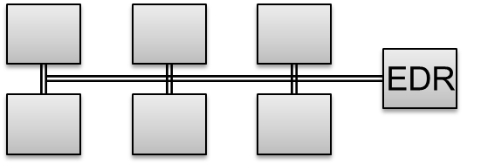

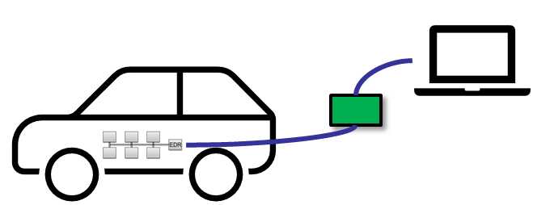
Concerns of EDR for ADS
EDR system
report
EDR recording system
EDR recording system must record the data element according to UN R160.
EDR retrieval tool must report the data element according to UN R160.
EDR retrieval tool
Approval authority
report
R94/R95/R137
Approval authority check EDR retrieval tool report to comply with UN R160.
Data element name update
Even if the name of a data element is only changed, the software of the EDR retrieval tool needs to be changed because of the approval authority check in the cases of non-ADS vehicles as well as ADS vehicles.

Slide 4

Concerns of EDR for ADS
Proposal of SG-EDR-44-02 DRAFT R160_02_S1 - ECE-TRANS-WP.29-GRSG-2025-XXe.docx
Occupant size classification, front seated occupant.
Range : [5th percentile female or larger or] 6yr old HIII US ATD or Q6 ATD or smaller
Resolution : Yes or No
Condition for requirement : Mandatory if fitted and used for deployment decision
Data element | Condition for requirement¹ | Recording interval/time² (relative to time zero) | Data sample rate (samples per second) | Minimum range | Accuracy³ | Resolution³ | Event(s) recorded for⁴
Occupant size classification, driver (if applicable) | If recorded | -1.0 sec | N/A | 5th percentile female or larger. | N/A | Yes or No | Planar Rollover
Occupant size classification, front passenger seated occupant ⁽⁹⁾. | Mandatory if fitted and used for deployment decision | -1.0 sec | N/A | [5th percentile female or larger or] 6yr old HIII US ATD or Q6 ATD or smaller | N/A | Yes or No | Planar Rollover
Current
After supplement
6yr old HIII US ATD or Q6 ATD or smaller
5th percentile female or larger
6yr old HIII US ATD or Q6 ATD or smaller
5th percentile female or larger
Passenger Seat
Driver Seat
Occupant Size
Driver & Passenger Seats
Driver & Passenger Seats
Occupant Size
=> Software change of EDR ECU
Counter proposal
Non-ADS vehicles
ADS vehicles (categories X and Y)
Data elements
Occupant size classification, driver
Occupant size classification, front passenger⁽¹⁸⁾⁽¹⁹⁾
Data elements
Occupant size classification, position 1-1 ⁽¹⁸⁾⁽¹⁹⁾
Occupant size classification, position 1-2 ⁽¹⁸⁾⁽¹⁹⁾
driver
Passenger
1-1
1-2
(18) The seating position can be changed as “position x-y” for only categories X and Y. A separate row shall be added to the report for each seating position, and the positions shall be denoted as: x = seat row number, starting with 1 at the vehicle front; y = seat number, starting with 1 at the vehicle’s left side. For example, ‘position 1-1’ denotes the front leftmost seat and ‘position 1-2’ denotes the front second seat from the left.
(19) List this element n times, once for each front seat.

Slide 5
EDR for ADS counter proposal
Counter proposal
Proposal of SG-EDR-44-02 DRAFT R160_02_S1 - ECE-TRANS-WP.29-GRSG-2025-XXe.docx | Counter proposal
Data elements name *Safety belt status (position x–y) *xxxx, front seated occupants *xxxx, front seat, vehicle’s near side *xxxx, front seat, vehicle’s far side | Data element names should be unchanged Adding Footnote for ADS vehicles <Foot note> The seating position can be changed as “position x-y” for only categories X and Y.
Occupant size classification, driver Occupant size classification, front passenger seated occupant [5th percentile female or larger or] 6yr old HIII US ATD or Q6 ATD or smaller | Occupant size classification, driver Occupant size classification, front passenger Minimum range : [5th percentile female or larger or] 6yr old HIII US ATD or Q6 ATD or smaller For non-ADS vehicles, and for ADS vehicles If there is a driver seat, record “Occupant size classification, driver”. If there is not a driver seat, record “Occupant size classification, front passenger”^{(*)}. ^{(*)} Record each front seat

Slide 6
Thank you for your support.

