Slide 1
UNECE IWG EqOP
Task Force Virtual Crash-Testing

Slide 2
Proof of Concept Use Case
Work on UN R137 – additional simulations in vehicle sled environment to check robustness of the restraint system
Check injury risk for different body shapes representing females and males
Open possibility to go for lower speeds / additional body regions
Define thresholds considering aging population

Slide 3
Proof of Concept Work Plan
0. ) Document general requirements on VCT procedure which have been defined so
far in report form (Decision list)
1.) What is needed to make level 3 (injury assessment with HBM) possible? (Review concepts from previous meetings)
2.) Develop concept a testing procedure + requirements of all involved tools in
written form (option 1 + 2 on next slide)
3.) Collect inputs for cost benefit analysis - how much reduction in injury risk can be
achieved with the introduction?
4.) Check with all contracting parties feasibility of the introduction of the procedure
developed in 2)
5.) Check with industry feasibility of the introduction of the procedure developed in 2)

Slide 4
General requirements on VCT procedure
Reproducibility (results have to be comparable among different CMs)
Traceability (avoid possibilities for manipulations, enable checking)
Biofidelity (occupant models need to be good (human-like) enough for the desired application)
Simulation software needs to be trustworthy and shall produce physically plausible reults
Simulation models of the vehicle (components) need to be good enough to predict the relevant behaviour for the desired application, which has to be proven in physical tests to ensure connection to real vehicle
For simulation models of the vehicle the procedure shall ensure protection of IP, but ensure at the same time trustworthiness.
Virtual testing results have to be trustworthy, plausible and complete. They need to be accessible for the authorities and shall include also testable conditions which can be checked by the authorities (also within CoP tests)
CoP tests consist only of physical tests to demonstrate that the simulations still reflect the behavior of the car; no need to rerun simulations as part of CoP

Slide 5
Criteria to evaluate the proof of concept
  Is safety benefit large enough that it is worth the effort (currently difficult to estimate the costs)?
  Is the procedure trustworthy enough for regulations?
    Define criteria? Decision by CPs? Compare with other “best practice” regulations (GRVA – credibility assessment, emissions)?
  Are the simulation models good enough?
    Predictive (ISO Score threshold?)
  Can the industry follow the procedure?
    What is needed that they could follow?
  Can the contracting parties follow the procedure?
    What is needed that they could follow?
  Is it feasible within the next ten years?

Slide 6
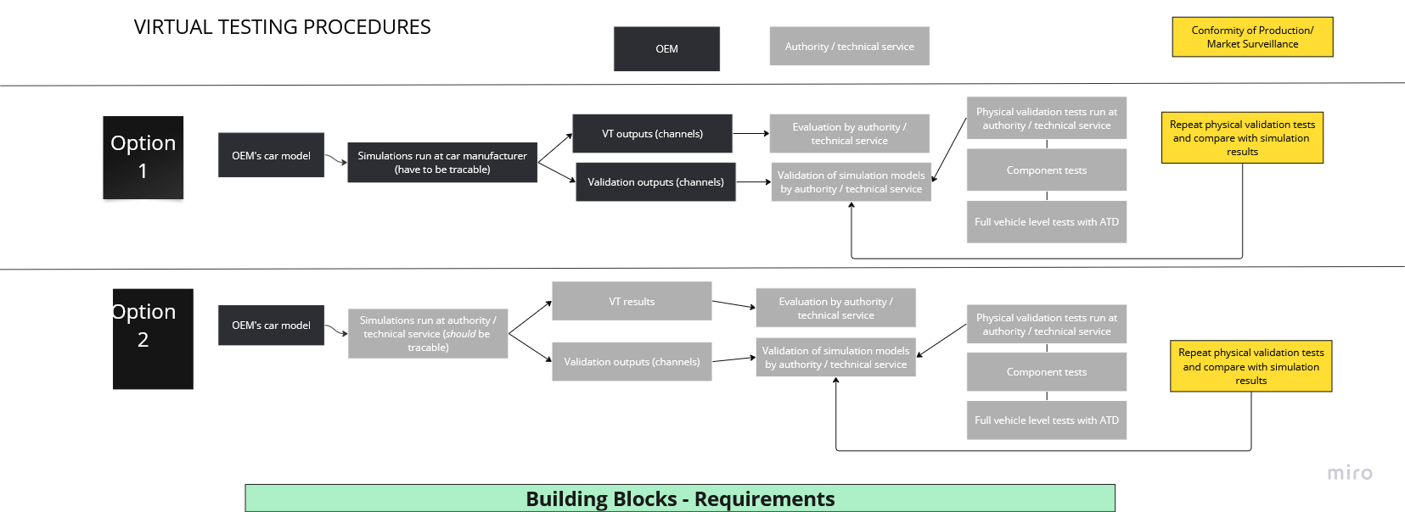
Virtual Testing Procedure

Slide 7
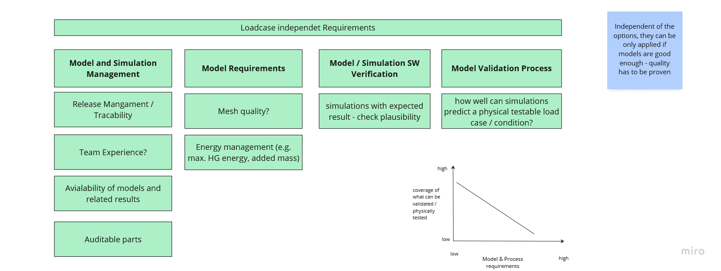
Loadcase Independet Requirements
Ready
Feasible in 3 years
Feasible in 5 years
Feasible in 10 years
(depending on final assessment target it might be longer)
tracabilty
HIII 5F, 50M, 95M
HBM 5F, 50F, 50M, 95M
Vehicle parts:
Harmonised standard on airbag component simulation models
Harmonised standard on seat component simulation models
Harmonised standard on belt component simulation models
Harmonised standard on other
Full-scale validation with ATDs with sled tests
(Harmonised standards could be used as reference for a checking)

Slide 8
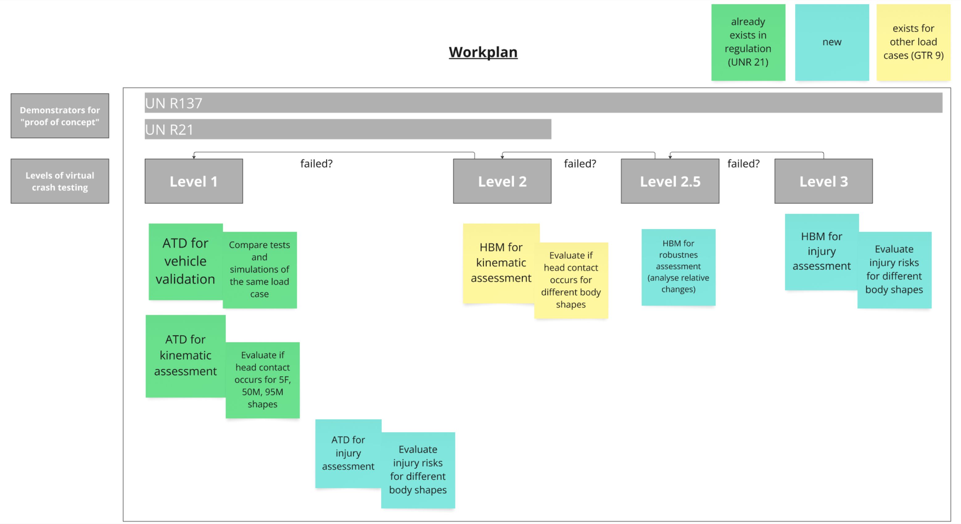
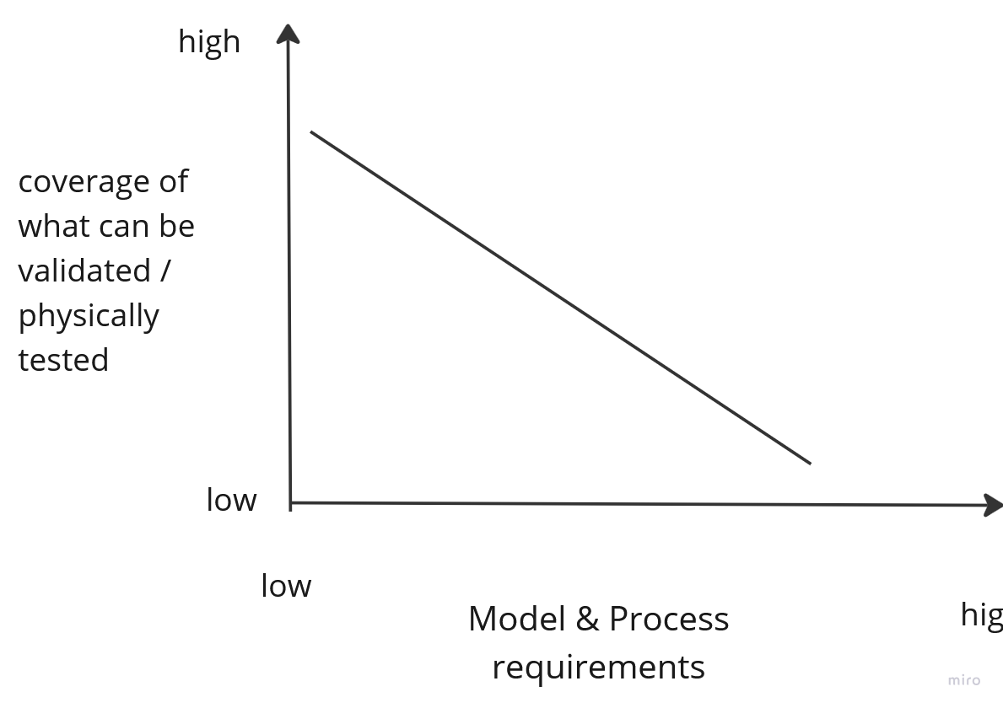
Different Levels of Virtual Crash Testing

Slide 9
What do we think is feasible with the HBM within 10 years?
  Which type of assessments?

Slide 10
Where do we see a value of HBM to close equity issues

