Slide 1
Summary of JRC tests of L2 vehicles
For Phase 3 of R171
A. Kriston, B. Ciuffo, D. Maggi
European Commission Joint Research Centre

Slide 2
Agenda
Objective
Testing overview
  Performed tests and vehicles under test
  Limitation of testing results

Slide 3
Objective
The current work aims to test and evaluate the hands-off and off-highway capabilities of currently available Level 2+ vehicles, with a focus on informing the development of UN Regulation No. 171 phase 3. Additionally, this study seeks to determine the extent to which field data can provide answers to key questions related to the performance and limitations of these vehicles, ultimately supporting the advancement of automotive safety standards.

Slide 4
L2 – Tests
USA testing summary

Slide 5
Tested vehicles (in the US)
Tesla Model 3 (v.11 and 12) - FSD
Ford Mach-e with lane centering and lane change during eyes-on warning (hands-off) only
BMW i7 xDrive60 with lane centering and lane change during eyes-on warning (hands-off) only
Nissan Ariya with ProPILOT Assist (hands-off and Lane Change)
Mercedes EQS with Driver Assistance Package (hands-on)
Cadillac Lyric (hands-off control and Lane Change)
RAM 1500 Laramie (hands-off control and Lane Change)
Cupra (tested in the EU - R79 compliant with ACC)

Slide 6
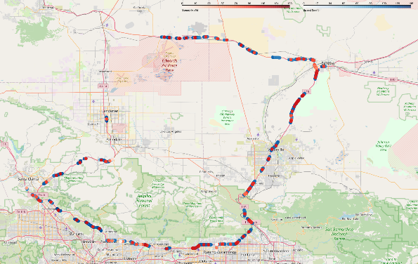
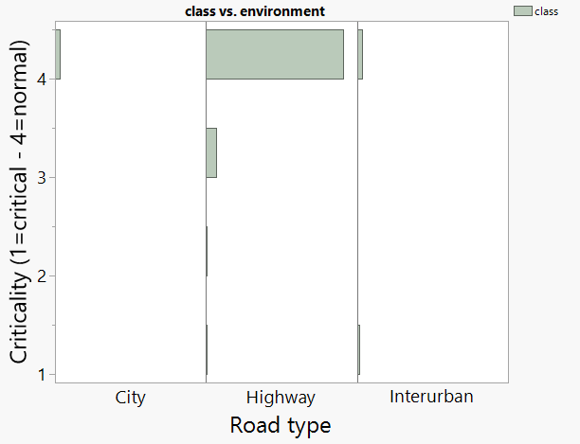
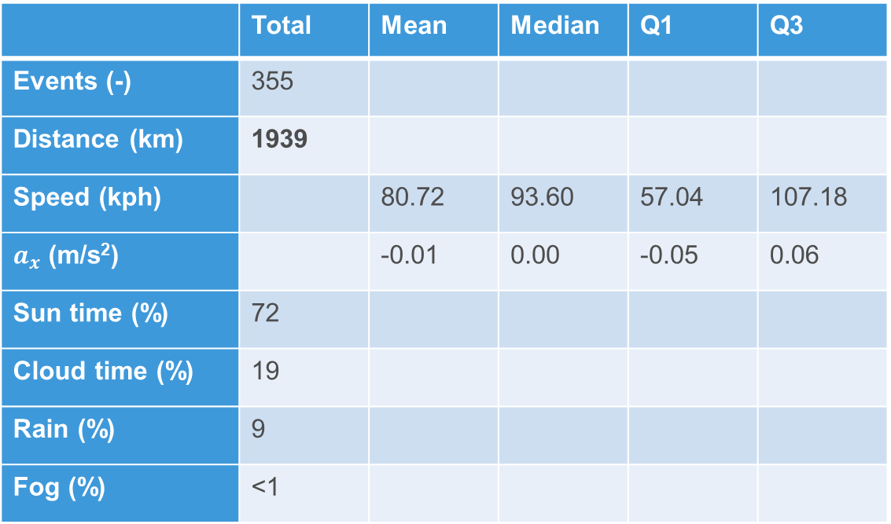
Test location 1 – CA, USA
 | Total | Mean | Median | Q1 | Q3
Events (-) | 355
Distance (km) | 1939
Speed (kph) |  | 80.72 | 93.60 | 57.04 | 107.18
$a_{x}$ (m/s²) |  | -0.01 | 0.00 | -0.05 | 0.06
Sun time (%) | 72
Cloud time (%) | 19
Rain (%) | 9
Fog (%) | <1

Slide 7
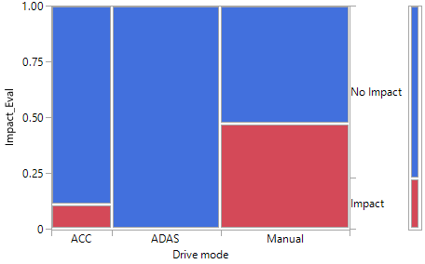
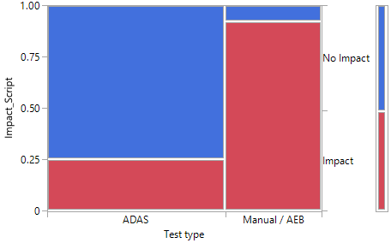
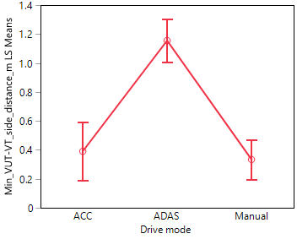
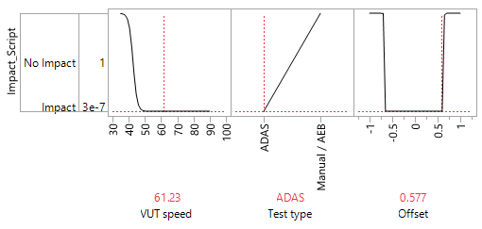
CCRs (AEB) tests on proving ground
L2 (steering and anticipatory capability)
L2 (LKA + ACC)
L2 systems with anticipatory behaviour and system initiated lane change can reduce the exposure of critical scenarios
Vehicle without LC capability does not react at small overlaps
Limitation of active safety concept?
Auto steer
Manual last moment of steering

Slide 8
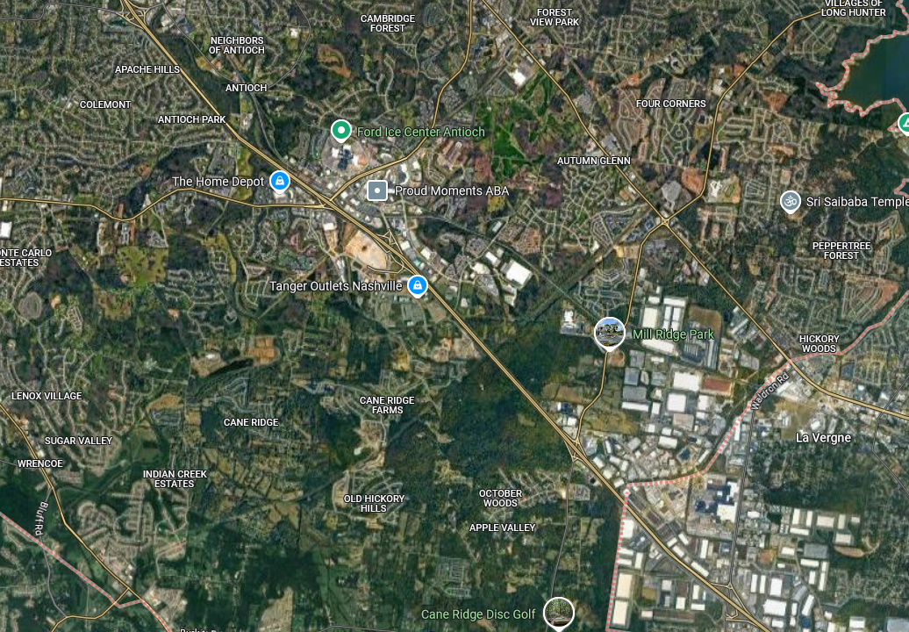
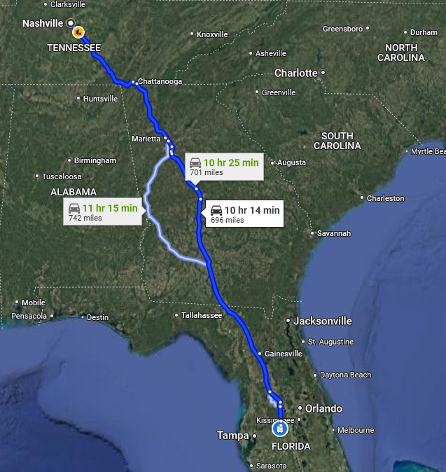
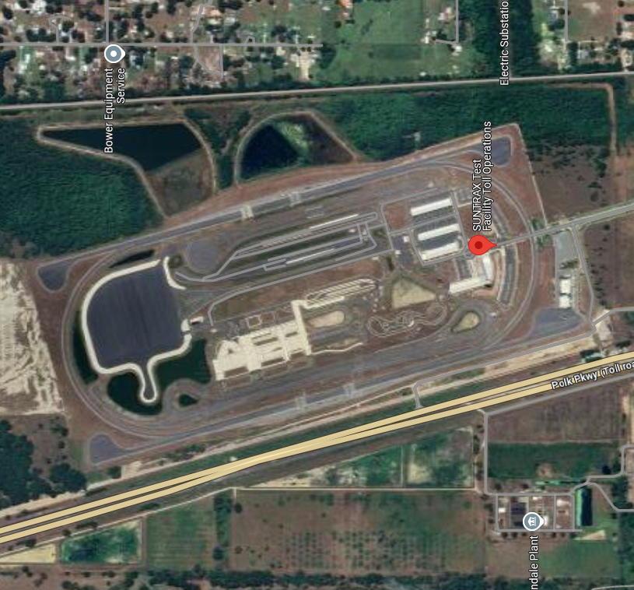
Test locations (3)
October 2024 - 2 weeks
https://i24motion.org/
SUNTRAX
Driving 2000 km / vehicle

Slide 9

Tests executed on I-24
Platoons of L2 vehicles
Automated Lane-Change characterization
Drivers’ attitudes towards automated lane changing
Planned analyses
  String-stability
  Properties of the generated traffic flow (hysteresis, FD, …)
  Energy consumption
  Adopted safety margin
  Lane-change probability
  Impact on traffic flow

Slide 10
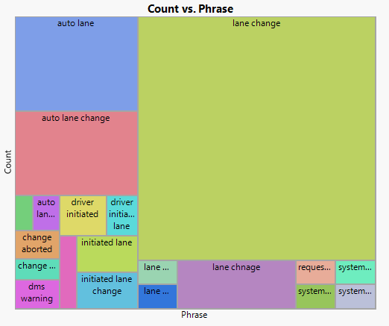
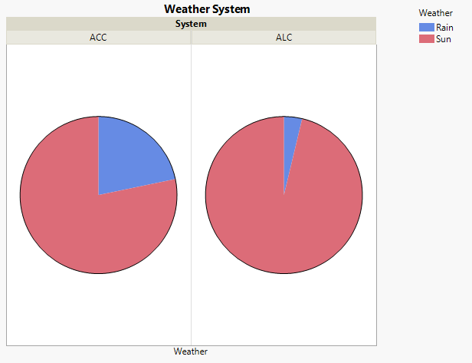
Testing events in numbers
Lane changes are implemented very differently

Slide 11
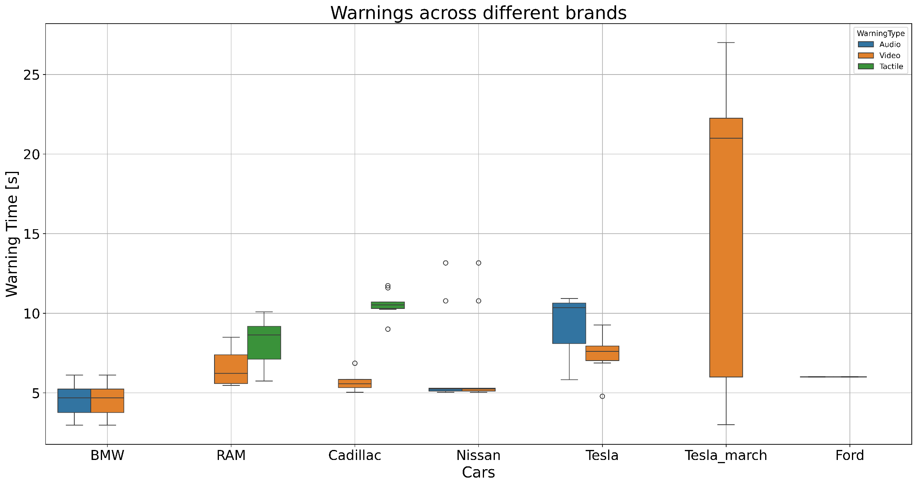
Driver monitoring tests
V1 V2 V3 V4 V5 V5a V6

Slide 12
Limitations of testing results
The current vehicles do not fully meet the requirements of UN R171. Moreover, testing critical scenarios and evaluating irresponsible driving behavior on public roads is hindered by the need to prioritize safety. Therefore, instead of solely examining existing systems, future work will focuses on:
Generalizing the key questions to better understand the limitations and potential of DCAS
Addressing safety concerns directly to strike a positive safety balance.
By taking this approach, we can move beyond the limitations of currently available data and work towards creating a safer and more effective driver assistance framework.

Slide 13

Thank you
© European Union 2025
Unless otherwise noted the reuse of this presentation is authorised under the CC BY 4.0 license. For any use or reproduction of elements that are not owned by the EU, permission may need to be sought directly from the respective right holders.
Notes:
Update/add/delete parts of the copy right notice where appropriate.
More information: https://myintracomm.ec.europa.eu/corp/intellectual-property/Documents/2019_Reuse-guidelines%28CC-BY%29.pdf

