Slide 1
UN-R158
Component Approval
JABIA

Slide 2
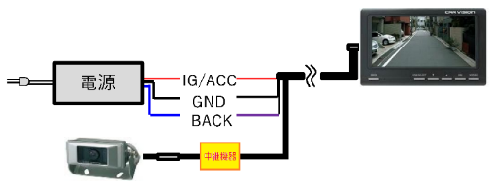
UN-R158 N2,N3 Vehicle
Body builder install the RVCS
RVCS Manufacturer
Body
Power
Vehicle manufacturer
(Only cab cassis)
In the case of N vehicles, cameras, monitors and processing equipment are
often sold as a set by RVCS manufacturers.
However, since the RVCS manufacturer is not a vehicle manufacturer,
Part II cannot be approved.

Slide 3
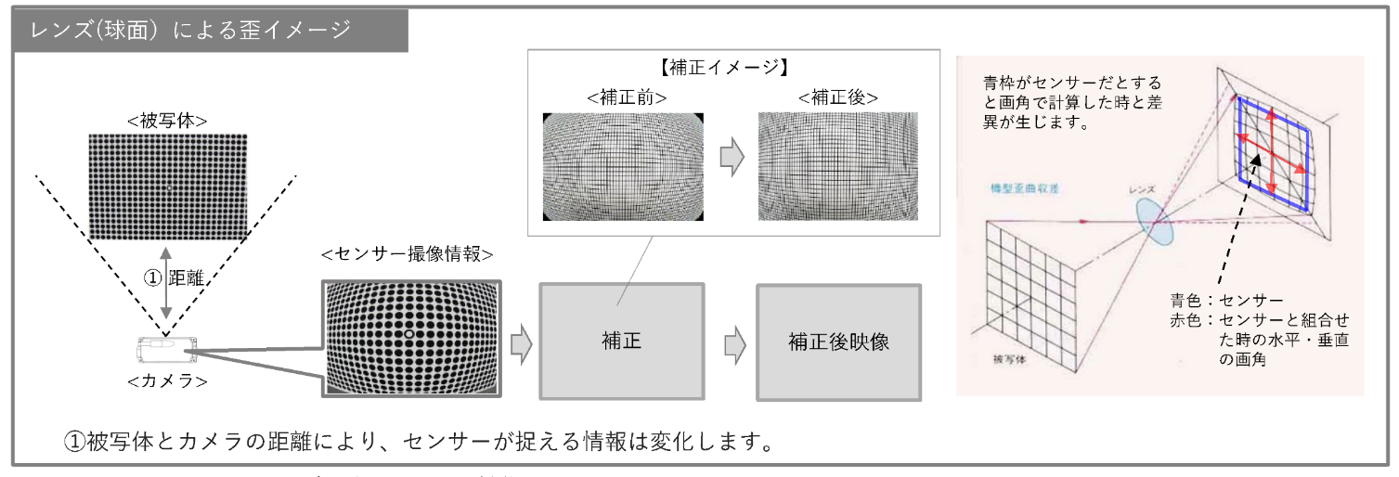
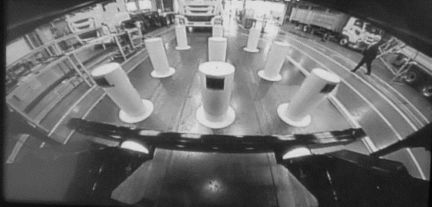
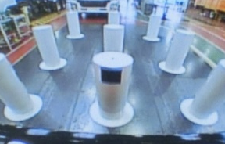
UN-R158 Component (Important!)
Image correction
photographic subject
before
after
Image
correction
Image
Camera
Difficult to approve angle of view !
There are a lot of ways to cut an image.
The projected images are images that have undergone complex image modification.
therefore it can only system approval.

Slide 4
Separation of Installation and Components Approval
Components(Part I)
Area of camera positions (UN-R158 15.2. Annex9 2.)
Response time from Reverse signal (UN-R158 16.1.2.1.)
Object size (UN-R158 16.1.1.)
System (UN-R158 16.1.1.1.-16.1.2)
Installation(Part II)
The installation on vehicles of RVCS
which have been type-approved to Part I of this Regulation
Whether the vehicle has a reverse signal or not
Optional equipment which may affect the rearward field of vision
Check the mounting position of the monitor and camera
Of course, Part I and Part II may be merged and approved by Part II.

Slide 5
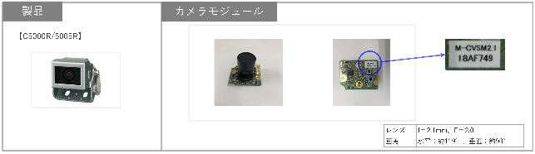
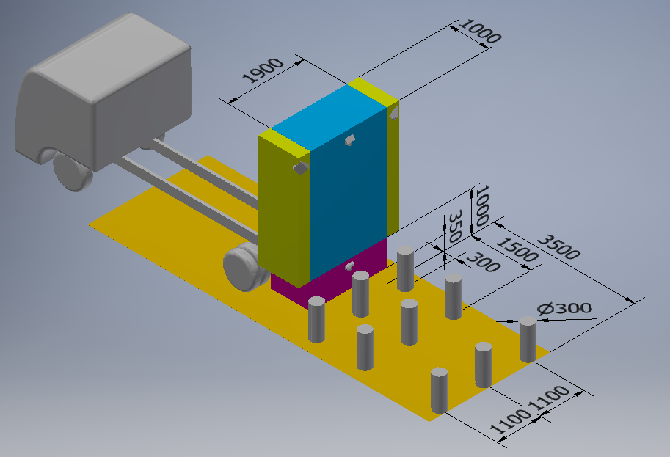
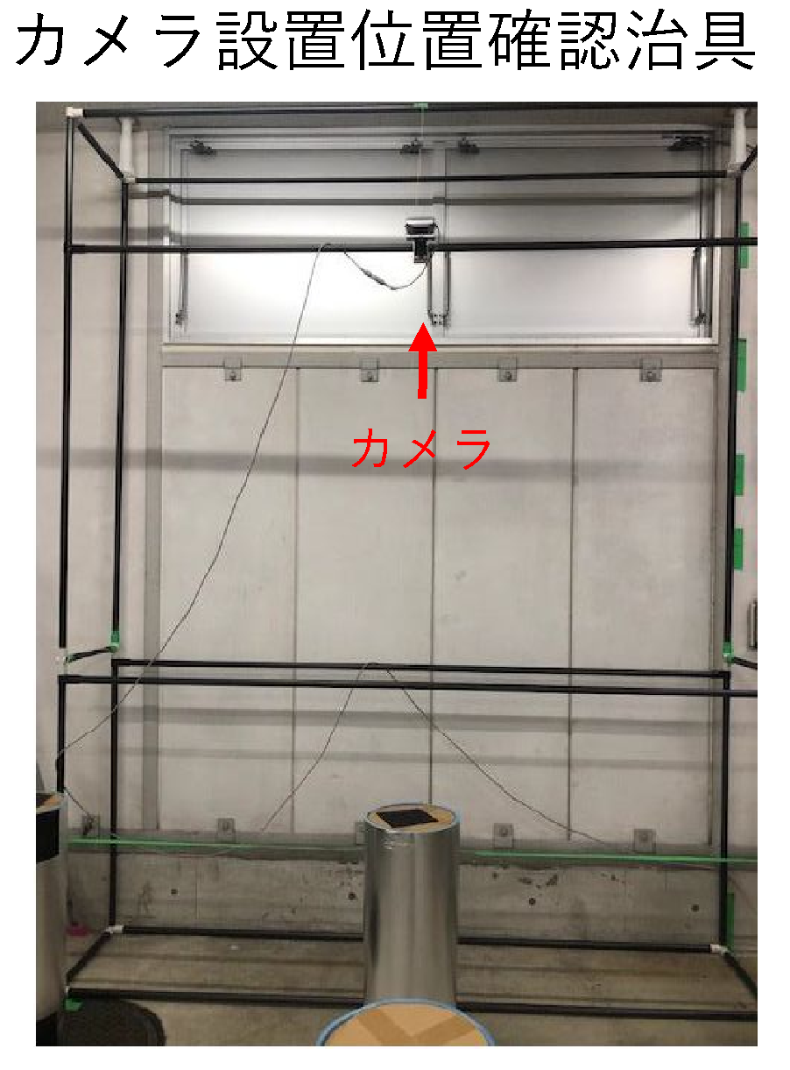
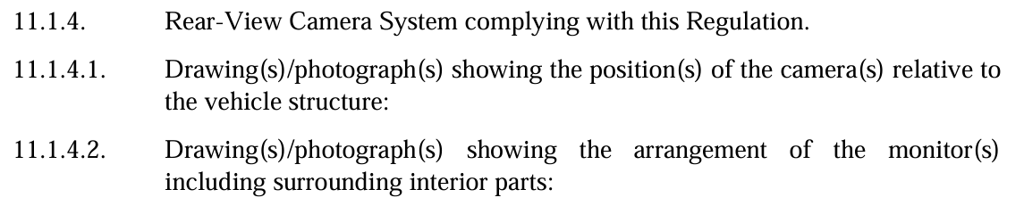
UN-R158 Component …Camera angle of view performance
(Even without a vehicle, the camera position can be simulated.)
Area of camera positions (UN-R158 15.2. Annex9 2.)
Determine the area in which the camera can be installed
using a test jig.
Camera
Rear end of Vehicle
Camera
UN-R158 Annex2
Notes:
Inversion of the idea

Slide 6
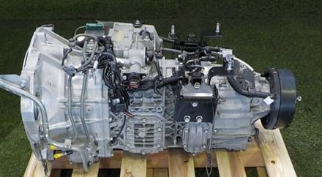
UN-R158 Component
Response time from Reverse signal (UN-R158 16.1.2.1.)
※UN-R158 Annex2 2.2(d)
Initiate/start the second timer, in accordance with the manufacturer's specification and
no later than when the reverse mode or gear is engaged.
Requirements of UN-R158 16.1.2.1.
Test by RVCS manufacture
Gear is engaged
It’s UN-R48 6.4.7. signal
(JPN 別添52 4.5.7.)
Reverse signal
Rear-view image on monitor
If the monitor shows the rear-view image within 2 seconds from the reverse signal, requirement of UN-R158 16.1.2.1. is satisfied.
Notes:
Using a reversing lamp signal would solve the problem.

Slide 7
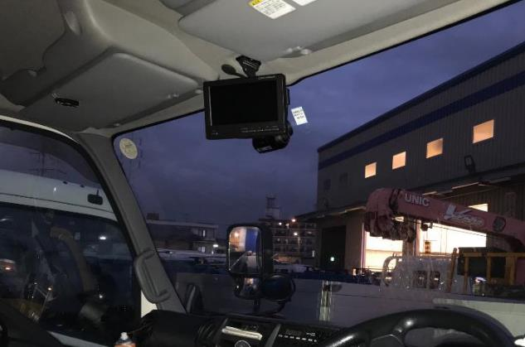

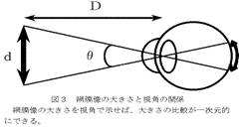

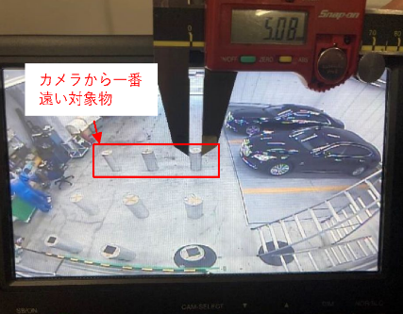
UN-R158 Component
Object size (UN-R158 16.1.1.)
Replacement of UN-R46 Class I mirror
(monitor capable of being adjusted
by the driver from the driving position.)
Put the camera on the worst position
Measure the size of the object on the monitor

Slide 8
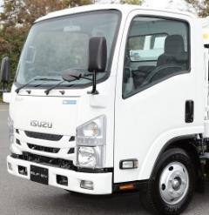


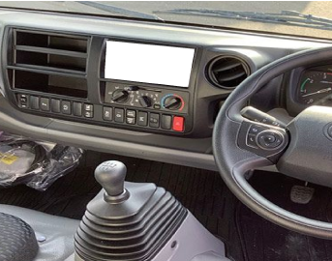
UN-R158 Component
Object size (UN-R158 16.1.1.)
Even if the vehicle changes, performance can be guaranteed without identifying the vehicle by fixing the furthest distance to be authenticated.
About 900mm
Fix (max 1500mm)
About 1000mm

Slide 9

UN-R158 Component
System (UN-R158 16.1.1.1.-16.1.2)
Power
Processor
Overlay system etc.
All devices (cameras, monitors and processors etc.) are sold as a set by RVCS manufacturers.

Slide 10
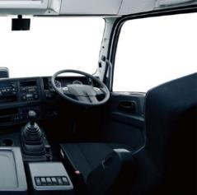
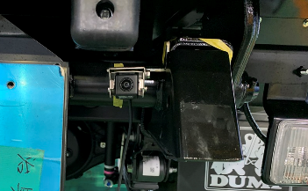
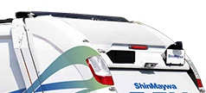
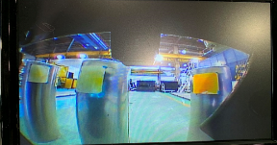
Installation Approval
Optional equipment which may affect the rearward field of vision
Reverse signal (available or not)
Mounting position of the monitor and camera
Body
Components approval checks with the devices installed on the vehicle

Slide 11
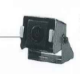
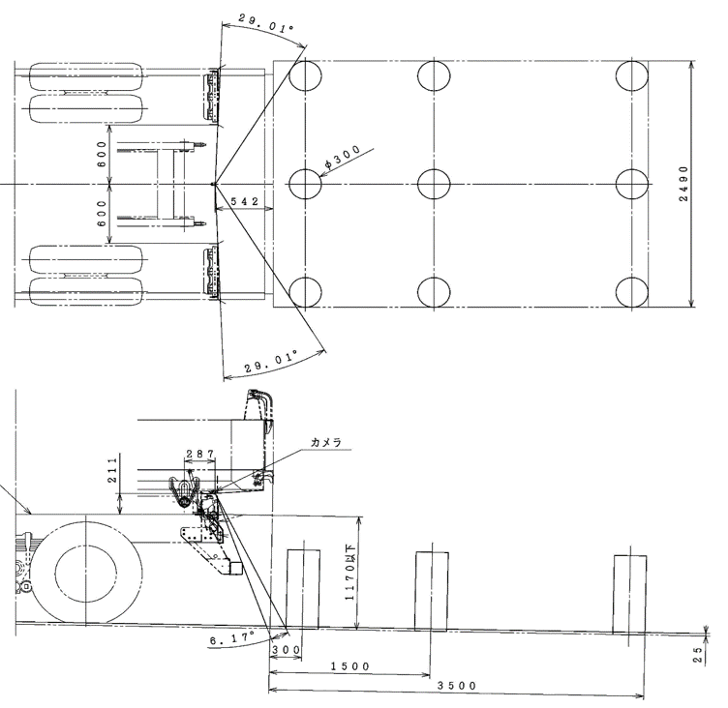
Guarantee area
RVCS Manufacturer
Guarantee the angle of view of the camera.
Body builder
Design the layout of obstacles.
Decide on the mounting position of the camera so that there are no obstacles blocking the object.
Next Page

Slide 12

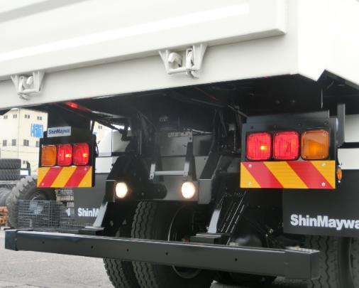
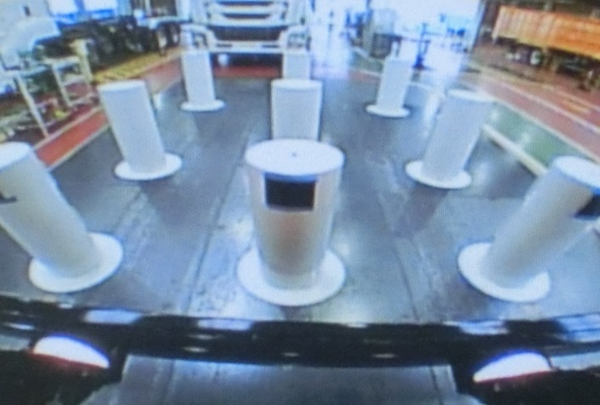
Design review for installation
If the position is correct, it is legal even if the camera has a different angle of view.

