Slide 1
38th UNECE IWG PMP MEETING
Non- exhaust particle emissions
UNITED NATIONS

Slide 2
Feedback from June 2015 GRPE Meeting
        The progress report created by the PMP IWG was presented in the GRPE meeting of the 11/06/2015
        The Chairman of GRPE requested a summary report as result of the information collection phase to be discussed within GRPE and WP29
        The GRPE will take a decision on what the next steps should be (extend the mandate of the PMP to the development of test procedure to be potentially used for regulatory purpose could be an option)
        There is no specific deadline for this summary report. The timeframe will have to be communicated to GRPE in the January session – Content and format of the report will be agreed at the next F2F PMP

Slide 3
Following the GRPE-69-23 Informal Document, the PMP IWG has identified and focused its work regarding non-exhaust particle emissions on 4 WI:
Background - Objective
        WI-1: Investigation of “normal” driving patterns
        WI-2: Compilation and monitoring of on-going projects related to non-exhaust particle emissions
        WI-3: Networking and exchange of information with experts in the field
        WI-4: Development of a set of recommended measurement techniques and sampling procedures

Slide 4
WI1 - Investigation of “normal” driving patterns – Status
        An analysis based on activity data collected in the framework of the WLTP project has been conducted
        Parameters relevant for both brake and tyre/road wear have been calculated.
        Among others distributions of speed, acceleration, deceleration, number of braking events, etc. were calculated and presented in the last PMP meeting
        One of the main results is that the differences in typical driving/braking patterns relevant for non-exhaust emissions are quite limited among the different regions

Slide 5
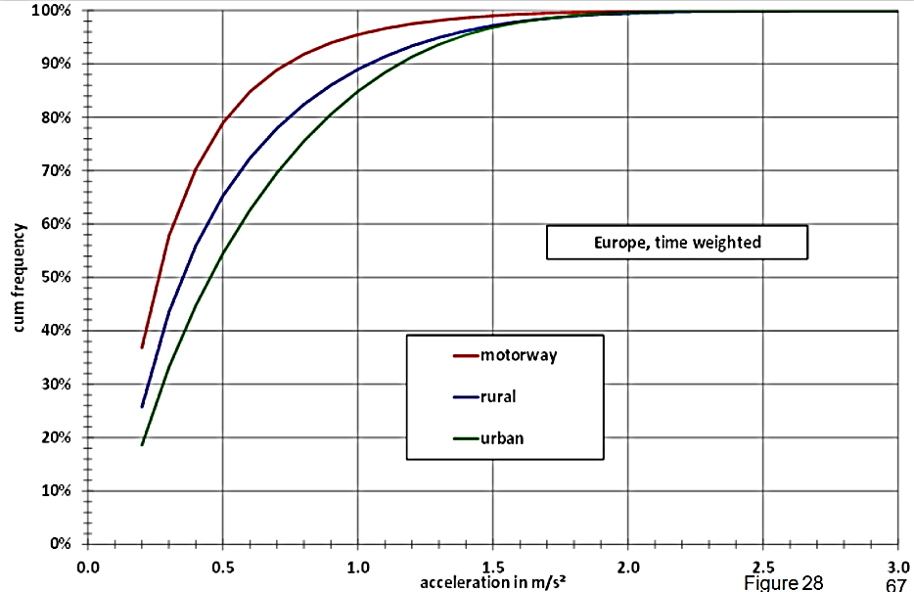
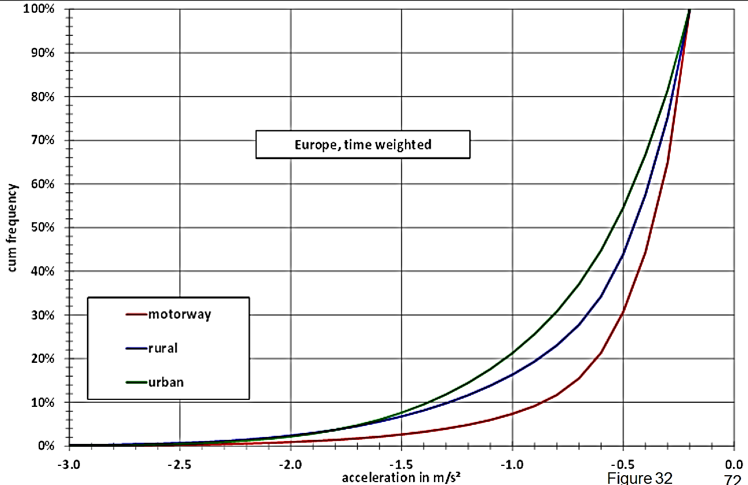
WI1 - Investigation of “normal” driving patterns – First results
The acceleration and deceleration distributions over urban, rural and motorway driving are provided
Only 8% of decelerations > 1.5 m/s2 were observed for urban and rural driving. Also only 4% of accelerations were higher than 1.5 m/s2

Slide 6
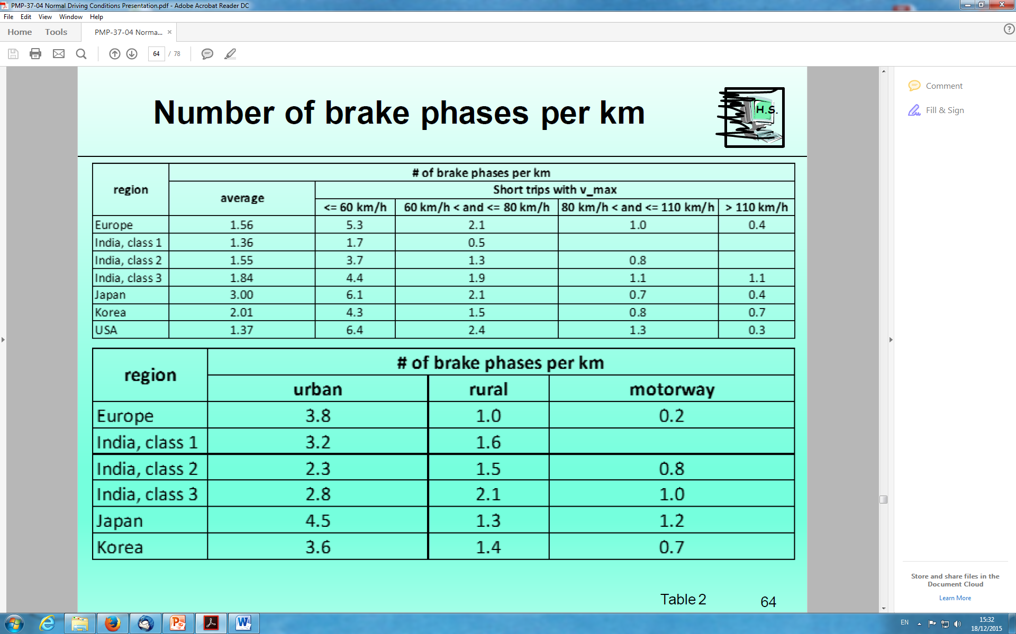
WI1 - Investigation of “normal” driving patterns – First results
        The number of brake phases per km over urban, rural and motorway driving is provided
        Higher braking frequency is observed in Europe and Japan with almost 4 brake events per km (urban driving). Lower frequency at rural and motorway conditions

Slide 7
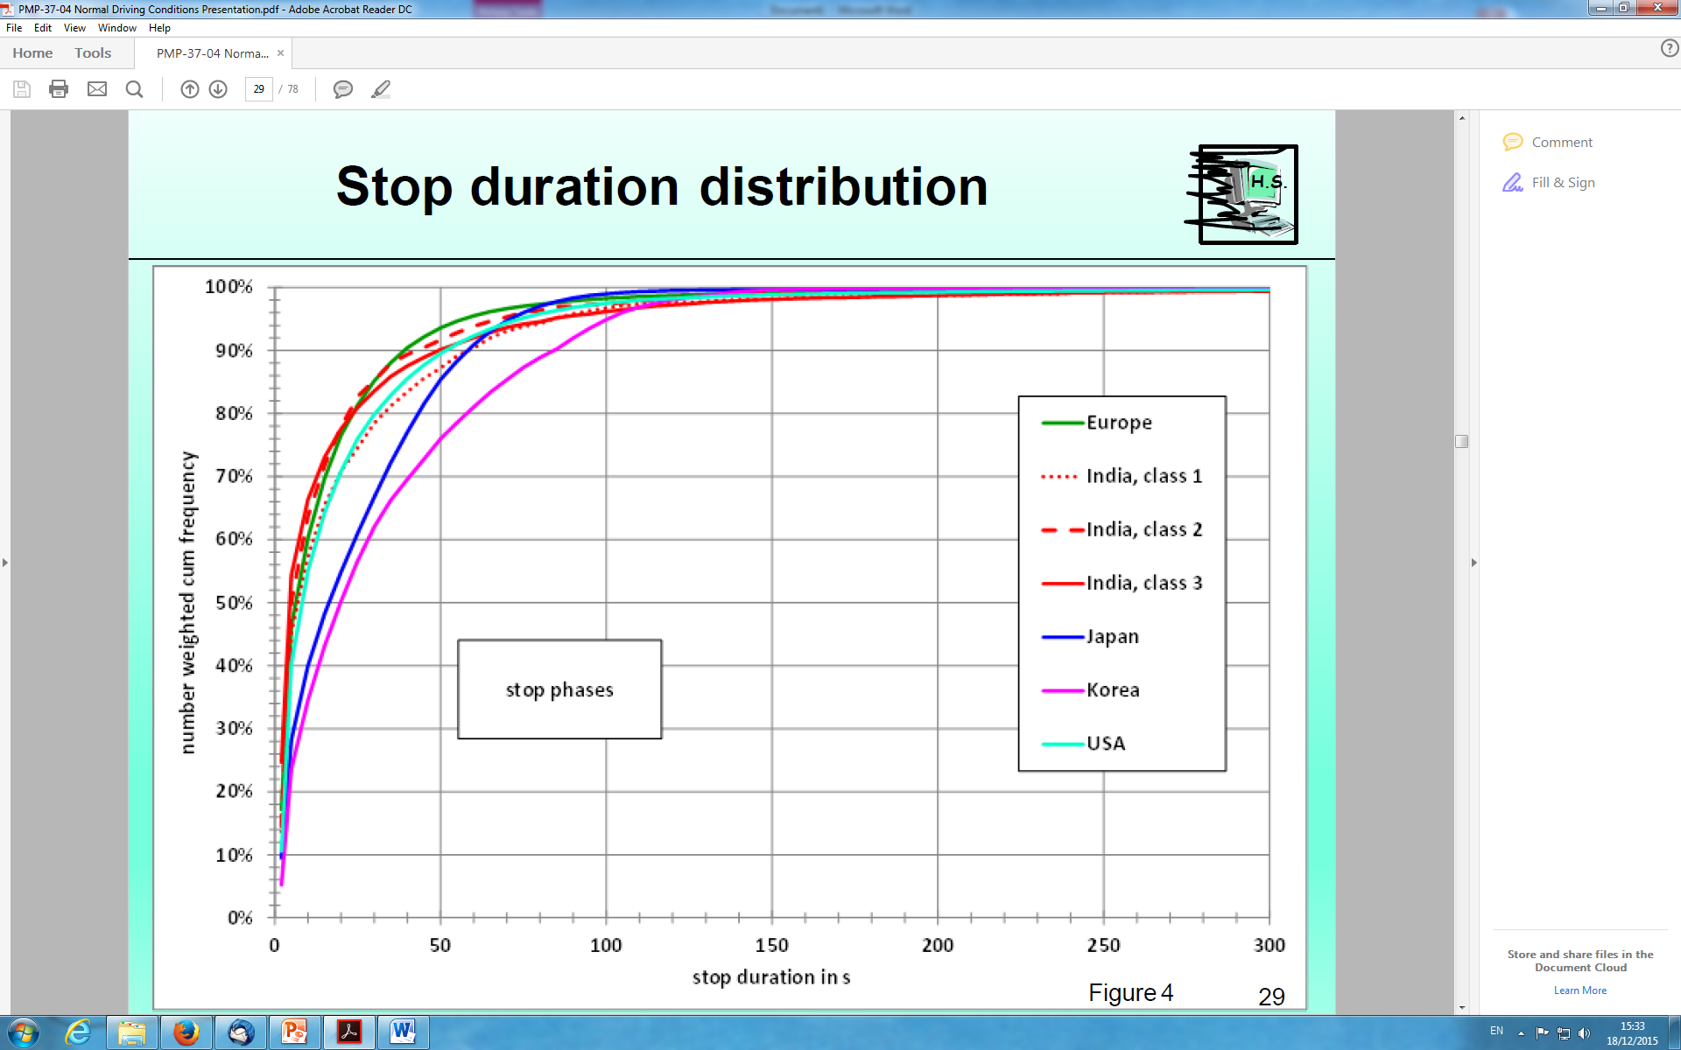
WI1 - Investigation of “normal” driving patterns – First results
        The stop duration distribution due to brake engagement is provided
        90% of stops in Europe last less than 40 sec while the majority last for about 6-8 sec

Slide 8
WI1 - Investigation of “normal” driving patterns – Next Steps
        The final report with all the results will be released in the next weeks and will be available on the PMP IWG dedicated webpage
        Real world data provided by industrial partners as well as industrial cycles for brake testing are being processed with the aim of comparing them to the data derived from the WLTP database
        Depending on the GRPE decision as well as on discussions within the PMP IWG, there could be the possibility to use this set of data for the development of a brake test cycle to assess particle emissions
        Depending on the GRPE decision, this could be the first step for the development of a standardized method at least for measuring particle emissions from brakes

Slide 9
WI2 & WI3 - Related research projects & Networking - Status
        So far, information on several research projects – mostly related to brake wear – have been presented to the F2F meetings. Also the results of the TIP project on tyre/road wear were discussed in detail
        A document that contains information related to the projects for keeping the group informed has been created and updated regularly
        Several experts from different origins (industry, research institutes, universities) have already been following the activities and contribute with their knowledge to the work done within the PMP IWG
        A list of experts who participate in the PMP IWG has been created and is available at the PMP website

Slide 10
WI4 - Sampling procedures and measurement techniques - Status
All methods that have been described in the literature for tyre/road/brake wear particles generation and sampling have been listed and discussed within the PMP IWG
Regarding tyre/road wear particles it seems that currently existing laboratory sampling methods fail to distinguish particles coming from the tyre and the road surface
As far as on-road methods are concerned, although there are experimental setups capable of measuring particle emissions from brake/tyre/road wear under real world conditions, the approach presents difficulties and high uncertainties

Slide 11
WI4 - Sampling procedures and measurement techniques - Status
        As far as brake wear emissions are concerned there are at least two different approaches that can be adopted for the generation and sampling of the particles: the test rig approach that focuses on the brake (disk + pad) system and the whole vehicle approach
        At this stage, there is a consensus among the PMP members to focus the attention on particle generation/reduction at brake system level with the view of developing a harmonized test procedure in the future
        Several different test rigs configurations, based on a brake dyno, exist. Some of them have already been presented to the group and have been quite extensively investigated. The comparison of the pros and cons of each configuration could be investigated as next step

Slide 12
Non-exhaust particle emissions – Key messages
  Brake wear emissions:
  Industry (OEMs and instrument manufacturers) is actively working on the development of brake dyno rigs to assess particle emissions from brake systems
  It is likely that in the near future data and experience acquired in these activities may represent a good basis for the development, in case this is considered necessary, of a standardised measurement procedure based on the brake dyno concept
  Other technologies non directly related to brakes could be used to reduce particle generation, for example by reducing the number of braking events. A different approach than measuring particle emissions may be needed to take into account the benefits of these technologies.

Slide 13
Non-exhaust particle emissions – Key messages
  Tyre and road wear particle emissions:
  Much more challenging situation - Particles mainly belonging to the coarse fraction and difficult to separate tyre and road contribution.
  A standardized methodology (ISO TS) for measuring the contribution of TRWP on air pollution for research purposes is under development
  No clear pathway for the development of a standardized methodology for the direct measurement of TRWP emissions (e.g. particle mass and/or particle number)

Slide 14
Non-exhaust particle emissions – Key messages
As far as tyre/road wear emissions are concerned, a full scale investigation on the open issues related to the sampling and measurement techniques of particles released by tyres would require a large experimental project. Resources?
As far as brake wear emissions are concerned there is a general consensus among the group members that a standardized method to generate and sample particle emissions from brakes could be developed in the near future and the PMP IWG could be a good forum for its development

Slide 15
Non-exhaust particle emissions – Key messages
The PMP IWG will submit a report to GRPE in June 2016 summarizing the key findings about brake and tyre/road wear particle emissions
On the basis of the existing knowledge, a decision on whether the PMP should expand the scope of the activity from information collection to specific objectives (e.g. test cycles and measurement procedure development) will have then to be taken by GRPE

Slide 16





Stay in touch
JRC Science Hub:
ec.europa.eu/jrc
Twitter and Facebook:
@EU_ScienceHub
LinkedIn:
european-commission-joint-research-centre
YouTube:
JRC Audiovisuals
Vimeo:
Science@EC

