Slide 1
Non Paper regarding component approvals
UNECE AECS

Slide 2
background
A component based approval would allow:
To use one component for various AECS system configurations
Smaller modifications of an AECS system can be handled at AECD level
Individual suppliers can obtain an AECD approval for individual components that are used in variety of emergency call systems
Flexibility to select an approval route in function of supply chain responsibility and OEM responsibility (one box solutions, individual components, semi-integrated and fully integrated ecall systems)

Slide 3
GNSS antenna can be:
External antenna dedicated to AECS
External antenna for navigation system
Antenna integrated in AECD unit
…….
MNO antenna can be:
External antenna dedicated to AECS
External antenna for other Vehicle communicaton functions
Antenna integrated in AECD unit
…….
Positioning function can be:
Dedicated AECS positioning module within AECD unit
Take info from vehicle navigation module
...
GNSS
Satellite
GNSS
ANT
MNO ANT
Can be:
Dedicated eCall power supply
12V starter battery
traction battery
….
SRS
UNIT,
SENSOR
AECS control unit
BAT
Trigger detection can be
Dedicated AECS crash sensor
Take signal from vehicle SRS unit
…
MIC
AUDIO
SW
SP
INDICATOR
Audio can be:
Dedicated AECS audio speaker/micro
Integrated with vehicle audio
….
Indicator can be:
AECS indicator integrated in AECD
Separate indicator in instrument panel/common place
...

Slide 4
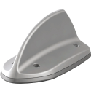
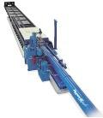

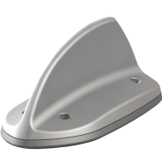
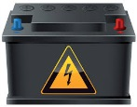



Current AECD
Supplier or
Manufacturer
Component
set
Sled test
Function check
AECD
approval
Incl. other requirements if requested by applicant
Par. 7.1 EMC
Par. 7.2 Position (& Annex 8)
Par. 7.4 Means of access to MNO
Par. 7.5 AECD information and warning signal
Par. 7.6 Power supply
1. AECD control unit
AECD control unit
AECD test bench
With intended fixation & part of wire harness
GNSS
antenna
2. Mobile Network antenna
A
AECD control unit
A
Manual button
With intended fixation & part of wire harness
or
3. Main power supply
If no back-up battery
or
Mobile network
Mobile network simulator
w/o fixation
+ VSWR measurement
(for wired procedure)
UNECE part I

Slide 5
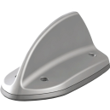
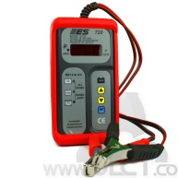
Individual components as AECD
Supplier
Individual Components
Sled test
Function check
AECD approvals
1. AECD control unit
eCall test bench
A
A
GNSS
antenna
MNO
antenna
AECD control unit
With intended fixation & part of wire harness
AECD control unit
Incl. other requirements if requested by applicant
Par. 7.1 EMC
Par. 7.2 Position (& Annex 8)
Par. 7.4 Means of access to MNO
Par. 7.5 AECD information and warning signal
Par. 7.6 Power supply
battery
Manual button
or
or
2. Mobile Network antenna
B
VSWR measurement
B
With intended fixation & part of wire harness
3. Main power supply
If no back-up battery
Battery tester
C
C
w/o fixation
Proposed as additional flexibility in UNECE part I

Slide 6
AECS approval
AECD approvals
A
Incl. other requirements if requested by applicant
Par. 7.1 EMC
Par. 7.2 Position (& Annex 8)
Par. 7.4 Means of access to MNO
Par. 7.5 AECD information and warning signal
Par. 7.6 Power supply
1. Check which part I requirements are already covered.
2. AECS requirements
(if not covered already by AECD
General installation
Full scale impact test
Positioning AECS Control
Information signal
warning signal
HF Audio
Power supply
B
C
3. AECS approval
D

