Slide 1
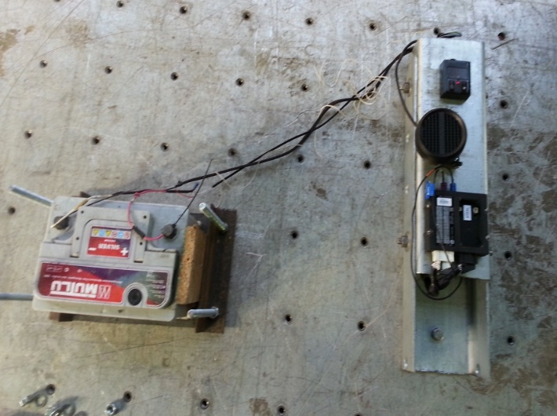
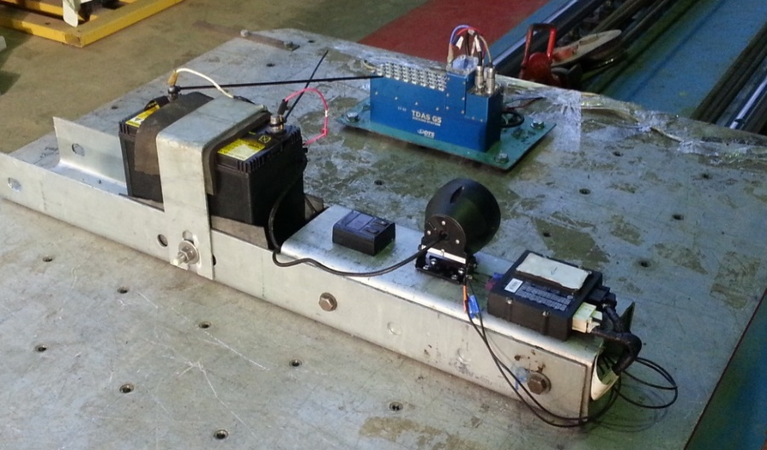
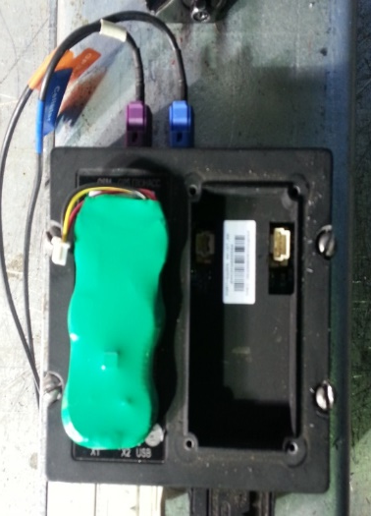
AECS sled testing (NAMI’ testing centre)
Sled testing conditions:
the following components of AECS, necessary for MSD triggering and establishing two-way voice communication were tested: control module, communication module (including microphones and loudspeakers), network and GNSS antenna, GNSS receiver);
AECS components were connected to the test fixture by the intended mountings provided for the purpose of attaching the AECS installation;
AECS was connected with the main battery (AECS’ back-up power supply was disconnected).

Slide 2
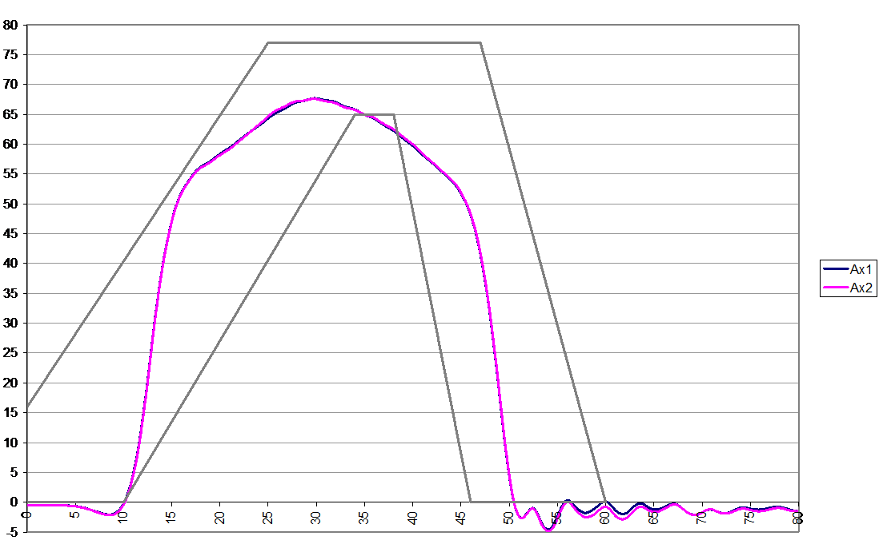
AECS sled testing (NAMI’ testing centre)
Sled testing results:
MSD has been transmitted;
two-way voice communication was established immediately after the test and after 60 minutes in call-back mode (5-60-5 test)
there were no visible damages of the main battery and AECS components;
peak decelerations were between 67g and 70 g;
Annex 7 deceleration corridor was no achieved at the lower boundary (the higher level of deceleration can be provided but the test result could exceed the upper level) at the NAMI’ sled test equipment
Proposal:
to reduce the lower limit to 60 g.
Peak deceleration: 67,7g
Acceleration/Deceleration (g)
Time (ms)

