Slide 1
4.2.1. Position determination
Proposed modifications
AECS 12nd. meeting
Moscow, 9-11 February 2016

Slide 2
Part I - General requirements
7.2.1.
The GNSS receiver shall be able to output the navigation solution in a NMEA-0183 protocol format (RMC, GGA, VTG, GSA and GSV message). The AECD setup for NMEA-0183 messages output to external devices shall be described in the operation manual.
In order to avoid any misunderstanding on the connectivity between the GNSS receiver and the GNSS simulator, it is eliminated any reference to “external devices”
(…)
7.2.10.
and
The GNSS receiver shall be able to obtain a position fix at least every second.
17.2.10.
Time between position fixes needs to be defined in order to be coherent with the current 1Hz signal output set for all the test methods.
At this point, this new sentence in the performance requirements section is purely informative. It does not imply any extra burden to the testing procedure.

Slide 3
Annex 8 - Test methods for the navigation solutions
3.1.5.
Test results are considered successful if navigation information via NMEA-0183 protocol is received in all the AECD/AECS samples.
(…)
3.7.13.
The test result is considered to be positive in case:
the value of time to first fix in “cold” start mode, as measured in 3.7.7, do not exceed 3600 seconds at signal level on the antenna input of the AECD/AECS of minus 144 dBm in all the eCall samples;
the GNSS navigation solution is available for at least 600 seconds at signal level on the antenna input of the AECD/AECS of minus 155 dBm as measured in 3.7.9 in all the eCall samples;
and re-acquisition of GNSS signals and calculation of the navigation solution at signal level on the antenna input of the eCall of minus 150 dBm is possible and time interval measured in 3.7.12 does not exceed 60 seconds in all the AECD/AECS samples.
In order to avoid misunderstandings and keep coherence in all the test descriptions, there is a need to explicitly mention to repeat the test for the 3 samples also in the “NMEA output” and the “Sensitivity” tests.

Slide 4
Annex 8 - Test methods for the navigation solutions
3.1.6.
The test of NMEA-0183 messages output and the assessment of the positioning accuracy in autonomous static mode can be combined.
In order to save 1 extra hour of GNSS testing, it is offered the chance to test the “assessment of positioning accuracy in autonomous static mode” and the “NMEA messages output” at the same time
(…)
2.1.1.
The number of the eCall test samples shall be at least 3 pieces and can be performed in parallel.
In order to reduce 3 times the total GNSS testing timing, it is permitted the use of modern simulators that permit to 'repeat' the tests with the 3 samples in parallel.

Slide 5
Overview on the time needed to test the navigation solution

Slide 6
Annex: Minor typo remarks (1/6)
16.2. Position determination
If the AECS is fitted, in accordance with paragraph 1.4. and not yet verified according to Part I of this Regulation, with GNSS receiver supporting at least three GNSS including GLONASS, Galileo and GPS, and is capable of reception and processing of SBAS signals, then the AECS shall comply with the requirements of paragraphs 17.2.1 to 17.2.11.
(…)
17.2.7 Sensitivity at receiver input shall be:
  GNSS signals detection (cold start) do not exceed 3600 s at signal level on the antenna input of the AECS of minus 144 dBm;
  GNSS signals tracking and navigation solution calculation is available for at least 600 s at signal level on the antenna input of the AECS of minus 155 dBm;
  Re-acquisition of GNSS signals and calculation of the navigation solution is possible and does not exceed 20 60 s at signal level on the antenna input of the AECS of minus 150 dBm.
(…)
17.2.11. The testing procedures in Annex 8 can be performed either on the AECS unit including post processing ability or directly on the GNSS receiver being a part of the AECS.

Slide 7
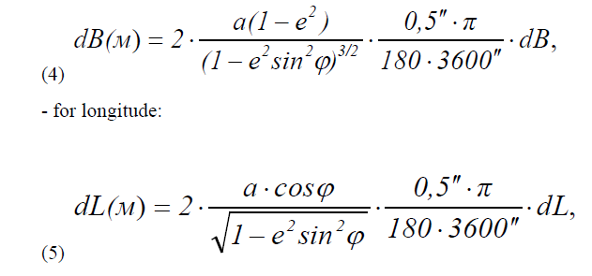
Annex: Minor typo remarks (2/6)
Annex 8 Test methods for the navigation solutions (paragraphs 7.2 and 17.2)
The purpose of the tests in this Annex is to verify the compliance of navigation characteristics of the AECD/AECS calculated by its GNSS receiver navigation module to the requirements defined in sections 7.2 and 17.2. of this Regulation.
2.1 – It should say: GNSS receiver (instead of navigation receiver)
2.1.6 – It should say: GNSS receiver (instead of navigation receiver)
3.5.2 – It should say: GNSS receiver (instead of navigation receiver)
3.7 – It should say: GNSS receiver (instead of navigation receiver)
3.7.4 – Figure 5 should say: AECD/AECS (instead of The AECD)

Slide 8
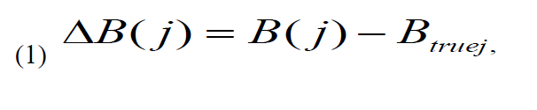
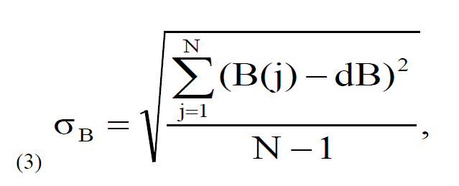
Annex: Minor typo remarks (3/6)
3.2.7.
3.2.8.
(2)
Where
- Btruej is the actual value of B coordinate in “j” time moment, in angle arc-seconds
- B(j) is the determined by the GNSS receiver value of B coordinate in “j” time moment by the GNSS receiver , angle arc-seconds;
(5) ,
Where
а is the semi-major semiaxis of ellipsoid, m
e – first eccentricity, [0 – 1]
φ – determined value ofcurrent latitude, radians.
3.2.9 Convert calculated SD values of latitude and longitude determination from angle arc-seconds to meters according to formulas (4) – (5):

Slide 9
Annex: Minor typo remarks (4/6)

Slide 10
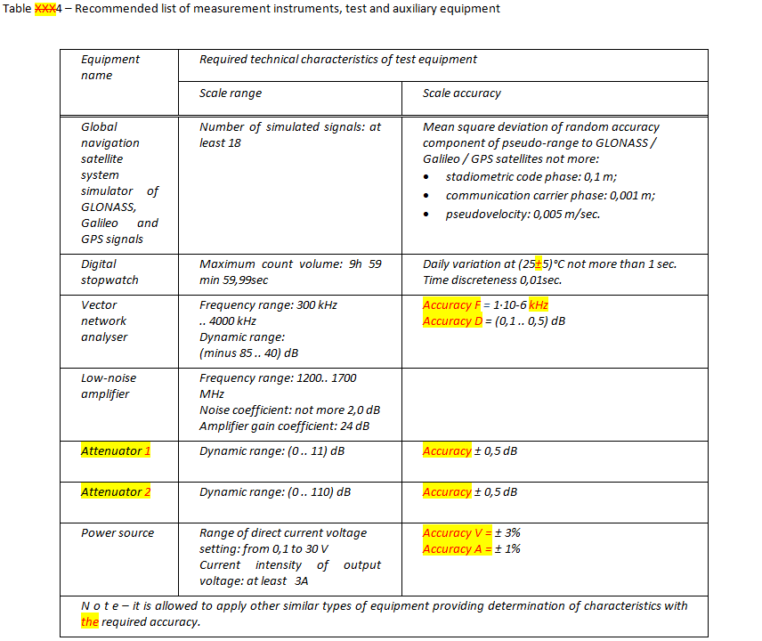
Annex: Minor typo remarks (5/6)
Table XXX4 – Recommended list of measurement instruments, test and auxiliary equipment

Slide 11
Annex: Minor typo remarks (6/6)

