Slide 1
Aecs regulation
Post-crash check with HMI method

Slide 2
01
Context

Slide 3
Context
Homologation time to be consider for one new function
  Part I – AECD (~4 weeks)
  Part II – AECD installation (~2 days or more)
  ➔ OEM aim to build harmonized and optimized testing plans
It exists currently 4 test methods using the over-the-air transmission for the MSD and voice call via a real or simulated PLMN and GNSS networks, or using the wired method.
These test methods will interfere with R94/R95 homologation procedures because focused after each crash test
It exists other approval protocols already used by technical services which uses vehicle HMI (e.g. EMC)

Slide 4
Constraints
For methods 1 to 4, AECS post-crash approval is included within the R94/R95 protocol (after each crash test)
Specificities of Electrical Vehicle which increase the verification time after crash (~30 minutes)
Need a network coverage within crash facilities or a specific location to conduct the post-crash tests after the moving of the crashed car
Take into account the AECD power supply autonomy in the above cases (e.g. Back-up battery)

Slide 5
AECD/AECS test phases for test methods 1 to 4
>3 weeks for the first approval (tbc)
PART I
AECD
EMC R10
GNSS check
Mobile network access check
HMI check
Power Supply check
Sled test
1 additional day without crash preparation (tbc)
Crash-tests
R94 / R95
1 day (tbc)
R94/95
tests
R94 and/or R95 operations + (optional) Electric Vehicle
Safety measures
Objective Audio test (optional)
MSD content
Functional check
Test methods 1 to 4
Subjective Audio test
Test methods 1, 2 and 3 : 1 day
Test method 4 : > 1 day
PART II
AECS
HMI – status indication
OR

Slide 6
AECD/AECS test phases for test method 5 : HMI check
>3 weeks for the first approval (tbc)
PART I
AECD
EMC R10
GNSS check
Mobile network access check
HMI check
Power Supply check
Sled test
1 additional day without crash preparation (tbc)
Crash-tests
R94 / R95
eCall pre-crash operations only for Method 5
R94/95
tests
R94 and/or R95 operations + (optional) Electric Vehicle
Safety measures
MSD content
Audio test
1 day
PART II
AECS
OR
HMI check
Test method 5
HMI by camera or recording signals
OPTIONAL
Visual check of the audio parts
(speaker, mic)
<1 hour

Slide 7
Synthesis
Benefits
  The main operations are now pre-crash, and can be done without time constrains just before the R94 or R95 homologation, and outside the crash area.
  Very fast post-crash check through video camera, or electrical signals recording, by checking a HMI’s sequence.
Drawback
  Need to have an extended self-test strategy within AECD/AECS

Slide 8
02
HMI check procedure proposal

Slide 9
Requirements
HMI check / Test method 5 can be only used if the in-vehicle AECD/AECS is capable :
1- to check and diagnose the electrical connections between all of the following devices :
- AECD control module
- PLMN communication module + antenna
- GNSS receiver + antenna
- Power source (from vehicle or back-up source)
- Warning/Information device (HMI)
- Hand free audio equipment (microphone, speaker)
2- to discriminate a network failure from an internal failure of the AECD Unit,
the communication with GNSS and mobile networks and PSAP is deemed to be compliant if no internal failure warning is indicated by the vehicle HMI.

Slide 10
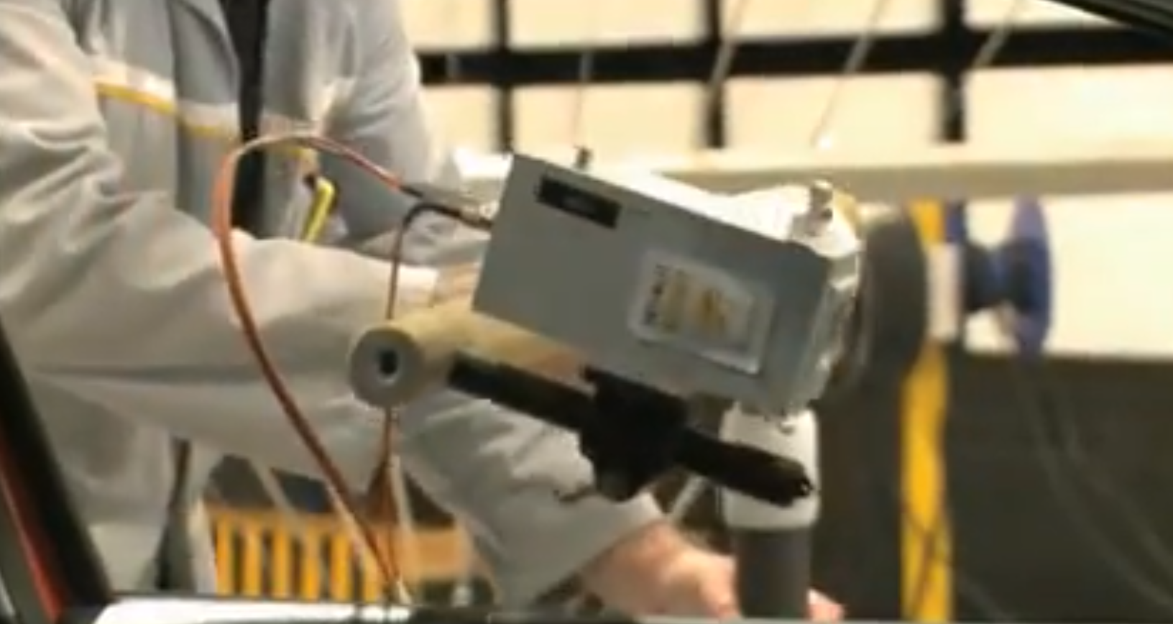
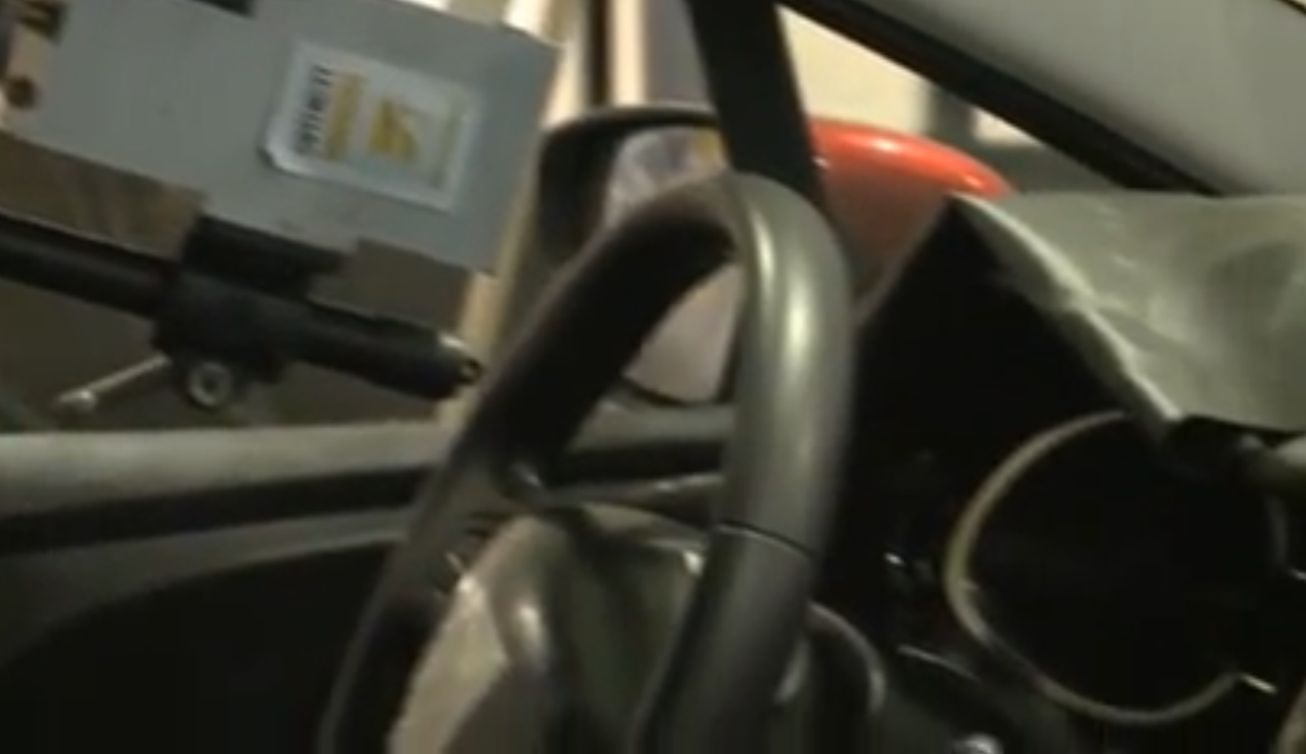
Pre-crash procedure
Cameras which records the Dashboard
(tell-tales) during EMC tests

Slide 11
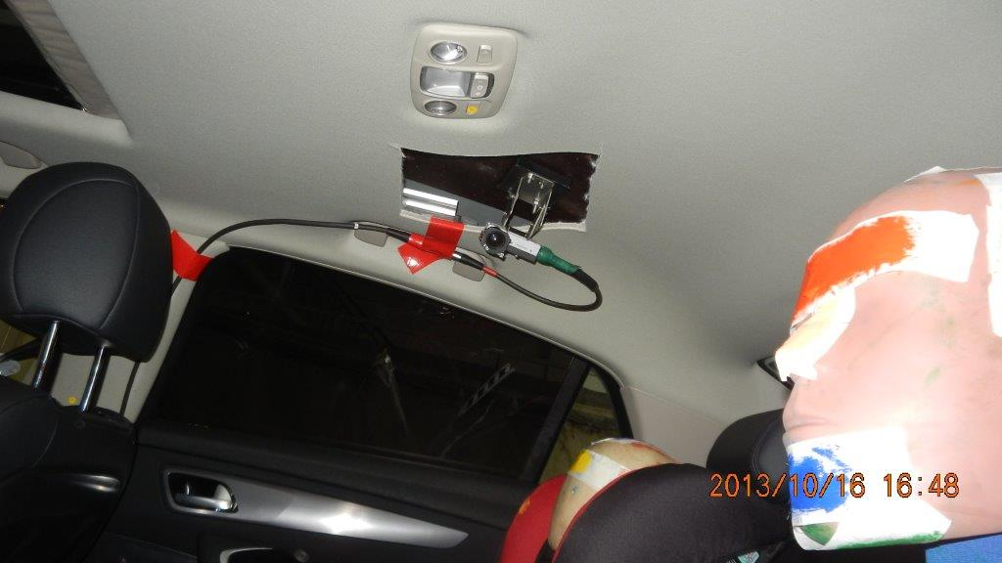
Pre-crash procedure
Camera used during
crash test

Slide 12
Pre-crash procedure
These operations are to be done before the R94 (frontal) and/or the R95 (Lateral) crash tests :
1- Functional check by test methods 1 to 4 following a manual call :
- Conformity of the content of the MSD (location, time stamp, vehicle identification)
- Hands-free voice communication assessment.
For this specific procedure, the possibility to use the subjective voice intelligibility test method should be allowed, as in European eCall with the rated performance at least “3” (appendix 3 to Annex 9), the objective test could also be chosen at the demand of applicant.
2- Installation in the vehicle of the video camera needed to check all HMI involved during an emergency call, or a recorder for all HMI signals.

Slide 13
Post-crash procedure : HMI check
After the R94 or R95 crash, the technical service will check the recording of the video camera or the recorded HMI signals, to verify if the HMI sequence defined by the manufacturer is conform.
[optional]
A visual check could be done to verify the damage on the audio parts (loud-speaker and the microphone).

Slide 14

EXAMPLE
Post-crash procedure : HMI check
Example of a sequence of HMI during a crash test, and possible failures.
AUTO
Crashtest
R94
or
R95
AUTO
AUTO
AUTO
AUTO
AUTO
FAST
SLOW
FAST
eCall
operational
+
Networks OK
Trigger
event
Automatic
eCall detected
Establishing
connection
with PSAP
- Connected to
PSAP
- MSD sending
- Voice request
and starts it
No coverage
System failure
Partial failure
Impossible to
Contact PSAP
after time-out
t
Conform sequence
Possible failures

Slide 15
03
Visual inspection of audio parts

Slide 16

Post-crash procedure : Visual inspection of audio parts
STATEMENT :
From point of view of functioning principle, a microphone and a loud-speaker are based on the same electrical, mechanical and physical principles.
EXPERIMENT :
What is the behaviour of a loud-speaker in function of its mechanical damage ?
Let’s listen and compare the effects of different damages on a loud-speaker

Slide 17
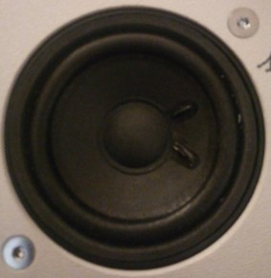




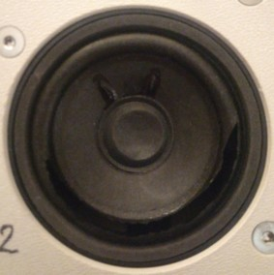
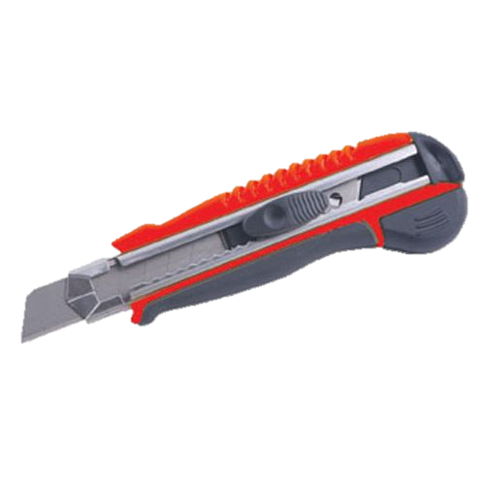


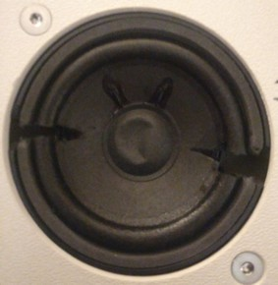

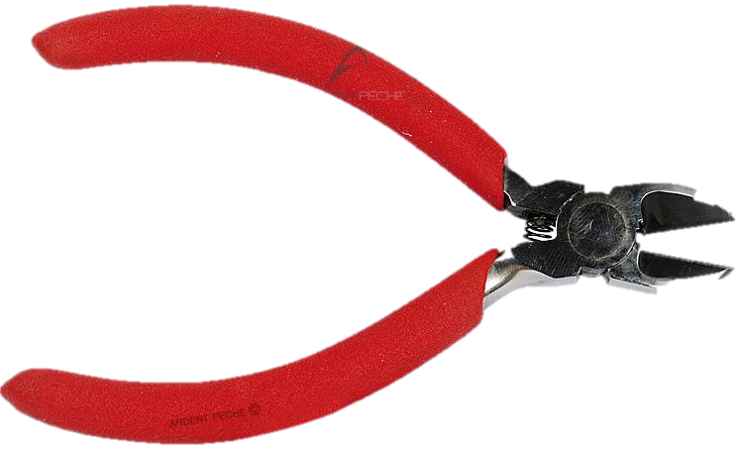

Post-crash procedure : Visual inspection of audio parts
Tests sentences
from ITU website
Loud Speaker 1
in good condition
Male
Female
Loud Speaker 2
half of the membran
is cutted
Loud Speaker 3
membran and frame
are cutted in 2 locations

Slide 18
Post-crash procedure : Visual inspection of audio parts
What is your opinion regarding the inteligibility of these differents sentences in several language ?
- Have you had some trouble to understand the sentence in your native language ? For each damaged loud-speaker ?
- Only a « severe mechanical damage » of the loud speaker or the microphone, or the impossibility to visually check these parts, could lead a complementary
audio subjectif test, at the demand of technical service.

