Slide 1

WLTP-13-15e
WLTP - GTR No. 15
ECE-TRANS-WP29-GRPE-2016-03e
Interpretation Issues- Views from India
WLTP IG Meetings
11th – 13th Jan 2016
Geneva

Slide 2
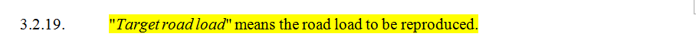
1. Target Road Load
GTR Text
II. Text of the global technical regulation
Concern
  Statement is open ended. Lacks clarity.
Proposal
  “ Target road load” means the road load to be reproduced on the chassis dynamometer
Justification
  For better understanding.
Notes:
Page 10 of GTR

Slide 3
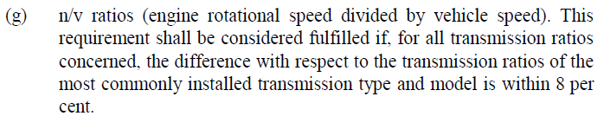
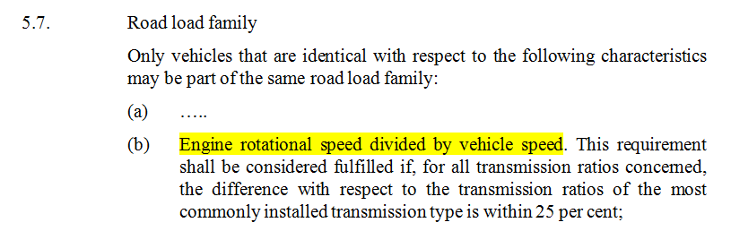
2. n/v ratios
GTR Text
II. Text of the global technical regulation
Proposal
  n/v ratios (engine rotational speed divided by vehicle speed). same as used in 5.6.1 / 5.6.3
Justification
  For better harmonisation in term definitions.

Slide 4
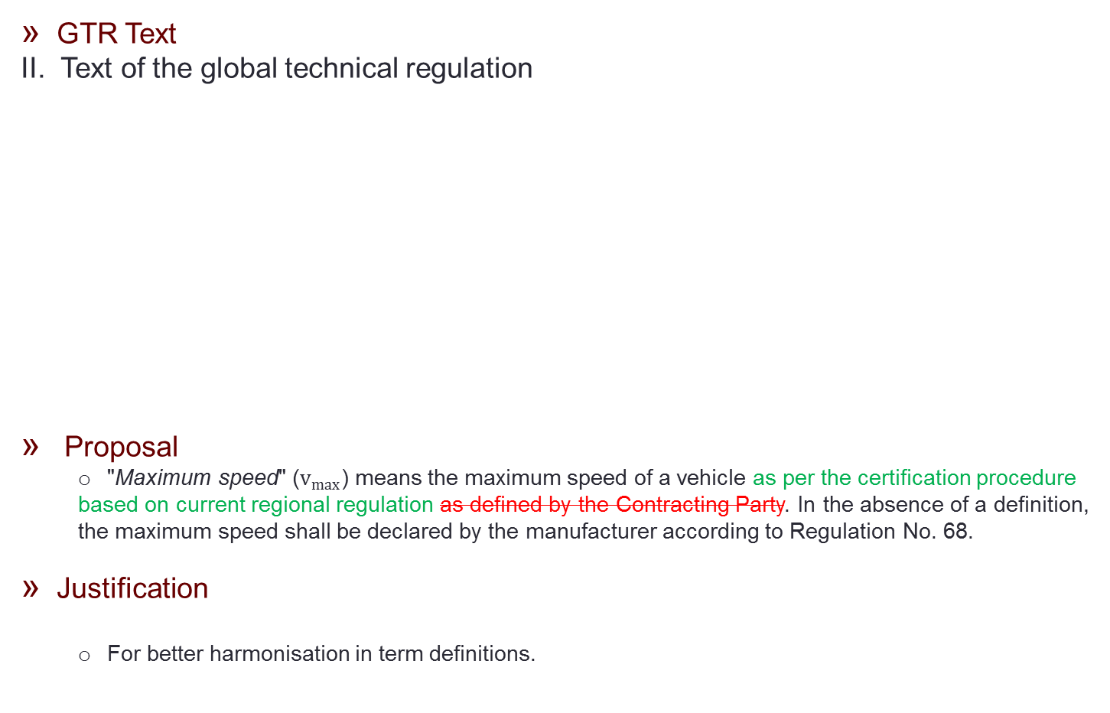
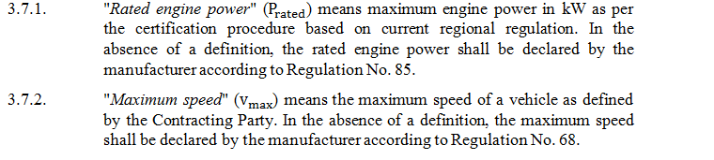
3. Vehicle speed

Slide 5
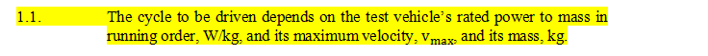
4. Test Cycle Applicability
GTR Text
Annex1
Concern
  The part in the red box is misleading.
Proposal
  The Cycle to be driven depends on the ratio of test vehicle’s rated power to mass in running order, W/Kg, and its maximum velocity V_{max} , and its mass, Kg.
Justification
  for better understanding.

Slide 6
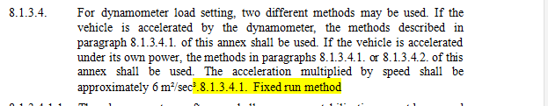
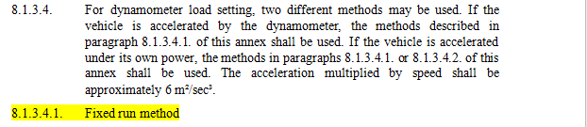
5. Typographical Error
GTR Text, Annex 4
Proposed Text

Slide 7
THANK YOU.

