Slide 1
12th ADS IWG
ISMR Open Items
Document ADS-12-46
12th ADS IWG session
7-11 July 2025 (Helsinki)
Espedito Rusciano and Riccardo Doná
Notes:
Cover slide option 1. Check layout for option 2 without the banner and footer

Slide 2
Status of the Open Items on ISMR
Item number | Ref. | Description of item, task(s) and updates | Actions and timeline for resolving | Status (open/resolved)
1 | ADS-10-05 6.4.2 | Without prejudice to applicable laws on the provision of information to other authorities (6.4.2 of ADS-07-02Rev.1) Text agreed, but final location to be decided and may be in the scope of the UNR. | To discuss the proposal related to ADS-12-08 (OPI ISMR) and Sec Suggestion | Open
2 | - | Title sections to be tidied up (minor editorial) | No document submitted | Open
6 | Annex on Occurrence | Occurrence list – complex/emergency manoeuvres | No document submitted | Open
11 | Short term template | Annex on reporting templates: Confidentiality of the information reported in the occurrence (Industry request for clarification) – Medium Priority | Related to ADS-12-32 and ADS-12-32 | Open
12 | Short term template | Annex on reporting templates: Root-cause analysis in case the ADS is not at fault (Industry request for clarification) – Medium Priority | To discuss the proposal in ADS-12-32 and ADS-12-32 | Open
18 | Short term template | Annex on reporting templates: Corrective action can require more than 30 days | To discuss the proposal in ADS-12-32 and ADS-12-32 | Open

Slide 3
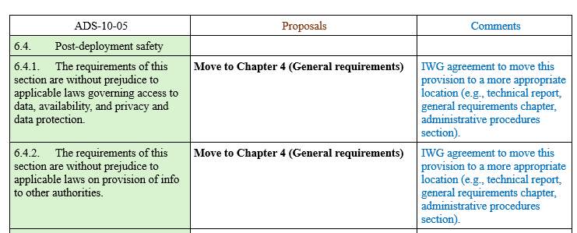
Open Item1
The document ADS-12-08 proposes to move in the chapter 4 (Agreed in the ISMR workstream)
Sec. proposes the following text for the Ch. 4:
4.4.4.5. These requirements are without prejudice to applicable laws governing:
(a) Access to data,
(b) availability of data,
(c) Data privacy,
Data protection,
Provision of data to other authorities
OPI suggests to accept the proposal and close the open point.

Slide 4
Open Item2
The open item concerns the Title section to be tidied up (minor editorial)
This is only an editorial change with no impact on the content.
OPI suggests to remove from the list and gives the task to the Sec.

Slide 5
Open Item6
The consolidated text include the following occurrences for reporting
Occurrences | Reporting Type
 | Notification | Short-term | Periodic
1. Critical occurrences¹ | X | X | X
2. Significant occurrences
……. |  | X | X
3. Other occurrences²
…..
[Emergency Manoeuvre] |  |  | X
Definition from DSSAD guideline
3.14.2. “Emergency manoeuvre” means a manoeuvre performed by the system in case of an event in which the vehicle is at imminent collision risk and has the purpose of avoiding or mitigating a collision.
3.14.3. “Imminent collision risk” means a situation or an event which leads to a collision of the vehicle with another road user or an obstacle which cannot be avoided by a braking demand lower than 5 m/s².
The emergency Maneuvers were added for the purpose of receiving information on How the ADS performs in the Real life in comparison with the Safety Case (i.e., Claims)
This occurrence in not targeting abnormal or unsafe behaviors of the ADS, but it aims at confirming the intended behaviors/performance
This information is also stored in the DSSAD which considers an EM as a maneuver where a collision cannot be avoided by a braking demand lower than 5 m/s2
The manufacturer shall periodically report this occurrence together with an analysis/review of such metrics to avoid any erroneous interpretations of the reported values/data (e.g., link with ODD where the ADS is operating)
OPI suggests to keep the occurrence as it is and close the open item

Slide 6
Open Item11
The documents ADS-12-32 and ADS-12-33 updates the templates concerning the confidentially as below:
The Assessment section already requires to ensure the confidentiality of the Sensitive and Business confidential reported information
There is no need to duplicate such information in the template
It is expected that management of confidential information is done according to the Agreements and Applicable laws (e.g., EU) 2018/858).
It is also recognized that the confidentiality topic should be evaluated in a broader perspective
  Information sharing between Manufacturer and relevant authorities (e.g., Use of DETA*)
  How the relevant authorities could use such information for sharing lesson learnt
For this reason, there is a proposal to include such topic in Interpretation Document to ensure a harmonized approach for sharing and using the information coming from ISMR
OPI suggests to keep the occurrence at it is and close open item
*Database for the Exchange of Type Approval documentation established by the United Nations Economic Commission for Europe

Slide 7
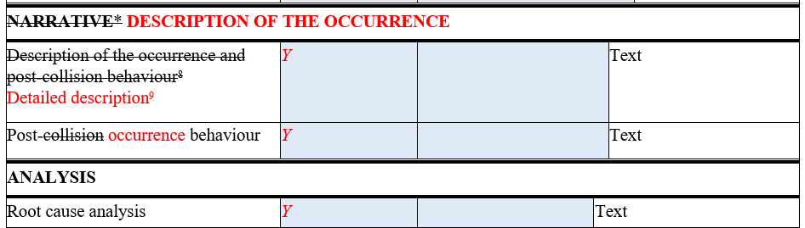
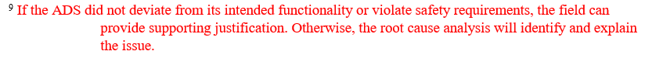
Open Item12
The documents ADS-12-32 and ADS-12-33 updates the templates for the Root-cause analysis in case the ADS is not at fault:
The Description provides the information needed to describe the occurrence
The root cause analysis will be provided if the ADS deviates from the Intended functionality or violate the requirements
No obligation to identify the cause of the occurrence if no deviations or violations were identified.
OPI suggests to accept the change and close open item

Slide 8
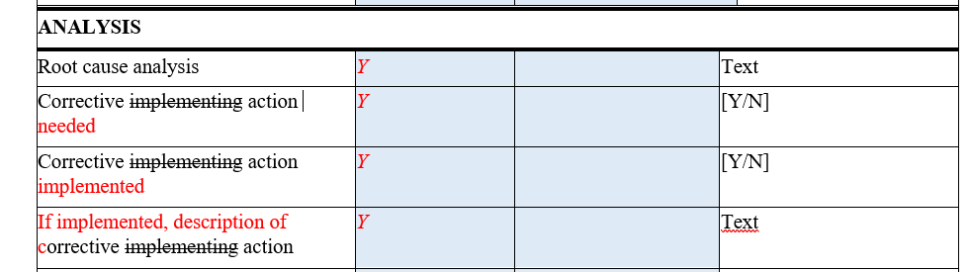
Open Item18
The documents ADS-12-32 and ADS-12-33 updates the templates for the corrective actions
The current text clarifies that there is no obligation to identify and implement a corrective action within 30 days as per the short-term report.
This information is only relevant to understand if an occurrence required a corrective action to ensure the safety of the ADS
The management of non-conformities is not part of the ISMR processes
OPI suggests to accept the change and close the open item

Slide 9


Thank you
© European Union 2025
Unless otherwise noted the reuse of this presentation is authorised under the CC BY 4.0 license. For any use or reproduction of elements that are not owned by the EU, permission may need to be sought directly from the respective right holders.

