Slide 1
Schedule until summer holiday (it means you are not able to take vacation until you get job done)
Deadline for submission of working document to GRPE(93): 22nd July 2025
A-LCA 23rd session: 27th May 2025 >web
A-LCA 24th session: 24th – 25th June 2025 >Hybrid(physical venue is tbc)
April | May | June | July
GRPE |  |  | ★ Deadline(22nd)
Drafting Meeting ★ (24) 3rd deadline (14) | ★ 4th deadline (12) | ★ 5th deadline (tbd) | ★ Final deadline (tbd) including all IWG member
IWG | ★ #23 session* (27) | ★ #24 session** (24-25)
SG
final refine
feedbacks
feedbacks
feedbacks
close to Final
Final
Develop methodology & text
* pursue the agreement
on contradictory items
**Final review

Slide 2

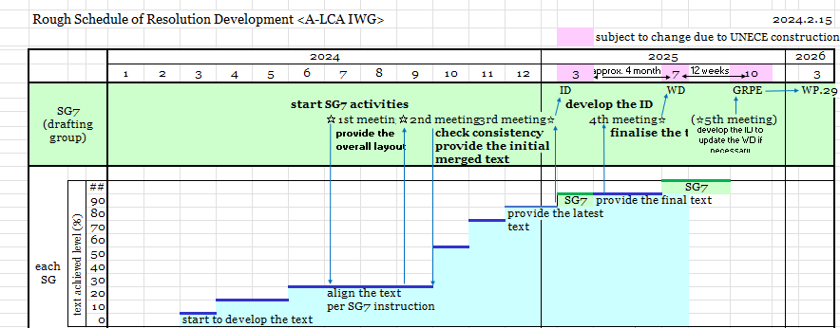
Updated Timeline
Each SGs provides their table of content
SG provides 3rd drafting : due date Friday 13th December
Official KOM
SG7 checks consistency, provides feedback and start writing
13th of December : SGs leader provide draft
18th or 19th or 20th of December : SG7 meeting to provide feedbacks
Milestones for SGs

