Slide 1
TF TA 33rd session
20th May 2025
Co-chairs’ note:
Key elements for agreement on C1 limits proposal

Slide 2
TF TA 33rd session
20th May 2025
Decisions for C1 limits proposal – recap from TFTA 32
Can we proceed on limit setting for both test methods based on current correlation?
  - Mixed views – some favouring proceeding with one method initially, others favouring both from the start
  Co-chairs’ proposal: proceed with both methods
What tyres should be in/out of scope for limit setting?
  - Majority supported meeting requirements of UNR 117 (conformity) as a prerequisite
  JASIC in favour of wider scope, but with exclusion of Q speed rated 3PMSF tyres
What tyre groupings should be used for limits?
  - Limited discussion at previous meeting
What limit values should be used?
  - Limited discussion at previous meeting
  Co-chairs’ proposal: ‘close to 1.0’ with data-driven separate uncertainty margin (including for CoP, as appropriate)
How should measurement uncertainty be accounted for within the limit setting?
  - Limited discussion at previous meeting
  Co-chairs’ proposal: a ‘core’ limit with separate uncertainty margin that reflects the methods’ evolution (tightening margins)

Slide 3
TF TA 33rd session
20th May 2025
Achieving a working document for 82nd GRBP
It is clear that concerns remain on both the measurement uncertainty and correlation between the two methods – this will require further work beyond our June deadline to resolve.
At the same time, the market assessment testing does provide us with a view of the spread of abrasion performance across the market – it should therefore be possible to take a view on limits.
Co-chairs’ proposed route forward:
Focus on the key decision points in relation to scope, abrasion limits and uncertainty margin handling to agree a working document for the June deadline.
Continue to analyse the COVA and MA data ahead of GRBP (September) to identify potential areas of method improvement or further work needed – initial improvements could be taken on-board within an informal document for September.
Propose updates to the TF TA ToR for GRBP with clear timelines in relation to concrete method improvements.

Slide 4
TF TA 33rd session
20th May 2025
TF TA views on decision points
Can we proceed on limit setting for both test methods based on current correlation?
  Co-chairs’ proposal: proceed with both methods, and set out a roadmap for method improvements in ToRs
What tyres should be in/out of scope for limit setting?
  Co-chairs’ proposal: meet requirements of UNR 117 as prerequisite (high degree of harmonization, ease of drafting)
What tyre groupings should be used for limits?
  Co-chairs’ proposal: Normal, 3PMSF [and Special] only to avoid proliferation of ad hoc limits
What limit values should be used?
  Co-chairs’ proposal: 1.0 for normal, 1.05 for 3PMSF – with separate uncertainty margin
How should measurement uncertainty be accounted for within the limit setting?
  Co-chairs’ proposal: a core limit with separate uncertainty margin (detailed on next slides)
(Proposed format: rapid rounds of discussion for questions 1 to 3 – max 1 minute per intervention)

Slide 5
TF TA 33rd session
20th May 2025
Co-chairs’ proposal – overview
Until date D1 | Accepted result
 | Convoy | Drum
Normal | 1.30-1.35 | 1.15-1.20
3PMSF | 1.20-1.25 | 1.20-1.25
Special | [as 3PMSF] | [as 3PMSF]
(until date [D1])
Convoy | Drum
0.30 | 0.15
0.15 | 0.15
[as snow] | [as snow]
(additional?)
Core limit
Normal | 1.00
3PMSF | 1.05
Special | [as snow]
[CoP]
[0.05]
[0.05]
[as snow]
(from date [D1])
From date D1 | Accepted result
 | Convoy | Drum
Normal | 1.15-1.20 | 1.10-1.15
3PMSF | 1.20-1.25 | 1.15-1.20
Special | [as 3PMSF] | [as 3PMSF]
Convoy | Drum
0.15 | 0.10
0.15 | 0.10
[as snow] | [as snow]
Measurement uncertainty

Slide 6
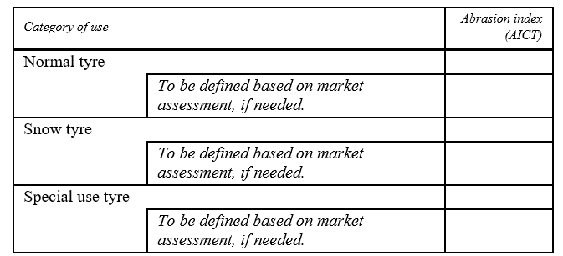
TF TA 33rd session
20th May 2025
Co-chairs’ proposal - limits
AICT_{corr} must meet these limits
1.00
1.05
[1.05]

Slide 7
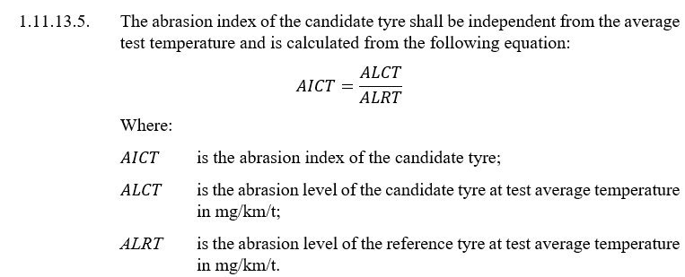
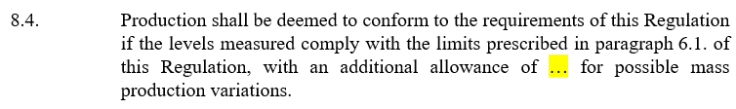
TF TA 33rd session
20th May 2025
Co-chairs’ proposal – limits
Example of integration of limit into draft reg.:
1.11.13.6. The abrasion index corrected for the measurement uncertainty AICT_{corr} of the candidate tyre is calculated from the following equation:
AICT_{MUcorr} = AICT – MU
Where MU is given in the Table (see next slide)
No need for additional uncertainty as it is the worst case. An additional MU_{COP} 0.05 could be added if any method can be used at COP regardless the method of type approval.

Slide 8
TF TA 33rd session
20th May 2025
TF TA views on decision points
Can we proceed on limit setting for both test methods based on current correlation?
  Co-chairs’ proposal: proceed with both methods, and set out a roadmap for method improvements in ToRs
What tyres should be in/out of scope for limit setting?
  Co-chairs’ proposal: meet requirements of UNR 117 as prerequisite (high degree of harmonization, ease of drafting)
What tyre groupings should be used for limits?
  Co-chairs’ proposal: Normal, 3PMSF [and Special] only to avoid proliferation of ad hoc limits
What limit values should be used?
  Co-chairs’ proposal: 1.0 for normal, 1.05 for 3PMSF – with separate uncertainty margin
How should measurement uncertainty be accounted for within the limit setting?
  Co-chairs’ proposal: a core limit with separate uncertainty margin (detailed on previous slides)
(Proposed format: rapid rounds of discussion for questions 4 and 5 – max 1 minute per intervention)

Slide 9
TF TA 33rd session
20th May 2025
Co-chairs’ proposal – limits and MU
Questions for TF TA
Do you agree to the approach we have proposed in structuring the limits and measurement uncertainty?
Do you agree with our proposals for limits?
Do you agree with our proposals for measurement uncertainty margins?
Do you think an additional 0.05 should be applied to the measurement uncertainty for COP?
Which date D1 should be considered?

Slide 10
TF TA 33rd session
20th May 2025
Back-up slides

Slide 11
From TF TA 32nd session
23rd April 2025
A possible framework for C1 limits proposal
Factual elements 1/2 – Data to support limit setting
Market assessment was a successful exercise, with an appropriate selection of tyres and extensive testing for both methods. This dataset is an appropriate basis for [initial] limit setting.
There is a trade-off between the stringency of the limit and the impact upon tyre references currently on the market. As a rule of thumb, a relationship of 3 to 1 (30% of tyres affected for a 10% reduction in AI) has been observed by independent analyses.
The uncertainties of both methods are reasonably understood. Some improvement can be expected.
Considering that the tyre selection is representative of the market, and excluding uncertainty considerations, there is a band for feasible limits around an abrasion index of 1.0.

Slide 12
From TF TA 32nd session
23rd April 2025
A possible framework for C1 limits proposal
Factual elements 2/2 - Method correlation
The two testing methods aim to measure the same thing. They have their own strengths and weaknesses, which complement each other.
The correlation of the two methods is currently poor (low R²). An ‘alignment’ formula looks difficult to derive.
Some improvement can be expected by focusing on specific situations and by incorporating new data from further tests.
A single limit for both methods may dilute the stringency of the regulation if compliance is only required for one method (‘inversion risk’).
A stringent nominal limit could improve the agreement between the methods by removing certain outliers (tyres with high differences between the methods).

Slide 13
From TF TA 32nd session
23rd April 2025
A possible framework for C1 limits proposal
Proposed building blocks for a TF TA limits proposal for C1 tyres
A nominal limit for normal tyres that is relatively stringent (close to 1.0, with possible special consideration of market impact on snow tyres). (supports long-term ambition and improvement in agreement between the methods).
A mechanism (in drafting) to separate the ‘core’ limit from the measurement uncertainty as the methods continue to evolve / improve. (mitigates the short-term impact upon existing tyre references).
A mechanism to address ‘inversion risk’ (via CoP or market surveillance provisions?) (addresses the shortcomings of the coexistence of two methods).
A review mechanism (in drafting) in case the alignment of methods is achieved in the future (allows single limit now without prejudging future development of both methods).

