Slide 1

Input to abrasion limit setting for C1 tyres
JRC presentation to TFTA
21 May 2025

Slide 2
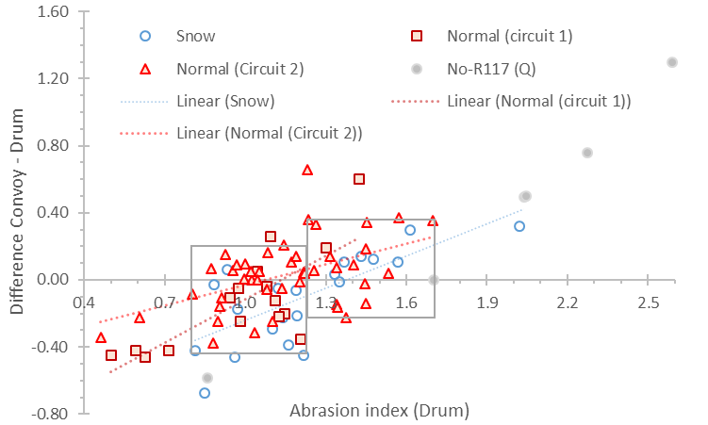
Convoy vs. Drum methods
Database 20250311, only common tyres
n=28 (snow tyres)
n=61 (normal tyres)
Ideally the two methods should agree within their combined uncertainty. Comparisons of the two methods reveal high scatter
Excluding high emitting tyres, the differences are ±0.4 with a few exceptions.
At abrasion index values >1.2 the difference is ±0.3 with the convoy slightly higher.
At abrasion index values <1.2 the difference is ±0.3 with the convoy slightly lower.

Slide 3
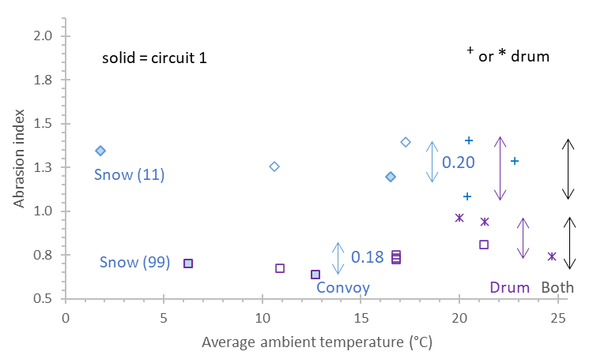
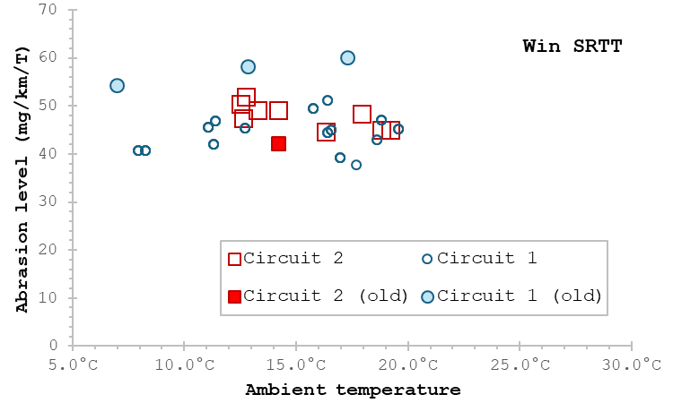
Measurement uncertainty
Database 20250327, validation data
Arrows show min-max range separately for the convoy and drum or the two methods combined
The max-min range is around 0.2 for snow tyres and similar for the two methods. No particular impact of temperature (range from 2 to 22°C) for the convoy method.
Database 20250311
Winter ref SRTT emissions show small impact of different ambient temperatures
SRTT=Standard Reference Test Tyre

Slide 4
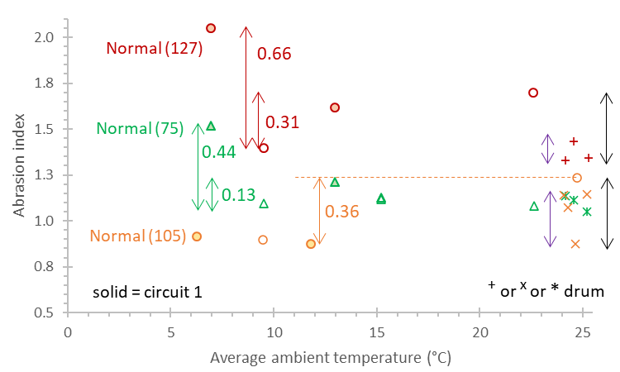
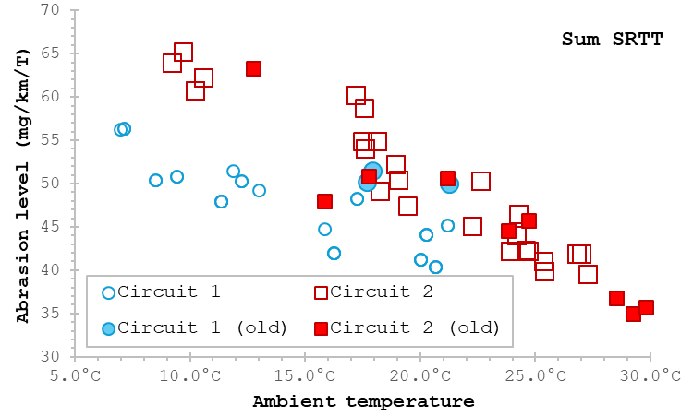
Measurement uncertainty
For normal tyres, the min-max range of the convoy method can be very high (0.66 units), particularly for high abrasion indices. It seems that low and, to a lesser degree, high temperatures have different impact on the candidate tyres. Restricting the lower average temperature to 10°C for some tyres seems to bring down the uncertainty to 0.36 units. Restricting the higher end might also improve the uncertainty but to a lesser degree.
Excluding tyre 127 low temperature and/or values >1.5 brings down the min-max range of the convoy method to around 0.36. The drum method min-max range is also around this value.
Database 20250311
Summer ref SRTT emissions ambient temperature dependent

Slide 5
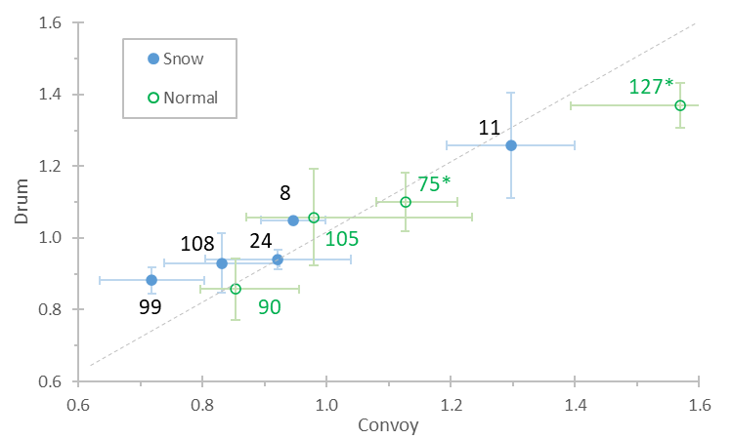
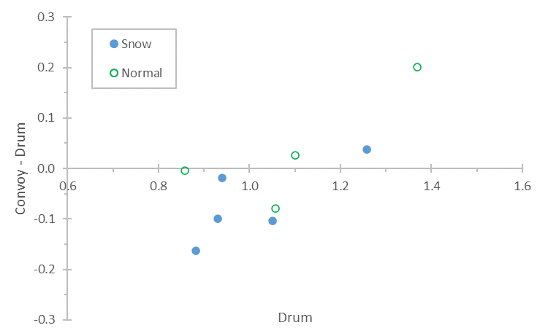
Correlation overview
In general, good agreement between the two method when examining the correlation database.
Significant differences at low and high abrasion index values (but good agreement close to 1)
The average differences between the two methods is around ±0.1
Convoy higher
Convoy lower

Slide 6
Measurement uncertainty
Half of max-min should be close to 2 standard deviations and close to the expected uncertainty
The max-min is on the order of 0.3 and thus an uncertainty of 0.15 is expected.
 | Convoy (2025) | Convoy (2023) | Drum (2025) | Drum (2023) | Convoy + Drum (2025) | Convoy + Drum (2023)
# of SNOW tyres | 5 | 3 | 5 | 3 | 10 | 6
Max of (max-min) | 0.21 | 0.35 | 0.32 | 0.17 | 0.33 | 0.35
Mean of (max-min) | 0.18 | 0.26 | 0.17 | 0.11 | 0.27 | 0.18
# of NORMAL tyres | 4 | 4 | 4 | 4 | 8 | 8
Max of (max-min) | 0.66 (0.36*) | 0.47 | 0.27 | 0.15 | 0. 72 (0.37*) | 0.47
Mean of (max-min) | 0.40 (0.16*) | 0.30 | 0.15 | 0.12 | 0.35 (0.26*) | 0.21
* Excluding outliers or high values at low temperatures of some normal tyres

Slide 7
Limits and uncertainties examples

Slide 8
Concluding remarks
The market assessment data demonstrated differences of the two methods around ±0.3 close to abrasion indices of 1.0.
The validation/correlation data confirmed high differences of the methods at some cases. Exclusion of extreme cases (e.g. tyres with high abrasion indices and/or some tyres at 7°C) can bring the differences around ±0.15
Based on the validation data, the combined uncertainty of the two methods does not increase much (n the order of 0.05)
Low convoy abrasion index limits (1.0*) seem to work also for the drum method.
*Excluding uncertainty

Slide 9
Back up

Slide 10
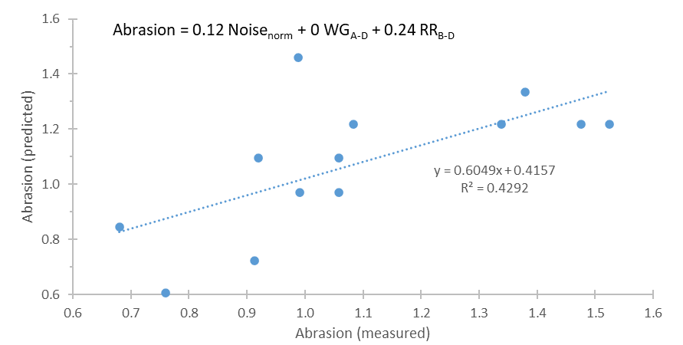
Abrasion, noise, WG, RR
In order to find whether low abrasion tyres have better or worse noise, wet grip and rolling resistance characteristics a simple linear model was set. The A to E characteristics of wet grip and rolling resistance were set to integral values of 1 to 5. For noise the numerical values of each tyre were compared to the mean value of all tyres.
Only small differences of the
coefficients for summer and
winter tyres
No negative correlation (i.e.
coefficient) for noise, WG, RR.
JRC data

Slide 11
Other text proposals (postp. discussion for informal doc)
Although at 6,000 km wear (abrasion, tread depth reduction) seem to stabilise, it is recommended to keep the 8,000 km distance in order to keep the measurement uncertainty of weight loss and tread depth at good levels.
The abrasion index at 20°C (SRTT17-S) and 10°C (SRTT17-W) should be reduced to 35-65 mg/km/t. To confirm with other circuits.
The mass measurements of wheel assembly should become compulsory at start, middle and end of the trip. They should also be added in the report.

