Slide 1
6th ACSF meeting
Tokyo, 19-21 April 2016
Transmitted by the Experts of OICA and CLEPA
Informal Document ACSF-06-22
Industry proposals for
ACSF status definition and HMI
Version 1.4

Slide 2
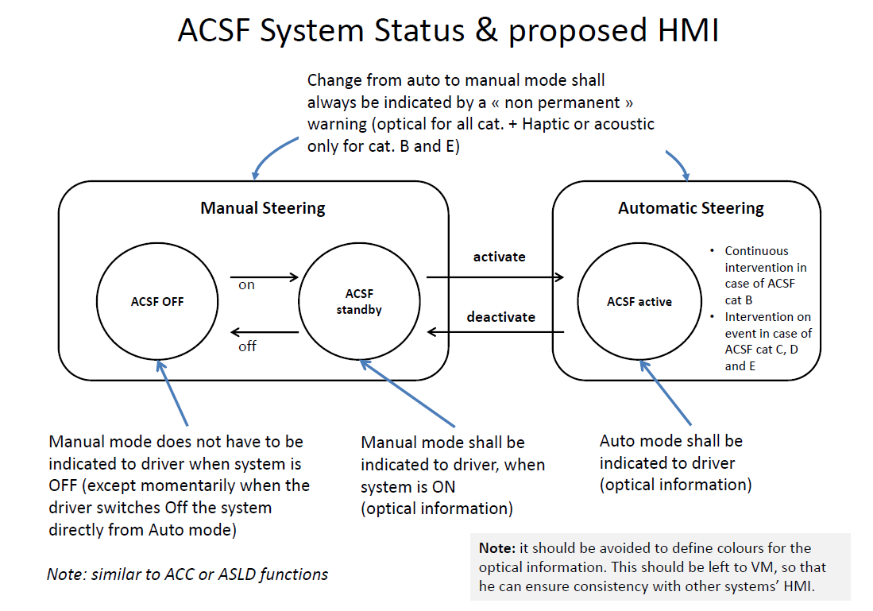
Reminder from ACSF-03-12 (Munich)

Slide 3
Extracts from ACSF-05-16
General provisions for ACSF
Special provisions for ACSF cat. E
5.1.6.1. Whenever the an Automatically Commanded Steering function becomes operational, this shall be indicated to the driver. and the control action shall be automatically disabled if the vehicle speed exceeds the set limit of 10 km/h by more than 20 per cent or the signals to be evaluated are no longer being received. Any termination of control shall produce a short but distinctive driver warning, [especially, in case of category E termination of control is described] in accordance with the requirements of paragraph 5.4.3. by a visual signal and either an acoustic signal or by imposing a tactile warning signal on the steering control.
5.4.3. Special Warning Provisions for Automatically Commanded Steering Functions
5.4.3.1 Any termination of control initiated by the system other than specified in 5.6.1.4.7 shall produce a distinctive driver warning including visual warning] and either an acoustic warning or an haptic warning until the driver has resumed steering control.
5.6.1. Special Provisions for Category E ACSF
5.6.1.1.7. The system shall at any time give a noticeable and distinctive signalization to the driver about the system status. This signalization shall be at least a visual signal. Any change in system status shall be indicated by an optical and [, if not initiated by the driver,] either an acoustic or haptic signal.
      The system status shall be indicated to the driver by a visual signal.
      The indication shall [at least] distinguish between the system status manual stand-by Mode, active Mode and failure Mmode.
      The indication shall be present as long as the relevant system status persists.
      When the system is manually switched off by the driver, the indication of manual stand-by Mmode and failure Mmode may be suppressed.
      Any change in system status shall be indicated by a visual and either an acoustic or haptic signal.
Consistency tbc

Slide 4
General provisions for ACSF
General provisions for ACSF
Comments & proposals
5.1.6.1. Whenever the an Automatically Commanded Steering function becomes operational, this shall be indicated to the driver. and the control action shall be automatically disabled if the vehicle speed exceeds the set limit of 10 km/h by more than 20 per cent or the signals to be evaluated are no longer being received. Any termination of control shall produce a short but distinctive driver warning, [especially, in case of category E termination of control is described] in accordance with the requirements of paragraph 5.4.3. by a visual signal and either an acoustic signal or by imposing a tactile warning signal on the steering control.
5.4.3. Special Warning Provisions for Automatically Commanded Steering Functions
5.4.3.1 Any termination of control initiated by the system other than specified in 5.6.1.4.7 shall produce a distinctive driver warning including visual warning] and either an acoustic warning or an haptic warning until the driver has resumed steering control.
Comments 1:
“operational” should be clarified
Consistency with 5.6.1.1.7. (HMI for cat E) to be checked
Comments 2:
“especially” is unspecific
Specific requirements to category should be in 5.6.1.1.7
Proposal to delete text in [ ]
Comments 3:
Not relevant for a low speed ACSF (e.g. park Assist or RCP). The proposal is to come back to the original requirement, given the low speed / low criticality: “Any termination of control shall produce a short but distinctive driver warning“
An haptic/acoustic warning is not necessary for an ACSF-B1, since the driver is hands-on and steering; a visual warning should be enough
When the vehicle comes to standstill, it should be possible to suppress the warning signal.
Proposal: amend this paragraph or move it to special provisions per category (e.g. 5.6.1.1.7 for cat E)

Slide 5
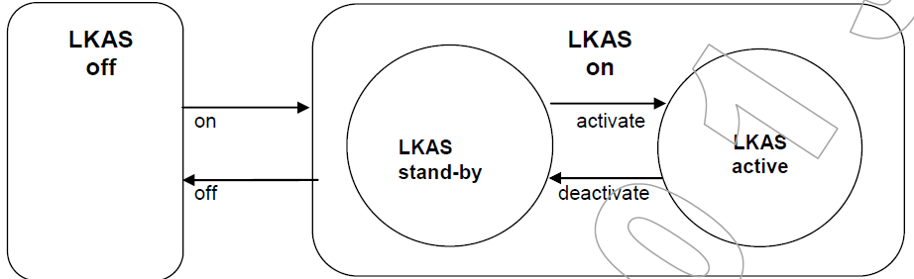
What does “operational” mean?
LKAS
(as in ISO 11270)
(valid for LKAS-CSF and ACSF-B1)
(ready to intervene or intervening)
= “available” in LKAS ad-hoc group
Remark →
Automatic activation when the conditions for operation are fulfilled
No automatic activation when the conditions for operation are fulfilled, deliberate action from driver required.
Manual Steering
Automatic Steering
ACSF-03-12
(valid for ACSF-B2 and E)
activate
ACSF OFF
ACSF standby
ACSF active
on
deactivate
off
What does “operational” mean:
  “switched on”
  “active”
  "the system is able to intervene without further action or confirmation by driver“ …?

Slide 6
Proposal for new definitions
2.4.8.18 An [ACSF / ADASS] is in “off mode” (or “switched off”) when prevented from controlling the steering system.
2.4.8.19 An [ACSF / ADASS] is in “standby mode” when the [function / system] is switched on but the conditions for being active are not all met. In this mode, the system does not control the steering system.
2.4.8.20 An [ACSF / ADASS] is in “active mode” (or “active”) when the [function / system] is switched on and the conditions for being active are met. In this mode, the system [continuously or discontinuously] controls the steering system.
[2.4.8.21 An [ACSF / ADASS] is “operational” when the system is [active] ]
Comment: maybe this definition is not needed, e.g. “operational” could be replaced by [active] in 5.1.6.1
2.4.8.22 An [ACSF / ADASS] is in “failure mode” when the [function / system] has detected a failure.

Slide 7
Proposed requirements
Changes to ACSF-05-16 in blue text
General provisions for ACSF
The same warning as for a transition demand maybe used.
In the case of ACSF category A, a short [but distinctive] warning is deemed to fulfill the warning requirement above.
In the case of ACSF category B1, the warning maybe optical only.
5.6.1. Special Provisions for Category E ACSF
5.6.1.1.7. The system … signal.
The system status shall be indicated to the driver by a visual signal.
      The indication shall [at least] distinguish between the system status manual stand-by Mode, active Mode and failure Mmode.
      The indication shall be present as long as the relevant system status persists.
      When the system is manually switched off by the driver, the indication of manual stand-by Mmode and failure Mmode may be suppressed.
      Any change in system status shall be indicated by a visual and either an acoustic or haptic signal.
5.1.6.1. Whenever the an Automatically Commanded Steering function becomes [operational] [active], this shall be indicated to the driver. and the control action shall be automatically disabled if the vehicle speed exceeds the set limit of 10 km/h by more than 20 per cent or the signals to be evaluated are no longer being received. Any termination of control shall produce a short but distinctive driver warning, [especially, in case of category E termination of control is described] in accordance with the requirements of paragraph 5.4.3. by a visual signal and either an acoustic signal or by imposing a tactile warning signal on the steering control.
5.4.3. Special Warning Provisions for Automatically Commanded Steering Functions
5.4.3.1 Any termination of control initiated by the system (i.e. when the active mode is automatically deactivated by the system), other than specified in 5.6.1.4.7 shall produce a distinctive driver warning including visual warning] and either an acoustic warning or an haptic warning until the driver has resumed steering control or the vehicle is at standstill.
Special provisions for ACSF cat. E

Slide 8
Proposed requirements
Cleaned-up version
General provisions for ACSF
The same warning as for a transition demand maybe used.
In the case of ACSF category A, a short [but distinctive] warning is deemed to fulfill the warning requirement above.
In the case of ACSF category B1, the warning maybe optical only.
5.6.1. Special Provisions for Category E ACSF
5.6.1.1.7. The system status shall be indicated to the driver by a visual signal.
      The indication shall [at least] distinguish between stand-by, active and failure mode.
      The indication shall be present as long as the relevant system status persists.
5.1.6.1. Whenever the an Automatically Commanded Steering function becomes [operational] [active], this shall be indicated to the driver. and the control action shall be automatically disabled if the vehicle speed exceeds the set limit of 10 km/h by more than 20 per cent or the signals to be evaluated are no longer being received. Any termination of control shall produce a short but distinctive driver warning, in accordance with the requirements of paragraph 5.4.3. by a visual signal and either an acoustic signal or by imposing a tactile warning signal on the steering control.
5.4.3. Special Warning Provisions for Automatically Commanded Steering Functions
5.4.3.1 Any termination of control initiated by the system (i.e. when the active mode is automatically deactivated by the system), other than specified in 5.6.1.4.7 shall produce a distinctive driver warning including visual warning] and either an acoustic warning or an haptic warning until the driver has resumed steering control or the vehicle is at standstill.
Special provisions for ACSF cat. E

Slide 9
Backup slides

Slide 10
Example of implementation
« ACSF off » may mean:
The ECU is electrically switched off
or… ACSF is waiting for the function to be switched on by driver and does nothing else
or… ACSF is waiting for the function to be switched on by driver, yet the ACSF sensors and/or actuators are used for other functionalities which are not ACSF (e.g. sign recognition, LDWS, steering assistance, side wind compensation…)
or… ACSF is monitoring the conditions for operation, waiting for the driver to request activation…
Manual Steering
Automatic Steering
ACSF OFF
ACSF standby
activate
ACSF active
on
deactivate
off
« ACSF standby » may work as follows:
ACSF is monitoring the conditions for operation
ACSF indicates to driver if the conditions for operation are fulfilled
ACSF is monitoring driver request to activate ACSF (“deliberate action”)
If conditions are fulfilled and driver requests ACSF to be activated, ACSF is activated

