Slide 1
OICA observation on venting
The 7th all TF F2F Meetings EVS
in Tokyo JAPAN

Slide 2
Back ground
JRC proposal（EVS TF-06-05e） green : JRC modification point.
[5.3.2. Vibration
The test shall be conducted in accordance with paragraph 6.2.2.
During the test, there shall be no evidence of rupture (applicable to high voltage REESS (s) only), electrolyte leakage, venting (for REESS other than open-type), fire or explosion.
The evidence of electrolyte leakage shall be verified by visual inspection without disassembling any part of the Tested-Device. The evidence of venting shall be verified by visual and/or audible inspection without disassembling any part of the Tested Device.
For a high voltage REESS, the isolation resistance measured after the test in accordance with paragraph 6.1.1. shall not be less than 100 Ω/Volt.]

Slide 3
OICA observation
OICA basically agrees with JRC proposal. However, OICA has concerns regarding verification methods as below.
<Audible inspection>
・From the points below, “audible inspection” is not
appropriate for the verification method.
-By audible inspection, we cannot judge if it is the
sond caused by severe venting (i.e. the smoke with
combustion, decomposition of electrolyte or other
phenomena) which should be prohibited or not.
-The sound caused by venting is an instant phenomena.
-It is difficult to identify recorded sound whether it is produced by venting or another source.

Slide 4
OICA observation
<Visible inspection>
・ We consider visible inspection is the only method to
identify sever venting.
・ We would like to share the image of “evidence of
venting by visible insepection“ in order to proceed
further discussion of TF3. (see following pages.)

Slide 5
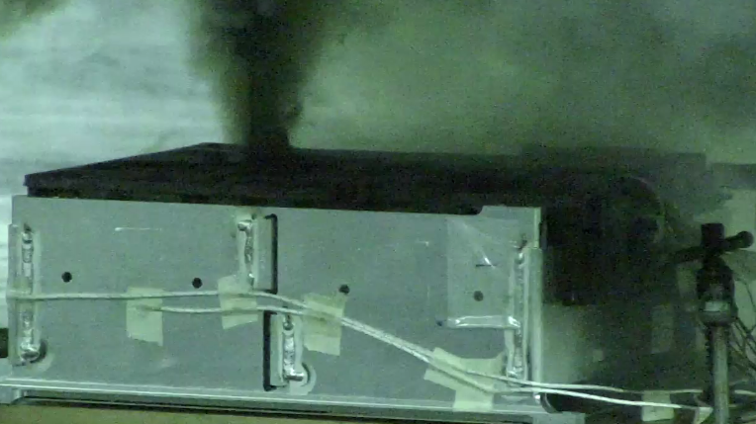
Example for the venting.

Slide 6
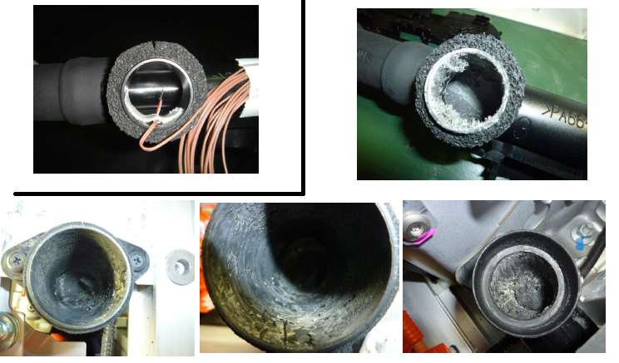
Example for the evidence of venting.
<Before the test>
<After the test>
※at vent gas pipe
-Soot remains inside the pipe after the venting.
-Soot can be verified by visible inspection without disassembling any
part of the tested Device.

Slide 7
<other concern>
Proposed text might induce some confusions or misunderstanding.
<modification proposal>
For REESS other than open-type traction battery, the requirement of 5.1.X.2is deemed to be satisfied, if no evidence of venting is verified by visual inspection without disassembling any part of the Tested-Device when tested according to 6.X.X.* (based on EVS-0719e).
JRC proposal（EVS TF-06-05e）
5.1.x.1.2
For REESS other than open-type traction battery, the requirement of 5.1.X.1 is deemed to be satisfied, if when no venting gas occurs is observed as verified by visual and/or audible inspection without disassembling any part of the Tested-Device when tested according to 6.X.X.* (based on EVS-0719e).

