Slide 1
ITU activities on secure vehicle software updates
Submitted by the expert form ITU Document No. ITS/AD-08-08
(8th ITS/AD, 9 March 2016, agenda item 4)
8th meeting of IWG ITS/AD
9 March 2016
T.Russell Shields, Co-Chair, Collaboration on ITS Communication Standards
Martin Adolph, Programme Coordinator, ITU

Slide 2
Outline
Draft Report on secure over-the-air vehicle software updates - operational and functional requirements
Draft Standard on secure software update capability for ITS communications devices
Other ITS communications related activities in ITU
Supplementary material

Slide 3
Report on secure over-the-air vehicle software updates - operational and functional requirements
Objectives:
  The principal objective of the report is to provide supportive information to the groups working on the technical specifications for a FOTA/SOTA telecommunications standard
  A secondary objective of the report is to provide background information to the vehicle manufacturer groups working on their internal processes aimed at delivering a vehicle-manufcturer-specific end-to-end FOTA/SOTA update solution for their own vehicles

Slide 4
Report on secure over-the-air vehicle software updates - operational and functional requirements
Status of Report:
  Reviewed in two meetings of the Collaboration on ITS Communication Standards (2015/12; 2016/03)
  Submitted to ITU-T Study Group 17 (Security; meeting late 2016/03) and ITU-T Study Group 16 Multimedia; meeting 2016/05) for adoption as ITU-T Technical Paper
  ITU-T Technical Papers are available on the ITU website, free of charge

Slide 5
Standard on secure software update capability for ITS communications devices
Objectives of “ITU-T X.itssec-1”:
  Assessment of security threats, risks and vulnerabilities
  Provision of common methods to update vehicle software by a secure procedure
  Security controls and protocol definition
Note:
  ITU-T standards (“Recommendations”) have non-mandatory status until they are adopted in national laws
  This standard is aimed to provide a guideline for baseline security for networked vehicles

Slide 6
Standard on secure software update capability for ITS communications devices
Status of “ITU-T X.itssec-1”:
  Initiated in 2014/09
  Draft achieved a certain level of maturity through discussions with some vehicle manufactures and suppliers
  Draft is to be “determined” as an ITU-T Recommendation, the final stage of standardization, during the meeting of ITU-T Study Group 17 (Security), Geneva, 16-23 March 2016
  ITU-T Recommendations are available on the ITU website, free of charge

Slide 7
Other ITS communications related activities ITU
An up-to-date list of ITS related work items in ITU is available at http://www.itu.int/en/ITU-T/extcoop/cits/Documents/ITS%20work%20items.xlsx

Slide 8
Supplementary Material

Slide 9
Report on secure over-the-air vehicle software updates - operational and functional requirements
Structure
Introduction
  Executive Summary
  Objectives
  References
  Acronyms and Definitions
The Automotive Context
  Are we ready for OTA Updates?
  Use Cases
  Conditions
  National Standards Regulation and Type Approval Regulation Compliance
  National Standards Initiatives for Security Risk Mitigation
Operational Requirements
  Update preparation
  Regulatory approvals
  Permissions to perform update
  End-to-end update management
  Confirm receipt and proper functioning
  Perform administrative tasks
Functional Requirements
  Recall
  Non-recall Operation Updates
  Improvements to Performance
  Security Risk Corrective Action

Slide 10
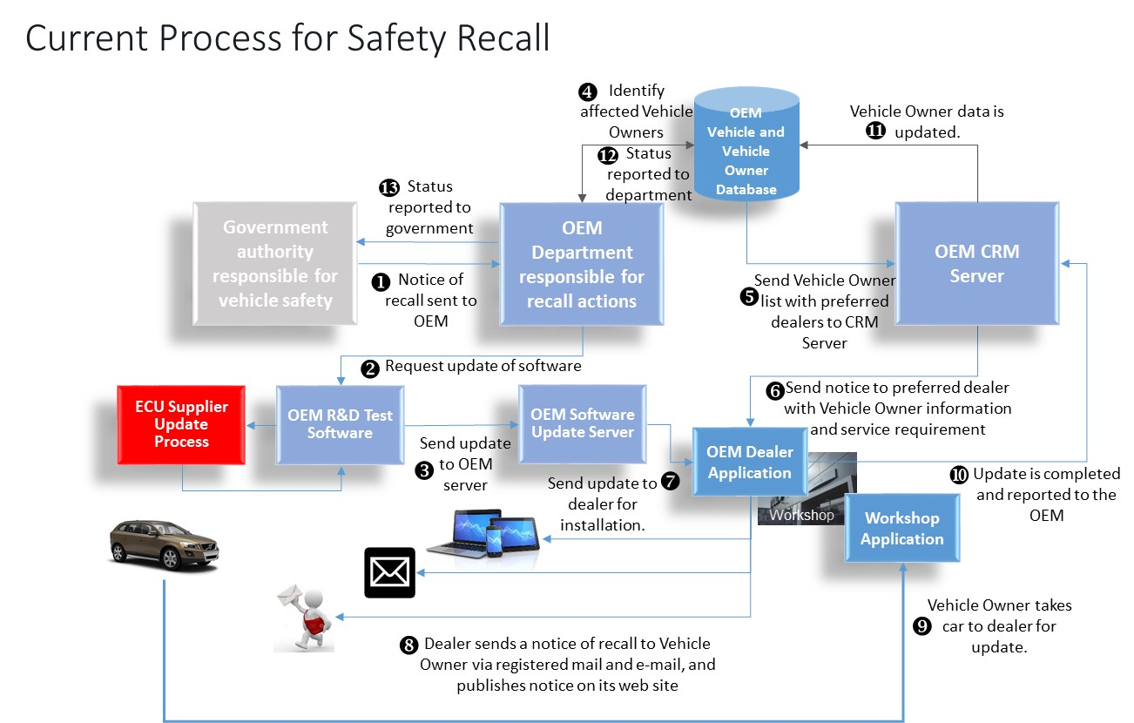
Report on secure over-the-air vehicle software updates - operational and functional requirements

Slide 11
Report on secure over-the-air vehicle software updates - operational and functional requirements
A properly designed system that provides for as high a level of security as is possible must protect each of the four levels of vehicle electronics systems that could be addressed by OTA software updates:
  Information and entertainment systems
  Fail safe body function systems
  Fail safe driving and vehicle dynamic function systems
  Fault functional driving and vehicle dynamic function systems

Slide 12
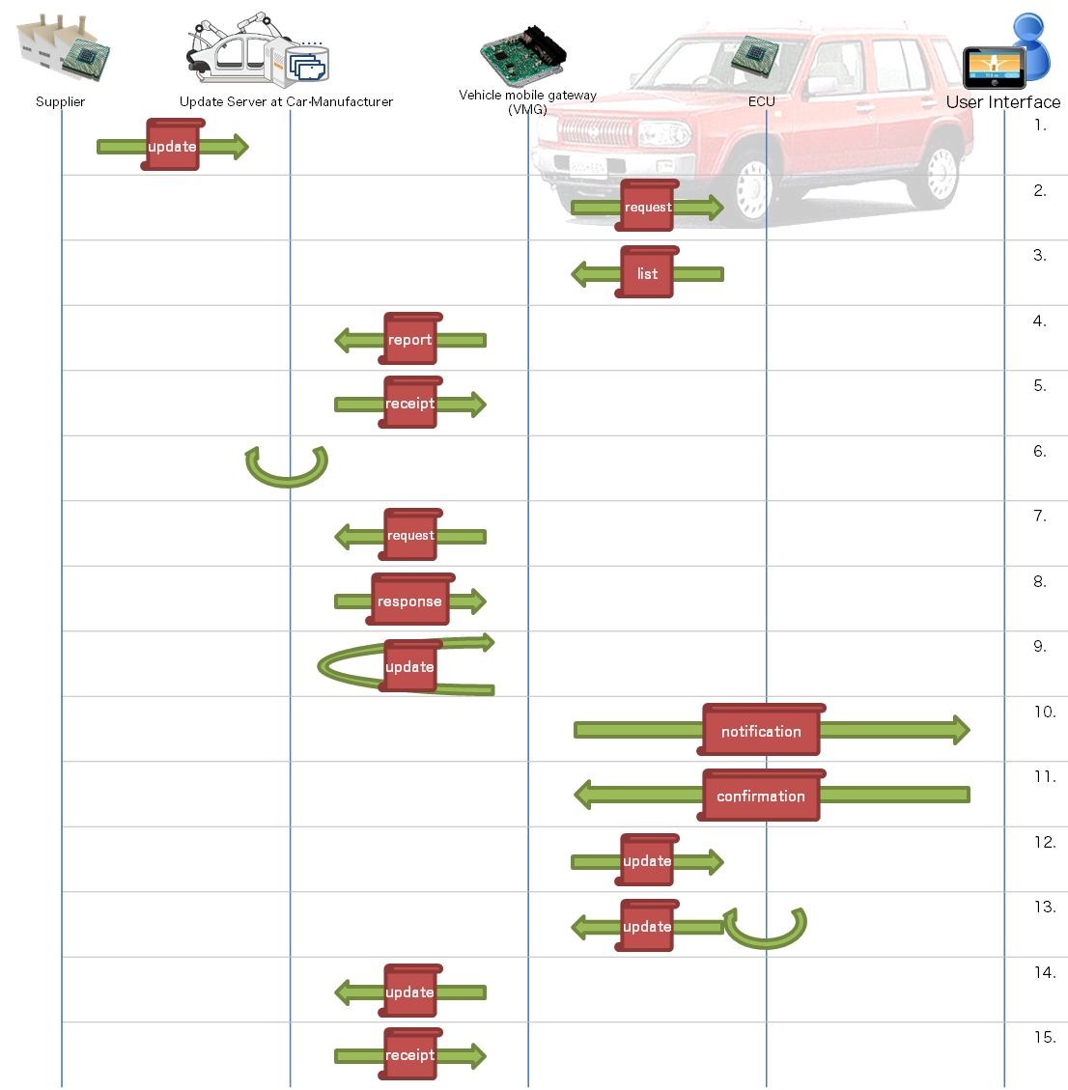
X.itssec-1: Model data flow of remote software update
Request of diagnose of software status
Result of diagnose with software status
Report of results of ECUs in a vehicle
Receipt for submit of diagnose report
Conducted threat analysis
for each step in the procedure
Request of update module
Update module is provided
Notification to User (driver) for Updates
Confirmation for the update
Request for updates to ECUs
Results for updates in ECUs
Report of application of the update
Conformation from the Update server

Slide 13
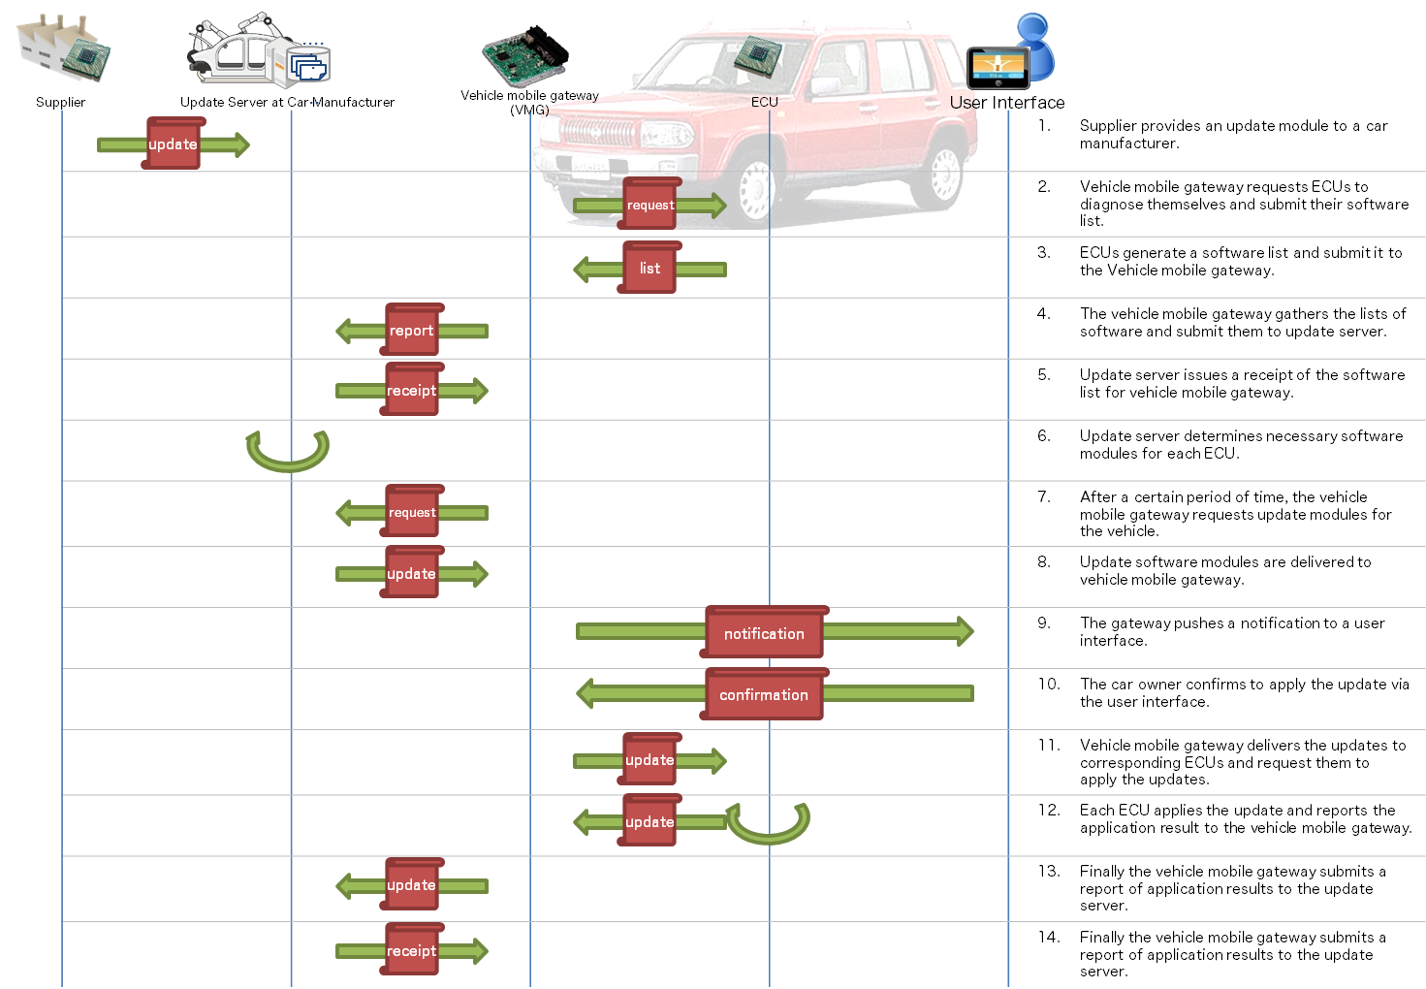
X.itssec-1: Threat analysis: example case
Impersonation of ECU
Improper software information is uploaded to VMG
DoS attack against VMG by sending forged data (e.g., enormously huge data)
Impersonation of VMG
Tampering / eavesdropping / replay of a message
Software information on every ECU in the vehicle is improperly collected
Improper software information is uploaded to VMG
Software information on every ECU in the vehicle is improperly collected
DoS attack against VMG by sending forged data (e.g., enormously huge data)

Slide 14

X.itssec-1: Security controls for the software update
Message verification
  Threats: tampering, eavesdropping and replaying of messages
  Measure: message verification mechanism based on Message Authentication Code (MAC) or digital signature method
Trusted boot of ECUs
  Threats: tampering of software in ECU
  Measure : hardware Security Module (HSM) to
  verify software modules in ECUs’ boot sequences
Authentication of communication entity
  Threats: impersonation of the entities
  Measure : authentication of both client and server of each communication based authentication protocol such as SSL/TLS

Slide 15
X.itssec-1: Security controls for the software update
Message filtering
  Threats: DoS attack against VMG or update server
  Measure : message filtering based on white listing of senders and frequency limitation of received messages, etc.
Fault tolerance
  Threats: DoS attack against VMG
  Measure : measures such as auto-reboot for recovery of normal state, safe suspension of operation should be taken if something irregular is detected on the operation of VMG.

Slide 16

X.itssec-1: Procedure definition (Phases)
diagnose phase
2. diagnose (request)
3. diagnose (report)
4. diagnose (submit)
5. diagnose (receipt)
update check
phase
7. update_check (request)
8. update_check (response)
update phase
10. update (notification)
11. update (confirmation)
12. update (application)
13. update (report)
update
report phase
14. update_report (submit)
15. update_report (receipt)

Slide 17
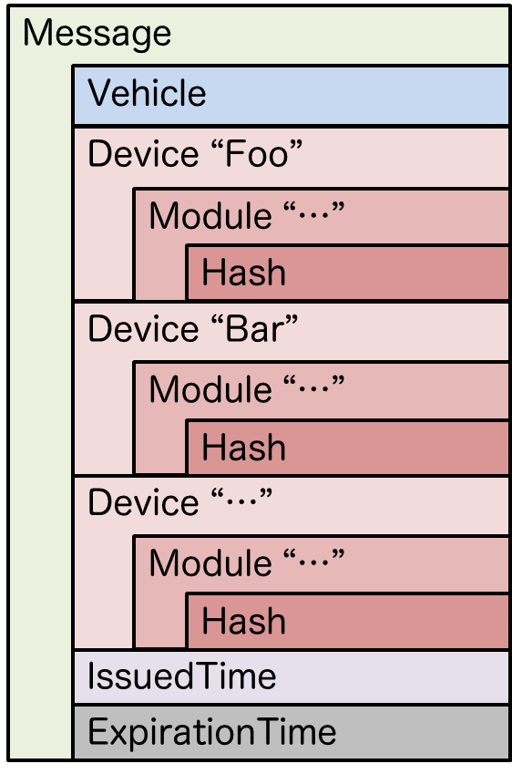
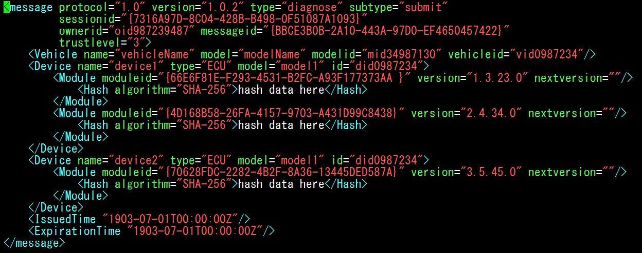
X.itssec-1: Example of a message: diagnose (submit)
Practical expression of a diagnose (submit) message (example: XML)
Structure of
diagnose (submit) message

Slide 18


Slide 19


