Slide 1
Transmitted by the Republic of Korea
PSG-04-XX
The explanatory statement on proposed amendments to GTR 6 by KOREA
24. Feb. 2016

Slide 2
Contents
Table of Contents
1. Introduction
2. The purpose of 227g ball drop test
3. Status of CPA application in Korea
4. Summary
5. GTR 6 amendment proposed by Korea
-2-
Notes:
2

Slide 3
1. Introduction
The members of IWG PSG reached an agreement to make an amendment of GTR 6 for CPA(ceramic printed area) limitation of vulnerable strength during 3rd PSG meeting in February 2016.
Therefore, The Korea is conducting the study for the decision about the methods and the specific value for CPA limitation, too.
- The Korea attempted to find the optimal size of CPA to consider both the minimum size for installing and the breakage prevention during driving.
- So the Korea made a plan for review about the current status of CPA application in Korea.
-3-
Notes:
3

Slide 4
1. Introduction
Of course, it happens the breakage of toughened glass in panoramic sunroof according to various causes.
In order to minimize glass breakage possibility of panoramic sunroof, the Korea first is reviewing by following factors for limitation about the CPA of vulnerable strength that we already found.
- The purpose of 227g ball drop test about toughened glass
- The current status about the CPA application in Panoramic sunroof
-4-
Notes:
4

Slide 5
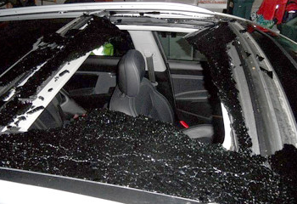
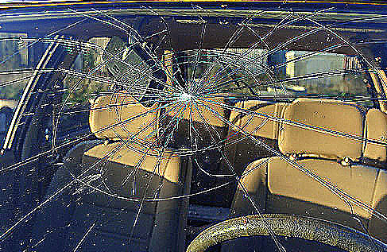
2. The purpose of 227g ball drop test
The purpose of 227g ball drop test
● Toughened glass and laminated glass have a difference in the purpose to
be used for application to automotive because of the differences in strength
and fracture properties due to the difference in the manufacturing process.
● Therefore, Toughened glass and laminated glass have different in the
purpose of the 227g ball drop test such as the follows, too.
- Toughened-glass : Mechanical Strength for resisting to breakage.
- Laminated-glass : Adhesion of interlayer for resisting to penetration.
<The fracture characteristic between toughened glass and laminated glass>
-5-
Notes:
5

Slide 6
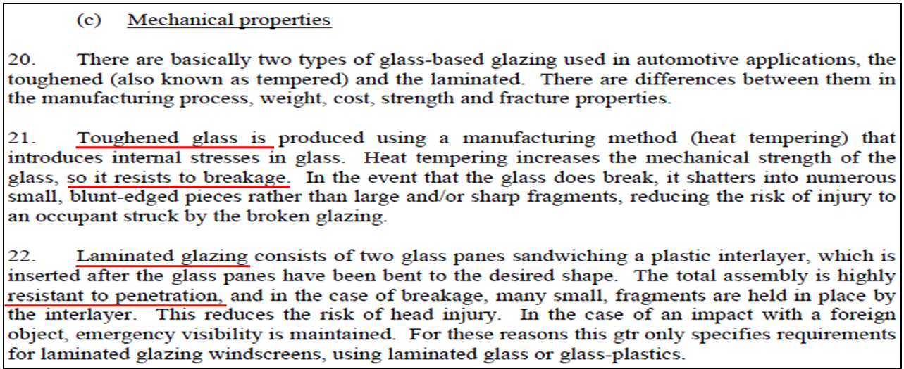
2. The purpose of 227g ball drop test
The purpose of 227g ball drop test
● Reference
- GTR 6 : To describe the test purpose about the mechanical property between
toughened glass and laminated glass.
◦ Toughened-glass is that first of all must have the specific strength for resistance to breakage.
Nevertheless, in the event of breakage, it shatters into small piece for minimizing the injury of
occupants into the vehicle.
◦ Laminated-glass is that first of all must have the specific strength for resistance to penetration.
-6-
Notes:
6

Slide 7
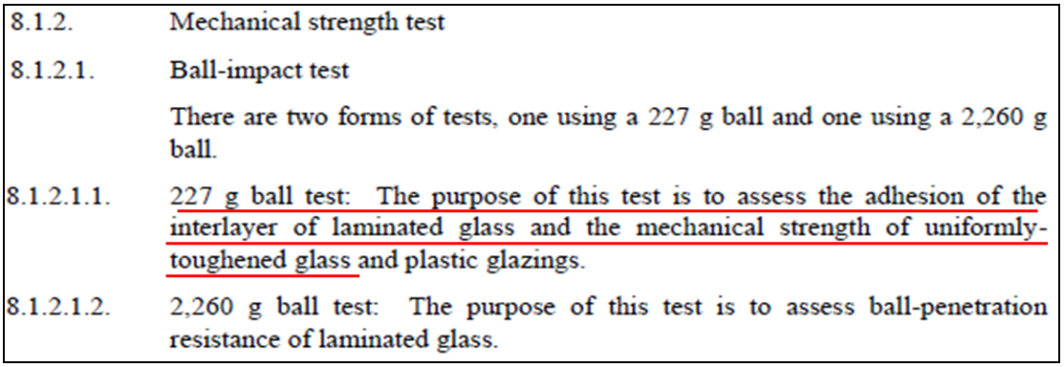
2. The purpose of 227g ball drop test
The purpose of 227g ball drop test
● Reference(con’t)
- UN R43 : To describe the test purpose about mechanical strength between
toughened glass and laminated glass.
◦ Toughened-glass is the evaluation of the mechanical strength.
◦ Laminated-glass is the evaluation of the adhesion between the glass and interlayer.
-7-
Notes:
7

Slide 8
2. The purpose of 227g ball drop test
The purpose of 227g ball drop test
● Conclusion
- As described the GTR 6 and UN R 43, Toughened glass and laminated glass
are different from the purpose of use to automotive according to the
differences in strength and fracture properties. Therefore, the purpose of
227g ball drop test is also established by the different evaluation standards
considering each glass advantages of use.
- In the case of using toughened glass in panoramic sunroof, the purpose of the
227g ball drop test means to evaluate the resistance strength to breakage in
terms of an external impact by flying objects.
-8-
Notes:
8

Slide 9

3. Status of CPA application in Korea
Survey on CPA status of PSG(Panoramic sunroof grazing)
● Toughened glass of panoramic sunroof mounting on the vehicles
sold in 2015 Korea market from the Korea vehicle manufacturer
: Panoramic sunroof : 20 models(All Top-Loading type)
- Because Panoramic sunroofs of Top-loading type are placed on about 95% of panoramic
sunroof models mounting on vehicles and about 99% of sales volume in Korea
-9-
Notes:
9

Slide 10
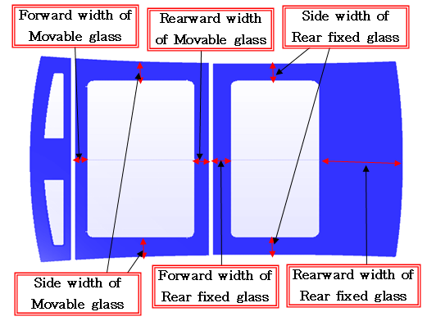
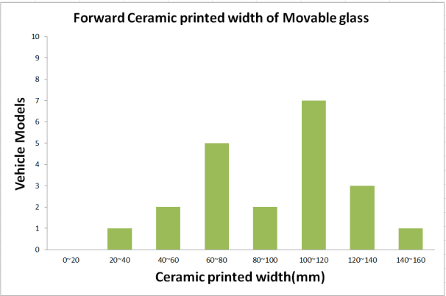
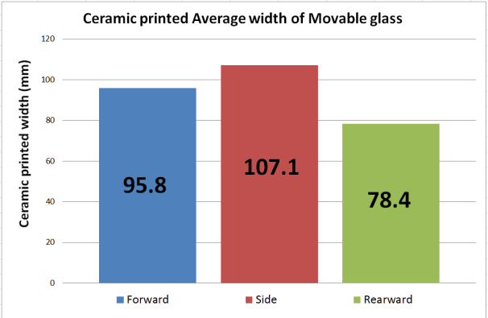
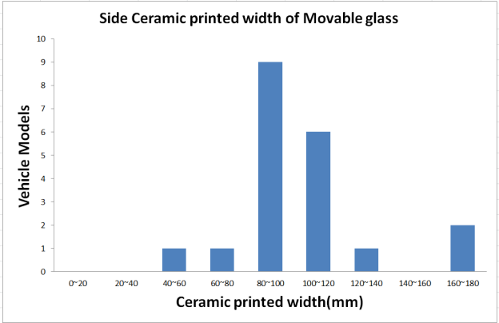
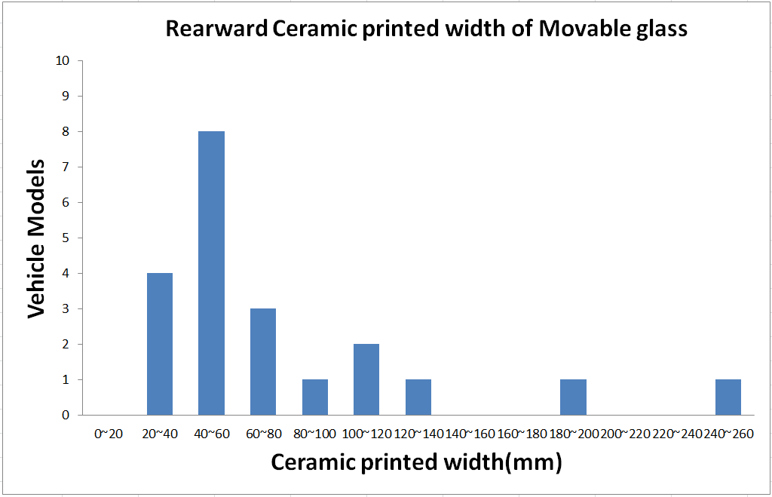
3. Status of CPA application in Korea
Survey on CPA status of PSG(Panoramic sunroof grazing)
● Width of CPA at each location in movable glass
-10-
Notes:
10

Slide 11
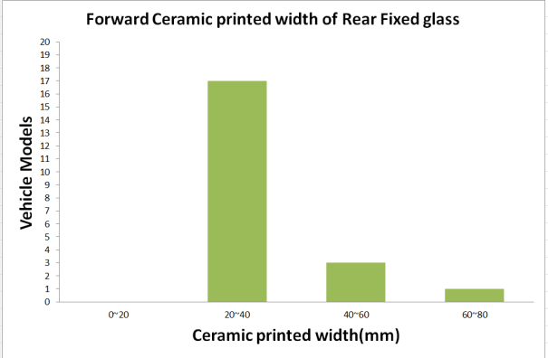
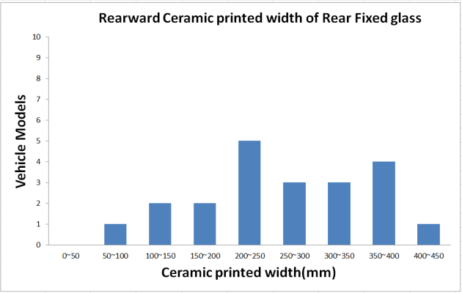
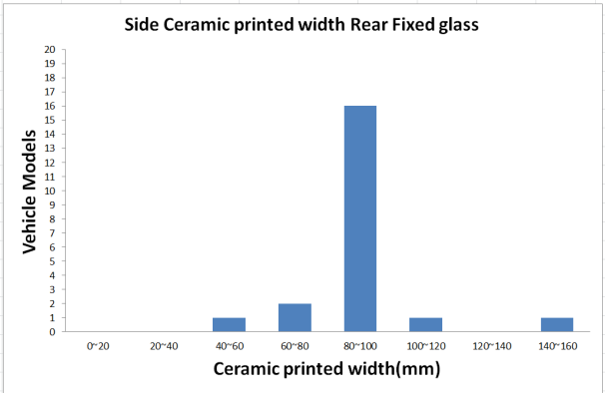
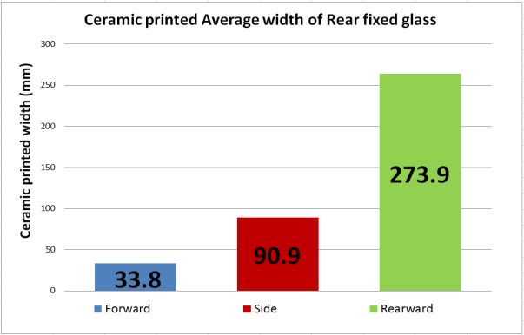
3. Status of CPA application in Korea
Survey on CPA status of PSG(Panoramic sunroof grazing)
● Width of CPA at each location in Rear fixed glass
-11-
-11-
Notes:
11

Slide 12
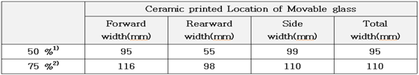
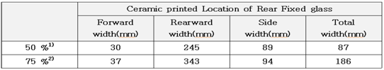
3. Status of CPA application in Korea
Survey on CPA status of PSG(Panoramic sunroof grazing)
● Width of CPA at each location of PSG
This ceramic width of movable glass can be applied to the middle quartiles of
Panoramic sunroofs mounting on total vehicle models
2) This ceramic width of movable glass can be applied to the upper quartiles of
panoramic sunroofs mounting on total vehicle models
◦ In the case of the width limitation to the ceramic printed area from the edge of finished product
outline, it is difficult to apply both the front moving glass and the rear fixed glass with same CPA
limit(because those difference occurs more than 4 times.)
- However there are no reasonable bases in terms of safety sides about the application of different CPA
width limit between the front moving glass and the rear fixed glass.
◦ In addition, it is difficult to apply same CPA width limit due to various toughened glass sizes according
to the panoramic sunroofs.
-12-
Notes:
12

Slide 13
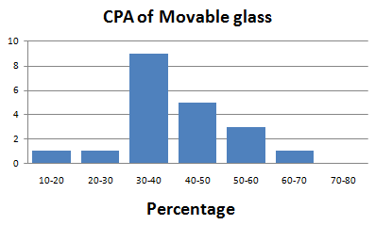
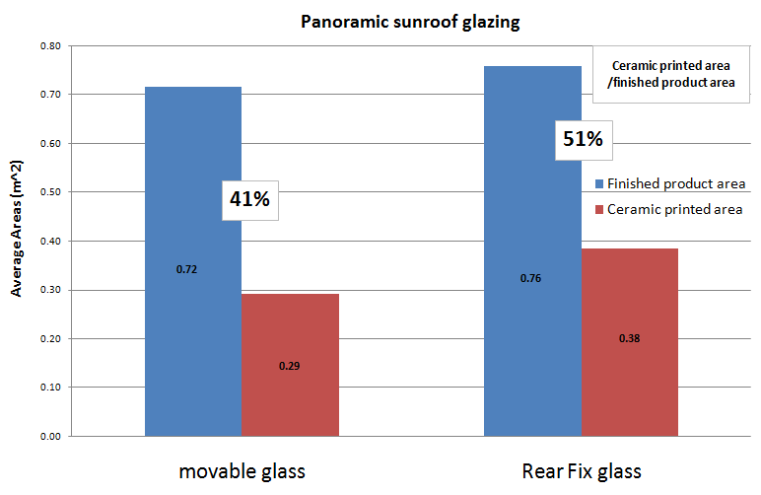
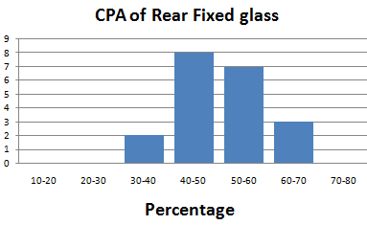
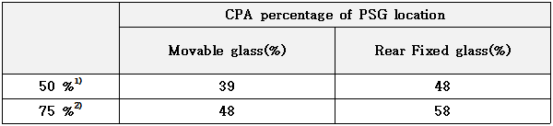
3. Status of CPA application in Korea
Survey on CPA status of PSG(Panoramic sunroof grazing)
● Percentage of CPA in PSG
-13-
-13-
Notes:
13

Slide 14
3. Status of CPA application in Korea
The CPA limit methods in terms of current CPA application.
● Conclusion
- Considering the current CPA application of the panoramic sunroof, the CPA limit method is
reasonable to limit the CPA application size ratio per the finished product because it is
difficult to limit the CPA application width.
- Current Korea CPA status applies to average 41 % at the front moving glass and average 51 %
at the rear fixed glass.
◦ Toughened glass applied to over 50% CPA shall be able to represent the strength property of
CPA because that looks like ceramic printed toughened glass.
- The CPA application to less than 50% is not technically impossible because more than half of
the Top Loading-type of the panoramic sunroof are applied with less than 50% CPA.
If the toughened glass applied to over 70 % CPA in panoramic
sunroof be reduced to less than 50 % CPA, the potential
breakage probability due to external object impact will be also
reduced.
-14-
Notes:
14

Slide 15
4. Summary
227g ball drop test of GTR 6 is the test method for evaluating about the resistance strength to breakage due to external impact.
The CPA limit method is reasonable to limit the CPA application ratio per the finished product because it is difficult to limit the CPA application width
- However, the CPA size shown inside of the vehicle shall be limited to the
minimum width for preventing excessive use from only specific areas(sides)
according to the CPA ratio limit on total area of the finished product.
Consequentially the Korea propose to limit less than 50% to the CPA ratio of the total finished product according to both current CPA application status and test representativeness reflecting the finished product.
In addition, to limit less than 25 mm to the CPA width from the edge of area
shown inside of the vehicle.
-15-
Notes:
15

Slide 16
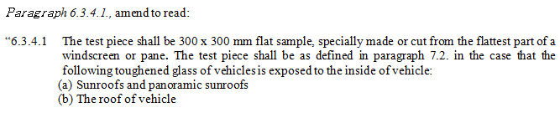
5. GTR 6 amendment proposed by the KOREA
The scope of toughened glass which would be subject to the amendment of GTR 6
- GTR 6 amendment will be applied to the minimum coverage of
toughened glass which may negatively affect safe driving in the case of
sudden breakage while driving.
-16-
Notes:
16

Slide 17
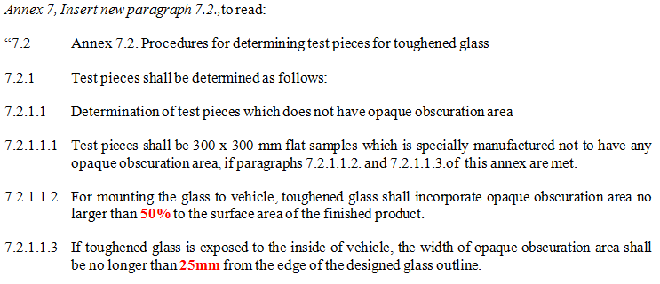
5. GTR 6 amendment proposed by the KOREA
Test methods depending on the range of CPA. (In the case of conducting
test on non-ceramic printed sample.)
- Conduct the ball drop test on non-ceramic printed sample if CPA is less
than minimum allowable range.
-17-
Notes:
17

Slide 18

5. GTR 6 amendment proposed by the KOREA
Test methods depending on the range of CPA. (In the case of conducting
test with 100%-ceramic printed sample.)
- Conduct the ball drop test on 100% ceramic printed sample if CPA
exceeds minimum allowable range.
-18-
Notes:
18

Slide 19
Thank you for your attention !
Notes:
19

