Slide 1
Republic of Korea
PSG-05-XX
The explanatory statement on CPA limitation
28. June. 2016

Slide 2
1. Why to limit CPA less than 50%?
1. The Representativeness
Toughened glass with ceramic printed area doesn’t have the same strength property of pure toughened glass itself.
With more than 50% ceramic printed toughened glass could be classified in a different manner.
2. The probability of breakage risk
The more ceramic printed, the more vulnerable to be broken by impact from external object, result in potential breakage probability become high.
Toughened Glass
Ceramic Printed Area
CPA < 50%
CPA > 50%
-1-
Notes:
2

Slide 3
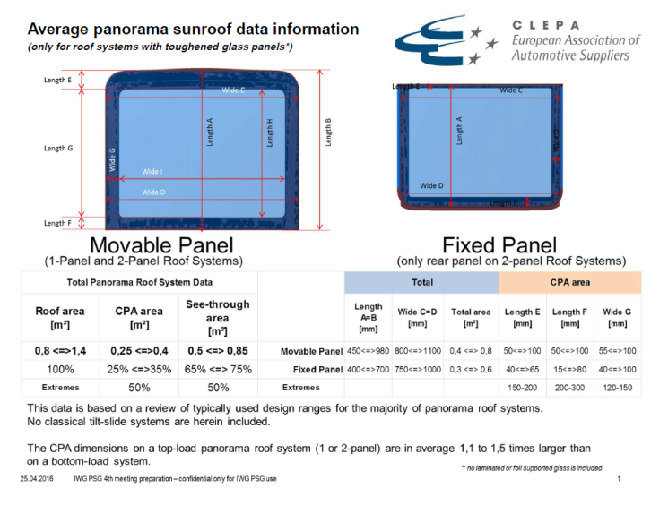
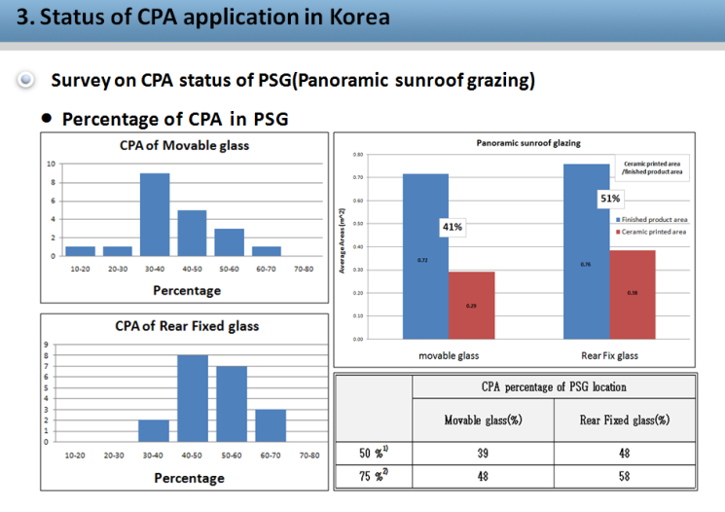
1. Why to limit CPA less than 50%?
3. Review on current industry status
In sunroof glazing, CPA account for less than 50% on average in Europe, but in Korea, there is a certain degree of sunroof glazing with more than 50% CPA especially in rear fixed glass.
Compared to Europe, Korea tend to have high CPA percentage, which might cause more accident by sunroof breakage
As roof glazing is getting more popular in the world, it is necessary to regulate CPA area at least less than [50%] to avoid potential risk from breakage.
[PSG-04-06] Average Sunroof data(by CLEPA)
[PSG-04-07] Average Sunroof data(by Korea)
-2-
Notes:
3

Slide 4
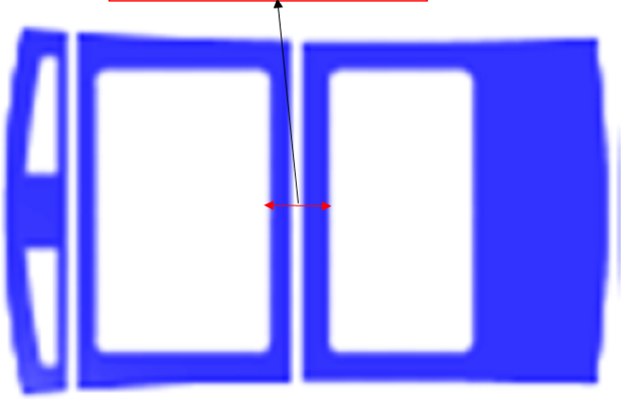
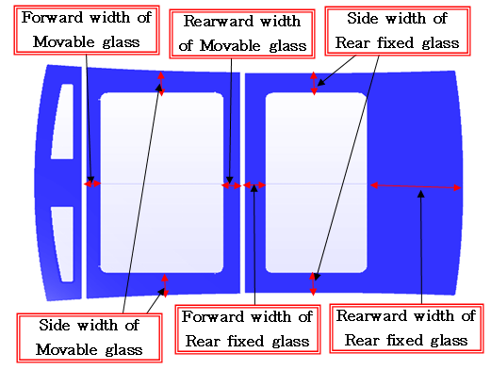
2. Where to measure CPA area?
View from above
In this area(=fihished product, in top-loading type), Ceramic Printed Area should be less than [50%] (externally exposed to outside)
View from side
(top-loading type)
Finished product
Ceramic Printed Area
A
B
A or B?
In case of a silant or others,
To be excluded or not?
Trim, shielding for mechanical devices, etc.
-3-
Notes:
4

Slide 5
2. Where to measure CPA area?
In total area < [50%]
A
A or B?
B
Movable glass <[50%]
Rear fixed glass < [50%]
The deflector(front panel) could be exempted since it is not
reaching into the interior view.
In case of seperated pane system, should “50% rule” be calculated
individually or totally?
-4-
Notes:
5

Slide 6
Thank you !
Notes:
6

