Slide 1
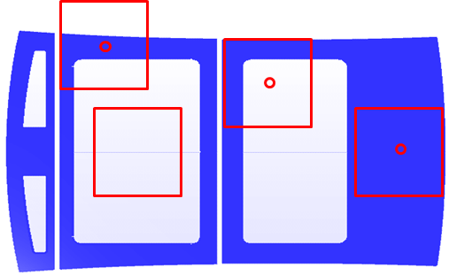
A Picture of test pieces selection of 227g ball drop test with finished product
Reference test

Slide 2
Test results of 227g ball drop test
Manufacturers | Vehicles (sunroof) | Compliance test | Reference test³⁾
BMW | 320d Touring (Rear fixed glass) | Pass¹⁾ | Breakage
TOYOTA | E350 (Rear fixed glass) | Fail²⁾ | Breakage
LINCOLN | LINCOLN MKX (Rear fixed glass) | Fail | Breakage
MERCEDES-BENZ | E-Class (Rear fixed glass) | Fail | Breakage
JAGUAR | All New XJ (Rear fixed glass) | Fail | Breakage
LAND-ROVER | Discovery4 (Rear fixed glass) | Pass | Breakage
NISSAN | Murano (Rear fixed glass) | Fail | Breakage
CHRYSLER | 300C | Pass | Breakage
Audi | A8 | Pass | Breakage
Volkswagen | The Beetle (5C5877071) | Pass | Breakage
Porsche | Cayenne | Pass | Breakage
Pass in compliance test means, the CPA width was less than 150mm, so the ball hit the toughened glass area(center of the test piece) which does not include ceramic printed area.
Fail in compliance test means, the CPA width was more than 150mm, so the ball hit the CPA.
The purpose of reference test is, to verify weakness of CPA in 227g ball drop test. Even pass the compliance test, all CPA glazing were broken.

Slide 3
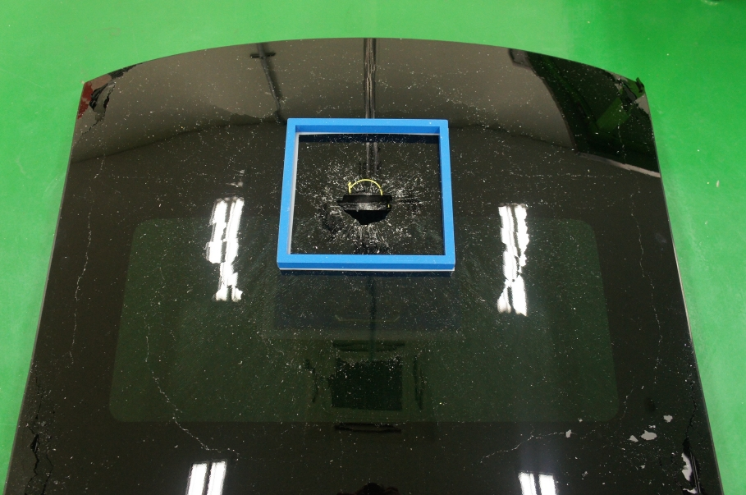
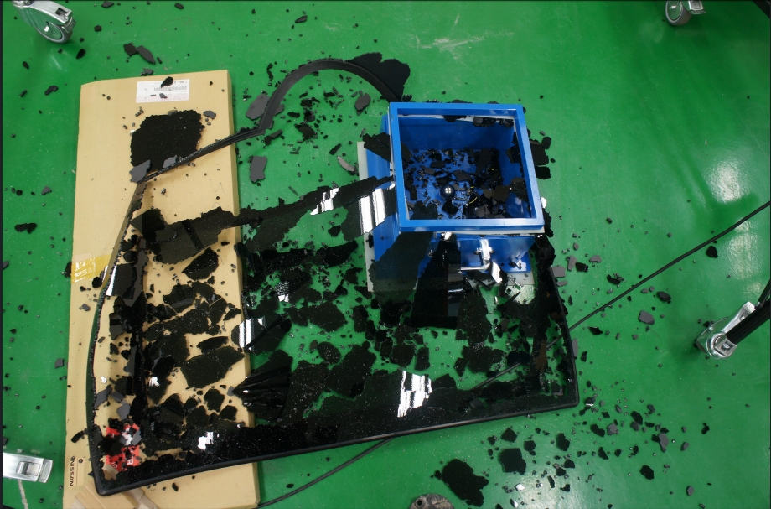
Photos of test pieces
Example 1
Example 2

