Slide 1
GTR amendments
WLTP-14-08e
Japan
#14 WLTP IWG at Paris

Slide 2
Clarification for n/v ratio
Current GTR: The 8% applies to what? Clarification would help readers.
5.6.3.(g)
n/v ratios (engine rotational speed divided by vehicle speed). This requirement shall be considered fulfilled if, for all transmission ratios concerned, the difference with respect to the transmission ratios of the most commonly installed transmission type and model is within 8 percent.
n1
Transmission ratio
n2
Final gear ratio
n3
Tire diameter
ratio
vehicle speed
Interpretation | ratio between n1 and n2 | ratio between n1 and vehicle speed
A | within 8 % | no limit
B | no limit | within 8%
Proposal for A case:
n/v ratios (engine rotational speed divided by vehicle speed) Transmission ratio. This requirement shall be considered fulfilled if, for all transmission ratios concerned, the difference with respect to the transmission ratios of the most commonly installed transmission type and model is within 8 percent.
Proposal for B case:
n/v ratios (engine rotational speed divided by vehicle speed). This requirement shall be considered fulfilled if, for all transmission ratios
concerned, the difference with respect to the transmission ratios n/v ratios of the most commonly installed transmission type and model is within 8 percent.

Slide 3
Vehicle mass for classification
Current GTR:
2. Vehicle classifications
2.1. Class 1 vehicles have a power to mass in running order ratio Pmr ≤ 22 W/kg.
2.2. Class 2 vehicles have a power to mass in running order ratio > 22
but ≤ 34 W/kg.
2.3. Class 3 vehicles have a power to mass in running order ratio > 34 W/kg.
Proposal:
2. Vehicle classifications
2.1. Class 1 vehicles have a power to mass in running order minus 75 kg ratio Pmr ≤ 22 W/kg.
2.2. Class 2 vehicles have a power to mass in running order minus 75kg ratio > 22
but ≤ 34 W/kg.
2.3. Class 3 vehicles have a power to mass in running order minus 75kg ratio > 34 W/kg.
Justification:
“unladen mass”, which had been in GTR until #12IWG and Japan used as basis of classification in its WLTP rule, should be equivalent to “mass in running order minus 75kg” not mass in running order.

Slide 4
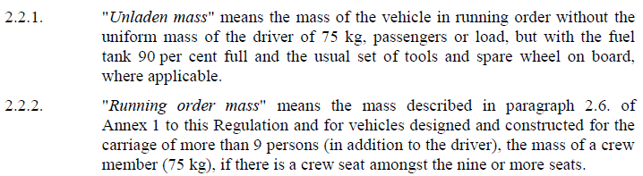
Vehicle mass for classification
R83
GTR
3.2.5. “Mass in running order” means the mass of the vehicle, with its fuel tank(s) filled to at least 90 per cent of its or their capacity/capacities, including the mass of the driver, fuel and liquids, fitted with the standard equipment in
accordance with the manufacturer’s specifications and, when they are fitted,
the mass of the bodywork, the cabin, the coupling and the spare wheel(s) as
well as the tools.

