Slide 1
TF TA 34th session
3rd June 2025
Co-chairs’ note:
Key elements for agreement on C1 limits proposal

Slide 2
Slide from TF TA 33rd session
20th May 2025
Decisions for C1 limits proposal – recap from TFTA 32
Can we proceed on limit setting for both test methods based on current correlation?
  - Mixed views – some favouring proceeding with one method initially, others favouring both from the start
  Co-chairs’ proposal: proceed with both methods
What tyres should be in/out of scope for limit setting?
  - Majority supported meeting requirements of UNR 117 (conformity) as a prerequisite
  JASIC in favour of wider scope, but with exclusion of Q speed rated 3PMSF tyres
What tyre groupings should be used for limits?
  - Limited discussion at previous meeting
What limit values should be used?
  - Limited discussion at previous meeting
  Co-chairs’ proposal: ‘close to 1.0’ with data-driven separate uncertainty margin (including for CoP, as appropriate)
How should measurement uncertainty be accounted for within the limit setting?
  - Limited discussion at previous meeting
  Co-chairs’ proposal: a ‘core’ limit with separate uncertainty margin that reflects the methods’ evolution (tightening margins)

Slide 3
Slide from TF TA 33rd session
20th May 2025
Achieving a working document for 82nd GRBP
It is clear that concerns remain on both the measurement uncertainty and correlation between the two methods – this will require further work beyond our June deadline to resolve.
At the same time, the market assessment testing does provide us with a view of the spread of abrasion performance across the market – it should therefore be possible to take a view on limits.
Co-chairs’ proposed route forward:
Focus on the key decision points in relation to scope, abrasion limits and uncertainty margin handling to agree a working document for the June deadline.
Continue to analyse the COVA and MA data ahead of GRBP (September) to identify potential areas of method improvement or further work needed – initial improvements could be taken on-board within an informal document for September.
Propose updates to the TF TA ToR for GRBP with clear timelines in relation to concrete method improvements.

Slide 4
Slide from TF TA 33rd session
20th May 2025
TF TA views on decision points
Can we proceed on limit setting for both test methods based on current correlation?
  Co-chairs’ proposal: proceed with both methods, and set out a roadmap for method improvements in ToRs
What tyres should be in/out of scope for limit setting?
  Co-chairs’ proposal: meet requirements of UNR 117 as prerequisite (high degree of harmonization, ease of drafting)
What tyre groupings should be used for limits?
  Co-chairs’ proposal: Normal, 3PMSF [and Special] only to avoid proliferation of ad hoc limits
What limit values should be used?
  Co-chairs’ proposal: 1.0 for normal, 1.05 for 3PMSF – with separate uncertainty margin
How should measurement uncertainty be accounted for within the limit setting?
  Co-chairs’ proposal: a core limit with separate uncertainty margin (detailed on next slides)
(Proposed format: rapid rounds of discussion for questions 1 to 3 – max 1 minute per intervention)

Slide 5
Slide from TF TA 33rd session
20th May 2025
Co-chairs’ proposal – overview
Intended to reflect method uncertainty
Until date D1 | Accepted result
 | Convoy | Drum
Normal | 1.30-1.35 | 1.15-1.20
3PMSF | 1.20-1.25 | 1.20-1.25
Special | [as 3PMSF] | [as 3PMSF]
(until date [D1])
Convoy | Drum
0.30 | 0.15
0.15 | 0.15
[as 3PMSF] | [as 3PMSF]
(additional?)
Core limit
Normal | 1.00
3PMSF | 1.05
Special | [as 3PMSF]
[CoP]
[0.05]
[0.05]
[as 3PMSF]
(from date [D1])
From date D1 | Accepted result
 | Convoy | Drum
Normal | 1.15-1.20 | 1.10-1.15
Snow | 1.20-1.25 | 1.15-1.20
Special | [as 3PMSF] | [as 3PMSF]
Convoy | Drum
0.15 | 0.10
0.15 | 0.10
[as 3PMSF] | [as 3PMSF]
Intended to reflect
production variability.
Too low?
Measurement uncertainty

Slide 6
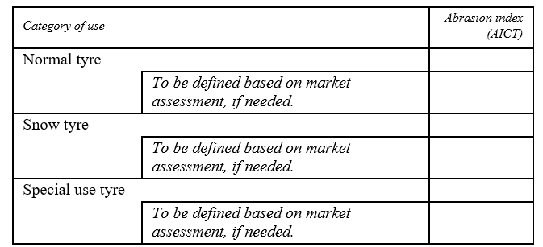
Slide from TF TA 33rd session
20th May 2025
Co-chairs’ proposal - limits
AICT_{corr} must meet these limits
1.00
‘Core’ limits support long-term environmental ambition
1.05
[1.05]

Slide 7
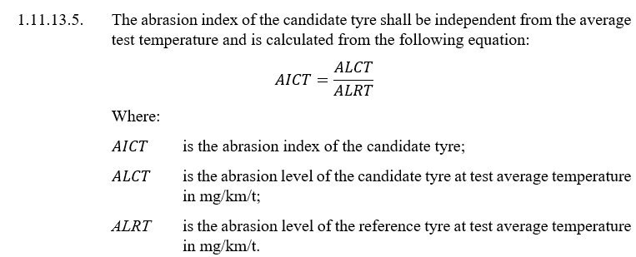
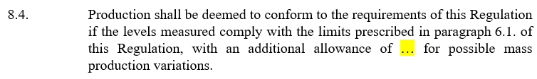
Slide from TF TA 33rd session
20th May 2025
Co-chairs’ proposal – limits
Example of integration of limit into draft reg.:
1.11.13.6. The abrasion index corrected for the measurement uncertainty AICT_{corr} of the candidate tyre is calculated from the following equation:
AICT_{MUcorr} = AICT – MU
Where MU is given in the Table (see next slide)
No need for additional uncertainty as it is the worst case. An additional MU_{COP} 0.05 could be added if any method can be used at COP regardless the method of type approval.

Slide 8
Slide from TF TA 33rd session
20th May 2025
TF TA views on decision points
Can we proceed on limit setting for both test methods based on current correlation?
  Co-chairs’ proposal: proceed with both methods, and set out a roadmap for method improvements in ToRs
What tyres should be in/out of scope for limit setting?
  Co-chairs’ proposal: meet requirements of UNR 117 as prerequisite (high degree of harmonization, ease of drafting)
What tyre groupings should be used for limits?
  Co-chairs’ proposal: Normal, 3PMSF [and Special] only to avoid proliferation of ad hoc limits
What limit values should be used?
  Co-chairs’ proposal: 1.0 for normal, 1.05 for 3PMSF – with separate uncertainty margin
How should measurement uncertainty be accounted for within the limit setting?
  Co-chairs’ proposal: a core limit with separate uncertainty margin (detailed on previous slides)
(Proposed format: rapid rounds of discussion for questions 4 and 5 – max 1 minute per intervention)

Slide 9
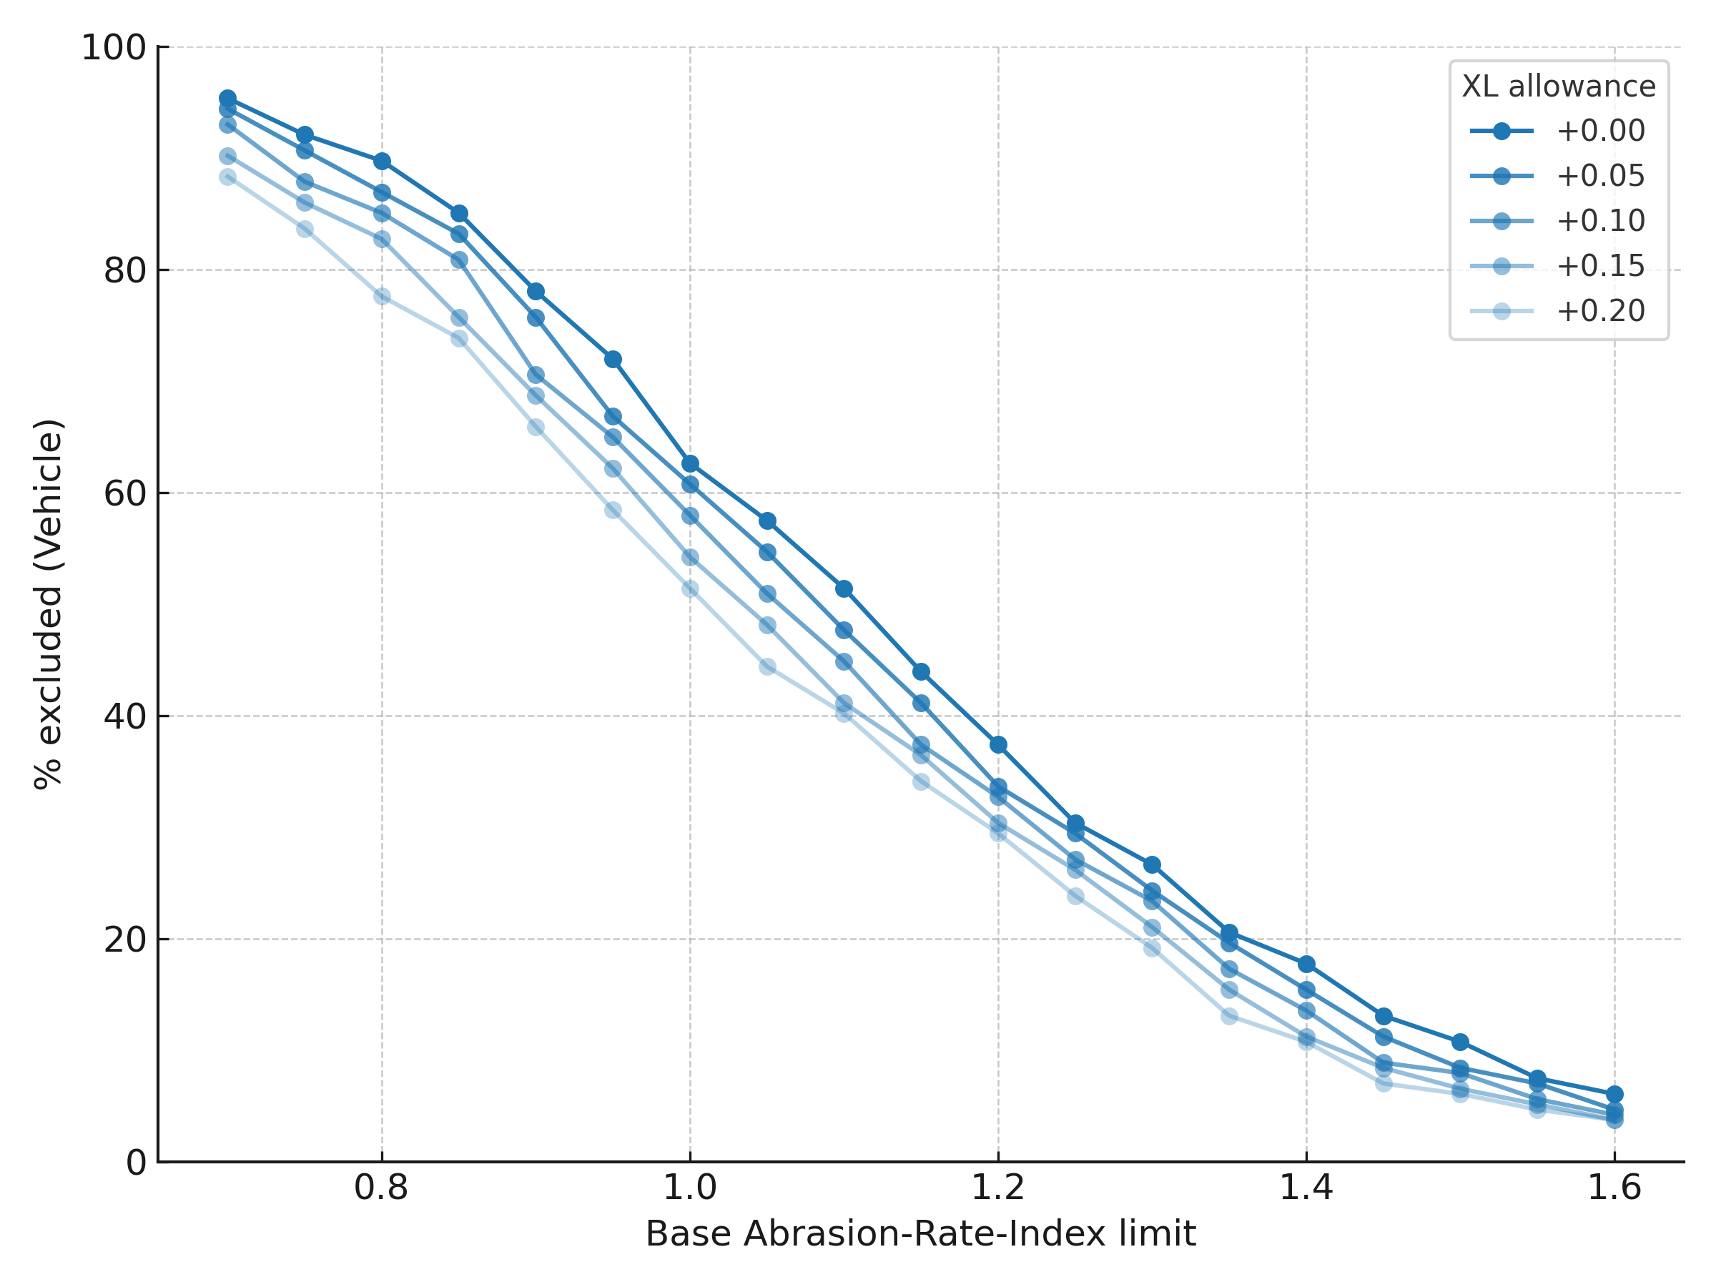
Elements for comparison of position
TF TA 34th session
3rd June 2025
Effect of XL allowance for normal tyres:
For the convoy method, an allowance of +0.1 decreases the exclusion rate by an average of 5.5 pct points in the ‘area of interest’ for normal tyres (AI 1.0 to 1.4)

Slide 10
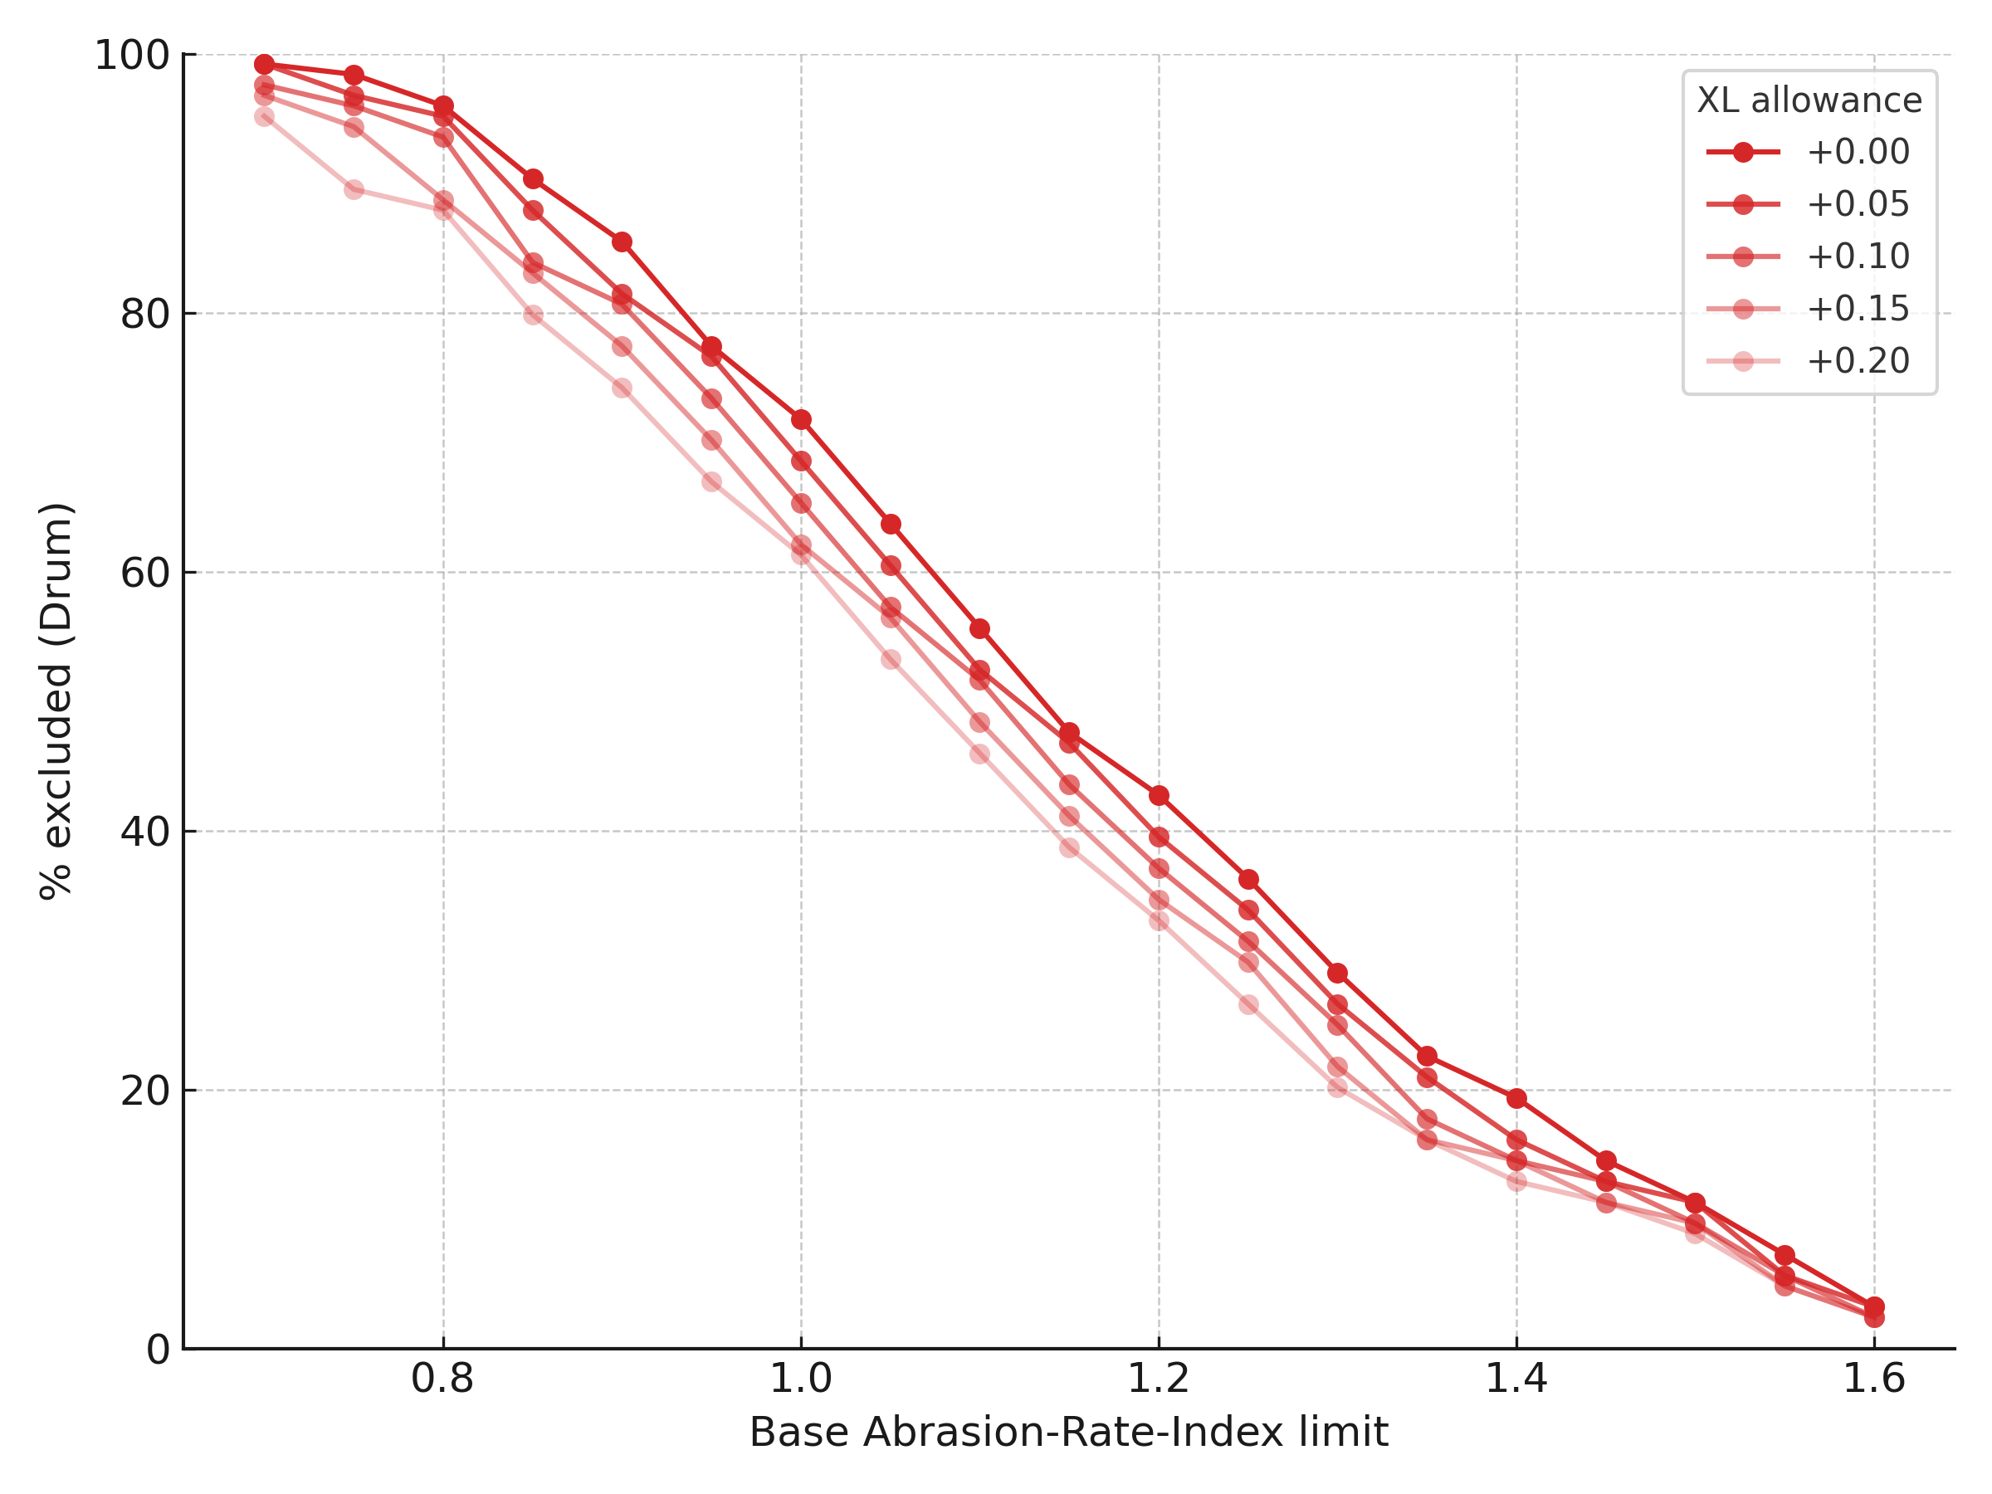
Elements for comparison of positions
TF TA 34th session
3rd June 2025
Effect of XL allowance for normal tyres:
For the drum method, an allowance of +0.1 decreases the exclusion rate by an average of 5.1 pct points in the ‘area of interest’ for normal tyres (AI 1.0 to 1.4).

Slide 11
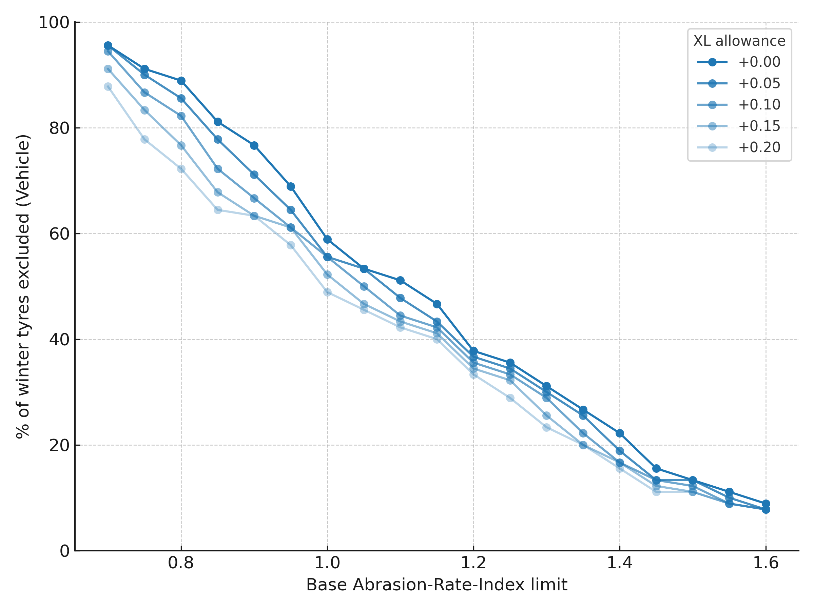
Elements for comparison of positions
TF TA 34th session
3rd June 2025
Effect of XL allowance for snow tyres:
For the convoy method, an allowance of +0.1 decreases the exclusion rate by an average of 3.8 pct points in the ‘area of interest’ for snow tyres (AI 1.0 to 1.4)

Slide 12
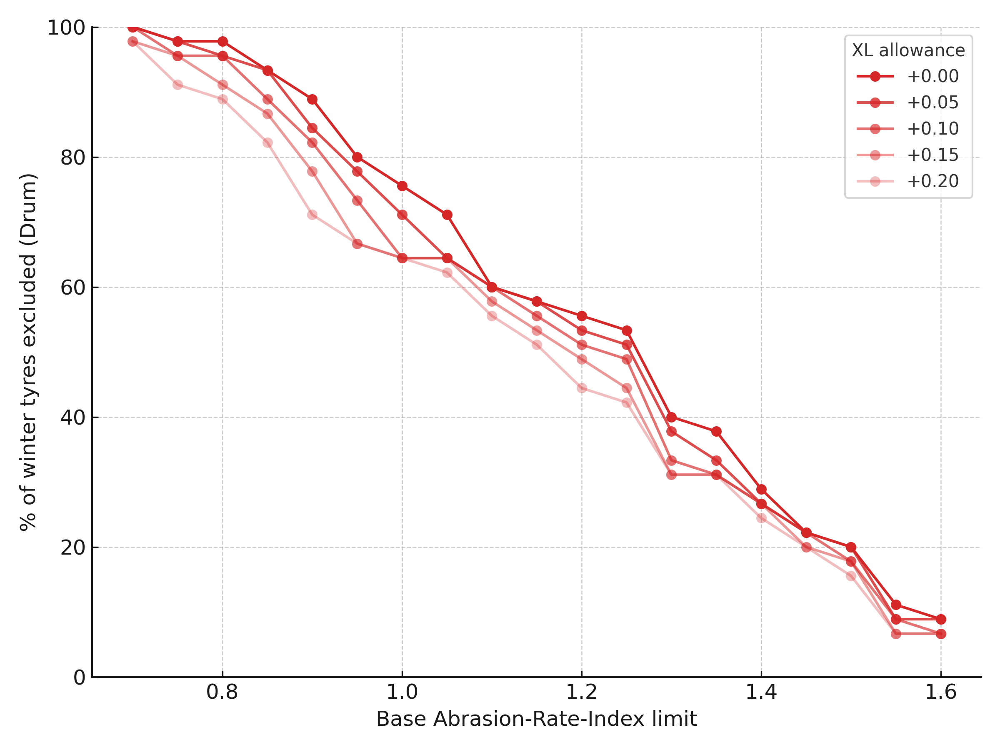
Elements for comparison of positions
TF TA 34th session
3rd June 2025
Effect of XL allowance for snow tyres:
For the drum method, an allowance of +0.1 decreases the exclusion rate by an average of 4.9 pct points in the ‘area of interest’ for snow tyres (AI 1.0 to 1.4).

Slide 13
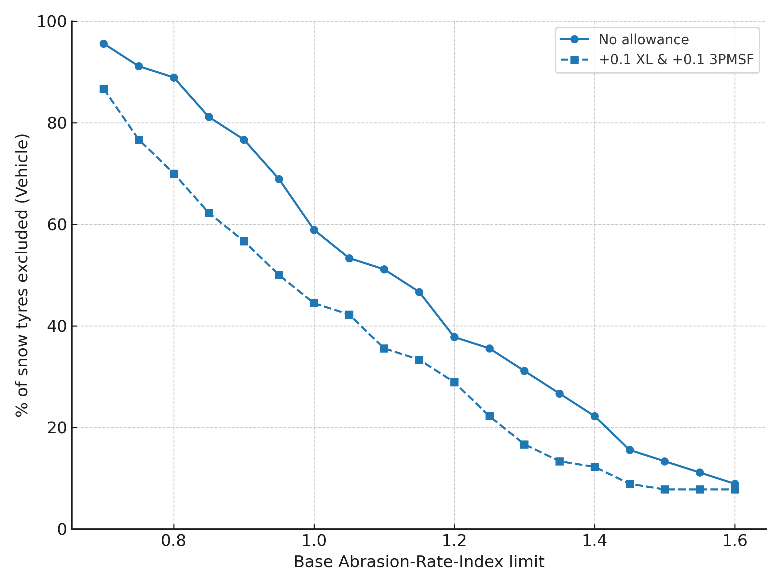
Elements for comparison of positions
TF TA 34th session
3rd June 2025
Effect of combined XL and 3PMSF allowance for snow tyres:
For the convoy method, an allowance of +0.1 for both XL and 3PMSF tyres decreases the exclusion rate by an average of 12.7 pct points in the ‘area of interest’ (AI 1.0 to 1.4) for snow tyres.

Slide 14
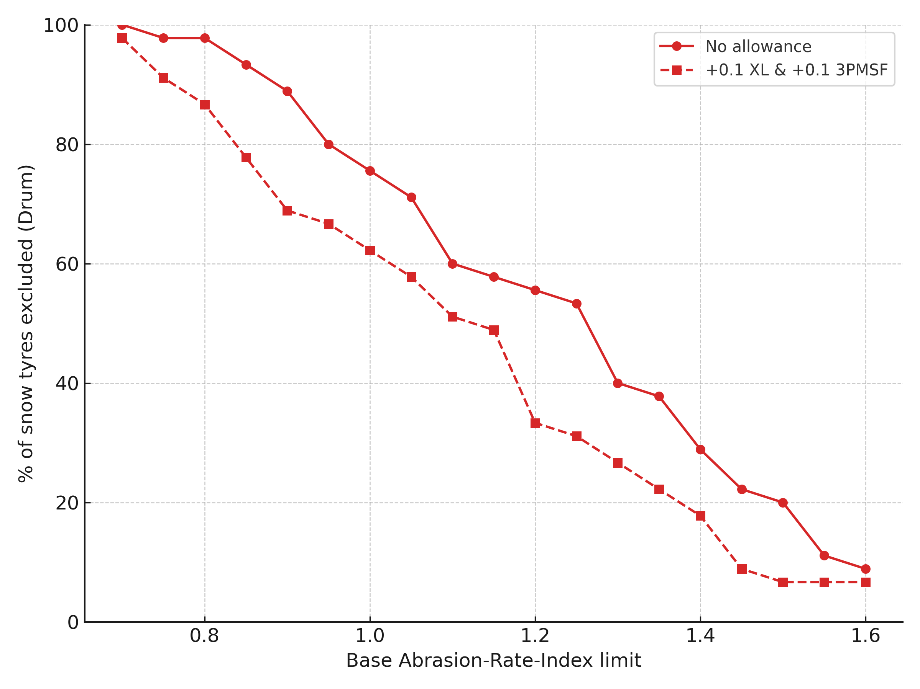
Elements for comparison of positions
TF TA 34th session
3rd June 2025
Effect of combined XL and 3PMSF allowance for snow tyres:
For the drum method, an allowance of +0.1 decreases the exclusion rate by an average of 14.3 pct points in the ‘area of interest’ (AI 1.0 to 1.4) for snow tyres.
Conclusion: the proposed allowances work consistently across methods throughout the range of abrasion indices. For winter tyres, the combination of the XL and 3PMSF significantly reduces the expected exclusion rate.

Slide 15
Summary of positions of TF TA stakeholders (where numeric limits have been proposed)
Based on TF TA 33
Topic | FRA | JPN | ETRTO | Co-chairs
Test method | Vehicle only | Both acceptable | Prefer vehicle | Both acceptable
Exclusions | - | Q-speed 3PMSF | Ice grip, special use, legal race | Under evaluation
Proposed limit (Normal) | 1.15 | ~1.35 | 1.4 | 1.15 / 1.30
Proposed limit (Snow M&S) | 1.15 | To be confirmed | 1.4 | 1.15 / 1.30
3PMSF allowance | +0.1 | To be confirmed | +0.1 | +0.05
XL allowance | +0.1 | To be confirmed | +0.1 | Under evaluation
UHP allowance | - | To be confirmed | +0.1 | -
CoP allowance | +0.2 | To be confirmed | +0.25 | +0.05
Implementation steps | One | One | One | Two (Date D1)

Slide 16
Towards a final compromise – Key Elements of the co-chairs’ framework
TF TA 34th session
3rd June 2025
Shared understanding of the core limit as a long-term ambition
Modular approach: allows targeted allowances (e.g., +0.1 XL, +0.1 3PMSF) to be added.
D1 date is a key lever to reflect tyre development cycles and modulate impact on the tyre market. It should reflect (long) tyre development cycles
Allowances can be transitional and phased out after D1.

Slide 17
TF TA 34th session
3rd June 2025
Co-chairs’ proposal – updated
Present methods’ uncertainty
NEW:
+0.1 XL and 3PMSF allowances
Until date D1 | Accepted result
 | Convoy | Drum
Normal | 1.40 | 1.40
Snow | 1.40 | 1.40
Special | [-] | [-]
(until date [D1])
(additional)
Convoy | Drum
0.20 | 0.20
0.20 | 0.20
[-] | [-]
[CoP]
0.20
0.20
[-]
Core limit
Normal | 1.00
Snow | 1.00
Special | [-]
(from date [D1])
(additional)
From date D1 | Accepted result
 | Convoy | Drum
Normal | 1.25 | 1.20
Snow | 1.25 | 1.20
Special | [-] | [-]
Convoy | Drum
0.15 | 0.10
0.15 | 0.10
[-] | [-]
[CoP]
0.10
0.10
[-]
Long-term methods’ uncertainty
After D1: XL allowance is removed
Measurement uncertainty
CoP uncertainty: inter-circuit and drum-to-drum variability, production variability (lower in the future)

Slide 18
TF TA 34th session
3rd June 2025
Comparison of positions
Goal: to compare all known positions to date on a ‘like-for-like’ basis
Approach:
  plot positions on the 2D space of tyre exclusions vs base abrasion index limit
  apply base AI limit = maximum value proposed for CoP – fixed CoP margin of 0.2
  apply allowances (XL, 3PMSF, UHP), if proposed
  estimate average abrasion reduction (assumption: removed tyre is replaced by a tyre with AI = average of remaining population).
Disclaimer: analysis reflects co-chairs’ understanding of stakeholder positions and could contain errors

Slide 19
TF TA 34th session
3rd June 2025
Comparison of positions – where we stand
Sets of allowances considered in the analysis
Allowance set | 3PMSF | XL | UHP
Baseline (co-chairs v1, Japan) | - | - | -
ETRTO v1 | +0.10 | +0.10 | +0.10
France/co-chairs v2 | +0.10 | +0.10 | -
ETRTO v2 | +0.06 | +0.10 | +0.09

Slide 20
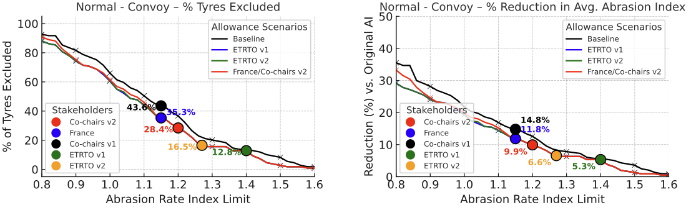
Comparison of positions
Normal tyres, convoy method
TF TA 34th session
3rd June 2025

Slide 21
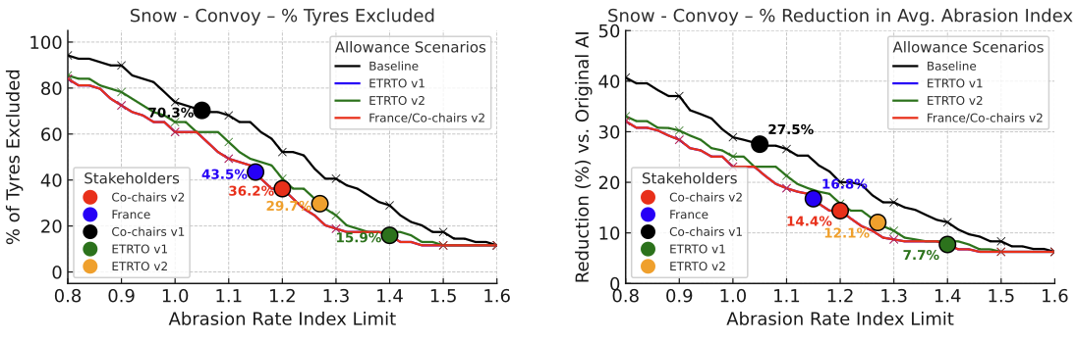
Comparison of positions
Snow tyres, convoy method
TF TA 34th session
3rd June 2025

Slide 22
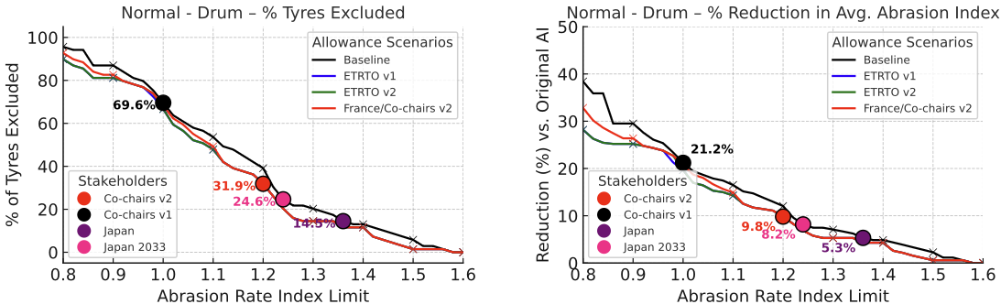
Comparison of positions
Normal tyres, drum method
TF TA 34th session
3rd June 2025

Slide 23
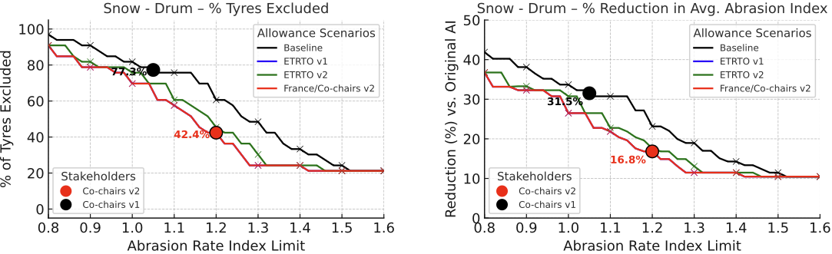
Comparison of positions
Snow tyres, drum method

Slide 24
Slide from TF TA 33rd session
20th May 2025
TF TA views on decision points
Can we proceed on limit setting for both test methods based on current correlation?
  Co-chairs’ proposal: proceed with both methods, and set out a roadmap for method improvements in ToRs
What tyres should be in/out of scope for limit setting?
  Co-chairs’ proposal: meet requirements of UNR 117 as prerequisite (high degree of harmonization, ease of drafting)
What tyre groupings should be used for limits?
  Co-chairs’ proposal: Normal, 3PMSF [and Special] only to avoid proliferation of ad hoc limits
What limit values should be used?
  Co-chairs’ proposal: 1.0 for normal, 1.05 for 3PMSF – with separate uncertainty margin
How should measurement uncertainty be accounted for within the limit setting?
  Co-chairs’ proposal: a core limit with separate uncertainty margin (detailed on previous slides)
(Proposed format: rapid rounds of discussion for questions 4 and 5 – max 1 minute per intervention)

