Slide 1
ETRTO review of Co-Chairs updated proposal for both limits and CoP
TFTA 34th session 5th June 2025

Slide 2
TF TA 33rd session
20th May 2025
Co-chairs’ proposal 1 – overview
Until date D1 | Accepted result
 | Convoy | Drum
Normal | 1.30-1.35 | 1.15-1.20
3PMSF | 1.20-1.25 | 1.20-1.25
Special | [as 3PMSF] | [as 3PMSF]
(until date [D1])
Convoy | Drum
0.30 | 0.15
0.15 | 0.15
[as snow] | [as snow]
(additional?)
Core limit
Normal | 1.00
3PMSF | 1.05
Special | [as snow]
[CoP]
[0.05]
[0.05]
[as snow]
(from date [D1])
From date D1 | Accepted result
 | Convoy | Drum
Normal | 1.15-1.20 | 1.10-1.15
3PMSF | 1.20-1.25 | 1.15-1.20
Special | [as 3PMSF] | [as 3PMSF]
Convoy | Drum
0.15 | 0.10
0.15 | 0.10
[as snow] | [as snow]
Measurement uncertainty

Slide 3
TF TA 33rd session
20th May 2025
Co-chairs’ proposal 1 – ETRTO visualization recommendation
Until date D1 | Type Approval Accepted result
 | Convoy | Drum
Normal | 1.30-1.35 | 1.15-1.20
3PMSF | 1.20-1.25 | 1.20-1.25
Special | [as 3PMSF] | [as 3PMSF]
(until date [D1])
Convoy | Drum
0.30 | 0.15
0.15 | 0.15
[as snow] | [as snow]
(additional?)
CoP Accepted result
Core limit
Normal | 1.00
3PMSF | 1.05
Special | [as snow]
[CoP]
[0.05]
[0.05]
[as snow]
(from date [D1])
From date D1 | Type Approval Accepted result
 | Convoy | Drum
Normal | 1.15-1.20 | 1.10-1.15
3PMSF | 1.20-1.25 | 1.15-1.20
Special | [as 3PMSF] | [as 3PMSF]
Convoy | Drum
0.15 | 0.10
0.15 | 0.10
[as snow] | [as snow]
Measurement uncertainty

Slide 4
Co-chairs’ proposal 1 – ETRTO visualization recommendation
[CoP]
[0.05]
[0.05]
[as snow]
(until date [D1])
Until date D1 | Type Approval Accepted result
 | Convoy | Drum
Normal | 1.30 | 1.15
3PMSF | 1.20 | 1.20
Special | [as 3PMSF] | [as 3PMSF]
Until date D1 | Accepted result only at CoP checks
 | Convoy | Drum
Normal | 1.35 | 1.20
3PMSF | 1.25 | 1.25
Special | [as 3PMSF] | [as 3PMSF]
Convoy | Drum
0.30 | 0.15
0.15 | 0.15
[as 3PMSF] | [as 3PMSF]
Core limit
Normal | 1.00
3PMSF | 1.05
Special | [as snow]
(from date [D1])
From date D1 | Type Approval Accepted result
 | Convoy | Drum
Normal | 1.15 | 1.10
3PMSF | 1.20 | 1.15
Special | [as 3PMSF] | [as 3PMSF]
From date D1 | Accepted result only at CoP
 | Convoy | Drum
Normal | 1.20 | 1.15
3PMSF | 1.25 | 1.20
Special | [as 3PMSF] | [as 3PMSF]
Convoy | Drum
0.15 | 0.10
0.15 | 0.10
[as 3PMSF] | [as 3PMSF]
Test Method Margin
Production variability and Test Method uncertainty

Slide 5
Co-chairs’ proposal 1 – ETRTO visualization recommendation
Until date D1 |  |  | Type Approval Accepted result
 |  |  | Convoy | Drum
Normal |  |  | 1.30 | 1.15
 |  | UHP
 |  | XL | 1.30 | 1.15
 |  | UHP XL
Snow (M+S) |  |  | 1.20 | 1.20
 | 3PMSF | 3PMSF | 1.20 | 1.20
 | 3PMSF XL | 3PMSF XL | 1.20 | 1.20
Special |  |  | [-] | [-]
[CoP]
[0.05]
[0.05]
[as snow]
(until date [D1])
Until date D1 | Accepted result only at CoP checks
 | Convoy | Drum
Normal | 1.35 | 1.20
3PMSF | 1.25 | 1.25
Special | [as 3PMSF] | [as 3PMSF]
Convoy | Drum
0.30 | 0.15
0.15 | 0.15
[as snow] | [as snow]
Core limit
Normal | 1.00
3PMSF | 1.05
Special | [as snow]
(from date [D1])
From date D1 |  |  | Type Approval Accepted result
 |  |  | Convoy | Drum
Normal |  |  | 1.15 | 1.10
 |  | UHP
 |  | XL
 |  | UHP XL
Snow (M+S) |  |  | 1.20 | 1.15
 | 3PMSF | 3PMSF
 | 3PMSF XL | 3PMSF XL
Special |  |  | [-] | [-]
From date D1 | Accepted result only at CoP
 | Convoy | Drum
Normal | 1.20 | 1.10-1.15
3PMSF | 1.25 | 1.20
Special | [as 3PMSF] | [as 3PMSF]
Convoy | Drum
0.15 | 0.10
0.15 | 0.10
[as snow] | [as snow]
Test Method Margin
Production variability and Test Method uncertainty

Slide 6
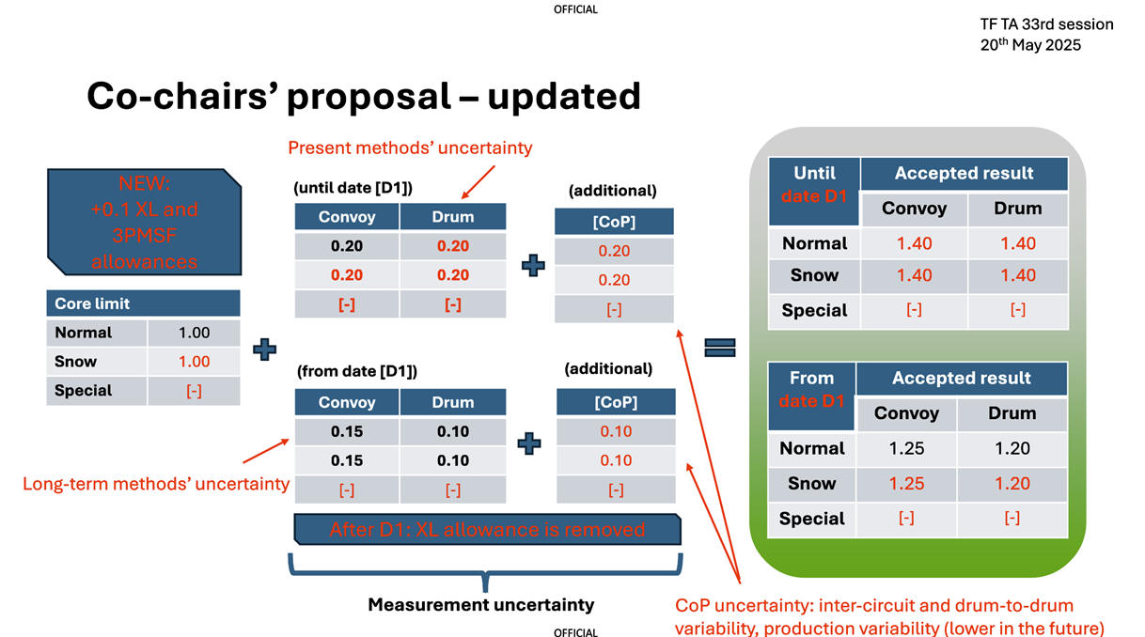

Slide 7
Co-chairs’ proposal 2 – ETRTO visualization recommendation
Until date D1 |  |  | Type Approval Accepted result
 |  |  | Convoy | Drum
Normal |  |  | 1.20 | 1.20
 |  | UHP
 |  | XL | 1.30 | 1.30
 |  | UHP XL
Snow (M+S) |  |  | 1.20 | 1.20
 | 3PMSF | 3PMSF | 1.30 | 1.30
 | 3PMSF XL | 3PMSF XL | 1.40 | 1.40
Special |  |  | [-] | [-]
[CoP] | Until D1 | From D1
Normal | 0.2 | 0.1
3PMSF | 0.2 | 0.1
Special | 0.2 | 0.1
(until date [D1])
Until date D1 |  |  | Accepted result only at CoP checks
 |  |  | Convoy | Drum
Normal |  |  | 1.40 | 1.40
 |  | UHP
 |  | XL | 1.50 | 1.50
 |  | UHP XL
Snow (M+S) |  |  | 1.40 | 1.40
 | 3PMSF | 3PMSF | 1.50 | 1.50
 | 3PMSF XL | 3PMSF XL | 1.60 | 1.60
Special |  |  | [-] | [-]
Convoy | Drum
0.20 | 0.20
0.20 (+0.1 for 3PMSF) | 0.20 (+0.1 for 3PMSF)
[-] | [-]
Core limit
Normal | 1.00
Snow | 1.00
Special | [-]
+0.1 for XL
From date D1 |  |  | Type Approval Accepted result
 |  |  | Convoy | Drum
Normal |  |  | 1.15 | 1.10
 |  | UHP
 |  | XL
 |  | UHP XL
Snow (M+S)
 | 3PMSF | 3PMSF | 1.25 | 1.20
 | 3PMSF XL | 3PMSF XL
Special |  |  | [-] | [-]
(from date [D1])
From date D1 |  |  | Accepted result only at CoP checks
 |  |  | Convoy | Drum
Normal |  |  | 1.25 | 1.20
 |  | UHP
 |  | XL
 |  | UHP XL
Snow (M+S)
 | 3PMSF | 3PMSF | 1.35 | 1.35
 | 3PMSF XL | 3PMSF XL
Special |  |  | [-] | [-]
Convoy | Drum
0.15 | 0.10
0.15 | 0.10
[-] | [-]
Test Method Margin
CoP Production variability and Test Method uncertainty

Slide 8
…to summarize limit settings (Convoy)

Slide 9
…to summarize ETRTO requests on exemption

Slide 10
ETRTO considerations (1/4)
ETRTO 2 PROPOSALS RATIONALE RECAP
ETRTO members majority 1st limits proposal has been based in the view of committing to the removal of at least 10% of the market from the very short term posed by the EU Euro7 (first time ever of such target magnitude when regulating a new performance, and even more complex given the timeframe).
ETRTO members majority, through a huge and lengthy debated effort, revised the initial proposal towards the Co-Chairs 1st proposal, by committing to a technological challenge for a revised proposal: ~23% market removal, by the EU Euro7 application timeline for C1 tyres (a truly unprecedent challenge for the industry, especially when considered market-wide).

Slide 11
ETRTO considerations (2/4)
ABOUT COP
ETRTO appreciates the Co-Chairs’ recognition of the critical technical necessity for a broader Conformity of Production (CoP) tolerance:
  as previously explained, CoP should be considered independently of the type approval limits: a wider CoP tolerance does not facilitate easier type approval;
  rather, CoP serves to the conformity verification mechanism that should account for production variability that is also affected by test method variability.
  As test method variability improves over time, UN regulatory supplements can be adopted, while the industry remains committed to enhancing test accuracy under, e.g. a revised TATF Terms of Reference, without the need of setting beforehand a CoP evolution which cannot be technical predicted nowadays.
A CoP of 0.20 vs ETRTO proposal of 0.25 is posing additional challenges while potentially contributing to introduce market surveillance uncertainty.

Slide 12
ETRTO considerations (3/4)
NEW CO-CHAIRS PROPOSAL ACTUAL EFFECT
In this context, it is crucial to have appropriate limits for Normal tyres and in particular for UHP tyres (with SS ≥ Y and AR ≤ 40, currently accounting for 7.2% of the market) for which OICA also requested to consider the peculiarities of those tyres for the regulation, as product availability and customer choices may suffer

Slide 13
ETRTO considerations (4/4)
ABOUT 2 STAGES APPROACH
The proposed new limits from D1 onwards appear to lack justification through any assessment or technical study, and instead seem to be based on policy aspiration and speculative assumptions about market-wide technology evolutions.
ETRTO doesn’t understand the rationale behind setting drum limits. ETRTO still believes that it is premature and that a stepwise approach will drive effective improvement and ensure in the end consistency of results between testing methods

Slide 14
Conclusions
ETRTO urges a reconsideration especially of the proposed margins for Normal tyres and in particular UHP tyres, in light of the technical and market implications,
There is currently no sufficient ground to consider now a 2 stages approach.
ETRTO recommends to delay the setting of limits for drum method
This is especially important given the novelty of the abrasion performance parameter and the consequent current lack of experience in forecasting technological developments and market impacts, over both the near future (=current EU Euro 7 deadlines) and the next decade.

Slide 15
Thank you

