Slide 1
JAPAN proposal on TF4
EVSTF-08- 16 e
8th all TF F2F Meetings EVS
Washington DC
JASIC

Slide 2
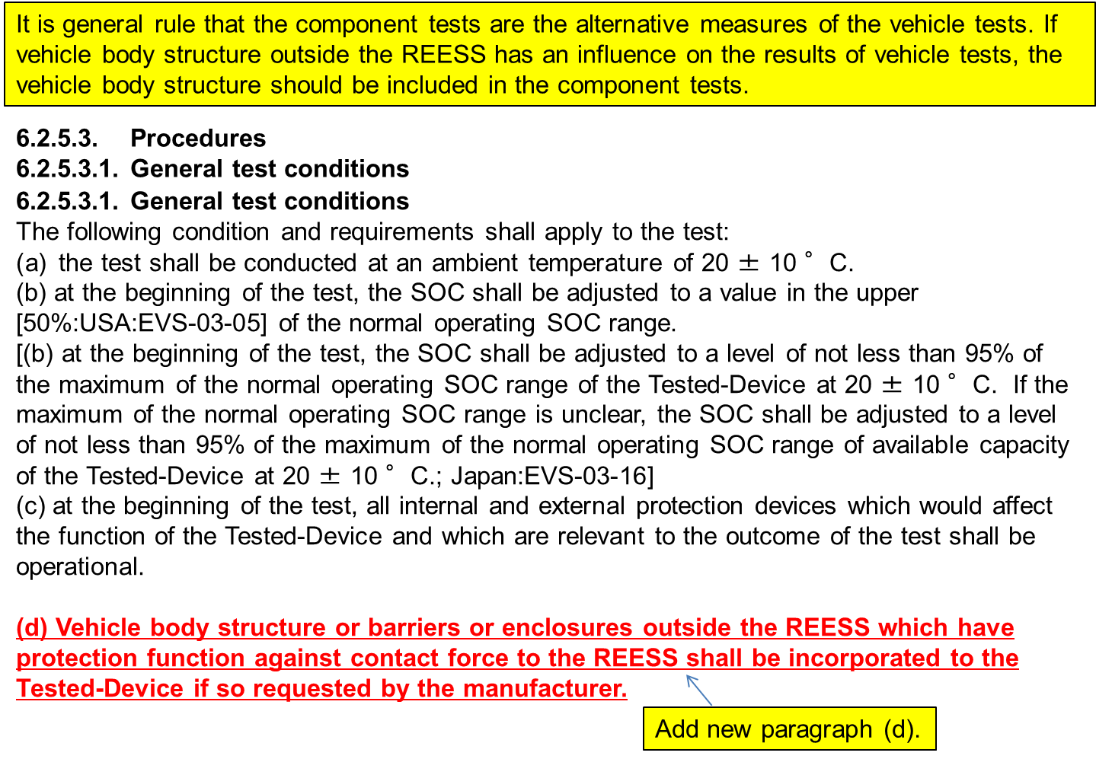
TF4: Proposal on Mechanical Integrity Test
ACTION ITEMS No.6 (EVS-10-16e)
Japan will define the term “vehicle protective structure” more precisely in mechanical integrity test.
EVSTF-07-08e

Slide 3
New proposal
Japan Proposal for modification of Mechanical Integrity Test condition
6.2.5.3. Procedures
6.2.5.3.1. General test conditions
(d)
Vehicle body structure or barriers or enclosures outside the REESS which have protection function against contact force to the REESS shall be incorporated to the Tested-Device if so requested by the manufacturer.
Vehicle body structure, barriers, enclosures, or other mechanical protection functional devices against contact force regardless outside or inside of the REESS shall be incorporated to the Tested-Device if so requested by the manufacturer.
The manufacturer shall define the relevant parts used for the mechanical protection of the REESS.
The test may be conducted with the REESS mounted to this vehicle structure in a way which is representative of its mounting in the vehicle.
Japan proposal at TF4 at Tokyo in March
(d)
Modified
Proposal

Slide 4
Referred ECE R100
Related part in ECE R100
6.4.2.1.2. Vehicle specific component test
The test shall be conducted in accordance with Annex 8D of this Regulation.
The crush force replacing the prescribed force specified in paragraph 3.2.1. of Annex 8D shall be determined by the vehicle manufacturer using the data obtained from either actual crash tests or its simulation as specified in Annex 3 of Regulations No. 12 or No. 94 in the direction of travel and
according to Annex 4 to Regulation No. 95 in the direction horizontally perpendicular to the direction of travel. These forces shall be agreed by the Technical Service.
The manufacturers may, in agreement with the Technical Services, use forces derived from the data obtained from alternative crash test procedures, but these forces shall be equal to or greater than the forces that would result from using data in accordance with the Regulations specified above.
The manufacturer may define the relevant parts of the vehicle structure used for the mechanical protection of the REESS components.
The test shall be conducted with the REESS mounted to this vehicle structure in a way which is representative of its mounting in the vehicle.
This paragraph is referred in Japan proposal.

