Slide 1
OICA TF8 drafting annex
EVSTF-08-25e
Mar. **, 2016
TF8 OICA pilot

Slide 2
Description of “Application and requirement in main text” to be modified for HD vehicles
OICA thinks this matter should be handled in coming new drafting group activities because of an editorial matter.
However china colleagues proposed to add “requirement for heavy duty vehicles is described in annex 99” in main text in Tokyo IWG meeting, so OICA prepared the modified sentences for application and requirement in main text for HD vehicles.
First of all, application should be expanded to include HD vehicles.
Current [2. Application
This regulation applies to all vehicles of Category 1-1 and 1-2, with a gross vehicle mass (GVM) of 4,536 kilograms or less, equipped with electric power train containing high voltage bus, excluding vehicles permanently connected to the grid.]
Modified [2. Application
This regulation applies to all vehicles of Category 1-1, 1-2, and 2 equipped with electric power train containing high voltage bus, excluding vehicles permanently connected to the grid.]

Slide 3
Description of “Application and requirement in main text” to be modified for HD vehicles
Secondly, “performance requirements for HD vehicles go to annex 99” is described in 5. of main text.
Current [5. Performance requirements
5.1. Requirements of a whole vehicle with regard to its electrical safety - in-use
Modified (added) [5. Performance requirements
Performance requirements for heavy duty vehicles, i.e. vehicles of Category 1-2 with a gross vehicle mass (GVM) exceeding 4,536kg, and category 2 with a GVM exceeding 3,500kg equipped with electric power train containing high voltage bus, excluding vehicles permanently connected to the grid, shall be determined in accordance with Annex 99 and related provisions.
5.1. Requirements of a whole vehicle with regard to its electrical safety - in-use

Slide 4
Annex 99 transposition is CP option
Rationale
Electrification of heavy duty vehicles currently is at an earlier development and commercial deployment phase compared to passenger vehicles. The vast scope of different vehicles types belonging to this category implies that extensive testing and evaluation of test methods to qualify vehicles for on road conditions is necessary to verify relevance to all category 1 and 2 vehicles, as well as to determine suitable test parameters and requirements, that may differ from passenger vehicle technology. The applicability of the proposed electrical and functional safety requirements on the REESS in the main text of the GTR have been discussed on a technical basis, and while they seem reasonable, they have not been validated for heavy vehicles. Differences in system designs and usage have been identified that result in necessity of modifying parts of the methods and requirements in order to be applicable. Therefore, the requirements in this annex are a subset of the requirements in the main GTR, where applicability at least on component level appears feasible. Due to time constraints and the limited experience with electrically propelled heavy vehicles some Contracting Parties have requested more time for testing and validation. Therefore, the requirements for electrical and functional REESS safety that are presented in this Annex are optional to Contracting Parties to adopt into regulation.

Slide 5
Annex 99 transposition is CP option
OICA propose the description of “CP option” as follows.
Current A.99.1. This annex specifies safety-related performance of electrically propelled road heavy duty vehicles and their rechargeable energy storage systems.
A.99.2. Application
Modified (added) A.99.1. This annex specifies safety-related performance of electrically propelled road heavy duty vehicles and their rechargeable energy storage systems.
The Contracting Parties may decide to not make Annex 99 and the related provisions for heavy duty vehicles, compulsory in their regional transposition of this gtr.
A.99.2. Application

Slide 6
GVM 3500kg or 4536kg by CP option
OICA proposed the description of “CP option” as follows.
A.99.2. Application
A.99.2.1. This annex applies to vehicles of Category 1-2 with a gross vehicle mass (GVM) exceeding 4,536kg, and category 2 with a GVM exceeding 3,500kg equipped with electric power train containing high voltage bus, excluding vehicles permanently connected to the grid..
A.99.2.2. A Contracting Party may restrict application of the requirements for GVM in its domestic legislation if it decides that such restriction is appropriate.

Slide 7
Out of scope of special purpose part, etc.
OICA also proposed the description for out of scope of this gtr “special purpose part” and “The additional specified performance for vehicles intended for transportation of dangerous goods” as follows.
A.99.2.3. The special purpose part of special purpose vehicles, e.g. ambulances, fire engines, tow trucks, construction vehicles, etc., are not within the scope of this gtr.
A.99.2.4. The additional specified performance for vehicles intended for transportation of dangerous goods is not within the scope of this gtr.

Slide 8
Requirement for HD vehicles special compared to passenger cars
OICA also proposed the exemption of physical protection to the conductive connection device located on the roof as follows;
A.99.3. Performance requirements
A.99.3.1.1.1. Protection against direct contact
Live parts shall be protected against direct contact and shall comply with paragraphs A.99.3.1.1.1.1. and A.99.3.1.1.1.2 except the conductive connection device located on the roof in the height more than 3 m above the ground or if located under the vehicle and not directly accessible by a person standing on the side of the vehicle.

Slide 9
Requirement for HD vehicles special compared to passenger cars
OICA also proposed the addition of something like a tool for heavy duty vehicle special as follows;
A.99.3.1.1.1. Protection against direct contact
………………..
Barriers, enclosures, solid insulators and connectors shall not be able to be opened, separated, disassembled or removed without conscious activity, e.g.. with the use of tools or activation/deactivation using an operator controlled device, or equivalent.

Slide 10
Requirement for HD vehicles special compared to passenger cars
OICA also proposed the editorial modification as follows;
A.99.3.1.1.2. Protection against indirect contact
A.99.3.1.1.2.1. For protection against electric shock which could arise from indirect contact, the exposed conductive parts, such as the conductive electrical protection barrier and enclosure, shall be conductively connected and secured to the electrical chassis with electrical wire or ground cable, by welding, or by connection using bolts, etc. so that no dangerous potentials are generated produced.
A.99.3.1.1.2.2. The resistance between all exposed conductive parts and the electrical chassis shall be lower than 0.1 ohm when there is current flow of at least 0.2 amperes.
The maximum resistance in any welded connection should either fulfill the above requirement or be specified by the manufacturer. This requirement is satisfied if the connection has been established by welding.

Slide 11
Requirement for HD vehicles special compared to passenger cars
OICA also proposed the exemption for grounded earth of the electrical chassis for special conductive charging system during charging from external power supply as follows;
A.99.3.1.1.2.3. In the case of motor vehicles which are intended to be connected to the grounded external electric power supply through the conductive connection, a device to enable the conductive connection of the electrical chassis to the earth ground for the external electric power supply shall be provided.
The device shall enable connection to the earth ground before exterior voltage is applied to the vehicle and retain the connection until after the exterior voltage is removed from the vehicle.
Compliance to this requirement may be demonstrated either by using the connector specified by the car manufacturer, by visual inspection or drawings.
The above requirements are only applicable for vehicles when charging from a fixed, dedicated charging point, with a harness of a maximum length, through a vehicle connector containing a plug and an inlet .

Slide 12
Requirement for HD vehicles special compared to passenger cars
OICA also proposed the editorial modification as follows;
A.99.3.1.1.3.4. Isolation resistance requirement for the coupling system for charging the REESS
For the conductive connection device vehicle inlet intended to be conductively connected to the external AC electric power supply and the electrical circuit that is conductively connected to the conductive connection device vehicle inlet during charging the REESS, the isolation resistance between the high voltage bus and the electrical chassis shall be at least 1M ohms when the charger coupler is disconnected. During the measurement, the REESS may be disconnected.

Slide 13
Requirement for HD vehicles special compared to passenger cars
OICA also proposed the expansion of the application of “On-board isolation resistance monitoring system” for all EVs not only FCV as manufactures option as follows;
A.99.3.1.1.3.5. On-board isolation resistance monitoring system
If on-board isolation resistance monitoring system for each high voltage bus of the vehicle is installed at the choice of the manufacture it shall comply with A.99.3.1.1.3.3.(b).

Slide 14
Requirement for HD vehicles special compared to passenger cars
OICA also proposed the exemption of the requirement to make the vehicle immobile during the charging from the external power supply as follows;
A.99.3.1.3.4. If the REESS can be externally charged, vehicle movement by its own propulsion system shall be impossible as long as the connector of the external electric power supply is physically connected to the vehicle inlet.
The above requirement are only applicable for vehicles when charging from a fixed, dedicated charging point, with a harness of a maximum length, through a vehicle connector containing a plug and inlet.
This requirement shall be demonstrated by using the connector specified by the vehicle manufacturer.

Slide 15
Requirement for HD vehicles special compared to passenger cars
OICA also proposed to use the limited description for the component based test of mechanical shock for HD vehicles as follows;
A.99.3.2.4. Mechanical shock
The test shall be conducted in accordance with paragraph A.99.4.1.5.4.
During the test there shall be no evidence of electrolyte leakage, fire or explosion.
The evidence of electrolyte leakage shall be verified by visual inspection without disassembling any part of the Tested-Device.
For a high voltage REESS, the isolation resistance measured after the test in accordance with paragraph A.99.4.1.1. shall not be less than 100 Ω/Volt.

Slide 16
Requirement for HD vehicles special compared to passenger cars
OICA also proposed to add the alternative installation for vibration test compared to R100 as follows;
A.99.4.1.5.2. Vibration test
………….
A.99.4.1.5.2.2.2. The Tested-Device shall be firmly secured to the platform of the vibration machine in such a manner as to ensure that the vibrations are directly transmitted to the Tested-Device.
As an alternative the Test-Device may be mounted with its original mounting points and holders as mounted in the vehicle. The holders should be firmly secured to the platform of the vibration machine in such a manner as to ensure that the vibrations are directly transmitted to the holders of the Tested-Device.
Finally it should be aligned with main text description proposed by TF4.

Slide 17
Requirement for HD vehicles special compared to passenger cars
OICA also proposed to modify the general test conditions, ambient temperature for component test of vibration , etc. compared to R100 as follows;
A.99.4.1.5.2. Vibration test
………….
A.99.4.1.5.2.3. Procedures
A.99.4.1.5.2.3.1. General test conditions
(a) the test shall be conducted at an ambient temperature of 22 ± 5 °C . 20 ± 10 °C .
Finally it should be aligned with main text description proposed by TF4.

Slide 18
Requirement for HD vehicles special compared to passenger cars
OICA also proposed to modify the purpose of the mechanical shock compared to that for passenger cars as follows;
A.99.4.1.5.4. Mechanical shock test
A.99.4.1.5.4.1. Purpose
The purpose of this test is to verify the safety performance of the REESS under inertial loads as the minimum requirement against a vehicle crash. which may occur during a vehicle crash
Note
Mechanical shock requirement for CNG container installed on the vehicle is already adopted in the regulation for heavy duty vehicles even there is no regulations of vehicle crash requirement.
The requirement for REESS in same manner is reasonable.

Slide 19
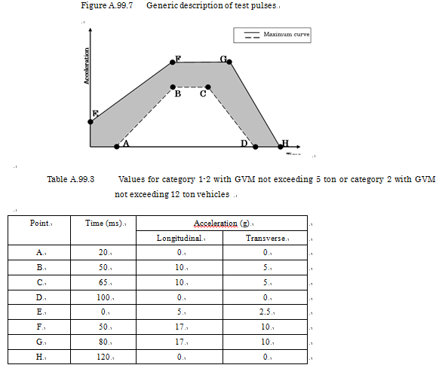
Requirement for HD vehicles special compared to passenger cars
OICA also proposed to modify the inertia specification tables of the mechanical shock compared to that for passenger cars as follows;

Slide 20
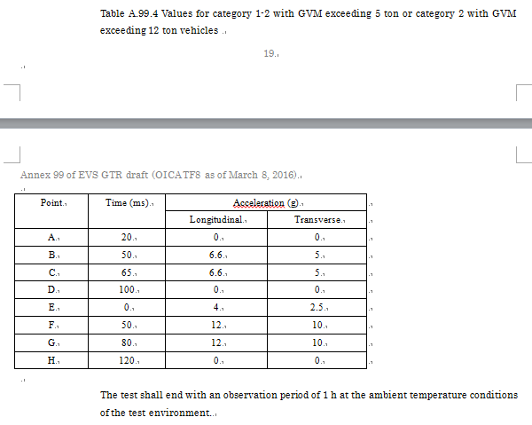
Requirement for HD vehicles special compared to passenger cars

