Slide 1

Informal Document PTI-40-05
40th Meeting of IWG on PTI
9 September 2025
ADAS Concepts
Assessment

Slide 2

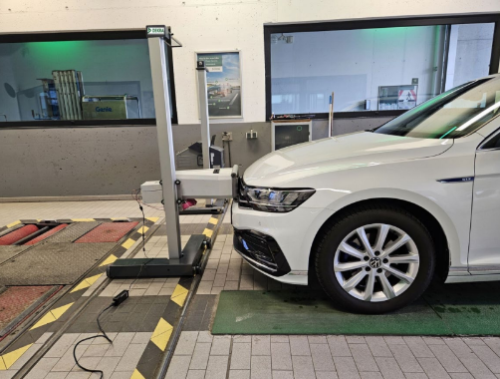
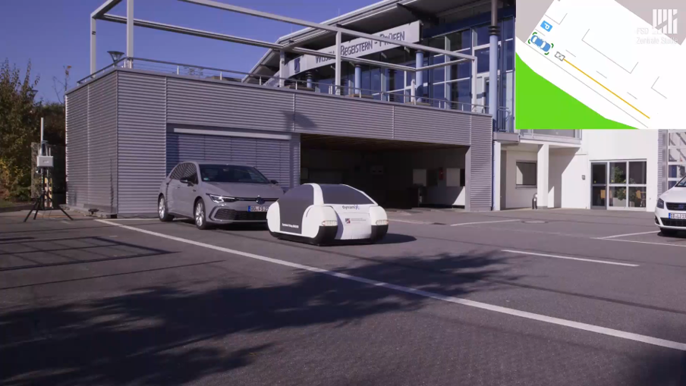
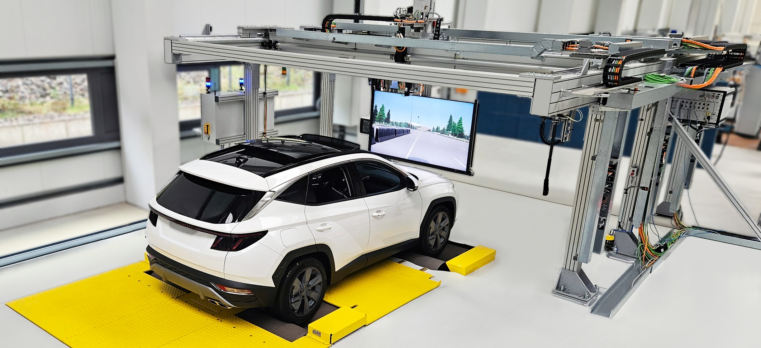
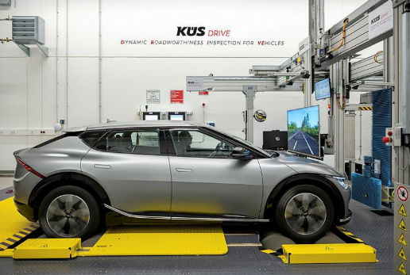
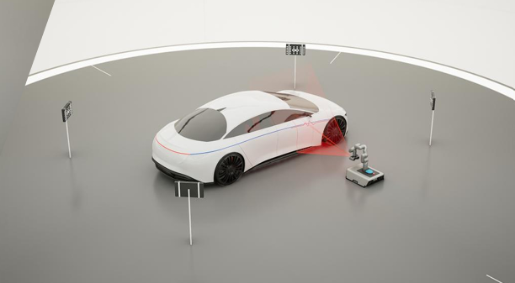
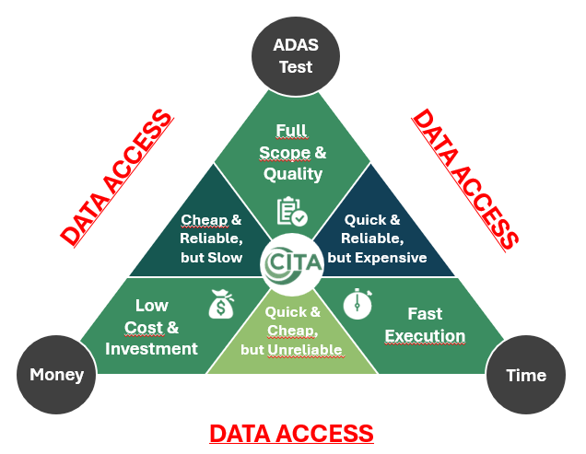
CONCEPTS Assessment Table
STATIC
DYNAMIC
1
2
3
4
5

Slide 3
CRITERIA FOR THE ASSESSMENT
Time consumption (incl. installation, equipment setting up, check test)
Time for vehicle entry / setting up
Time for equipment installation / setting up
Time for ADAS testing / check
Time for disassembly / vehicle exit
Total test time
Investment
Initial investment
Operating cost per vehicle (considering staff + facility time)
Return on invest (ROI)
Time
Money

Slide 4
CRITERIA FOR THE ASSESSMENT
Type of sensor to be inspected (which ADAS system?)
Sensors/Actors:
  Camera
  Radar
  Brakes
  Steering actuator
  Indicators (acoustic/visual)
ADAS systems:
  ACC/AEB/FCW
  LDW/LKA/LCA
  TSR/ISA
  AFL/AHB
  BSD/ALC
ADAS
Test
Static (no movement allowed) or dynamic (incl. speed limit)
Multiple / single sensor inspection?
Space requirement for installation / inspection
Possibility to combine with actual system tests (brake, light, ABS, etc.)
Vehicle communication needed? (OBD mandatory or optional)
Environmental conditions
Safety
Contribution from manufacturers
Scope

Slide 5
Next Phase(s)

Slide 6
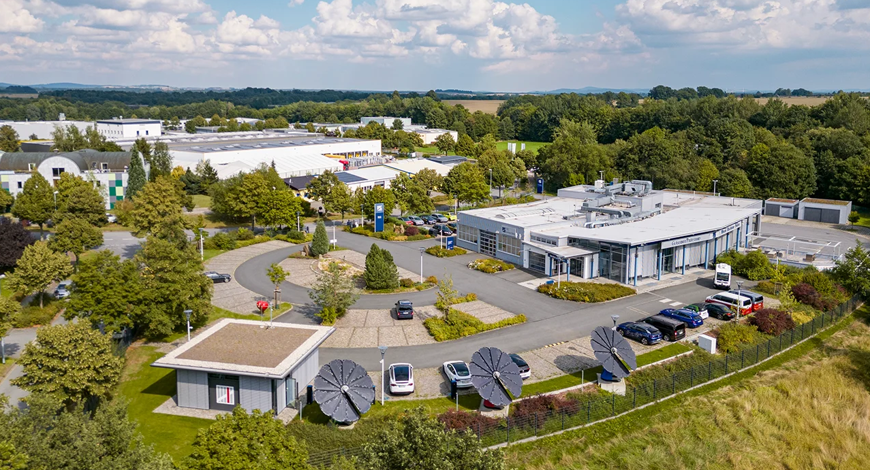
NEXT PHASE(S)
F2F meeting in Radeberg
FSD offered to host us at their premises to consolidate the various analyses regarding the proposed concepts.
Location: FSD Testing Laboratory (Radeberg)
Dates: November 11 & 12, 2025
Discussion topics (TBC):
  GTÜ concept + demo
  Sharing of Test Results Using KOTSA’s ADAS Evaluation System
  Updates on the x-proof 360 Vehicle-in-the-Loop DÜRR ADAS test concept
  ROHDE & SCHWARZ®RadEsT Radar Essential Tester
  FSD concepts
  Continuation of the discussion initiated on the subject of the different concepts for evaluating ADAS systems within the PTI framework

Slide 7
NEXT PHASE(S)
Statistics figures
The need to argue our proposals through statistics is a key element in convincing decision-makers of the merits of our approach.
It will therefore be important to be able to support our choices by presenting real figures in accordance with our final goal.
Recalls DB (information available from manufacturers through recall campaign or letter)
Investigation of accidents (e.g. from DEKRA Investigation Department)
Field tests (data availabilities) → will certainly be the subject of a point during discussions with decision-makers
Scientific studies to show that degraded sensors, for example, can influence the function of driver assistance systems without the self-diagnosis system recognizing this

Slide 8
NEXT PHASE(S)
Final Document
Since our national governments are not the instigators of this approach (as opposed to what is done in South Korea), the final goal will be to establish a document allowing decision-makers to position themselves in relation to the real need(s) to include the check of ADAS systems during PTI.
It is therefore our responsibility to gather as many arguments as possible and to propose several viable solutions at the economic, logistical or ecological levels.

Slide 9
THANK YOU
www.citainsp.org
Rue du Commerce 123 - 1000 Brussels, Belgium
+32 (0)2 469 06 70
secretariat@citainsp.org

