Slide 1
Japan’s Focus

Slide 2
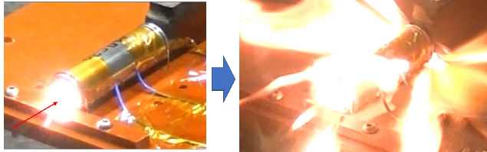
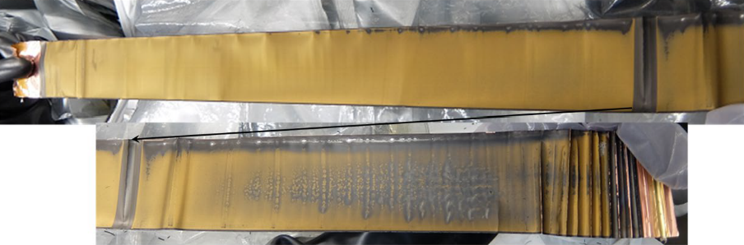
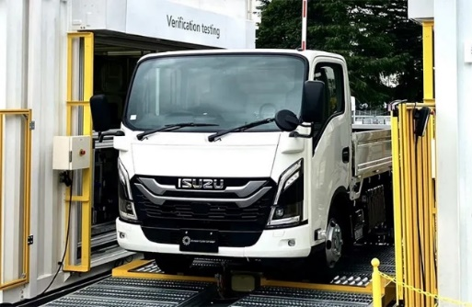
Japan’s focus in the next phase
Maintaining EV battery safety during the in-use phase
With EV batteries, there are cases where their thermal stability reduces as they degrade.
Lithium-ion batteries simulating use in low-temperature environments
If degradation progresses as lithium metal precipitates, batteries become prone to thermal runaway.
Lithium metal deposition reduces thermal stability.
Proposal from Japan
Since batteries operate in various environments, regulations should consider battery safety during the in-use phase.
*They should also consider swappable batteries used by a variety of users.
Swappable battery EVs
Establishing regulations that consider the in-use phase enables timely maintenance, thereby suppressing potential future vehicle fires.
For example, regulations including provisions on the following points could be considered:
・Durability requirements for battery terminals and structure considering the in-use phase (swappable batteries)
・Introduction of battery monitoring requirements utilizing non-destructive safety diagnostic technology
・Addition of requirements for devices that inform drivers of reduced battery safety based on diagnostic results with alerts and warning lights
Source: JAMA

