Slide 1
#17 ADS Tokyo Meeting
Date: December 8-12, 2025
Venue: AP ICHIGAYA, Room C on the 6th floor
Time
8 (Mon.) 10:00-17:00
9 (Tue.) 09:30-17:00
10 (Wed.) 09:30-17:00
11 (Thu.) 09:30-17:00
12 (Fri.) 09:30-12:30
The meeting room is open from 9:00. Please do not come before 9:00. Please vacate the meeting room by 18:00 at the latest.
Please tell your name and organization to Secretary (oshita@jasic.com) by November 14 (Friday) if you plan to join the meeting in person.
If you need support for VISA application or have any queries, please do not hesitate to reach JASIC staff R. Oshita oshita@jasic.com or E. Fujita e-fujita@jasic.org .

Slide 2
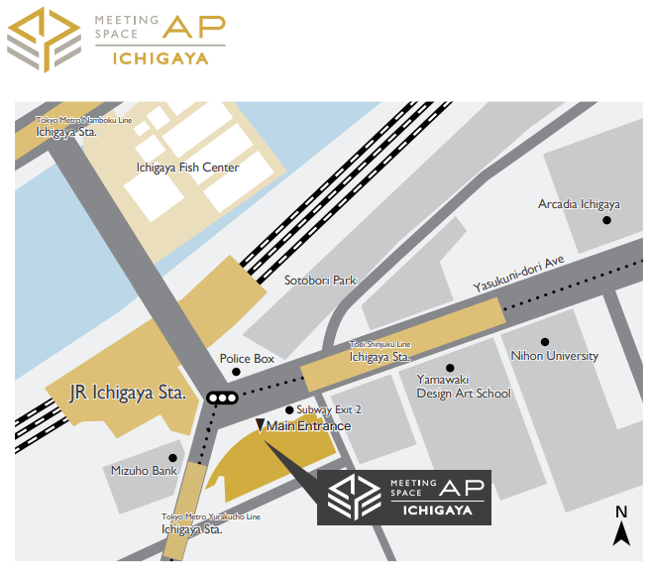
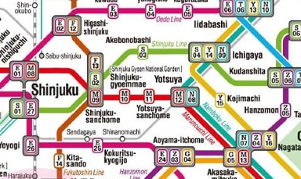

Access to the venue
Name of the venue:
AP ICHIGAYA
Address:
Ichigaya Osato Bldg. 5-8F
1-10, Gobancho, Chiyoda-ku, Tokyo 102-0076
(〒102-0076 東京都千代田区五番町1-10 市ヶ谷大郷ビル)
TEL: 03-3511-3109
AP ICHIGAYA is 1 minute walk from Ichigaya stations of JR and subway.
You can use JR, Toei Shinjuku, Tokyo Metro Nanboku, and Tokyo Metro Yurakucho lines to get to Ichigaya stations.
https://goo.gl/maps/kTPysAam5BBrS5c68

Slide 3
Accommodations
Hotels that are close to the meeting location are:
Hotel Grand Hill Ichigaya : https://www.ghi.gr.jp/en/index.html
Hotel Monterey Hanzomon : https://www.hotelmonterey.co.jp/en/hanzomon/
Best Western Fino Tokyo Akasaka : https://bwhotels.jp/tokyo-akasaka_en/english_ak
Tokyu Stay Yotsuya Shinjuku : https://www.tokyustay.co.jp/e/hotel/YOT/
Hotel Keihan Tokyo Yotsuya : https://www.hotelkeihan.co.jp/yotsuya/
Please also search by apps. (booking.com, etc.) for your preference.

