Slide 1
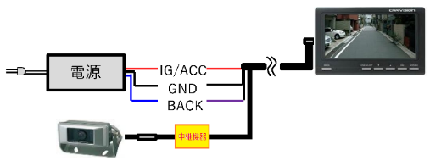
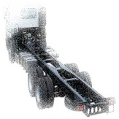
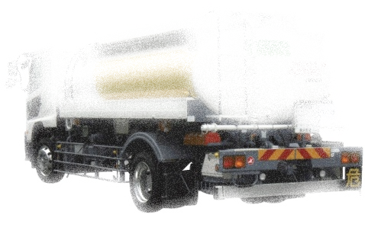

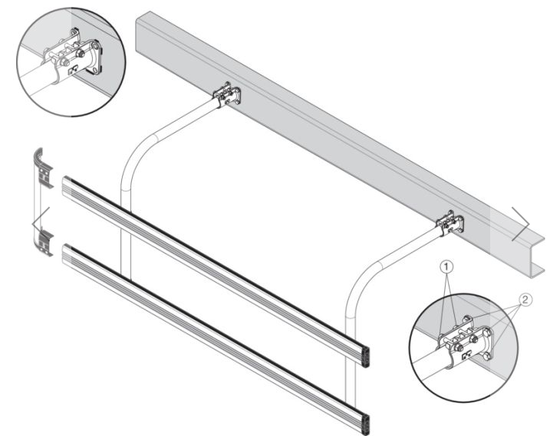
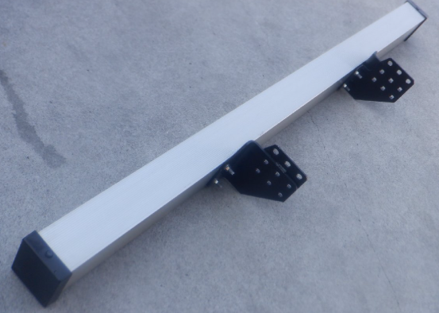
Parts manufacturers cannot get approval.
because there is no requirement in UN-R158 Part 1
the vehicle manufacturer’s duly accredited representative.
UN-R158 for N ???
the vehicle manufacturer
dealer
The completed by the vehicle manufacturer are approved as vehicles.
UN-R14,29,46,49, etc…
ideal
Installation of parts
UN-R48
UN-R73 Part 1
UN-R58 Part 2
Etc…
the body
manufacturer
the Parts manufacturer
UN-R3,6,23 etc…
the Parts manufacturer
the Parts manufacturer
UN-R73 Part 2
UN-R58 Part 1

