Slide 1


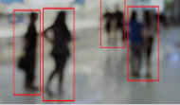


1)Only Camera
Depend on N3
Image data (NTSC,PAL)
2)Sonar, Radar, Image recognition etc…
CAN communication？
VRU position
Left Right Center?
VRU distance
〇〇 m?

Slide 2
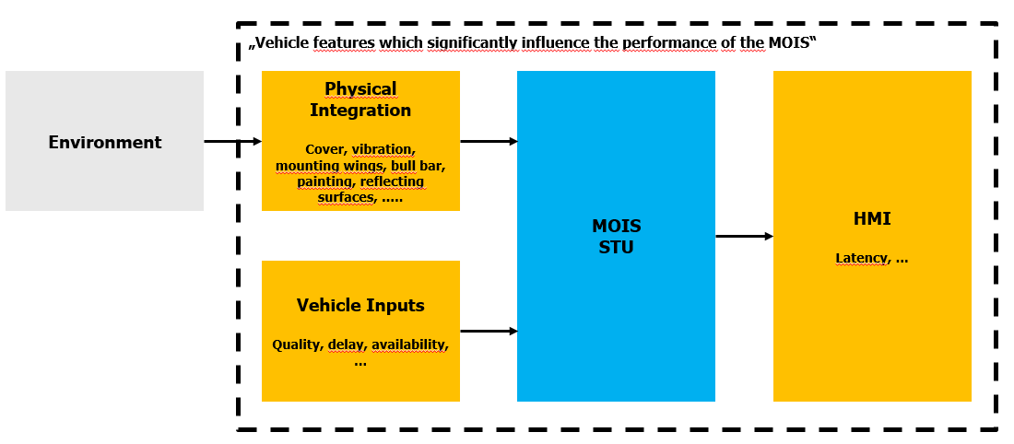

Human-Machine
Interface (HMI)
Standard : Components
Non Standard(Depend on Vehicle) : STU??
Is this concept you gave us similar to the one in 2) on the previous page?
1)Only Camera
2)Sonar, Radar, Image recognition etc…
R158 Easy!
Components
Parts
Parts
Text
data
camera
system
monitor

