Slide 1
V_H
V_H
physical test
factor : 0.95
Your Proposal
factor : xx for this system
current
V_H
V_L
factor : 0
Vehicle_conf_A
CED

Slide 2
Modified
V_H
V_H
physical test
factor : 0.95
Your Proposal
factor : xx for specific systems
current
V_H
V_L
factor : 0
Vehicle_conf_A
CED

Slide 3
What is a problem on current procedure ?
What is your target accuracy band and what is the reason ?
How much the accuracy band will be shrunk for ① and ② ?
Why only for PEV ?
①Fixed factor
for all system,
but only PEV
conduct the test for every single configuration
Accuracy band
target
②Develop the factors
for each system
(need family definition)
Current
(factor = 0)
Testing burden

Slide 4
What is a problem on current procedure ?
With the introduction of Battery Durability SOCR, the measured Range (recuperation is considered as individual vehicles are tested) will be compared to the certified range (recuperation is not considered in the interpolation of individual vehicles). This can cause a "fail" for the monitor (SOCR) accuracy, which has no physical reason but is only due to unprecise/wrong modelling of range/consumption influenced by optional equipment (e.g. tires, rims, spoilers, sunroof, …), neglecting the physical behaviour during recuperation phases. Additionally, we expect more market surveillance testing for el. Range with e.g. introduction of EU7.
What is your target accuracy band and what is the reason ?
Example: 600 km +/- 18km (could be even more). Reason: Inform customers about physical correct range / consumption influence of optional equipment for improved customer decision making/ information (=continue in the original spirit of WLTP). In any case the proposal is always better than the current situation efficiency factor = 0). We would like to achieve a big improvement in accuracy with a very simple approach
How much the accuracy band will be shrunk for ① and ② ?
E.g. for ①: +/-18km improved to +/-3km. E.g. for ② : +/-18km improved to +/-1 km.
Why only for PEV ?
PEVs with biggest physical influence (highest recuperation energies), OVC-HEV range is lower and the interpolated ranges are smaller, so the impact is also smaller, can be considered at a later stage for simplification reasons
Modified
A fixed factor is proposed to ensure a smooth certification process with predictable outcomes for setting OEM declared values
Accuracy band
target
①Fixed factor
for all system,
but only PEV
②Develop the factors
for each system
(need family definition)
conduct the test for every single configuration
Current
(factor = 0)
Testing burden

Slide 5
Backup

Slide 6
RECU-FACTOR: Sensitivity Analysis
Example data to show the sensitivity for a high recu vehicle and a low recu vehicle
A 10% change in drivetrain efficiency leads to +/2 km (0,3%) higher spread in range values between „high recu“ and „low recu“ variants

Slide 7
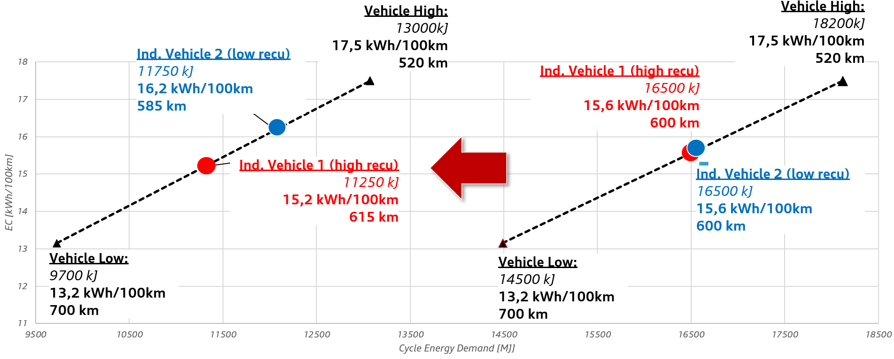
RECU-FACTOR: Sensitivity Analysis
Schematic visualisation with example data
582 km
High RRC, high aero drag, low weight
Low RRC, Low aero drag, high weight
618 km
Low RRC, Low aero drag, high weight
High RRC, high aero drag, low weight

