Slide 1
A-LCA IWG SG2 MTG
<Agenda>
Confirmation of the upcoming schedule
Latest document link
July 24th 2025

Slide 2
Schedule for GRPE drafting
Schedule for GRPE drafting
Deadline for submission of working document to GRPE(93): 22nd July 2025
April | May | June | July
GRPE |  |  | ★ Deadline(22nd)
Drafting ★ | ★ |  | ★
IWG | ★ #23 session (27) | ★ #24 session (18-19)
Final Draft N5
Comment deadline
(7)
★
Inputs for compiled draft N4
(20)
Inputs for compiled draft N3
(14)
Inputs for compiled draft N5
(15)
SG7 co-leaders will compile the drafts and send this compiled draft N5 to all IWG.
SG1 will organize an IWG session on the 21st of July to confirm the open topics to put into [ ] before submission

Slide 3
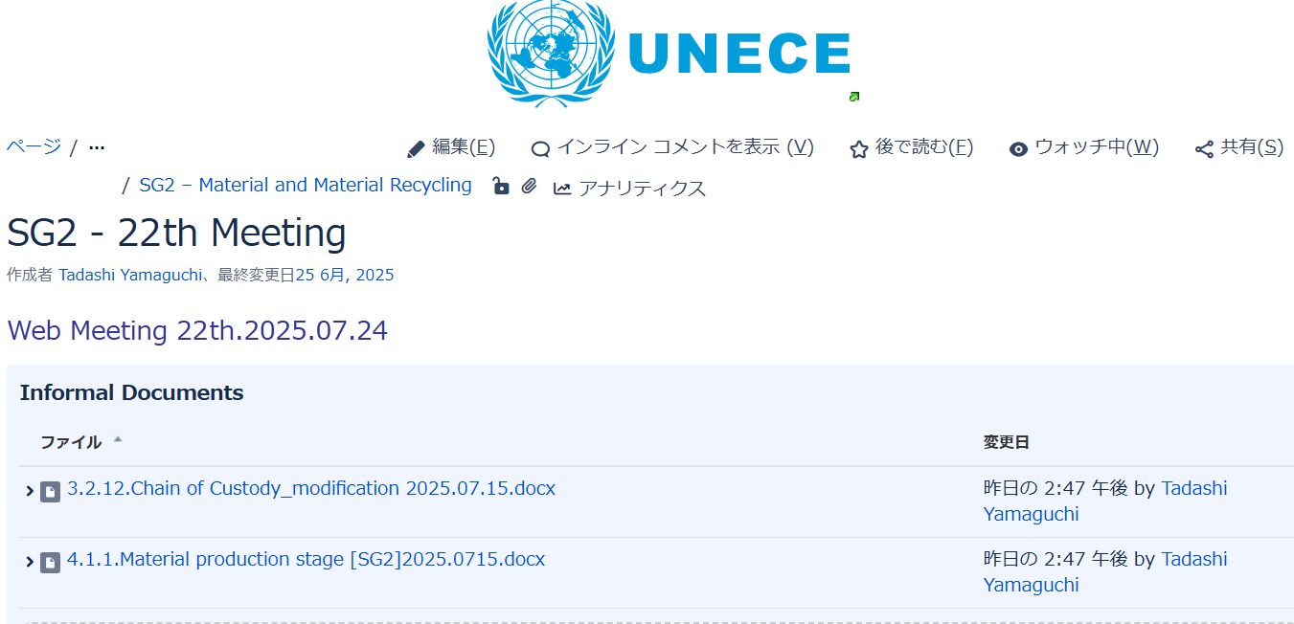
latest document(compiled draft N5)
Schedule for GRPE drafting
SG2 latest draft N6
SG7 latest draft N5
https://wiki.unece.org/x/HYCmEg
latest draft for reference only

Slide 4
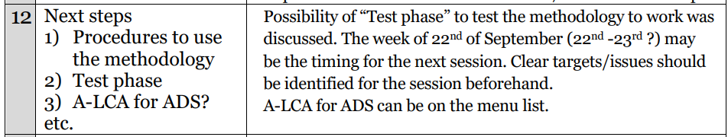
SG2 regular meeting
Schedule for GRPE drafting
 | 2025
 | Apr | May | Jun | Jul | Aug | Sep | Oct
week | 4th Thu
day | 24 | 29 | 26 | 24 | 28 | 25 | 23
time | 11-12 am CET 18-19 pm JST
Summer time
A-LCA Face-to-face session Planning: 22th-23th in September>(venue is in Pari and Brussels)

