Slide 1
Representative Vehicle
Explanation of draft

Slide 2
Vehicle LCA: Representative vehicle is key link between declaration and application
Vehicle LCA
Methodology
Declaration
Application
Electricity Modeling
Primary data share
Secondary data set
End of life modeling
Representative vehicle
Reporting rules
Verification process
Labelling
Green public procurement
Incentive
…
According to method proposed by SG2/3/4/5/6
Representative vehicles
NOT in SCOPE of GUIDELINE
Completely up to contracting parties
Notes:
CATENA X: mention verification framework for components

Slide 3

Vehicle LCA : Why we need a representative vehicle ?
Material
acquisition
Material
Refining
Part
production
System
Assembly
Vehicle
assembly
Ideal LCA calculation:
Track each component of each vehicle → NOT manageable
Complex Supply chain:
It is required a simplification for the calculation of the carbon footprint
It is not practical to follow energy use minute by minute.
→ Instead, use average values over a set time (e.g. 12 or 24 months)
It is impossible to track every source
→ Average production values (e.g. secondary data set)
It is not efficient calculating LCA for each individual vehicle, no additional benefit
→ Use a representative vehicle (this makes calculations simpler and reduces the workload)

Slide 4














Vehicle Carbon footprint : Modular Approach
Production
Usage
End of Life
Material acquisition
Part Production
Vehicle assembly
Well to Tank
Tank to wheel
Re-use
Recycling
Vehicle
Structure
Carbon footprint (CO₂ eq)
Usage
Carbon footprint (CO₂ eq)
Recycling
Carbon footprint (CO₂ eq)
-Vehicle structure family
-Powertrain type
-Region of Production
Calculated values on Representative vehicle
+
Estimated values for declared vehicle
Actual Vehicle mass without battery (kg)
Vehicle Cycle energy demand
Vehicle mass with options (kg)
+
Maintenance
+
Battery type
Carbon footprint (CO₂ eq)
Carbon footprint (CO₂ eq)
-Per Battery Model
-Per production plant
Given Battery Model
Vehicle cycle energy demand
According to existing WLTP regulation with additional co-efficient on ‘well-to-tank’ and ‘real- life usage’
A modular approach is best suited for vehicle life cycle carbon footprint

Slide 5




Upstream Emission : ICE vehicle
Production
LCA Group 1
Representative vehicle
Highest selling vehicle
Vehicle Structure Family
Vehicle structure Family 1
Vehicle structure Family 2
All Body Types of a same vehicle structure are covered by same group
…
Vehicle structure Family n
Carbon Footprint kgCO2e
Powertrain Type
EV
ICE
…
All the variations of one powertrain type are covered by same group
Region of production
Actual vehicle mass, with installed options (kg)
Region 1
Region 2
…
An upstream LCA group can cover only one region

Slide 6








Upstream Emission : Electric vehicle
Production
LCA Group 2
Representative vehicle
Highest selling vehicle
Vehicle Structure Type
Vehicle structure Family1
Vehicle structure Family2
…
All Body Types of a same vehicle structure are covered by same group
without the traction battery
Vehicle structure Family n
Carbon Footprint kgCO2e
Powertrain Type
EV
ICE
…
Region of production
Actual vehicle mass, with installed options w/o traction Battery (kg)
Region 1
Region 2
…
An upstream LCA group can cover only one region
w/ traction Battery B
Carbon Footprint kgCO2e
w/ traction Battery A
Battery Type
A
w/o traction Battery
Chemistry A, capacity 40kwh
Chemistry A, capacity 60kwh
B
…
Chemistry B, capacity 80kwh
Actual vehicle mass, with installed options (kg)

Slide 7



Use phase Emission : ICE/EV vehicle
Usage
Use phase
Declared vehicle
Vehicle individual*
Powertrain Family
IP Family 1
Carbon Footprint kgCO2e
IP Family 2
…
Grouping according to present practice of contracting party
Maintenance
IP Family 1
OEM declare (if not available default value)
Cycle energy demand (kg)
IP Family 2
A single value from a powertrain group can be considered
+
…
Carbon Footprint kgCO2e
IP Family n
Region of usage
Region 1
Cycle energy demand
Region 2
…
=
Carbon Footprint kgCO2e
*Certified fuel consumption and energy consumption data, which are included in official homologation documents and regulatory certifications of contracting party.
Cycle energy demand

Slide 8

Representative vehicle example: Interaction with IP family and LCA grouping
IP 1
IP 2
IP 3
IP 4
LCA group 1
(upstream & End of Life)
LCA group 2
(upstream & End of Life)
LCA group 3
(upstream & End of Life)
LCA group : does not include use phase criteria ( powertrain config.) => May include multiple IP families
IP family : Vehicle segment or platform or region of production is not a criteria => May include multiple LCA family

Slide 9
EoL Emission : ICE vehicle
Similar approach to upstream emission
End of Life
LCA Group 1
Representative vehicle
Highest selling vehicle
Vehicle Structure Family
Vehicle structure Family 1
Vehicle structure Family 2
All Body Types of a same vehicle structure are covered by same group
…
Vehicle structure Family n
Carbon Footprint kgCO2e
Powertrain Type
EV
ICE
…
Actual vehicle mass, with installed options (kg)
All the variations of one powertrain type are covered by same group
Region of End of life
Region 1
Region 2
…
An EoL LCA group can cover only one region

Slide 10
Example how to follow Representative vehicle approach

Slide 11




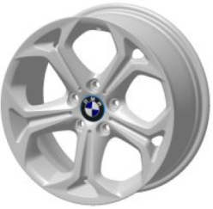


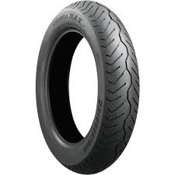
Representative vehicle: How can be implemented ?
LCA group
LCA Group 1
LCA Group 2
LCA Group 3
LCA Group 4
LCA Group …
Upstream & End of Life emission
Vehicle structure family, Powertrain type, production region
╚> Emission factor upstream = 5 kg CO_{2e}/kg
╚> Emission factor EoL = 0.15 kg CO_{2e}/kg
Actual Vehicle mass with installed options without battery
╚> mass w/o battery = 1398 kg
Battery
╚> Battery carbon footprint 6350 kg CO_{2e}
Battery Type
Battery model 1
Battery model 2
Battery model …
Customer Order
Upstream + EoL = (5 + 0.15) * 1398 + 6350 = 13550 kg CO_{2e}
Use phase= 9412 + 148 = 9560 kg CO_{2e}
Choice of
Vehicle type
Powertrain type
Options etc.
Total CFP
23 110 kg CO_{2e}
Powertrain Family
IP Family 1
IP Family 2
IP Family 3
IP Family 4
IP Family …
Use phase emission
Powertrain family => IP family 4
╚> energy consumption real life (WTW)= 9412 kg CO_{2e}
Powertrain family => IP family 4
╚> maintenance factor = 148 kg CO_{2e}

Slide 12
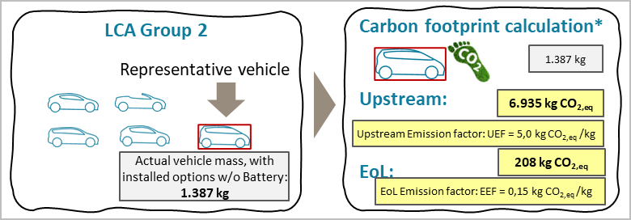
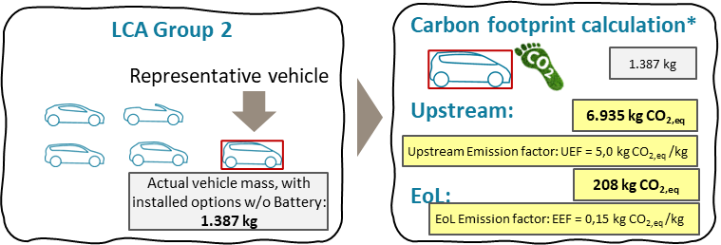

Step 1
Rep-resentative Vehicle
LCA Group 2
Carbon footprint calculation*
Upstream:
EoL:
Representative vehicle
1.387 kg
6.935 kg CO_{2,eq}
Upstream Emission factor: UEF = 5,0 kg CO_{2,eq} /kg
Total carbon footprint
Actual vehicle mass, with installed options w/o Battery: 1.387 kg
208 kg CO_{2,eq}
EoL Emission factor: EEF = 0,15 kg CO_{2,eq} /kg
*Excluding: Use phase & traction battery
6.935 + 6.350 + 9.640 +208
= 23.133 kg CO_{2,eq}
Representative vehicle
for LCA Group 2
Step 3
Down-stream emission
IP family 2
VH
IP family 2
Traction battery emission
Separate calculation
Calculate In-use energy consumption
9.640 kg CO_{2,eq}
+
Calculated value
Calculate Maintenance
384 kg
Estimated value
VL
6.350 kg CO_{2,eq}

Slide 13
Step 1
Rep-resentative Vehicle
LCA Group 2
Carbon footprint calculation*
Upstream:
EoL:
Representative vehicle
1.387 kg
6.935 kg CO_{2,eq}
Upstream Emission factor: UEF = 5,0 kg CO_{2,eq} /kg
Total carbon footprint
Actual vehicle mass, with installed options w/o Battery: 1.387 kg
208 kg CO_{2,eq}
EoL Emission factor: EEF = 0,15 kg CO_{2,eq} /kg
*Excluding: Use phase & traction battery
6.935 + 6.350 + 9.640 +208
= 23.133 kg CO_{2,eq}
Vehicles for LCA declarations
Representative vehicle
for LCA Group 2
Step 2
Upstream
End-of-Life emission
LCA Group 2
Estimated Upstream Carbon footprint
Estimated End of Life Carbon footprint
Emission factors LCA group 2:
UEF = 5,00 kg CO_{2,eq} /kg
EEF = 0,15 kg CO_{2,eq} /kg
Upstream Carbon Footprint (kgCO_{2e})
End-of-Life Carbon Footprint (kgCO_{2e})
6.740 + 6.350 + 8.620 +202
= 21.912 kg CO_{2,eq}
6.990 kg CO_{2,eq}
Declared vehicle 1
6.935 kg CO_{2,eq}
1.348 kg
1.398 kg
1.387 kg
6.740 kg CO_{2,eq}
210 kg CO_{2,eq}
202 kg CO_{2,eq}
208 kg CO_{2,eq}
6.990 + 6.350 + 9.560 +210
= 23.110 kg CO_{2,eq}
Actual vehicle mass, with installed options w/o battery (kg)
Actual vehicle mass, with installed options w/o battery (kg)
Declared vehicle 2
Step 3
Down-stream emission
IP family 1
IP family 2
IP family 1
Calculate In-use energy consumption
VH
+
8.620 kg CO_{2,eq}
VH
Calculate Maintenance
Traction battery emission
Separate calculation
Calculated value
IP family 2
Calculate In-use energy consumption
9.640 kg CO_{2,eq}
Estimated value
+
384 kg
VL
VL
Calculate Maintenance
9.560 kg CO_{2,eq}
6.350 kg CO_{2,eq}

